Slide 1
Big Data Econometrics
ADEC|ADAN 7430.02|.03: what is this about
August 25th, 2025

Slide 2
Caveat Emptor
Remember the big picture while studying the details

Slide 3
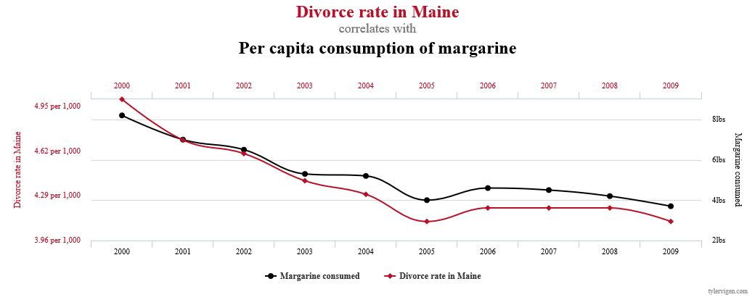
The relevance of caring to understand
Correlation ≠ causation
Credit: http://www.tylervigen.com/spurious-correlations

Slide 4
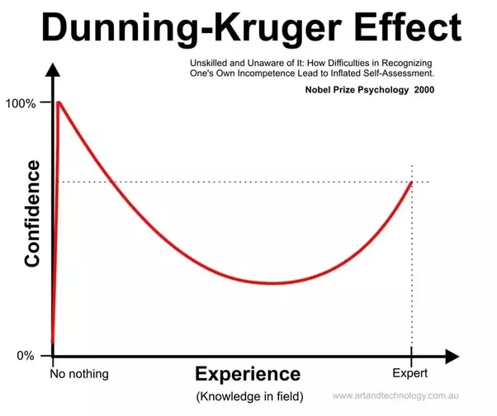
How much do we know
Where do you think our knowledge places us?
Can you identify ambiguities in this question?
Define 3 ambiguities that come to mind in 20 words or less
To ponder (about this picture, but relevant in general):
Scale
Bias
How does it matter?
Related: Gartner’s Hype Cycle

Slide 5
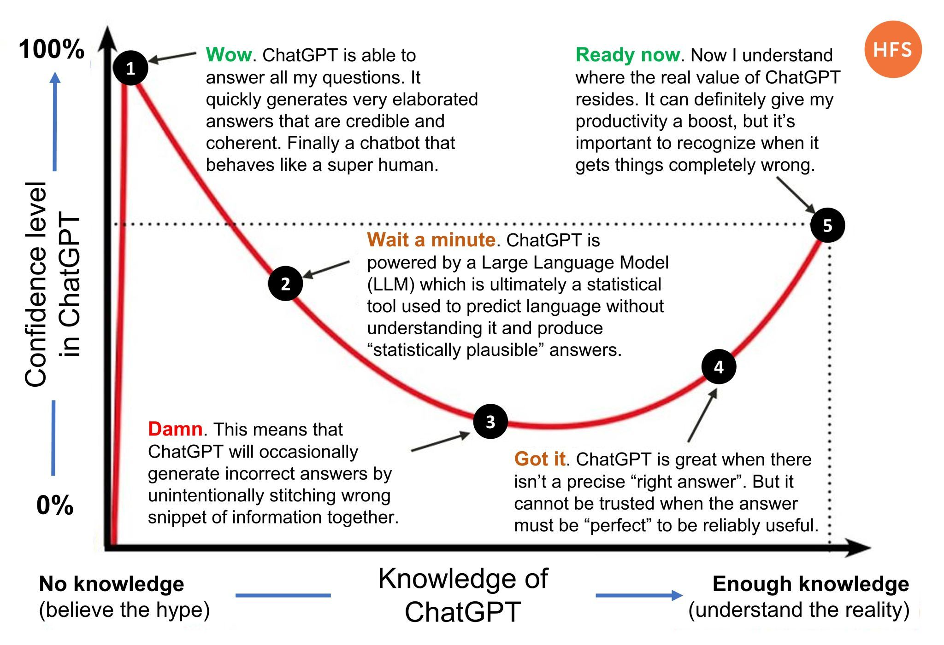
How much do we know (updated)
Source:
6 important AI near-future breakthroughs, or why the AI hype peak is likely to be ahead of us
https://www.codium.ai/blog/6-important-ai-near-future-breakthroughs-or-why-the-ai-hype-peak-is-likely-to-be-ahead-of-us/

Slide 6
Starter for your library of “uh-oh”s
The coming software Apocalypse
The software did exactly what it was told to do. The reason it failed is that it was told to do the wrong thing.
“Software engineers don’t understand the problem they’re trying to solve, and don’t care to.”
“I hope people won’t be allowed to write programs if they don’t understand these simple things.”
“When your tires are flat, you look at your tires, they are flat. When your software is broken, you look at your software, you see nothing.”
Same Stats, Different Graphs
“...make both calculations and graphs. Both sorts of output should be studied; each will contribute to understanding.” F. J. Anscombe, 1973
Hard disks listening to ambient sounds
“[…]something as innocuous as your computer’s hard disk can be used to record sound. The technique works by measuring the vibrations of the hard drive’s magnetic disks.”
Using Machine Learning to build keyloggers for smart phones

Slide 7
Economics & Machine Learning

Slide 8
Economics vs Machine Learning
Not opposites ☺
Economics – ML – AI will be applied depending on problem
Traditional economics focused on inference:
what feature has most effect, and how much, on an outcome
Confidence levels (intervals) around estimates
Goodness of fit tests
Machine learning focused on predictions:
Given what I know about an input (“situation”), what is the best guess for the outcome?
Test results by keeping data in reserve, and evaluating performance there
Absence of structural models (and goodness-of-fit tests) leads to Train/Test, or even Train/Validate/Test, paradigm for estimating performance of model
Train
Validate
Test

Slide 9
(Model) Learning Types
Regression vs Classification
Continuous (including ordinal) response vs discrete, categorical response
Supervised, Unsupervised, Semi-supervised
Supervised: clear “ask” (target variable) used to guide learning
Unsupervised: “tell me something” – no target to guide learning, think clustering of comments in positive, negative, neutral
If this sounds uninteresting or “soo last century”, read https://newatlas.com/robotics/dog-robot-keeps-running/
Semi-supervised: small amount of training data, learn something, surface ambiguous (hard to classify) data points, get input, iterate
Single vs ensemble models
Think: linear regression vs random forest
Structural vs data-driven models
Think linear regression vs tree models

Slide 10



Generating process vs hypothesis space
We can probably (likely!) never identify the real data generating process function!
Given a hypothesis space, we can identify the best (closest?) function to that elusive “real f”
Different hypothesis spaces will lead to different approximating functions
Crucial: the objective of the learning (“measure of success”) dictates whether an approximation is better than another
Usually involving a test on “unseen” (by the training process) dataset
$\hat{f_{s}}$
Splines
PolyR
LR
Real “f”
$\hat{f_{p}}$
$\hat{f_{l}}$

