Slide 1
Big Data Econometrics & AI/ML Algorithms
ADEC|ADAN 7340.02|.03: September 2nd, 2025
Linear regression review; project setup; big data

Slide 2
About Big Data

Slide 3
What is Big Data?
Data that takes a long time to process
Q: What is “long time”?
Data larger than I could process “yesterday” (infrastructure, software)
Data requiring different “thinking” (audio/video/IoT/embedded sensors)
Why do we care about Big Data?
Progression of Analytics: Descriptive -> Explanatory -> Predictive -> Prescriptive
Natural tendency to understand more, or deeper, the world around us…
…and take action to obtain more favorable results
*Think about the definition of “impact” of “favorable result”

Slide 4
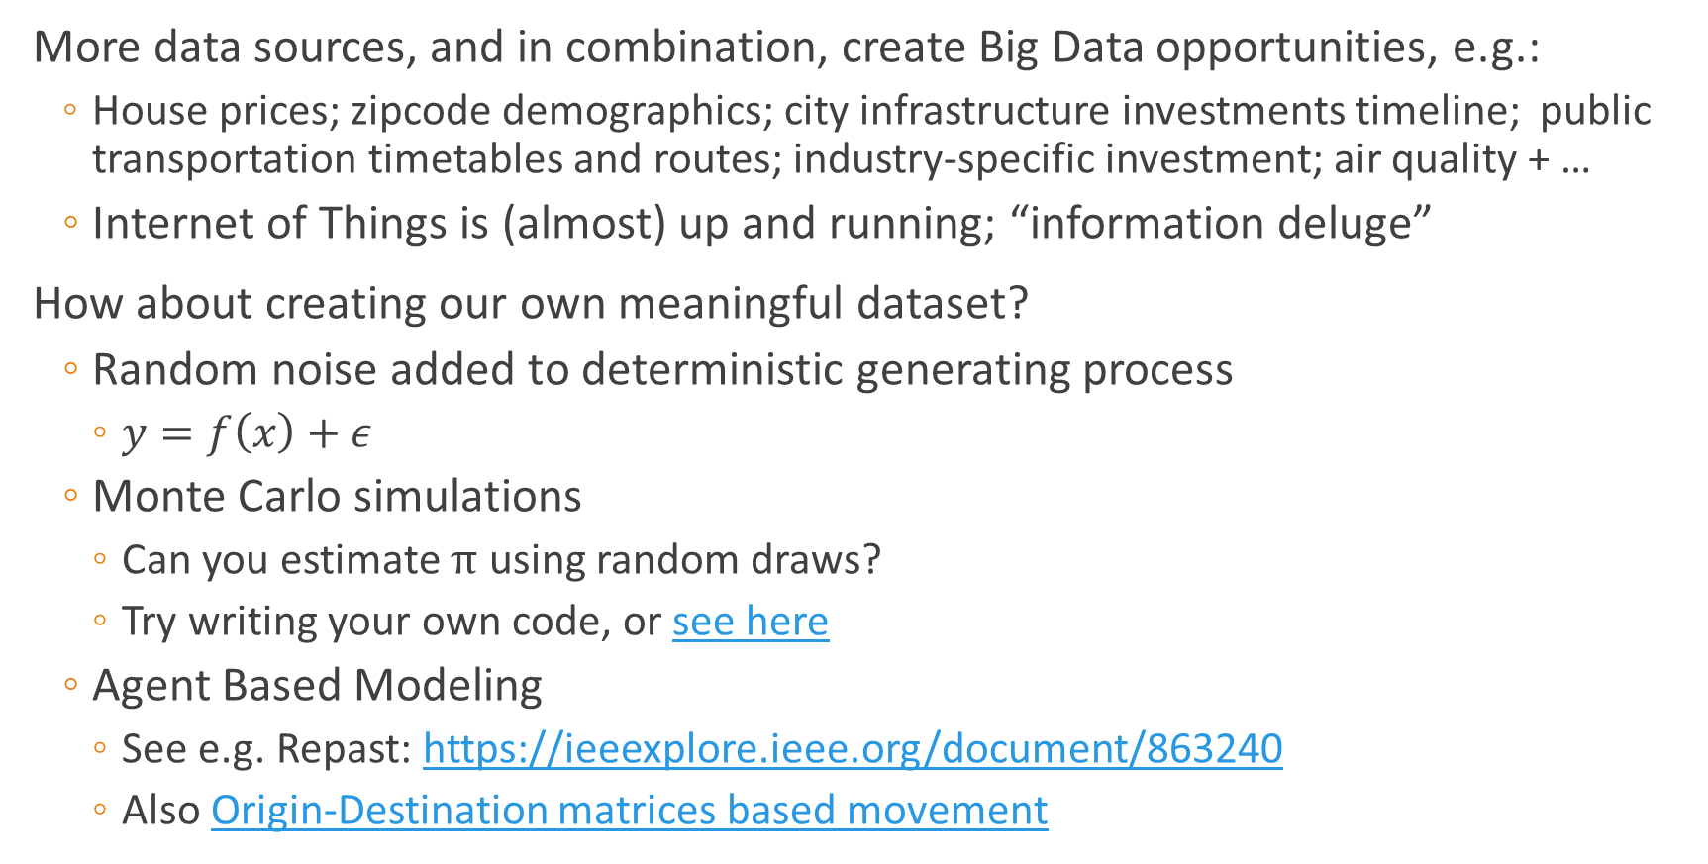
Where is this Big Data coming from?
More data sources, and in combination, create Big Data opportunities, e.g.:
House prices; zipcode demographics; city infrastructure investments timeline; public transportation timetables and routes; industry-specific investment; air quality + …
Internet of Things is (almost) up and running; “information deluge”
How about creating our own meaningful dataset?
Random noise added to deterministic generating process
$y=f\left(x\right)+ε$
Monte Carlo simulations
Can you estimate $π$ using random draws?
Try writing your own code, or see here
Agent Based Modeling
See e.g. Repast: https://ieeexplore.ieee.org/document/863240
Also Origin-Destination matrices based movement

Slide 5
Processing Big Data

Slide 6
(Some) Data Scale Issues
More data means:
More CPU/cores for computations
More RAM/memory to hold larger chunks for faster processing
More disks/storage to hold the raw and processed data
More data may be:
Wide (lots of variables):
Potential for overfitting (model dependent) and multicollinearity concerns
Long (lots of data points)
Noise may be interpreted as signal

Slide 7
How to
Scale up: more powerful servers (CPU / RAM / Disk / Network)
Usually the same software stack is being run
Scale out: cluster servers to share the workload (parallel/grid computing)
Requires specialized software (e.g. load balancers, head/worker configurations)
Decentralized processing: Map-Reduce(-Merge) paradigm:
Split the workload into chunks executable by one “worker”
One master, many (hundreds, thousands or more) “slaves”
Master distributes tasks and aggregates results [*terminology is getting revised]
Occasionally trivial (“embarrassingly parallelizable problems”)
Not so great for matrix inversion (but algorithms for parallelizing this exist)
Good to know some linear algebra, and computer architecture…

Slide 8
Tools of Big Data – Infrastructure (HW/SW)
Specialized hardware
GPUs (worth watching the video)
ASICs
AI dedicated processors built from ground up to deal with AI workloads
Intel’s Loihi, Nvidia’s Grace, AMD won’t fall behind, Morpheus
Search for latest products (TPU, Cerebras, etc.)
Cloud computing
Flexible resources (scale up/out/decentralize)
Turned on/off on demand, tuned to the workload at hand
Pricing by usage – but also by data transfer
Reading: Scalability, but at what COST?

Slide 9
Statistics Terminology

Slide 10
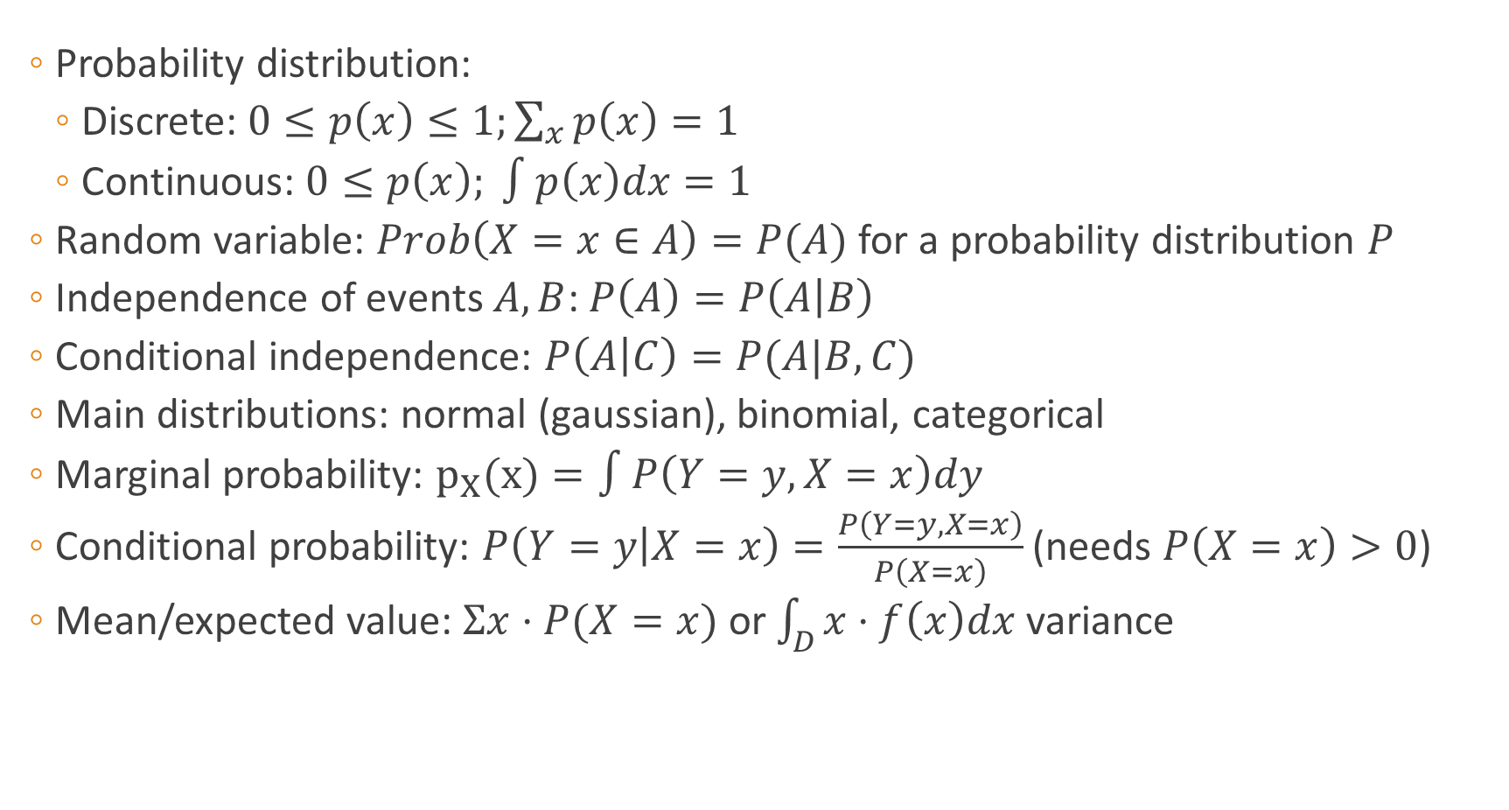
Brief review of Statistics terminology
Probability distribution:
Discrete: $0≤p\left(x\right)≤1;\sum_{x}{p\left(x\right)=1}$
Continuous: $0≤p\left(x\right); ∫p\left(x\right)dx=1$
Random variable: $Prob\left(X=x∈A\right)=P(A)$ for a probability distribution $P$
Independence of events $A, B$: $P\left(A\right)=P\left(A | B\right)$
Conditional independence: $P\left(A | C\right)=P(A|B,C)$
Main distributions: normal (gaussian), binomial, categorical
Marginal probability: $p_{X}(x)=∫P\left(Y=y, X=x\right)dy$
Conditional probability: $P\left(Y=y | X=x\right)=\frac{P\left(Y=y, X=x\right)}{P\left(X=x\right)}$ (needs $P\left(X=x\right)>0$)
Mean/expected value: $Σx⋅P(X=x)$ or $\int_{D}{x⋅f\left(x\right)dx}$ variance

Slide 11
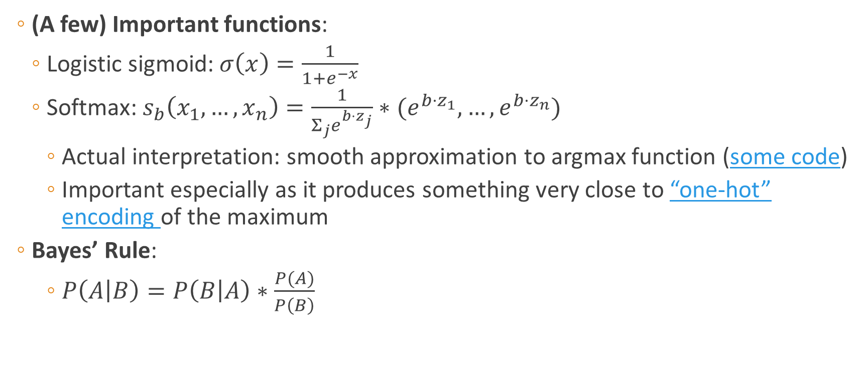
Brief review of Statistics terminology
(A few) Important functions:
Logistic sigmoid: $σ\left(x\right)=\frac{1}{1+e^{−x}}$
Softmax: $s_{b}\left(x_{1},…,x_{n}\right)=\frac{1}{Σ_{j}e^{{b⋅z}_{j}}}∗(e^{{b⋅z}_{1}},…,e^{{b⋅z}_{n}})$
Actual interpretation: smooth approximation to argmax function (some code)
Important especially as it produces something very close to “one-hot” encoding of the maximum
Bayes’ Rule:
$P\left(A | B\right)=P\left(B | A\right)∗\frac{P(A)}{P\left(B\right)}$

Slide 12
Data exploration
Sampling
Univariate analysis
Correlations & multivariate analysis
Exact binomial test
Kolmogorov-Smirnov test
Student’s t-test
One-way ANOVA, two-way ANOVA
! Good reference for type of analyses performed…
But always be mindful of the trap of p-values

Slide 13
Linear Regression

Slide 14
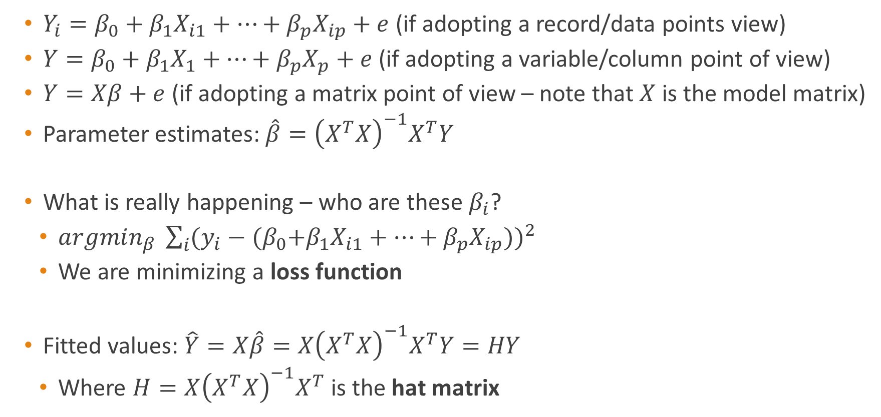
Multi-linear regression review
$Y_{i}=β_{0}+β_{1}X_{i1}+⋯+β_{p}X_{ip}+e$ (if adopting a record/data points view)
$Y=β_{0}+β_{1}X_{1}+⋯+β_{p}X_{p}+e$ (if adopting a variable/column point of view)
$Y=Xβ+e$ (if adopting a matrix point of view – note that $X$ is the model matrix)
Parameter estimates: $\hat{β}={\left(X^{T}X\right)}^{−1}X^{T}Y$
What is really happening – who are these $β_{i}$?
$argmin_{β} \sum_{i}{{(y_{i}−{(β}_{0}+β_{1}X_{i1}+⋯+β_{p}X_{ip}))}^{2} }$
We are minimizing a loss function
Fitted values: $\hat{Y}=X\hat{β}=X{\left(X^{T}X\right)}^{−1}X^{T}Y=HY$
Where $H=X{\left(X^{T}X\right)}^{−1}X^{T}$ is the hat matrix

Slide 15
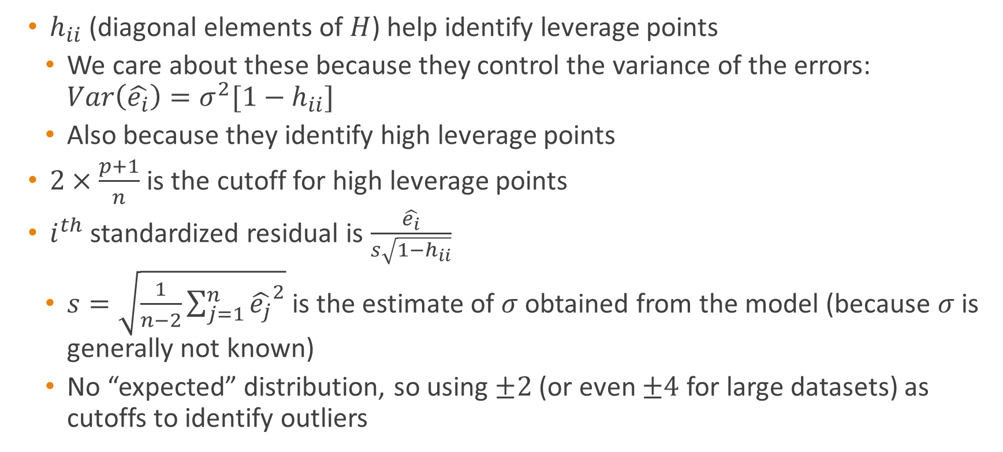
Multi-linear regression review
$h_{ii}$ (diagonal elements of $H$) help identify leverage points
We care about these because they control the variance of the errors: $Var\left(\hat{e_{i}}\right)=σ^{2}[1−h_{ii}]$
Also because they identify high leverage points
$2×\frac{p+1}{n}$ is the cutoff for high leverage points
$i^{th}$ standardized residual is $\frac{\hat{e_{i}}}{s\sqrt{1−h_{ii}}}$
$s=\sqrt{\frac{1}{n−2}\sum_{j=1}^{n}{{\hat{e_{j}}}^{2}}}$is the estimate of $σ$ obtained from the model (because $σ$ is generally not known)
No “expected” distribution, so using $±2$ (or even $±4$ for large datasets) as cutoffs to identify outliers

Slide 16
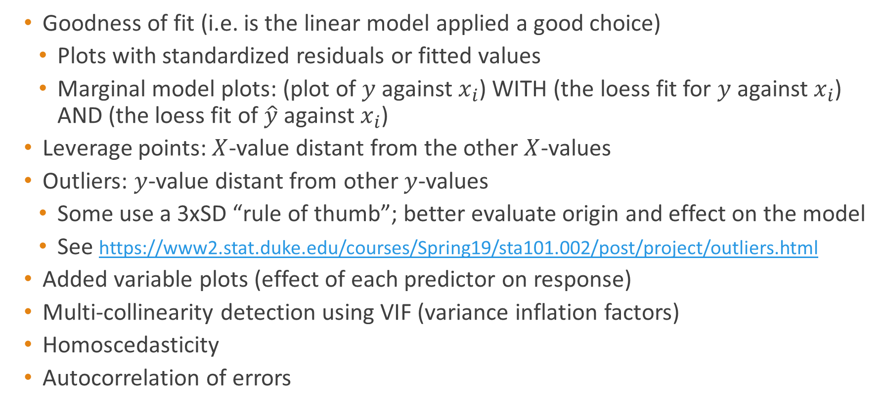
Diagnostic tools
Goodness of fit (i.e. is the linear model applied a good choice)
Plots with standardized residuals or fitted values
Marginal model plots: (plot of $y$ against $x_{i}$) WITH (the loess fit for $y$ against $x_{i}$) AND (the loess fit of $\hat{y}$ against $x_{i}$)
Leverage points: $X$-value distant from the other $X$-values
Outliers: $y$-value distant from other $y$-values
Some use a 3xSD “rule of thumb”; better evaluate origin and effect on the model
See https://www2.stat.duke.edu/courses/Spring19/sta101.002/post/project/outliers.html
Added variable plots (effect of each predictor on response)
Multi-collinearity detection using VIF (variance inflation factors)
Homoscedasticity
Autocorrelation of errors

Slide 17
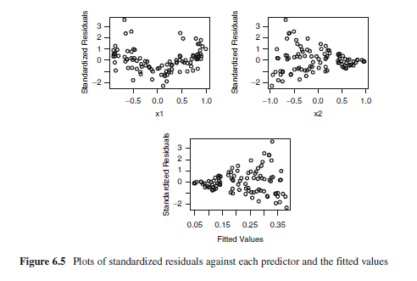
Residual plots
Residual plots themselves do not give any indication about which part of the model is mis-specified
See examples in Sheather’s “A Modern Approach to Regression with R” (~pp.160)

Slide 18
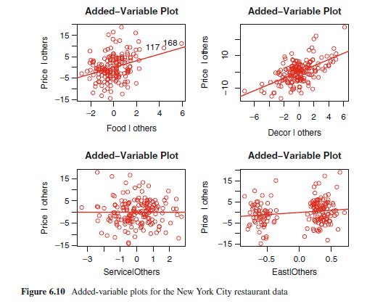
Diagnostic plots
Added variable plots:
Remove the effect of a group of variables
From both the response and another predictor
Then plot the residuals from both regressions against each other

Slide 19
Working Setup

Slide 20
Tools used in this class (Already installed during week1)
Python: Version 3.10.11
Install virtualenv or miniconda, pandas, numpy, matplotlib, scikit-learn, spyder
Git
In Windows, Git comes with Git Bash, a custom terminal facilitating code distribution operations; in MacOS, Git is accessible from terminal
GitHub
Everybody should have set up their GitHub account with their BC email
Invitations to the class repository were sent; accept and connect to the repo
Additional details in the posted video in Panopto Recordings

Slide 21
Tools used in this class (Already installed during week1)
Read about fast(er) input/output (I/O) formats:
Feather
Parquet
Others?

Slide 22
Project Pipeline

Slide 23
Project Pipeline
Storage
Code
Compute
RawData
ETL
Investigate & split
Model
Output
Think of code as the transformation of data. Try to chunk it in “do one thing, do it right” bites (scripts).

Slide 24
Recommended project folder structure
Data: all data for the project (class) should reside here. Subfolders:
RawData: original data; keep an untouched/unmodified copy at all times
InputData: copies or slightly modified versions of RawData sources
SavedData: data transformed by code, not yet final
FinalData: final dataset(s), ready for analysis
Output: results, charts, data exported from the project
Code: (maybe subfolders) code devoted to this project
Subfolder “utils” for general purpose and/or project-specific functions
Other subfolders as needed (e.g. for HW1, HW2, Final, etc.)
Docs: Keep here data schema, mappings, custom (manual) grouping info etc.
Presentations: Materials to present project’s results

Slide 25
Practice / to-do
Read the chapters assigned for Week 1 (syllabus)
Identify and review the readings linked in these slides
Create the Project Folder Structure (slide 24) dedicated to this class
Connect to GitHub using your BC account (create user with that email)
Connect to the class repo following the steps outlined in class
Practice using scripts and resources indicated in class or through announcements

Slide 26
Appendix

Slide 27
GPU & Deep Learning (AI?)
News from the past: The Battle of AI Processors Begins in 2018
Terms to note: CPU, GPU, TPU, FPGA
Ideas to note:
Speed
Efficiency (PFLOPS/watt)
Self-learning
Niche areas for applications
Best hardware might not win if not part of a solution around the best app (!)
*Read about Betamax vs VHS
How about reliability?
More precisely, how far (and how long) can we trust the results of an algorithm?
Incentives to “save time” and “reuse proven algorithms/methods”
But doing so without a deeper awareness of the assumptions and limitations involved can be… catastrophic?
See research into attacks on deep neural networks
and ongoing “battle” to define and fight bias in training models

