Slide 1
Fearless Rankings
Section 0502 – Team 07
Hung Dao
Dongmin Zheng
Fei Liu
Yasho Vardhan
Shixuan Chuai
11/29/2016
Notes:
1-4 henry

Slide 2
Background
Client: ABC Consulting firm – a local SME that provides customized solution for end users to compare schools and their rankings, and generate reports for multiple purposes.
Database of universities and national rankings on three graduate degree programs in the US (MBA, MSBA and MSIS) by different agencies.

Slide 3
Mission Statement
“Fearless Rankings is committed to the accuracy, reliability, quality and comprehensiveness of the data and produce real-time, outstanding, seamless and customized solutions to customers with highest standard of services in a fast-changing market”

Slide 4
Mission Objectives
Serve users with accurate, comprehensive rankings of all universities in the US with their full details.
Provide constantly updated, real-time data to end users
Offer an user-friendly, one stop-shop solution for end clients to utilize the ranking system.
Allow end users to easily generate customized reports for multiple purposes.

Slide 5




Data Sources
Notes:
5-8 Andrew

Slide 6
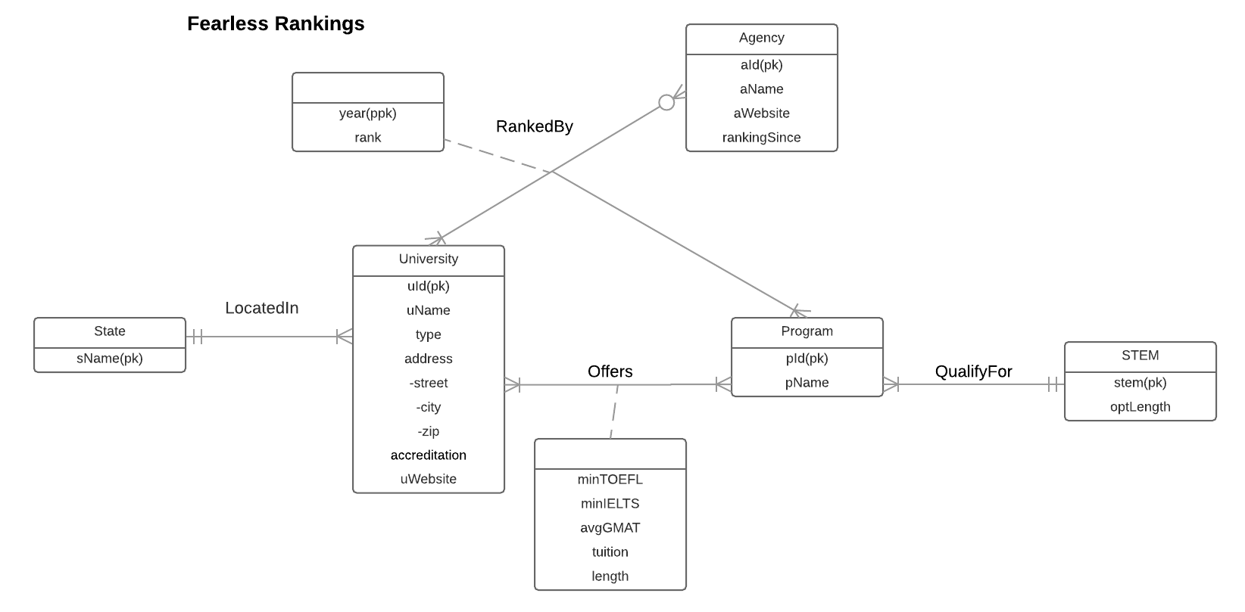
ERD

Slide 7
Relational Schema
University (uId, uName, type, street, city, zip, accreditation, uWebsite, sName)
State (sName)
Program (pId, pName, stem)
Stem (stem, optLength)
ProgramStats (uId, pId, minTOFEL, minIELTS, avgGMAT, tuition, length)
Agency (aId, aName, aWebsite, rankingSince)
Rank (uId, pId, aId, year, rank)

Slide 8
Physical Database Design
CREATE TABLE Program (
pId CHAR (3) NOT NULL,
pName VARCHAR (4),
stem VARCHAR (10)
CONSTRAINT pk_Program_pId PRIMARY KEY (pId),
CONSTRAINT fk_Program_STEM FOREIGN KEY (stem)
REFERENCES STEM (stem)
ON DELETE NO ACTION
ON UPDATE NO ACTION);

Slide 9
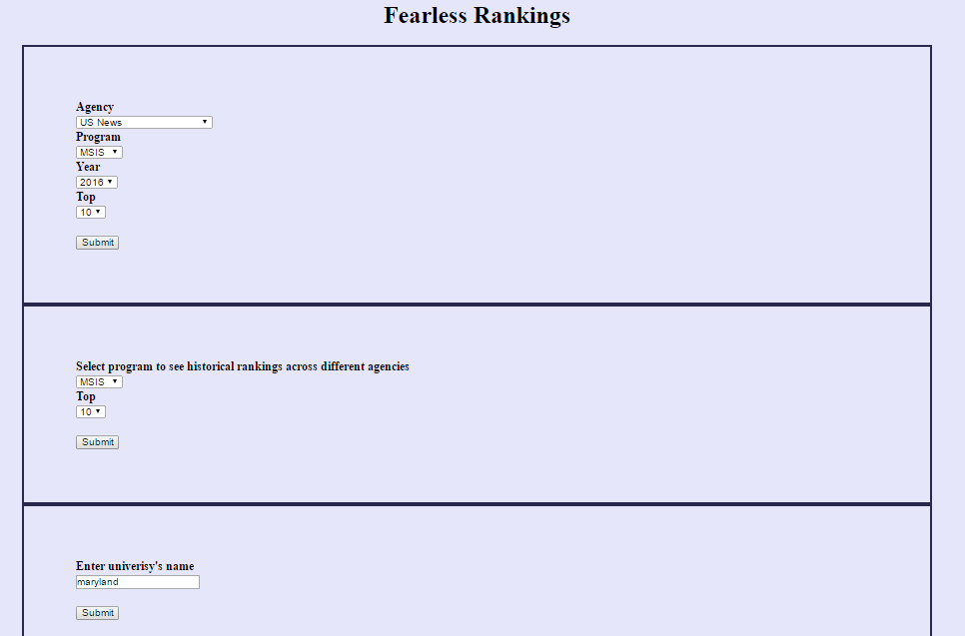
Technology
WAMP server
PHP
MySQL
Notes:
9-14 yasho

Slide 10
Use Cases
1. What are the top 10 Universities ranked by US News for MBA in 2016?
SELECT uName, rank
FROM University U
JOIN Rank R ON U.uId= R.uId
JOIN Agency A ON R.aId=A.aId
WHERE pId='003'
AND rank<=10
AND A.aId='1001'
AND R.year = 2016;

Slide 11
1. What are the top 10 Universities ranked by US News for MBA in 2016?

Slide 12
Use Cases
2. What is the Rank of MBA program of Northwestern University in different agencies in 2016?
SELECT uName, pName, aName, rank
FROM Program p, University u, Agency a, Rank r
WHERE u.uId = r.uId
AND p.pId = r.pId
AND a.aId = r.aId
AND p.pName = 'MBA'
AND u.uName = 'Northwestern university'
AND r.year=2016;

Slide 13
2. What is the Rank of MBA program of Northwestern University in different agencies in 2016?

Slide 14

Thank You!

