Slide 1
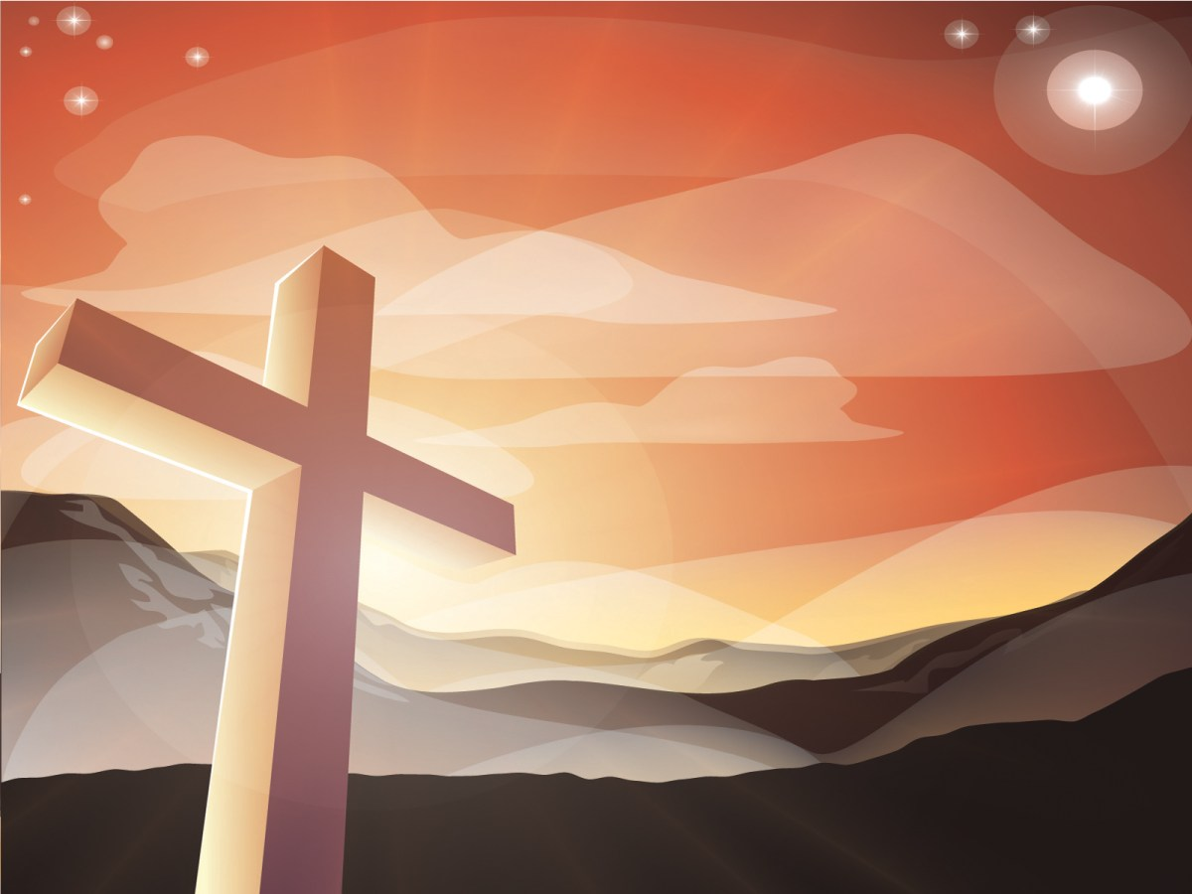


Slide 2
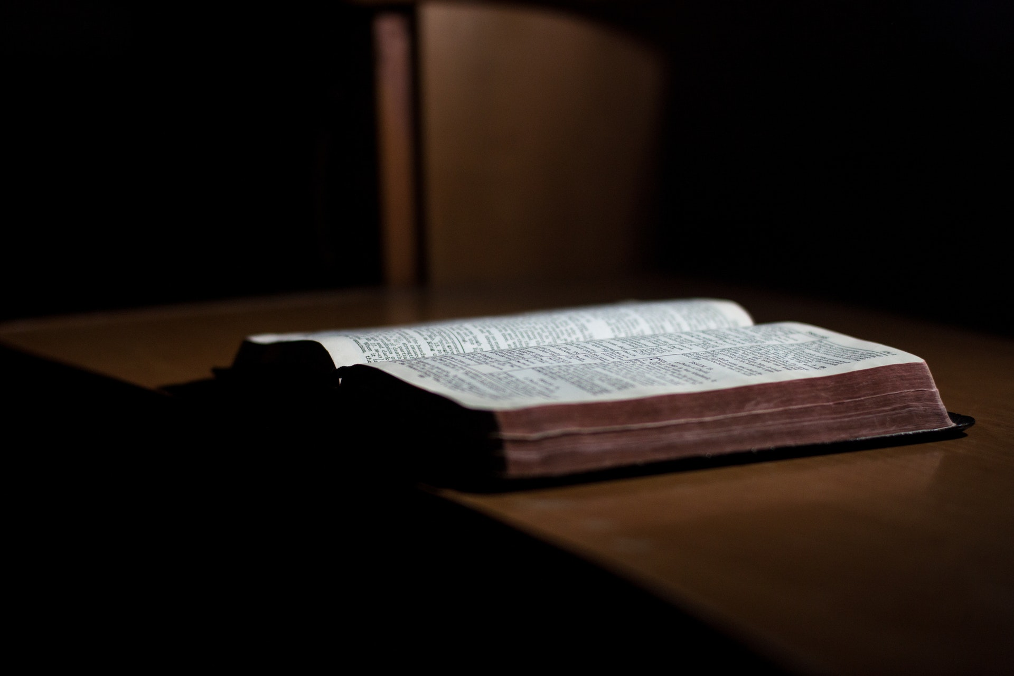
Adult Bible Class (ABC)
1st week: “How to Know God’s Will”
2nd week: “How to Read God’s Word”
To be led by Pastor Romy Alag

Slide 3

Board Meeting
This Coming Thursday (Nov. 9)
Please mark your calendar and be On Time

Slide 4
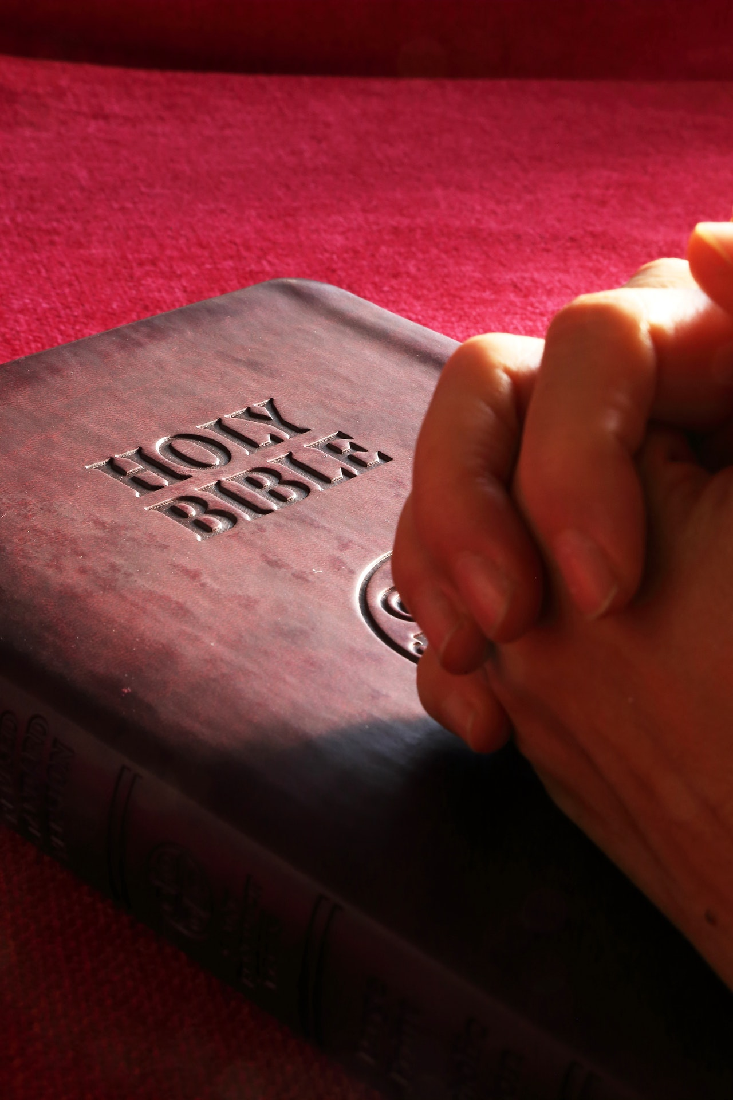
Prayer Items

Slide 5
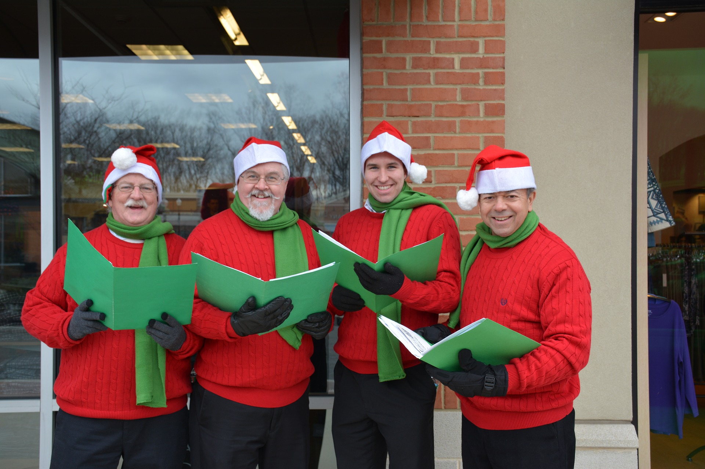
Christmas Caroling

Slide 6

Candlelight Service
December 22, 2017

Slide 7


Slide 8


