Slide 1


TASK 1 - ATLAS COPCO
The 300`s
Scheduling Optimization

Slide 2



0. Problem definition

Slide 3




Metrics evaluated and tools
TOOLS
Average idle time of the rotors in the queue
METRICS
Global temperature variation of a scheduling

Slide 4

First Task
CONSIDERATIONS
INFOS FOR PALLET
No stackable pallets
Duration of the job = (Heating t - Cooling t)
ΔT° between two process is correlated with the Energy consumption
Start time of cure
End time of cure
Oven n°

Slide 5
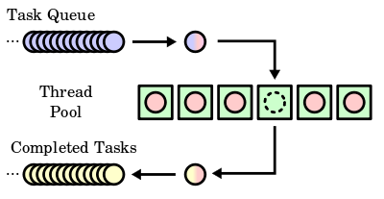
1.1 First Task - First in, First out (FiFo) Solution
Queues processes in the order that they arrive in the ready queue

Slide 6
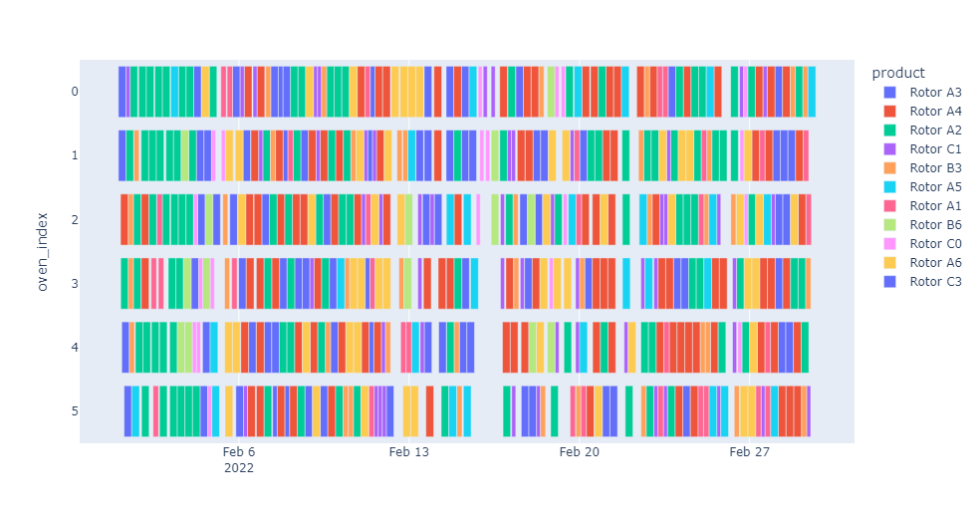


1.1 First Task - First in, First out (FiFo) Solution
Less than 147400 ºC
of temperature variation
Approx. mean of 165 min
to start to cure

Slide 7
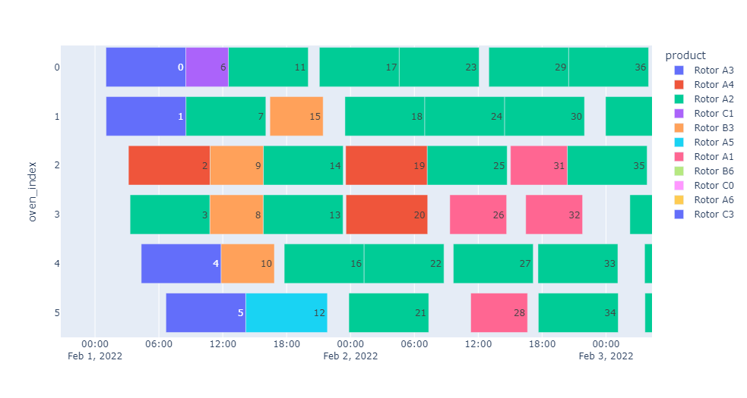
1.1 First Task - First in, First out (FiFo) Solution

Slide 8
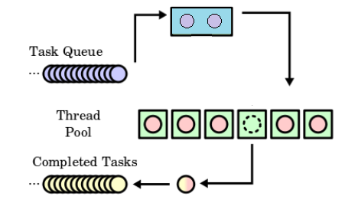
1.2 First Task - FiFo solution with energy to sort buffer
Buffer sorted using the difference from previous rotor cooling temperature and the target temperature from all rotors in buffer, prioritizing the smaller variation
Buffer

Slide 9
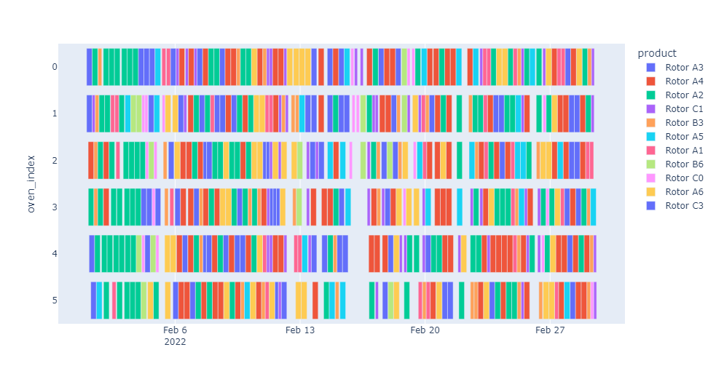
1.2 First Task - FiFo solution with energy to sort buffer

Slide 10
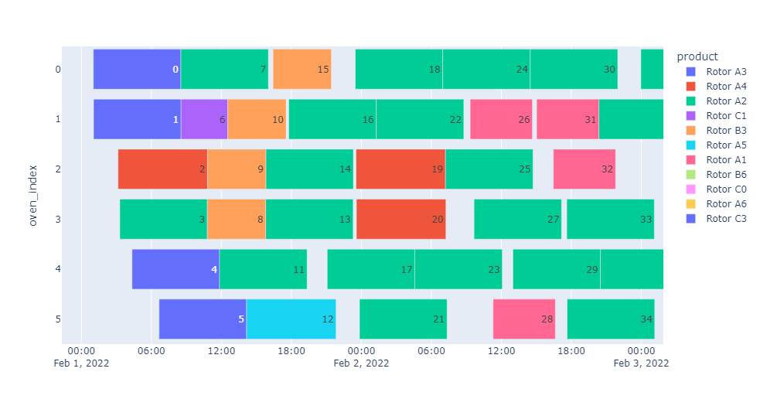
1.2 First Task - FiFo solution with energy to sort buffer
Less than 147300 ºC
of temperature variation
Approx. mean of 203 min
to start to cure

Slide 11
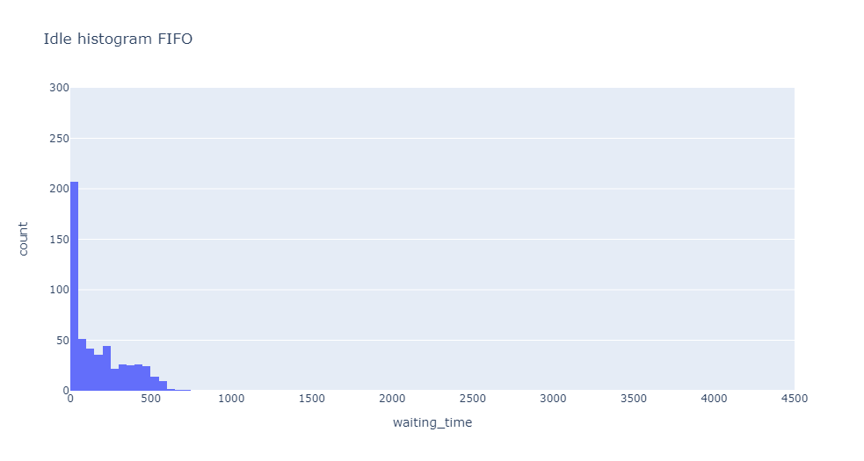
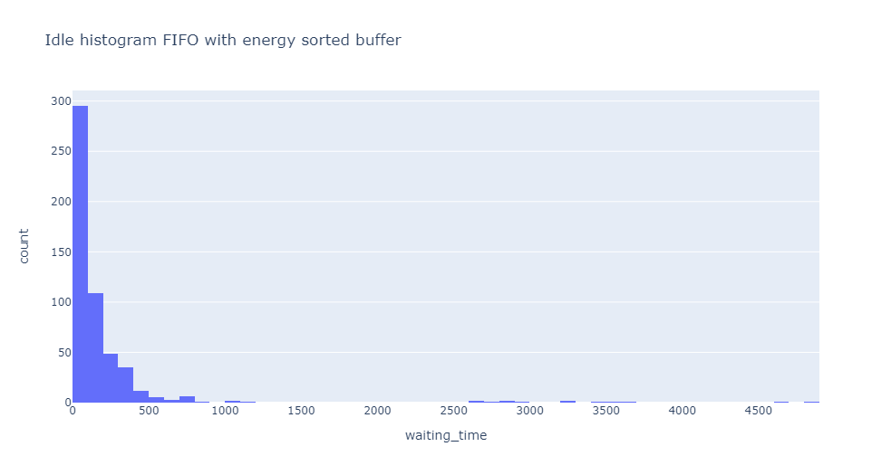
Rotors Idle time in queue comparison

Slide 12
2. Second Task - Solution
It was used DFS algorithm with an heuristic. So, the next schedule text will be always the one with less cost in the next ten. The cost depend of the time and energy consumption of the task.
C1
n1
n2
n3
n4
…
n10
n2
n3
n4
n5
…
n11

Slide 13

2. Second Task - Solution
C: cost to prioritize nodes;
T: variation of temperature to allocate that rotor type on the oven normalized by the maximum temperature;
t: time since the first pallet is ready until program is concluded, normalized by the longest program;
𝜆: number of stacks.
C1
n1

Slide 14
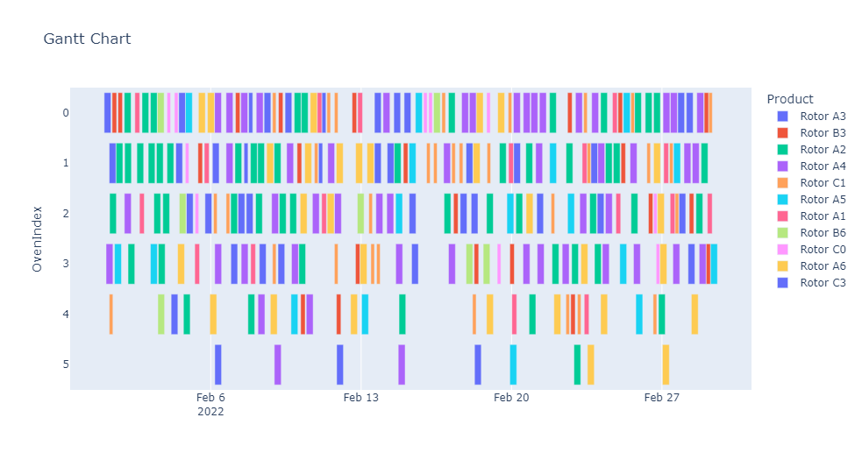
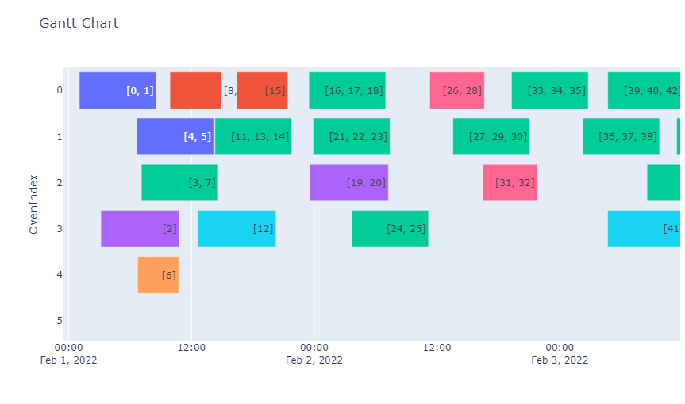
2. Second Task - Results
Less than 77.000 ºC
of heating
Approx. mean of 66 min
to start to cure

Slide 15
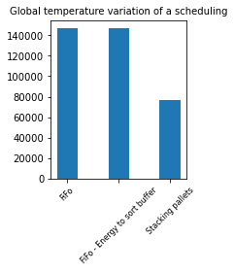
2. Second Task - Results
Stacking pallets logic, reduced temperature variation in more than 47% compared to previous solutions

Slide 16
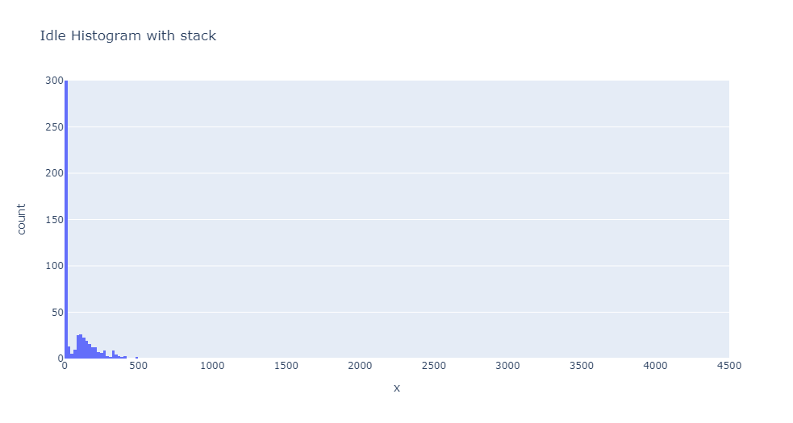
2. Second Task - Results

Slide 17



3. Third Task
PROBLEM
STRATEGY
START POINT
Notes:
Para a terceira task foi pedido para que caso acontecesse problemas de logistica ou quebra de algum robo compromentendo a entrega de pallets, deveriamos analisar a estrategia de deixar um forno em stand by

Slide 18
3. Third Task - Previous Solution
More than in 90%
of time the evan 6 is free
Notes:
Observando o gannt da segunda task, observamos que o 6 forno ficava mais de 90% sem utilizar
Com isso fizemos a simulacao utilizando a abordagem da segunda task com um forno a menos

Slide 19
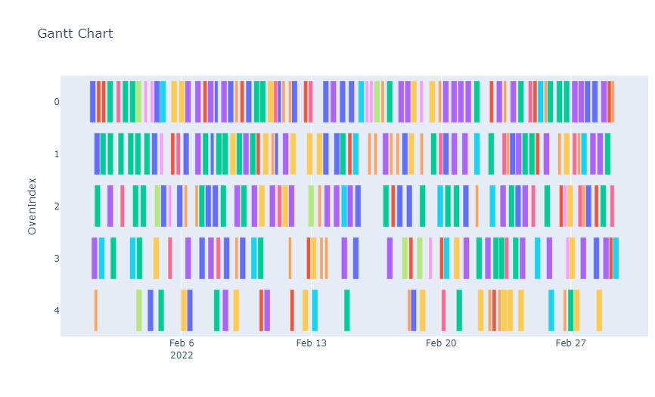
3. Third Task - New Solution
Less than
1%
increase of temperature total heating and time consuming
Notes:
Assim observamos uma variacao de menos de 1% no aumento da variacao de temperatura e no idle time, demostrando que retirar um forno nao ocorreu uma variacao muito grande

Slide 20
Thank you!
Nicolas Antero Nunes
Pedro Yves Fracari Ceripes
Victor Negosek de Oliveira
https://github.com/yvesfracari/IPThackathon
Questions?

