Slide 1





EICV7 FINDINGS DISSEMINATION
GAKENKE DISTRICT
July 2025

Slide 2




Outline
EICV7
Introduction
Poverty indicators
Population structure and distribution
Social economic indicators
Conclusion and Policy Reflections
“If You Don’t Count, You Don’t Count”

Slide 3






Introduction
EICV4 EICV5
EICV7
EICV7
2024
EICV7 features methodological improvements for a more comprehensive assessment of poverty in Rwanda. Main reasons for change are:
Evolutions in economic welfare of individuals.
More usage of restaurants School feeding program
Shift from agricultural to non-agriculture jobs
Recent Methodological improvements in concepts and measurements.
Approved at regional and international level
EICV1 EICV2 EICV3
EICV6
Conducted every Five years
Conducted every Three years
2001
2006
2011
2014
2017
2020
Not completed due to the COVID-19
The six previous rounds used the same methodology developed in EICV1 (2001)
“If You Don’t Count, You Don’t Count”

Slide 4
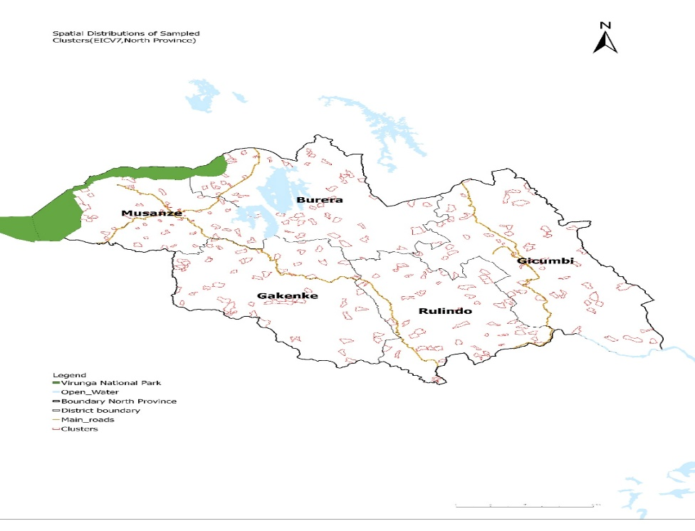
EICV7
Spatial Distribution of Sampled EAs in Northern Province for EICV7 Cross-sectional Survey
“If You Don’t Count, You Don’t Count”

Slide 5
Poverty Indicators
EICV7
“If You Don’t Count, You Don’t Count”

Slide 6



Trends in poverty line in RWF
EICV7
EXTREME POVERTY LINE (RWF)
2024
POVERTY LINE (RWF)
356,432
2,400 kcals
The food poverty line is based
on the cost of 2,400 kcal/day
RWF 356,432
The annual cost of food equivalent to 2400kcal/day per adult (January 2024 prices).
2024
560,127
2014
105,064
2014
159,375
2011
83,000
RWF 560,127
The annual cost of food and non
food per year per adult (January
2024 prices).
2011
118,000
2006
63,500
2006
90,000
2001
45,000
2001 64,000
The large increase between the 2014 and 2024 poverty lines reflects two things:
Inflation and improvements in poverty measurement in EICV7.
“If You Don’t Count, You Don’t Count”

Slide 7












Trends of poverty and extreme poverty rate
EICV7
58.9
27.4%
of poverty rate reduced from 39.8 in 2017
Old Series
New Series
56.7
44.9
Poverty rate decreased by 12.4 percentage points (2024 vs. 2017).
1.5M
People graduated from
poverty in last 7 years
39.1
38.2
39.8
27.4
2001 2006 2011 2014 2017 2017 2024
31.6%
16.7%
Changes in methodology prevented direct poverty comparisons, so we used modelling techniques to analyze trends.
Urban
Rural
from 18.9% in 2017
from 44.3% in 2017
“If You Don’t Count, You Don’t Count”

Slide 8


Extreme Poverty Rate
EICV7
Extreme poverty
Poverty rate
37.4
5.4%
Extreme Poverty rate
reduced from 11.3% in 2017
Northern Province has the second lowest population living in poverty. After Kigali city
34.7
26.8
20.2
9.1
7.4
9.0
3.1%
Rural
6.4%
4.5
Urban
1.1
3.2
from 6.0% in 2017
from 12.5% in 2017
City of Kigali Northern
Eastern
Southern
Western
“If You Don’t Count, You Don’t Count”

Slide 9
Trend of Poverty rate(%) in Northern Province
EICV7
“If You Don’t Count, You Don’t Count”

Slide 10
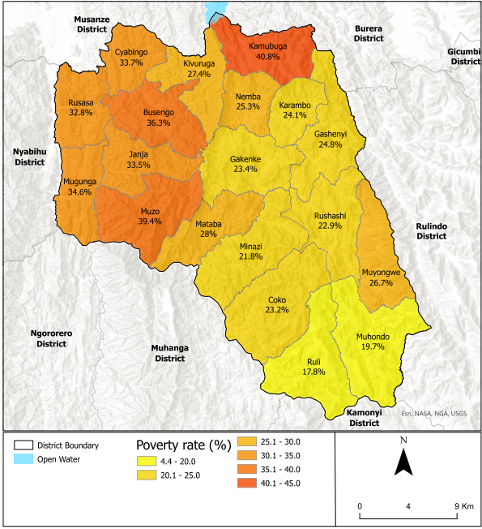
Poverty rate by Sectors of Gakenke district
EICV7
Source: Small area estimation based on EICV7 and 2022 GPHC
“If You Don’t Count, You Don’t Count”

Slide 11
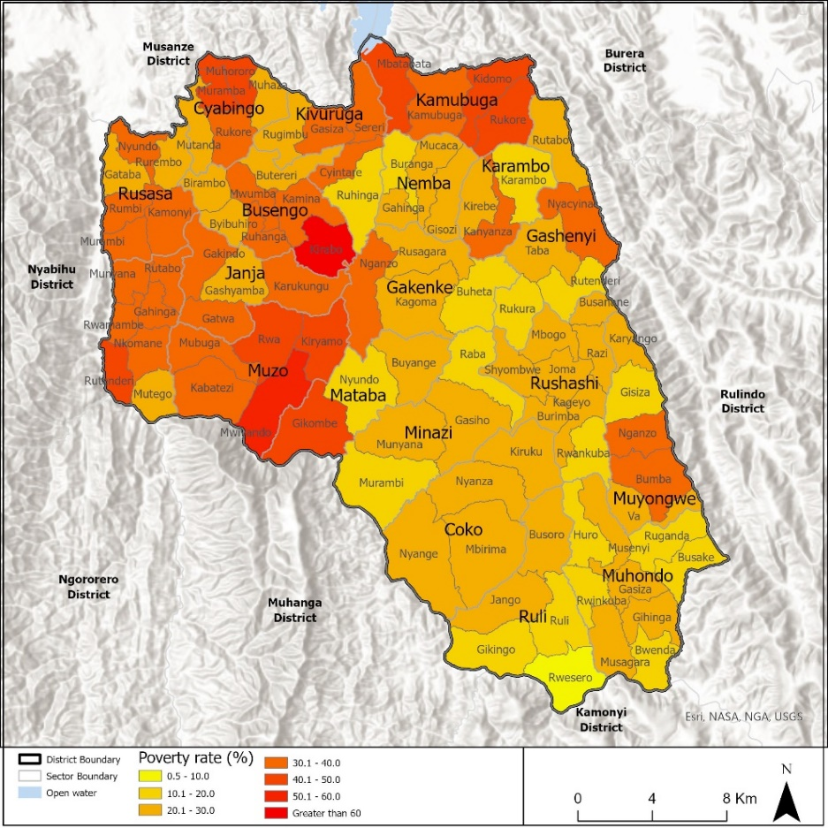
Poverty rate by Cells of Gakenke district
EICV7
Source: Small area estimation based on EICV7 and 2022 GPHC
“If You Don’t Count, You Don’t Count”

Slide 12
Population structure and distribution
EICV7
“If You Don’t Count, You Don’t Count”

Slide 13
Trends of population size by sector (2012 & 2022)
EICV7
 | 2012 | 2022 | % increase from 2012-2022
Rwanda | 10,515,973 | 13,246,394 | 26
Northern Province | 1,726,370 | 2,038,511 | 18
Gakenke district | 338,234 | 365,292 | 8
Busengo | 20,164 | 21,392 | 6
Coko | 16,340 | 17,942 | 10
Cyabingo | 17,544 | 18,785 | 7
Gakenke | 22,670 | 25,325 | 12
Gashenyi | 20,067 | 22,647 | 13
Janja | 15,804 | 16,007 | 1
Kamubuga | 20,758 | 23,336 | 12
Karambo | 12,159 | 13,617 | 12
Kivuruga | 18,226 | 19,967 | 10
Mataba | 14,346 | 15,520 | 8
Minazi | 13,527 | 14,193 | 5
Mugunga | 19,361 | 19,963 | 3
Muhondo | 20,125 | 21,334 | 6
Muyongwe | 15,550 | 16,053 | 3
Muzo | 21,378 | 21,816 | 2
Nemba | 15,643 | 16,854 | 8
Ruli | 18,516 | 22,464 | 21
Rusasa | 18,250 | 19,242 | 5
Rushashi | 17,806 | 18,835 | 6
Source: Fifth Rwanda population and housing census, 2022(NISR)
“If You Don’t Count, You Don’t Count”

Slide 14
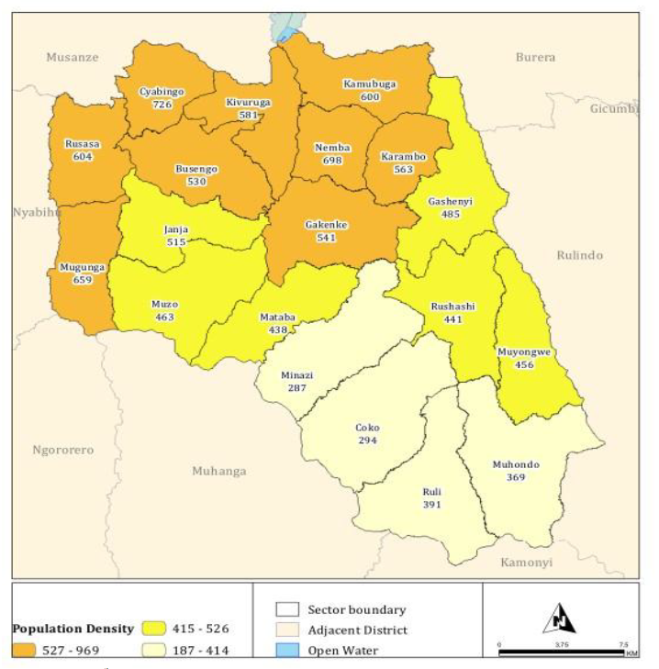
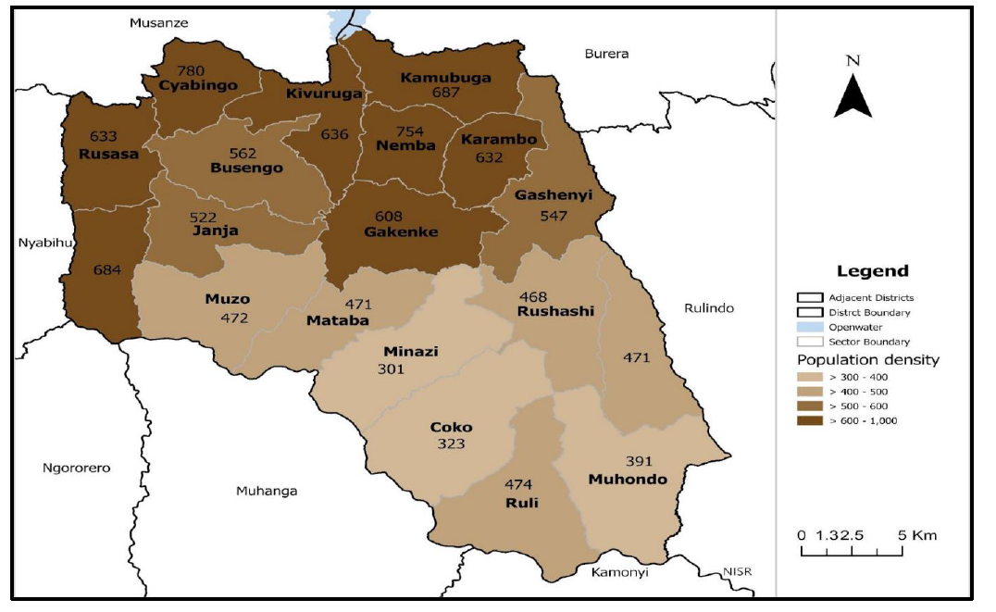
Population density by sectors (Inhabitants per Square km)
EICV7
Source: Fifth Rwanda population and housing census, 2022(NISR)
Source: Fourth Rwanda population and housing census, 2012(NISR)
“If You Don’t Count, You Don’t Count”

Slide 15
Projected Population of Gakenke district
Year | Both sexes | Male | Female | Population density
2023 | 368,601 | 174,374 | 194,227 | 524
2024 | 371,758 | 176,048 | 195,710 | 529
2025 | 375,027 | 177,767 | 197,260 | 533
2026 | 378,402 | 179,527 | 198,875 | 538
2027 | 381,808 | 181,293 | 200,515 | 543
2028 | 385,196 | 183,048 | 202,148 | 548
2029 | 388,563 | 184,783 | 203,780 | 553
2030 | 391,933 | 186,509 | 205,424 | 557
2031 | 395,287 | 188,221 | 207,066 | 562
2032 | 398,594 | 189,907 | 208,687 | 567
Source: Fifth Rwanda population and housing census, 2022(NISR)
“If You Don’t Count, You Don’t Count”

Slide 16
Net migration by district(,000)
Source: EICV7
“If You Don’t Count, You Don’t Count”

Slide 17
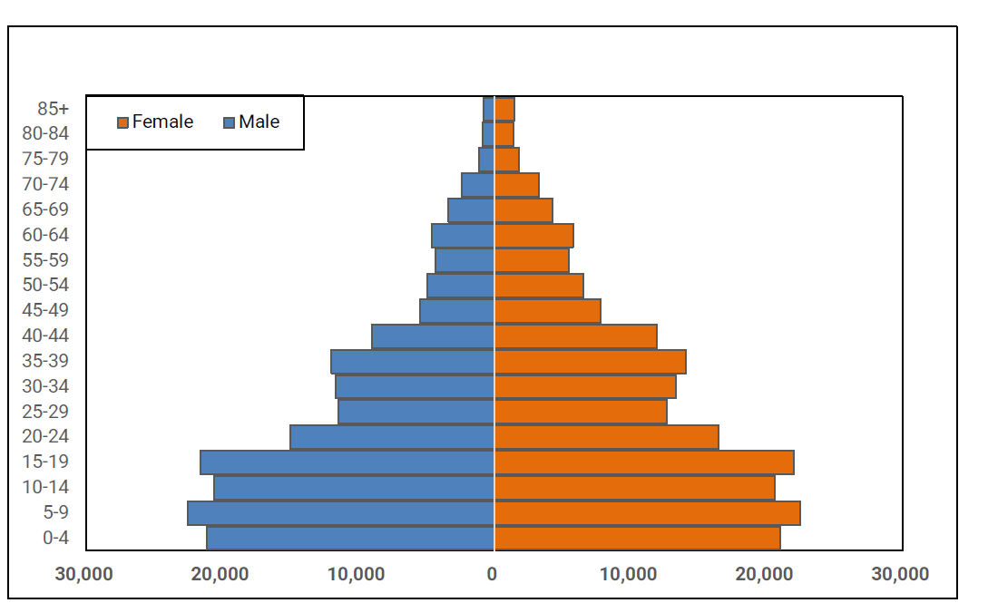
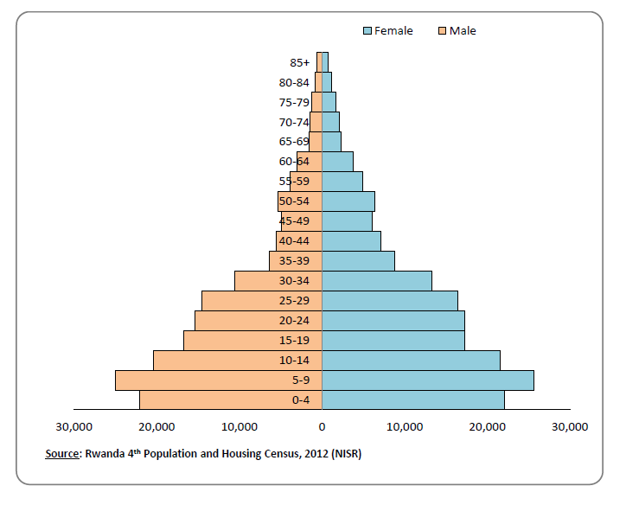
Age pyramid of Gakenke district in 2012 Vs 2022
Gakenke,2012
Gakenke,2022
Source: Fifth Rwanda population and housing census, 2022(NISR)
“If You Don’t Count, You Don’t Count”

Slide 18
Demographic Dependency ratio (%)
EICV7
RPHC5 2022
“If You Don’t Count, You Don’t Count”

Slide 19
ECONOMIC ACTIVITY
EICV7
“If You Don’t Count, You Don’t Count”

Slide 20
Workforce to population ratio 2017 and 2024
EICV7
“If You Don’t Count, You Don’t Count”

Slide 21
Economic Dependency ratio
EICV7
“If You Don’t Count, You Don’t Count”

Slide 22

Share (%) of agricultural workers in total workforce
EICV7
“If You Don’t Count, You Don’t Count”

Slide 23
Share % of agriculture HH without any livestock
EICV7
“If You Don’t Count, You Don’t Count”

Slide 24
% of HH with Agriculture land below 0.5 Ha
EICV7
Seasonal agriculture survey
“If You Don’t Count, You Don’t Count”

Slide 25
Agricultural land use per district (000Ha) 2020-2024
EICV7
District | Total land area excluding water bodies | 2020/2021 | 2023/2024 | Changes 2020-2024
Rulindo | 56.7 | 36.7 | 33.3 | -9.3%
Gakenke | 70.1 | 48.9 | 43.8 | -10.4%
Musanze | 50.9 | 30.8 | 29.6 | -3.8%
Burera | 58.4 | 37.9 | 37.5 | -1.0%
Gicumbi | 82.5 | 54.3 | 48.2 | -11.3%
Seasonal Agriculture Survey
“If You Don’t Count, You Don’t Count”

Slide 26
Youth Not in Employment, Education or Training (NEET)
EICV7
“If You Don’t Count, You Don’t Count”

Slide 27
Youth Not in Employment, Education or Training or subsistence agriculture(NEETS)
EICV7
“If You Don’t Count, You Don’t Count”

Slide 28
EDUCATION
EICV7
“If You Don’t Count, You Don’t Count”

Slide 29
Proportion of population aged 16+ and 16-30 years who didn't complete at least primary school in Northern Province
EICV7
 | 16+ years |  | 16-30 "Youth"
 | EICV5 | EICV7 | EICV5 | EICV7
Rwanda | 56.9 | 50.9 | 47.1 | 37
Northern Province | 57.1 | 52.8 | 46.3 | 36.4
Rulindo | 56.2 | 48.5 | 45.7 | 32.7
Gakenke | 57.7 | 58.1 | 46.8 | 39.5
Musanze | 55.2 | 45.4 | 44.8 | 28.4
Burera | 59.4 | 59.0 | 50.0 | 43.0
Gicumbi | 57.1 | 54.7 | 44.7 | 39.5
“If You Don’t Count, You Don’t Count”

Slide 30
Proportion of population aged 16+ and 16-30 years who have ever attended secondary school in Northern Province
EICV7
“If You Don’t Count, You Don’t Count”

Slide 31
Proportion of population who completed at least secondary school 18years and above and 18-30 years (EICV5 & EICV7)
EICV7
 | EICV5 |  | EICV7
 | 18 Years and above | 18-30 years | 18 Years and above | 18-30 years
Rwanda | 9.4 | 13.7 | 12.9 | 16.2
Northern Province | 7.8 | 11.4 | 10.0 | 13.4
Musanze | 10.9 | 13.5 | 17.0 | 21.8
Gicumbi | 7.5 | 12.4 | 8.9 | 13.8
Gakenke | 5.4 | 8.2 | 7.0 | 10.6
Rulindo | 7.5 | 11.8 | 7.7 | 10.0
Burera | 7.2 | 10.1 | 7.6 | 7.9
“If You Don’t Count, You Don’t Count”

Slide 32
Literacy rate among youth population (16 – 30 years)
EICV7
“If You Don’t Count, You Don’t Count”

Slide 33
Socio-Economic Indicators
EICV7
“If You Don’t Count, You Don’t Count”

Slide 34
% of HHs using improved drinking water source
EICV7
“If You Don’t Count, You Don’t Count”

Slide 35
% of households with limited drinking water services (take greater than 30 min to access)
EICV7
“If You Don’t Count, You Don’t Count”

Slide 36
% of HHs satisfied with drinking water source
EICV7
“If You Don’t Count, You Don’t Count”

Slide 37
% of HHs with Improved Sanitation
EICV7
“If You Don’t Count, You Don’t Count”

Slide 38
Access to electricity (Electricity from REG or other Private distributor/ Solar Power)
EICV7
“If You Don’t Count, You Don’t Count”

Slide 39
% of HHs owning at least one Mobile phone
EICV7
“If You Don’t Count, You Don’t Count”

Slide 40
Proportion of households with cement/tiles as floor material of the dwelling
EICV7
“If You Don’t Count, You Don’t Count”

Slide 41
Health insurance by consumption quintiles
EICV7
 | Quintile1-Quintile2 | Quintile3-Quintile5 | Total
Rwanda | 78.7 | 89.6 | 85.2
Northern Province | 89.0 | 93.1 | 91.7
Rulindo | 87.7 | 91.9 | 90.4
Gakenke | 95.4 | 96.9 | 96.3
Musanze | 84.7 | 91.1 | 88.9
Burera | 92.1 | 93.5 | 93.0
Gicumbi | 85.7 | 92.9 | 90.8
“If You Don’t Count, You Don’t Count”

Slide 42


Conclusion
EICV7
Most socio-economic indicators has improved over the last 7 years.
Some socio-economic indicators like, employment, education, sanitation, housing and piped water need to be improved.
Poverty levels are strongly correlated with economic activities but the high level of dependency and shocks can negatively affect the progress.
“If You Don’t Count, You Don’t Count”

Slide 43


Way forward:
EICV7
There is a need to create more productive job opportunities.
There is a need to sustain agriculture productivity.
Build capacity to mitigate effects of shocks.
Continue expanding access to basic services to all Rwandans.
“If You Don’t Count, You Don’t Count”

Slide 44
THANK YOU
EICV7
“If You Don’t Count, You Don’t Count”

