Slide 1
Generative Adversarial Networks for Hyperspectral Image Classification
2018.06.13

Slide 2
INTRODUCTION
Most of the supervised methods that have been applied in the machine learning community have been explored for HIS classification in the last few decades. In general, there are two kinds of data classification methods: spectral classifiers and spectral–spatial classifiers.
Traditional spectral classification algorithms typically include K nearest neighbors (KNN), maximum likelihood, neural network, and logistic regression [3]. Most of those algorithms dramatically suffer from the so-called curse of dimensionality (Hughes phenomenon) [4]. Support vector machines (SVMs) have shown their low sensitivity to high dimensionality with respect to the number of training samples and are unlikely to suffer from the Hughes phenomenon. During the first decade of this century, SVM-based spectral classifiers were considered as the state-of-the-art methods in the hyperspectral community.

Slide 3
With the advancement of the sensor and imaging systems, the spatial resolution of hyperspectral data is becoming finer and finer. With the help of spatial information, which can be extracted by diverse methodologies such as filtering or segmentation approaches, the classification performance can be significantly improved. Spectral–spatial classification approaches are regarded as the mainstream of HSI classification. Many methods have been proposed in recent years on the spectral–spatial classification of hyperspectral data.
Most of the traditional spectral and spectral–spatial classifiers do not classify the hyperspectral data in a “deep” manner, linear SVM and logistic regression (single layer ), decision tree or SVM with kernels (two layers). Deep models, which contain two or more hidden layers, tend to extract the invariant and discriminant features of the input data. Recently, deep learning has also been utilized for remote sensing data processing including HSI classification. A survey of deep learning-based approaches for remote sensing data can be found in [15].

Slide 4
In recent years, lots of deep models, especially deep convolutional neural networks (CNNs), have been proposed in the remote sensing community. (a deep CNN with five layers and pixel-pair method - spectral classifiers).
In order to utilize the spatial and spectral information of HSIs simultaneously, some spectral–spatial classifiers based on deep CNNs have been proposed [21], [22]. For example, in [22], a framework based on principal component analysis (PCA), deep CNN, and logistic regression was used for HSI classification. HSIs are inherently 3-D data, so it is reasonable to design 3-D CNNs to effectively extract the spectral–spatial features of HSIs [23], [24].
Although great progress has been achieved in HSI classification using deep learning-based methods, deep models usually face a serious problem known as overfitting. The reason behind this problem is that deep learning-based methods need to train a large number of learnable parameters, which requires a lot of training samples. The problem becomes serious when the number of training samples is limited. Deep models are often over-trained if there are not sufficient training samples available. Therefore, new and effective training strategies for deep models are needed to address the issue of overfitting. [The generative adversarial network (GAN), which this paper investigates, is one of those strategies.] Actually, the generator network of GAN can be regarded as a regularization method, which can mitigate the overfitting phenomena to a great extent.

Slide 5
GAN is a new kind of model, which usually contains a generative model G and a discriminative model D [28]. The models G and D are trained in an adversarial manner, in which G tries to generate the fake inputs as real as possible, and D tries to classify the real and fake inputs. In this adversarial game, both participants wish to get optimized results (i.e., D can achieve the best classification results, and G can generate the fake data which possess the most similar distribution with real data). Through the adversarial manner and competition of two networks, the training process of the discriminator will proceed both continuously and effectively instead of getting trapped into overfitting immediately when we use a limited number of training samples.

Slide 6
Furthermore, GAN generates samples which can be used as virtual samples. The proper usage of the virtual samples improves the classification performance. In this paper, the generated samples are used to boost the classification accuracy, and the experimental results prove the effectiveness of the usage of such samples.
In this paper, the use of the GAN for hyperspectral data classification is explored for the first time. With the help of GANs, the deep CNN achieves better performance in terms of classification accuracy and the overfitting problem raised by CNNs can be considerably mitigated. Two frameworks, 1D-GAN and 3D-GAN, are proposed for HSI classification, and the classification results obtained by these two frameworks showed that our GANs are superior to traditional CNNs even under the condition of limited training samples.

Slide 7
The use of GAN for hyperspectral data processing is explored for the first time in this paper.
The adversarial samples including 1-D spectra and 3-D spectral–spatial patches are generated by a well-designed GAN.
2) Two GAN frameworks including spectral classifiers and spectral–spatial classifiers are proposed for HSI classification. The frameworks use well-designed CNNs to classify HSIs, and the adversarial training is adopted by a regularization technique.
3) Adversarial samples are used for HSI classification for the first time, which is investigated to fine-tune the aforementioned GANs for an improved classification performance.
4) The proposed methods are tested on three well-known hyperspectral data sets under the condition of having limited training samples available.

Slide 8
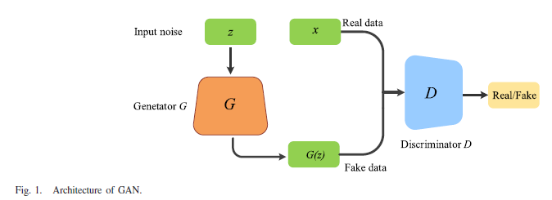
PROPOSED METHOD

Slide 9
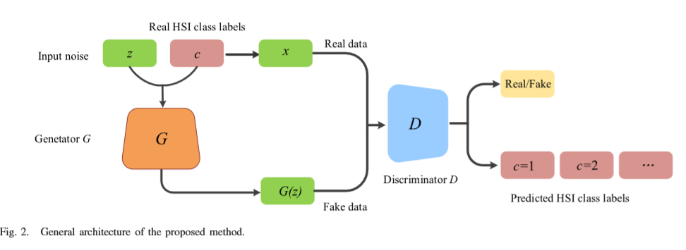
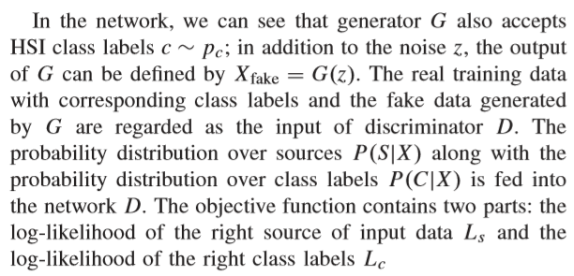
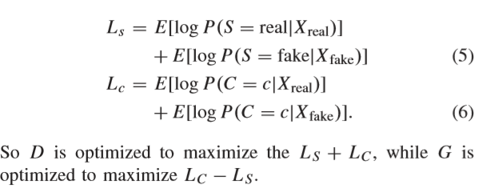

Slide 10
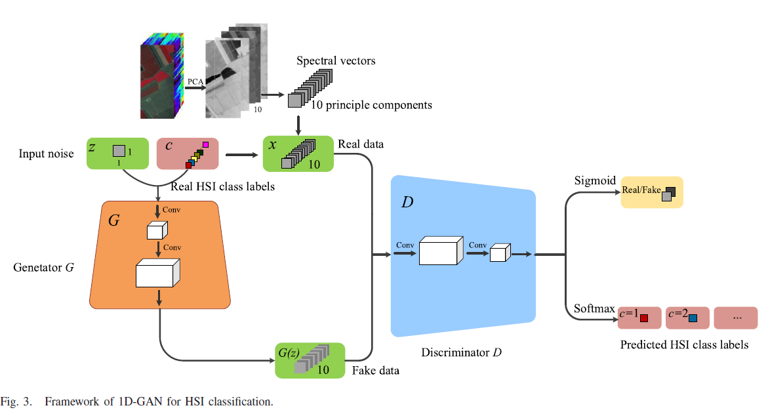
1D-GAN

Slide 11
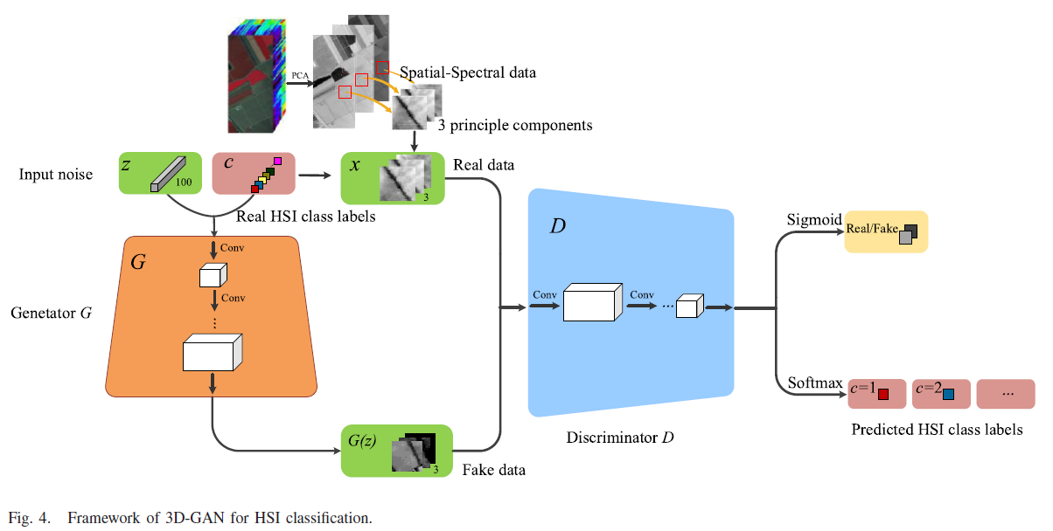
3D-GAN

Slide 12
Generative Adversarial Samples for Classification
On the other hand, using the fake samples from the generator also has a potential in improving the final classification results in terms of accuracies. In fact, when the discriminator cannot distinguish the real data from the synthetic fake data, we can also conclude that the generated abilities of G are superior to that of D. Consequently, the whole adversarial network achieves the global optimality in theory [28].
In this paper, the generated fake samples can be regarded as augmentation data [45] that increase the number of training samples. Then, both the fake samples and the true samples are fed into the networks in order to optimize the nets. Let us suppose that the original data set has N classes, during network training. To begin with, each generated sample is passed forward through the network and assigned a label by taking the maximum value of the probability prediction vector. These fake samples can consequently be used for training in the network with these labels. In addition, the generated samples do not belong to any class of real samples. Due to the difference of real samples and generated samples, a new class label is then created (i.e., N +1) and every fake sample is endowed with this new label. In this paper, we adopted this method to assign N + 1 to the labels of fake samples.

Slide 13
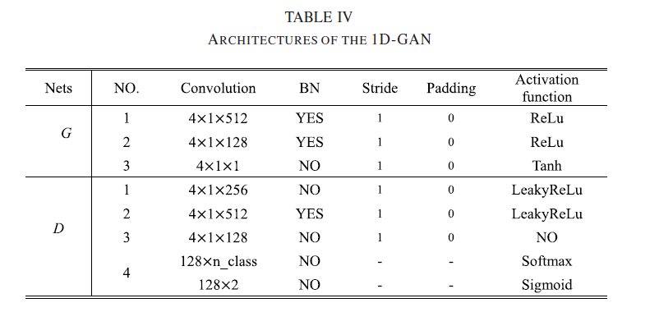
EXPERIMENTAL RESULTS
A. Data： Salinas、 Kennedy Space Center (KSC)、 Indian Pines
B. Classification Results for 1D-GAN

Slide 14
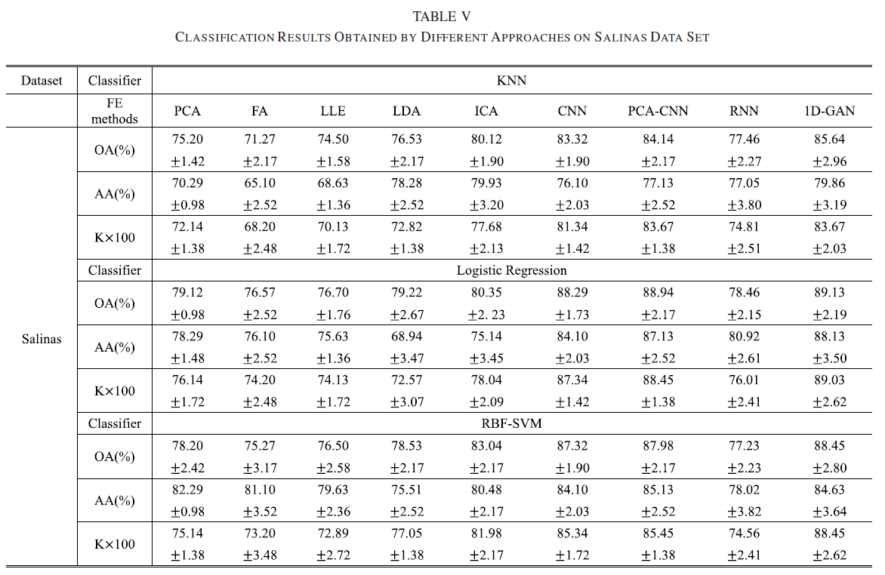

Slide 15
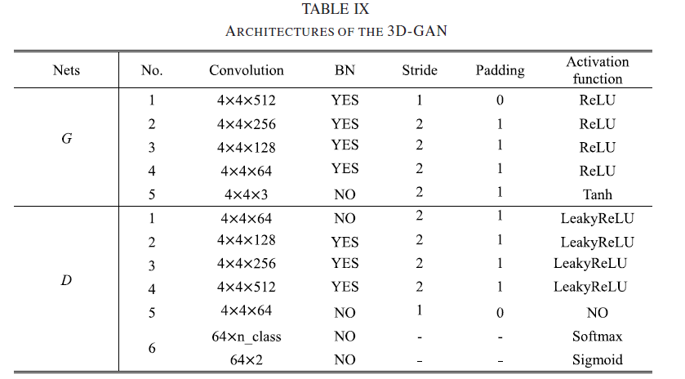
C. Classification Results for 3D-GAN

Slide 16
