Slide 1
Credit Card Fraud Detection using Apache Spark Streaming and Kafka
Nancy Jemimah – packiyanathan.n@husky.neu.edu
Venu Gopal Reddy – yerrangunta.v@husky.neu.edu

Slide 2
Goals of the project
To predict the fraud transactions on a streaming data
Use Databricks Notebook to explore the dataset
To use Apache Spark MLlib to build a machine learning model
Use Apache Kafka for data ingestion and Spark streaming to process the data and apply machine learning model on streaming data to detect the fraud transactions

Slide 3
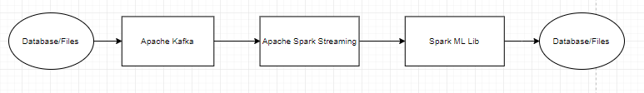
Architecture

Slide 4
Use cases
Actor – User who uses the credit card
Action – At the time of credit card transaction
Reaction – Detecting the fraud transaction

Slide 5
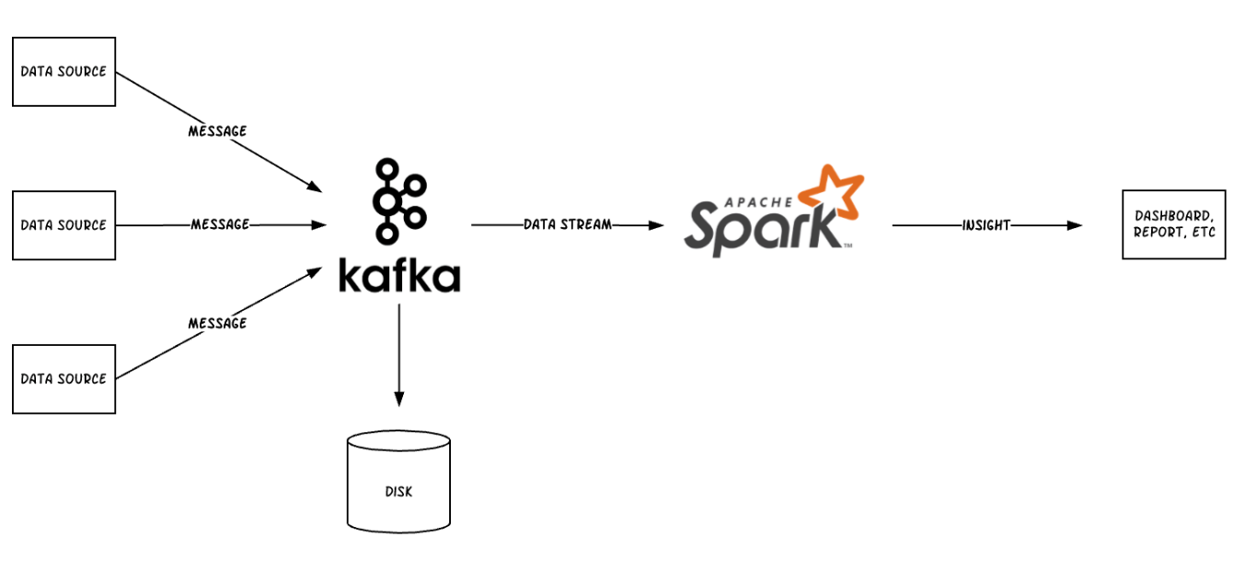
Methodology
Deploy ML model in Spark
Publish user transaction to Apache Kafka
Spark subscribes to Kafka
Apply ML model on the streaming data
Predict the fraud transactions

Slide 6
Data sources
Reference: https://www.kaggle.com/mlg-ulb/creditcardfraud
Data Size : 285,000 rows and 31 Columns

Slide 7
Milestone/Sprints
March 23- 29
Preprocessing and Cleaning Module Development
March 30 – April 11
Spark Learning and Spark ML Lib – Model Building
April 1- April 17
Unit Test Case and Implementation
March 18-24
Kafka Setup/ Understanding dataset and databricks notebook

Slide 8
Programming in Scala
Most part of our project will be programmed in scala including
Parsing
Cleaning
Filtering
Identifying
Unit Test
Coding Repository : https://github.com/yvgr00/CSYE7200FinalProject/tree/master

Slide 9
Acceptance criteria
Precision >= 80%
Recall >= 80%
Response time = 2 seconds

Slide 10

Thank you

