Slide 1
Credit Card Fraud Detection using Apache Spark Streaming and Kafka
TEAM - 16
Nancy Jemimah – packiyanathan.n@husky.neu.edu
Venu Gopal Reddy – yerrangunta.v@husky.neu.edu

Slide 2
Goals of the project
To predict the fraud transactions on a streaming data
Use Databricks Notebook to explore the dataset
To use Apache Spark MLlib to build a machine learning model
Use Apache Kafka for data ingestion and Spark streaming to process the data and apply machine learning model on streaming data to detect the fraud transactions

Slide 3
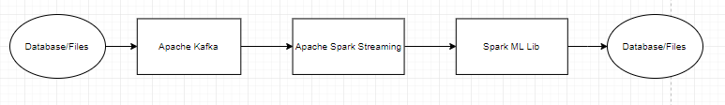
Architecture
Database/files → From the database, the data is published to the kafka.
Apache Kafka → The data is stored in the Kafka topic and spark subscribes to that topic for data
Apache Spark → In the spark framework, the data will be transformed, and given as input to the machine learning model built.
Database/file → The predicted result is again stored to database

Slide 4
Use cases
Actor – Administrator of the bank
Action – When admin initiates the data pipeline to detect fraud transactions
Reaction – Detecting the fraud transaction

Slide 5
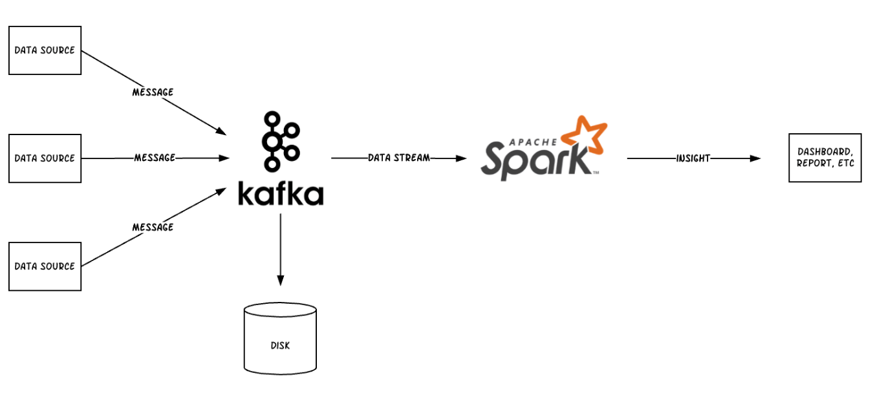
Methodology
Deploy ML model in Spark
Publish user transaction to Apache Kafka
Spark subscribes to Kafka
Apply ML model on the streaming data
Predict the fraud transactions

Slide 6
Data sources
Reference: https://www.kaggle.com/mlg-ulb/creditcardfraud
Data Size : 285,000 rows and 31 Columns

Slide 7
Milestone/Sprints
Venu’s Work →
March 23- 29
Unit Test cases to verify our implementation/ Check the workflow
Mar 30 – Apr 11
Final Implementaion and verification of Acceptance criteria
March 18-24
Kafka Setup/ Understanding dataset/Data Injestion
March 24 – 30 Data cleaning and Preprocessing in scala and Unit Test
March 24 – 30 Spark set up and integrating kafka and spark/ process the data
Mar 30- Apr 1 Building ML algorithm in spark framework
Nancy’s Work →

Slide 8
Programming in Scala
Everything will be programmed in Scala
Coding Repository : https://github.com/yvgr00/CSYE7200FinalProject/tree/master

Slide 9
Acceptance criteria
Precision >= 80%
Recall >= 80%
Response time = 2 seconds(optional)

Slide 10

Thank you

