Slide 1
Credit Card Fraud Detection using Apache Spark Streaming and Kafka
Nancy Jemimah – packiyanathan.n@husky.neu.edu
Venu Gopal Reddy – yerrangunta.v@husky.neu.edu

Slide 2
Use cases to be satisfied for hypothetical customers
Actor – User who uses the credit card
Action – At the time of credit card transaction
Reaction – Detecting the fraud transaction

Slide 3
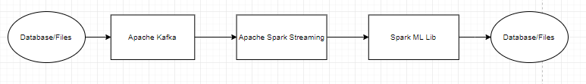
Architecture

Slide 4
Methodology
Publish user transaction to Apache Kafka
Spark subscribes to Kafka
Apply ML model on the streaming data
Predict the fraud transactions
Visualization using Apache Zeppelin

Slide 5
Data sources
Reference: https://www.kaggle.com/mlg-ulb/creditcardfraud
Data Size : 285,000 rows and 31 Columns

Slide 6
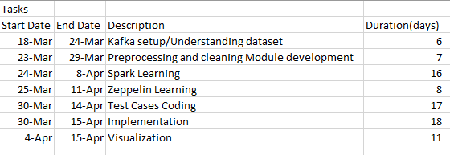
Milestones/sprints

Slide 7
Programming in Scala
Most part of our project will be programmed in scala including
Parsing
Cleaning
Filtering
Identifying
Unit Test
Coding Repository : https://github.com/yvgr00/CSYE7200FinalProject/tree/master
Documents : Google Slides

Slide 8
Acceptance criteria
Verify analysis results using test data – The accuracy should reach 90%

Slide 9
Goals of the project
Process Kaggle credit card dataset to find out the fraud transactions occured

Slide 10
Thank you

