Slide 1

Sports Booking portal
Team MEMBERS:
gutta Raghavendra Chowdary (200396)
Kembasaram nitin (200505)
modem sai Charan (200586)
napa Jayaprakash (200622)
yeginati vinay teja (201161)
TEAM NUMBER : 7

Slide 2

Why ?
A sports booking portal can be useful for individuals who want to book facilities or services related to sports, such as booking a tennis court, soccer field, gymnasium, or other sports-related activities. It can provide a centralized platform for users to search and compare options based on location, availability, and other relevant factors. A sports booking portal can make the booking process more efficient and convenient for users, especially when it comes to reserving popular or hard-to-get facilities or services.

Slide 3

Directions to open the website
Extract the zip file in your system and open the terminal in that directory.
Make sure flask and python3 are installed.
Run “python3 backend.py” in terminal.
Copy and Paste the Ip address in your browser to open the home page of the website.
Backend- Python, Frontend-Html, Database- Sqlite.

Slide 4
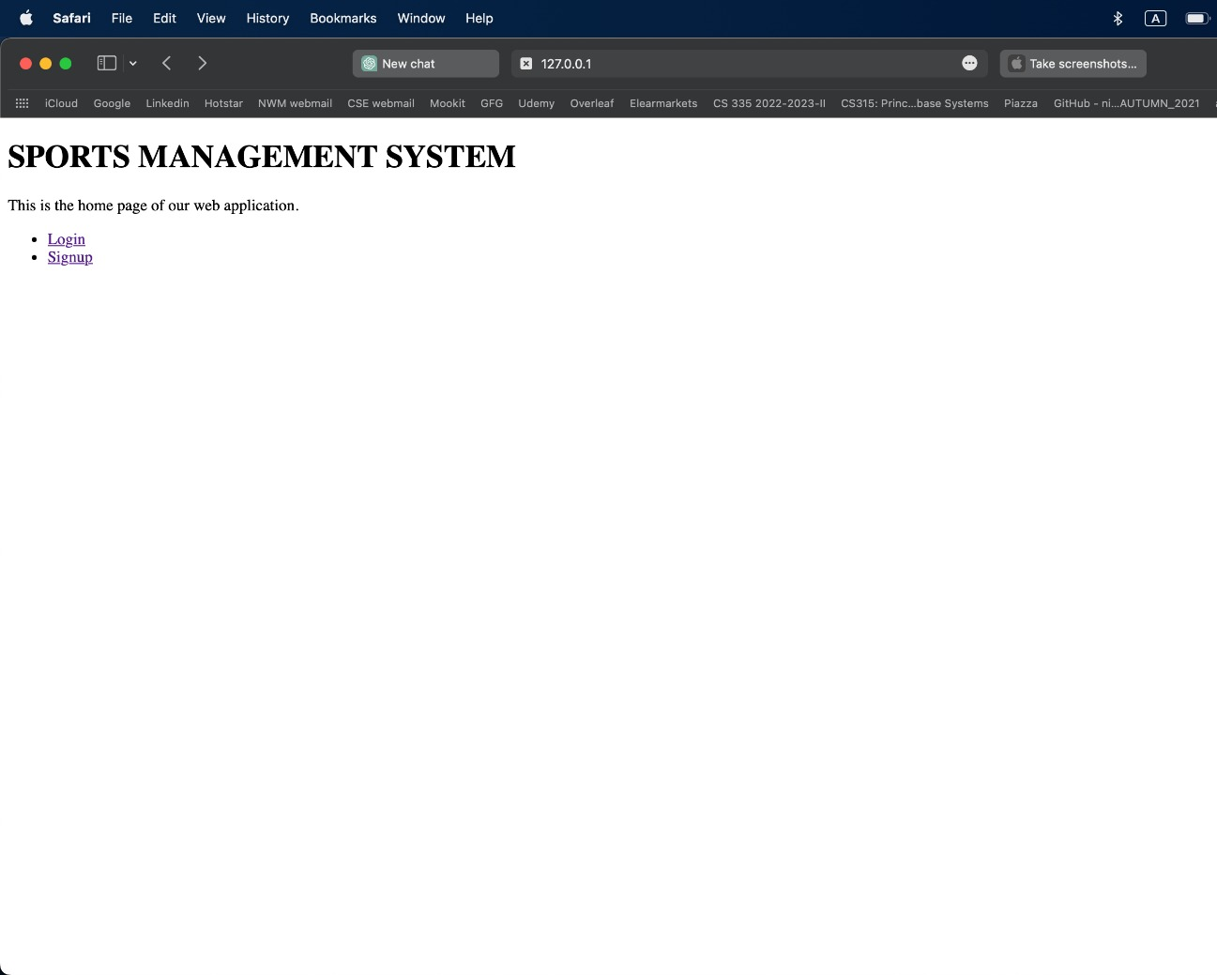
Home page
The user is presented with two options.
Login – if you already have an account.
Signup – to create an account.

Slide 5
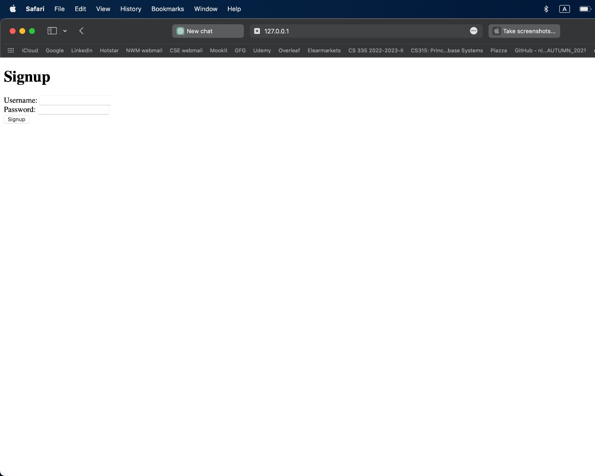
signup page
The user is required to fill the desired username and password.
If it encounters a wrong entry, the server pops an error message.
After successful Signup, user can now login with these credentials.

Slide 6
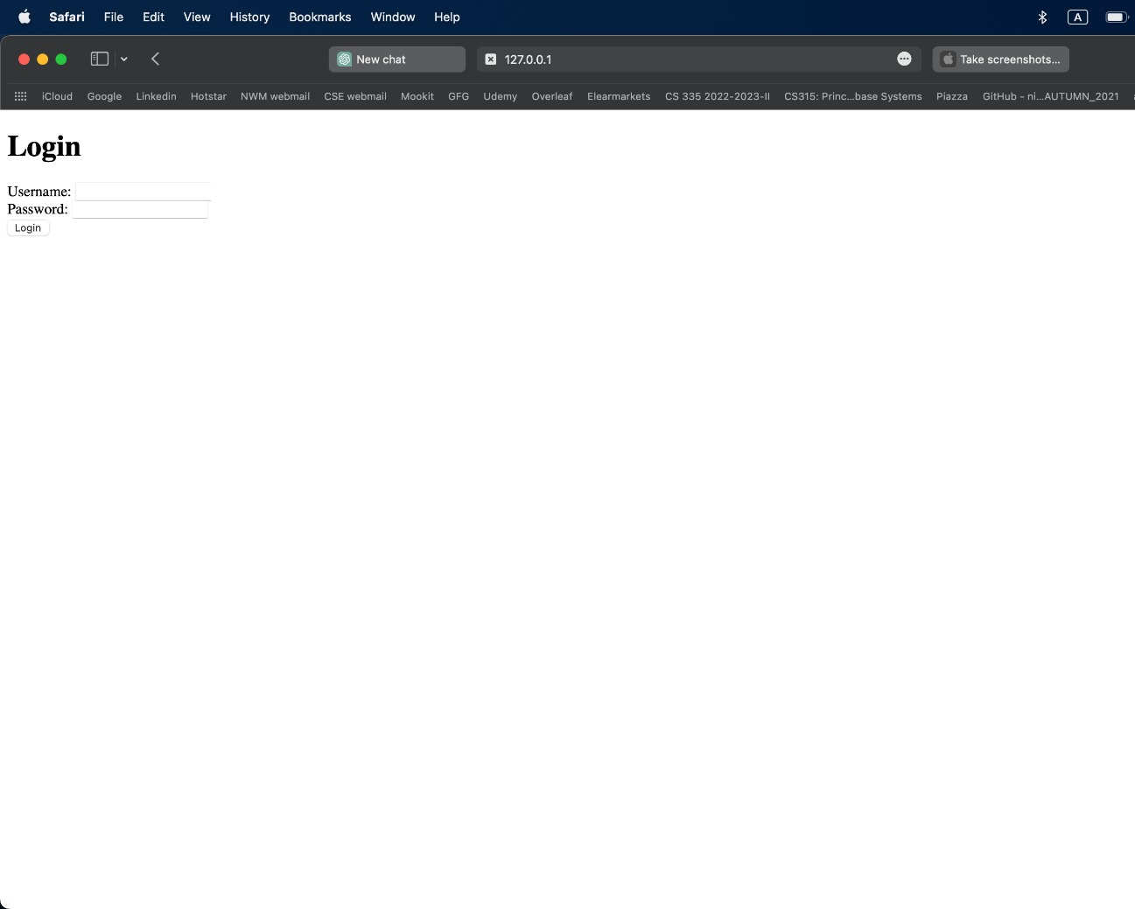
LOGIN page
The user has to enter his account details to login to the portal.
Upon entering valid credentials the user is re-directed to bookings page.

Slide 7
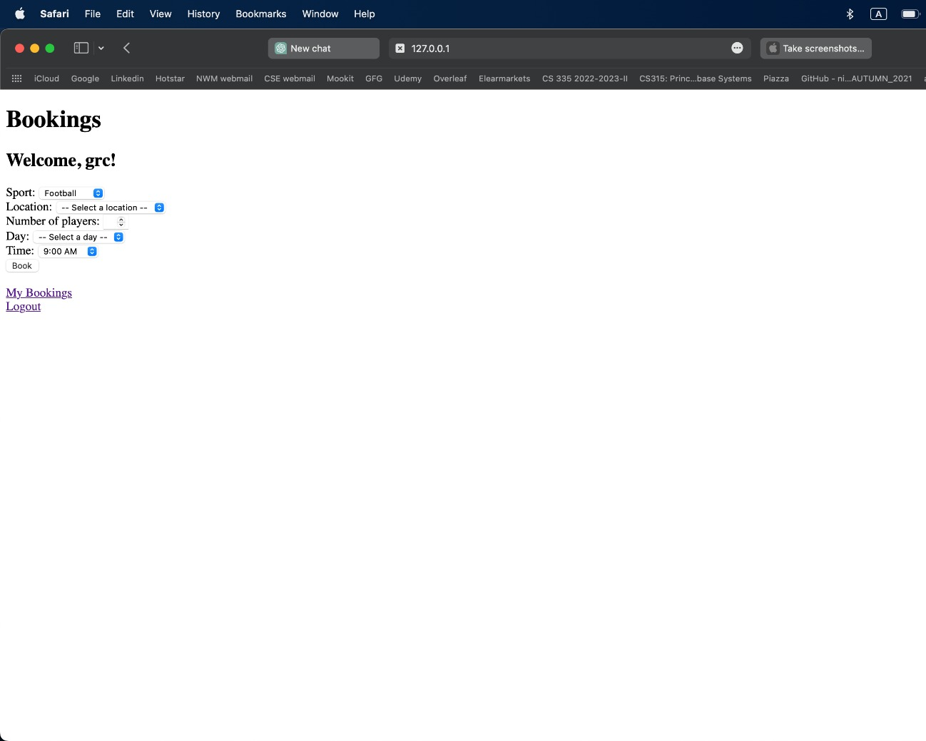
Bookings page
The user is supposed to enter the relevant details to book the desired slot.
If the requested slot has fewer vacancies than the requested number, then it displays the number of vacancies left and aborts booking.
If the entered details are valid then it displays the message as “Booking successful”.

Slide 8
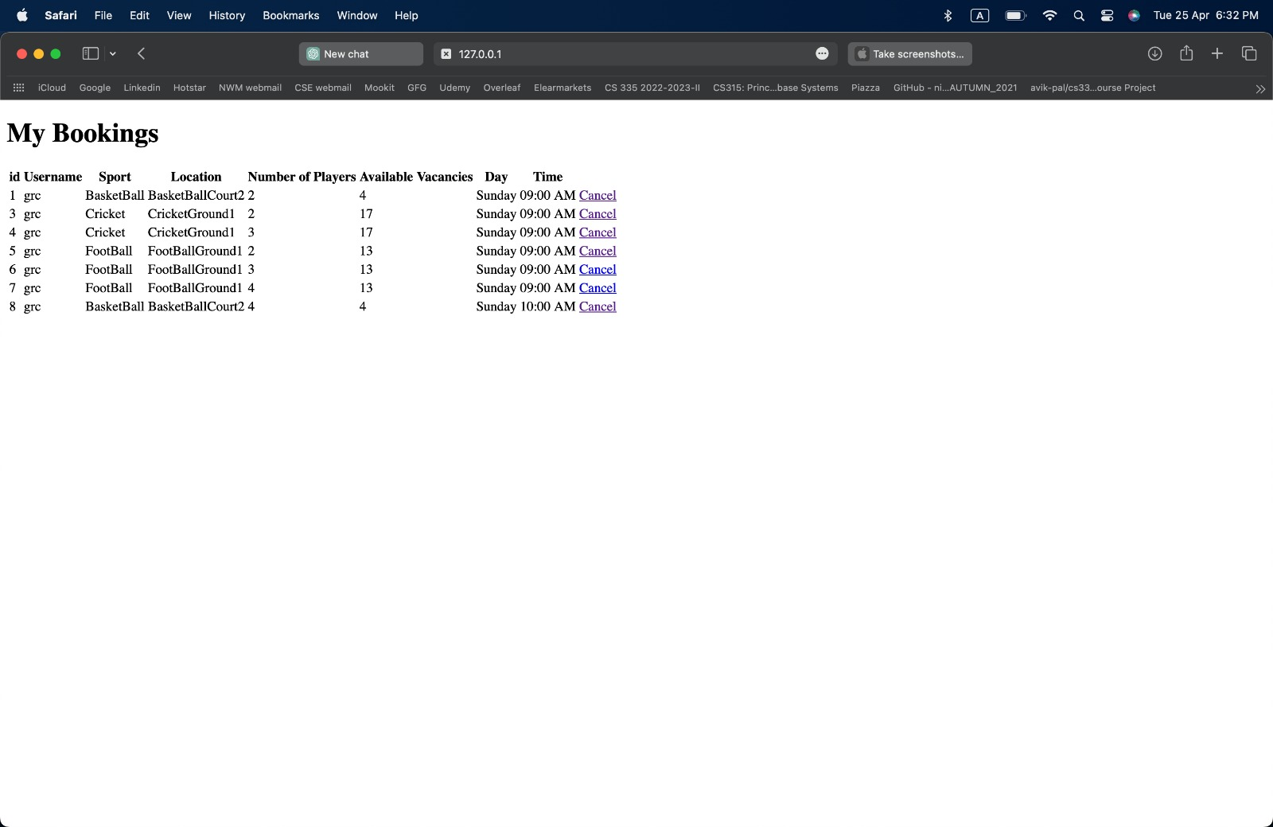
My Bookings page
The user can review his bookings and cancel if required.

Slide 9
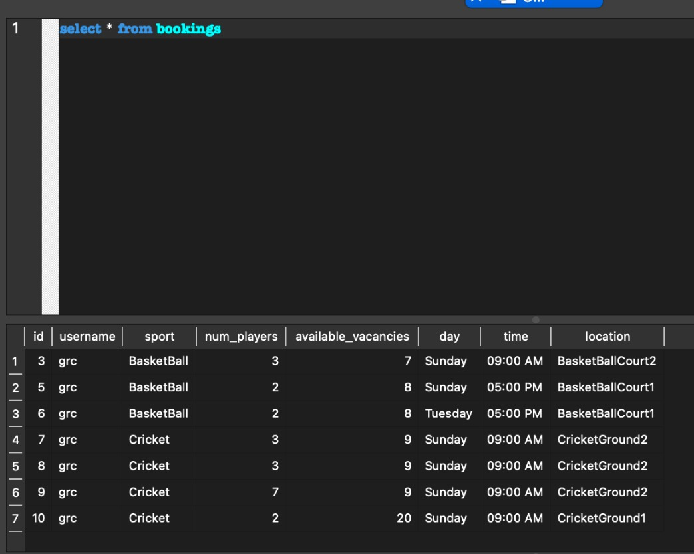
Bookings data
This query displays the data of successful bookings which can be further queried.

Slide 10
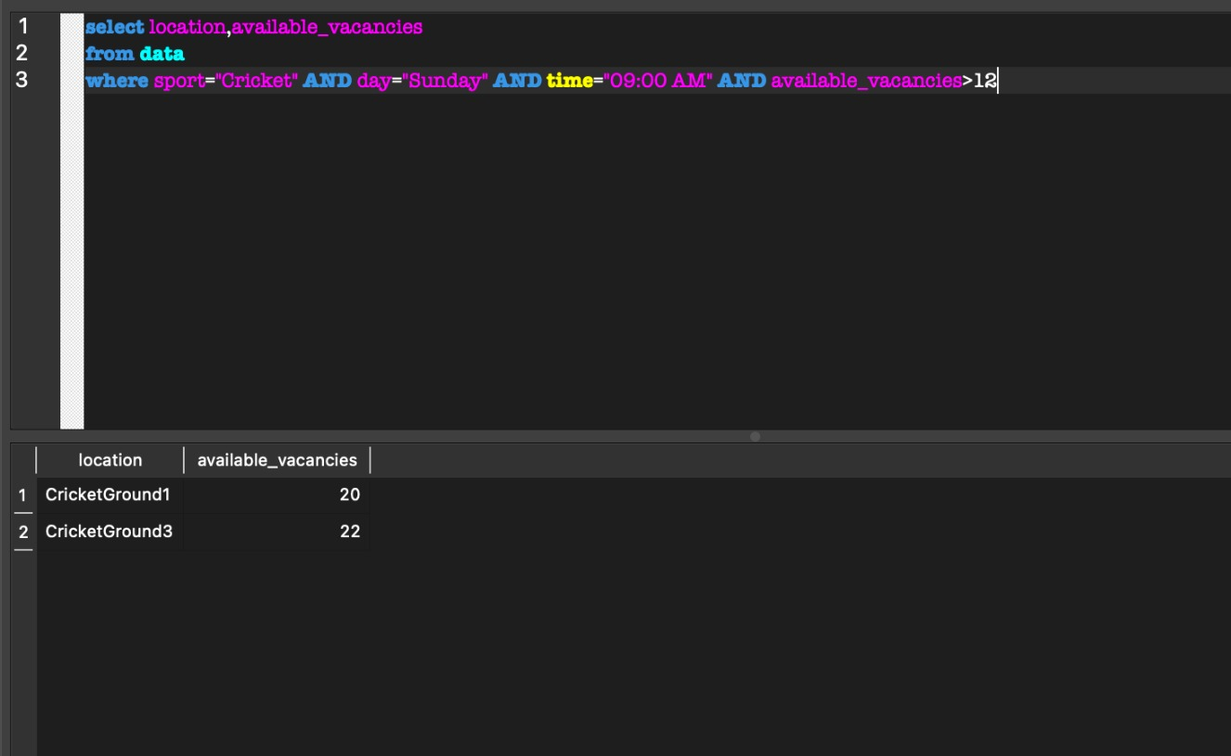
query
Here is an example which queries the database to provide information about the booking availability and location given the sport, day, time and number of players.

Slide 11
ACKnowledgement
We would like to thank our Professor, Dr. Arnab Bhattacharya for giving us this opportunity to extend our knowledge to real life applications.
We would also like to underscore dynamic efforts of the teamwork and their expert advice and contributions to the preparation of this report.

Slide 12


