Slide 1


St1501 DATA ENGINEERING CA1 AY2020/21
X

Slide 2
Naming OF entities
For the online shop, product is assigned using a three-tier hierarchy system. The three levels are Categories, Subcategories and Groups.
As an online user, I must be able to browse the products based on brand.
As the store owner, I must be able to update the discount information and promotion information at any time.
Therefore, the 6 entities are Products, Categories, Subcategories, Groups, Brands, Promotion.

Slide 3
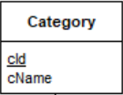
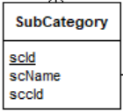
ATTRIBUTES FOR Category and subcategory Entity
cId – INT IDENTITY PRIMARY KEY – Auto increments and id uniqueness to a category
cName – VARCHAR(100) NOT NULL
scId – INT IDENTITY PRIMARY KEY – Auto increments and id uniqueness to a subcategory
scName – VARCHAR(100) NOT NULL
sccId – INT – Foreign key referencing to Category cId

Slide 4
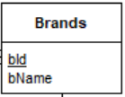
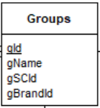
ATTRIBUTES FOR BRANDS AND GROUP Entity
bId – INT IDENTITY PRIMARY KEY – Auto increments and id uniqueness to a brand
bName – VARCHAR(100) NOT NULL
gId – INT IDENTITY PRIMARY KEY – Auto increments and id uniqueness to a group
gName – VARCHAR(100) NOT NULL
gBrandId – INT – Foreign key referencing to Brands bId
gSCId – INT – Foreign key referencing to SubCategory scId

Slide 5
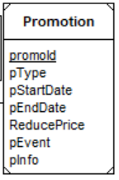
ATTRIBUTES FOR PROMOTIONS Entity
Product discount/promotion can be presented in a variety format such as reduce price, reduce price if purchase more quantity, offer free item for purchase. Direct discount simply offers a reduction based on the original price, such as $10 off or 10% off and this reduction is applied to a single product, while Quantity-Based Discounts encourage shoppers to increase their order value to a specific threshold.
promoId – INT IDENTITY PRIMARY KEY – Auto increments and id uniqueness to a product
pType – VARCHAR(100) NULL – State the Type of Promotion (Direct / Quantity-Based)
pInfo – VARCHAR(100) NULL – State the details of Promotion
pEvent – VARCHAR(100) NULL – State the Promotional event
pStartDate – DATE NULL – Starting date of Promotional event
pEndDate – DATE NULL – Ending date of Promotional event
ReducePrice – DECIMAL(5, 2) NULL – Accepts product price of 5 digits with 2 decimal places eg.124.50

Slide 6
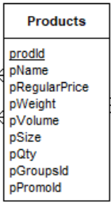
ATTRIBUTES FOR Products ENTITY
For each product, the product name, a short product description, price and promotion/discount information must be (compulsory) displayed. For some products, the weight/volume/size information should also (depends on product meaning optional) be displayed.
prodId – INT IDENTITY PRIMARY KEY – Auto increments and id uniqueness to a product
pName – VARCHAR(100) NOT NULL
pRegularPrice – DECIMAL(5, 2) NOT NULL – Accepts product price of 5 digits with 2 decimal places eg.124.50
pWeight – VARCHAR(100) NULL
pVolume – VARCHAR(100) NULL
pSize – VARCHAR(100) NULL
pQty – INT – counts the number of product available in database, if out of stock then Qty will be 0
pGroupsId – INT – Foreign key referencing to Groups gId attribute
pPromoId – INT – Foreign key referencing to Promotions promoId attribute

Slide 7
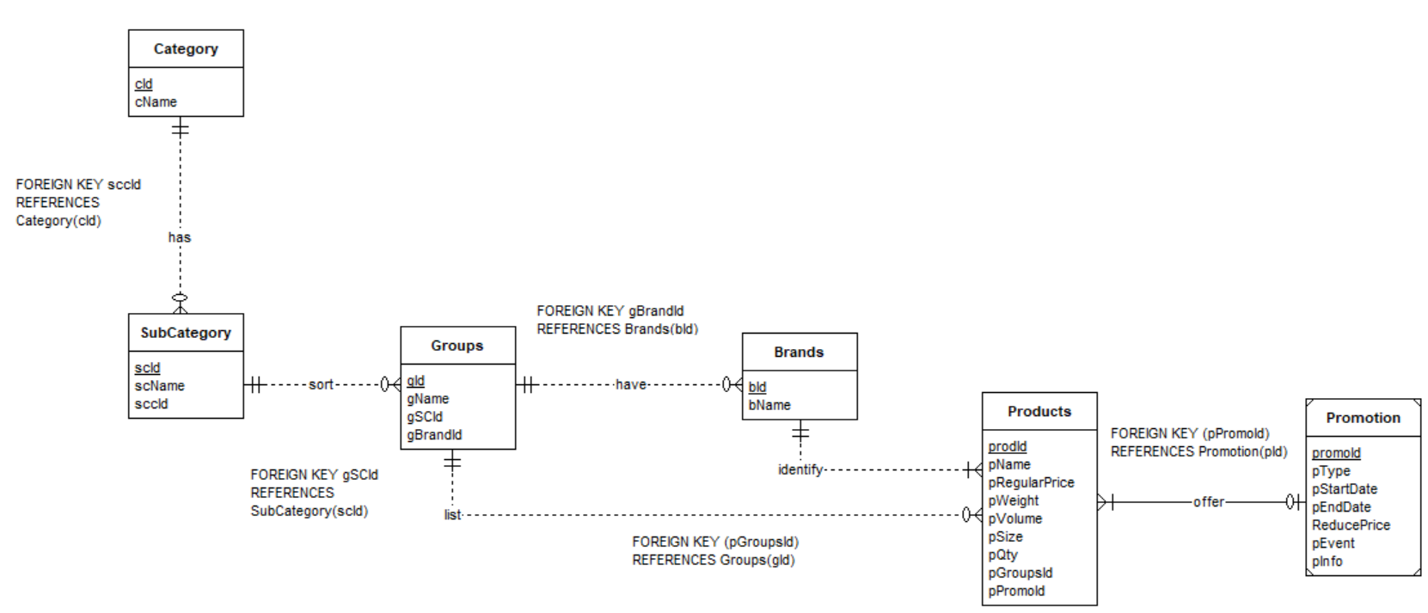
ERD Diagram with No Hierarchy

Slide 8
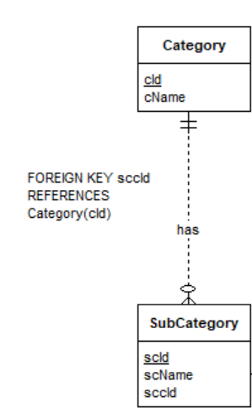
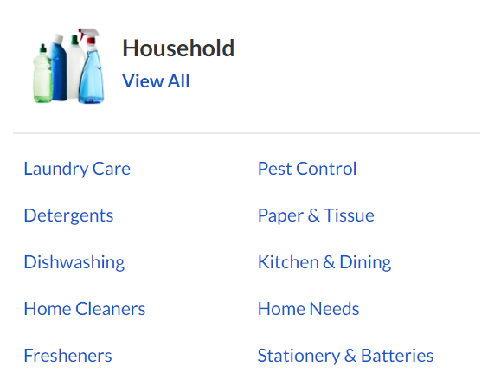
1 : M relationship – one category have many subcategories
Eg. 1 Household category have 9 subcategories.
Participation constraint for category is mandatory, while it’s optional for subcategory.
Eg. Without the Household category, the Detergent subcategory has no category of belonging. The user will not be able to find Detergents by Household filtering.
Foreign key sccId is used to join Category and SubCategory entity to find subcategory by its category.

Slide 9
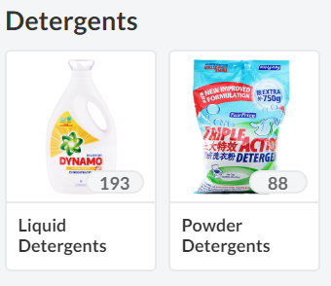
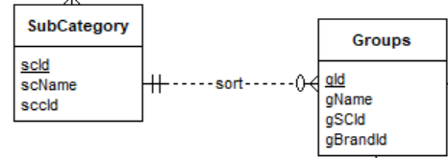
1 : M relationship – one subcategory have many groups. Subcategories are further sorted into groups.
Eg. 1 Detergent subcategory have 2 groups.
Participation constraint for subcategory is mandatory, while it’s optional for groups.
Eg. Without the Detergent subcategory, the Liquid Detergent and Powder Detergent groups have no subcategory of belonging. The user will not be able to find Liquid Detergents or Powder Detergents by Detergents filtering.
Foreign key gSCId is used to join SubCategory and Groups entity to find groups by its subcategory.

Slide 10
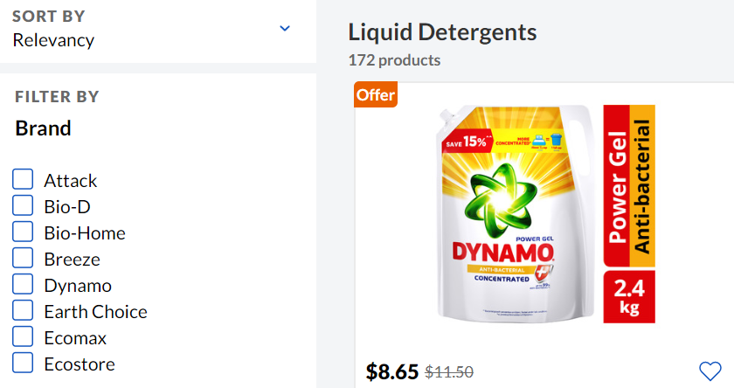
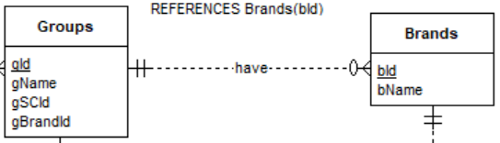
1 : M relationship – one group have many brands.
Eg. 1 Liquid Detergents group have many brands. Likewise, for Powder Detergents group.
Participation constraint for groups is mandatory, while it’s optional for brands.
Eg. Without the Liquid Detergent subcategory, the brands have no group of belonging. The user will not be able to find liquid detergents by Breeze brand or Dynamo brand filtering.
Foreign key gBrandId is used to join Groups and Brands entity to find brands of groups.

Slide 11
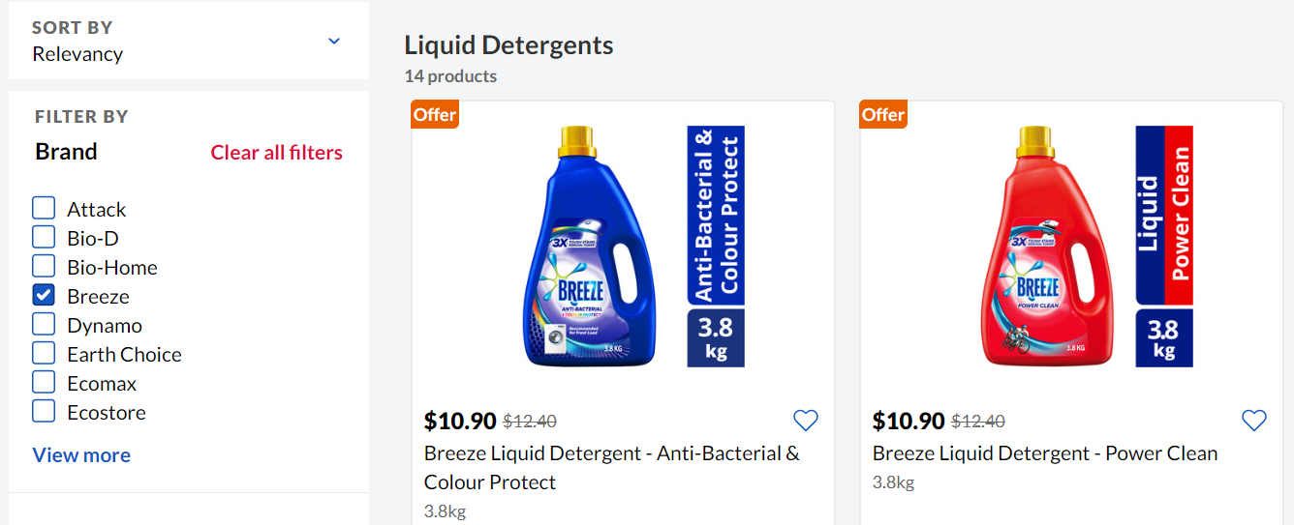
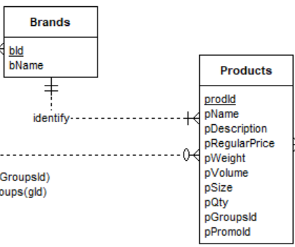
1 : M relationship – one brand have many products. Brands identify products.
Eg. 1 Breeze brand have many types of products. Likewise, for Dynamo brand.
Participation constraint for brands and products is mandatory.
A product must have a brand for the user to find it by brands filtering. A brand can produce many types of products, but each product has only one brand.
Eg. Breeze have many types of detergents, but each bottle of detergent has only one brand.

Slide 12
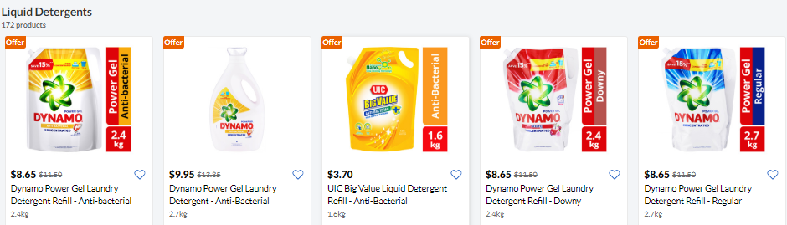
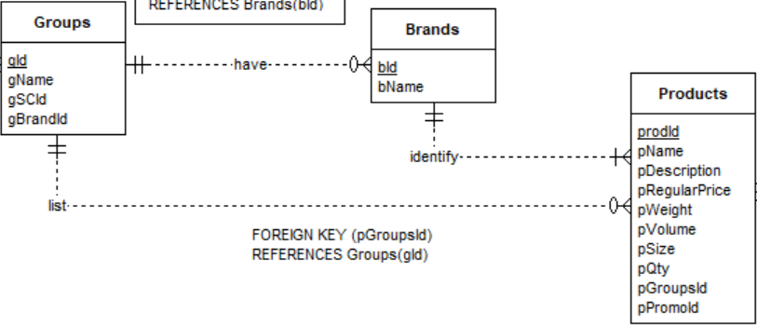
1 : M relationship – one group lists the many products.
Eg. 1 Liquid Detergents group have many types of products. Likewise, for Powder Detergents group.
Participation constraint for groups is mandatory, while it’s optional for products.
Eg. Without the Liquid Detergents group, the products have no group of belonging. The user will not be able to find the product by group filtering.
Foreign key pGroupsId is used to join Groups and Products entity to find products of group.

Slide 13
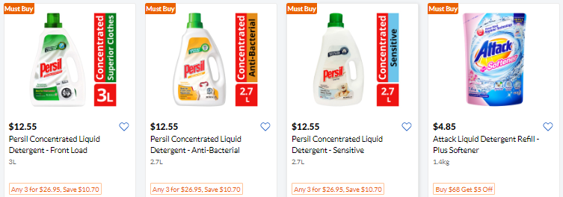
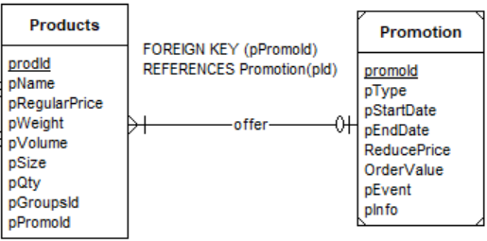
M : 1 relationship – many products can offer the same promotions.
Eg. 1 Different types of detergents but offering same type of promotion.
Participation constraint for products is mandatory, while it’s optional for promotion.
A promotion’s availability is dependent on the existence of products, so the Promotion entity is a weak one and its relationship is identifying.
Eg. Without products, the promotion have no representation. The user will not be able to find any products, or any accompanying promotion.
Foreign key pPromoId is used to join Products and Promotion entity to find promotion of products.

Slide 14


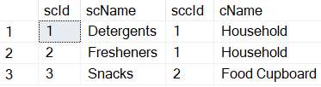
TABLES CREATED
CATEGORY
SUBCATEGORY
Eg. The Detergents and Fresheners subcategory belong to the Household category.
Eg. The snacks subcategory belong to the Food Cupboard category.
Combination of category and subcategory

Slide 15
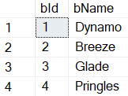
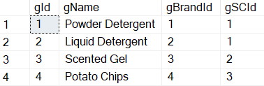
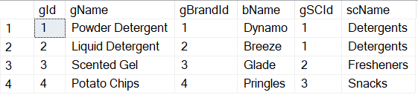
TABLES CREATED
Brands
GROUPS
Eg. The Powder Detergent group belong to the Detergents subcategory.
Eg. The Potato Chips brand is Pringles.
Combination OF Brands and groups

Slide 16
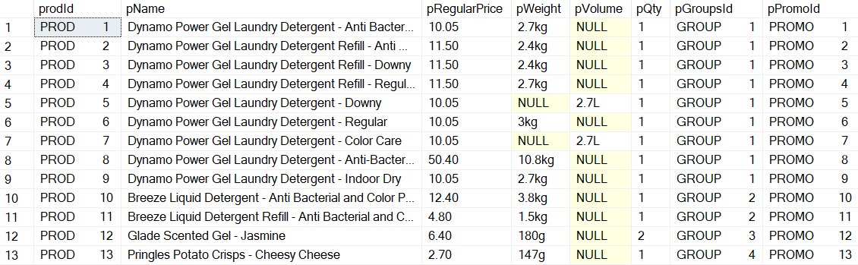
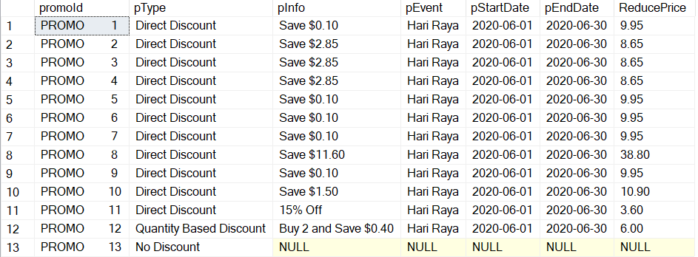
TABLES CREATED
Products
Eg. Product with Id 12 is offering Quantity-Based Discount of Promo Id 12. The user must purchase minimally 2 of such products for the total cost to be charged at $6.
Promotions

Slide 17
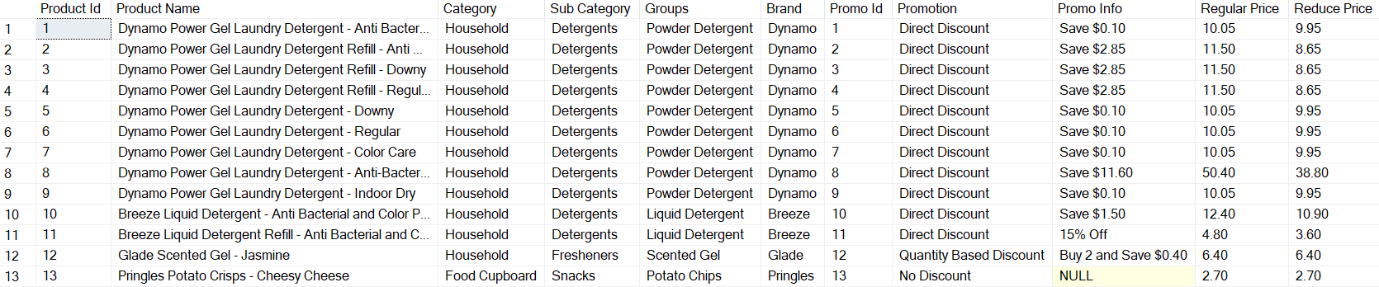
Combination of all tables

Slide 18
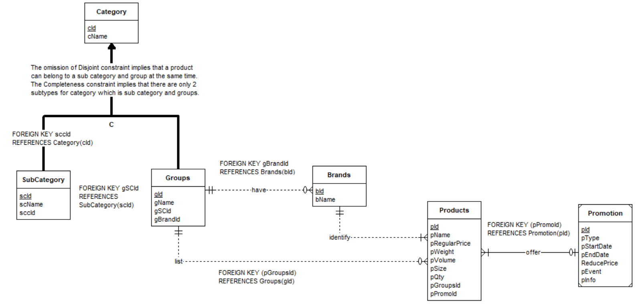
EXTRA: ERD Diagram with Hierarchy

