Slide 2
DETECTION OF 5MC MODIFICATION IN NANOPORE SEQUENCING DATA USING DEEP LEARNING
Author: Yari Van Laere
Promotors: Gerben Menschaert, Willem Waegeman Tutor: Gaetan De Waele

Slide 3
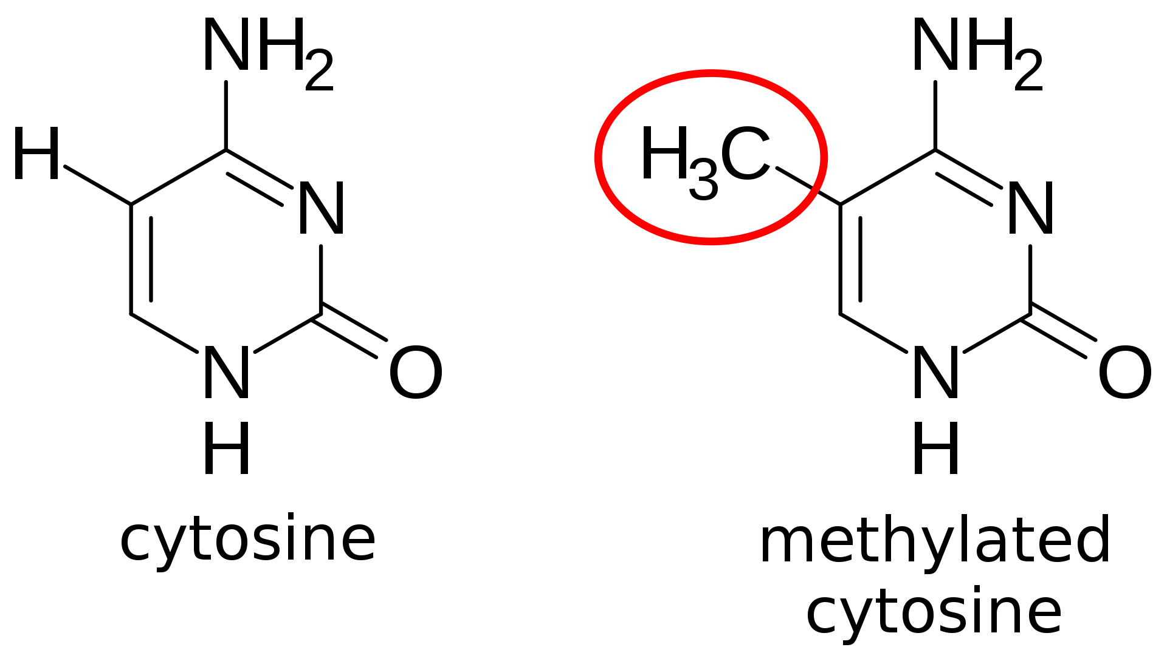
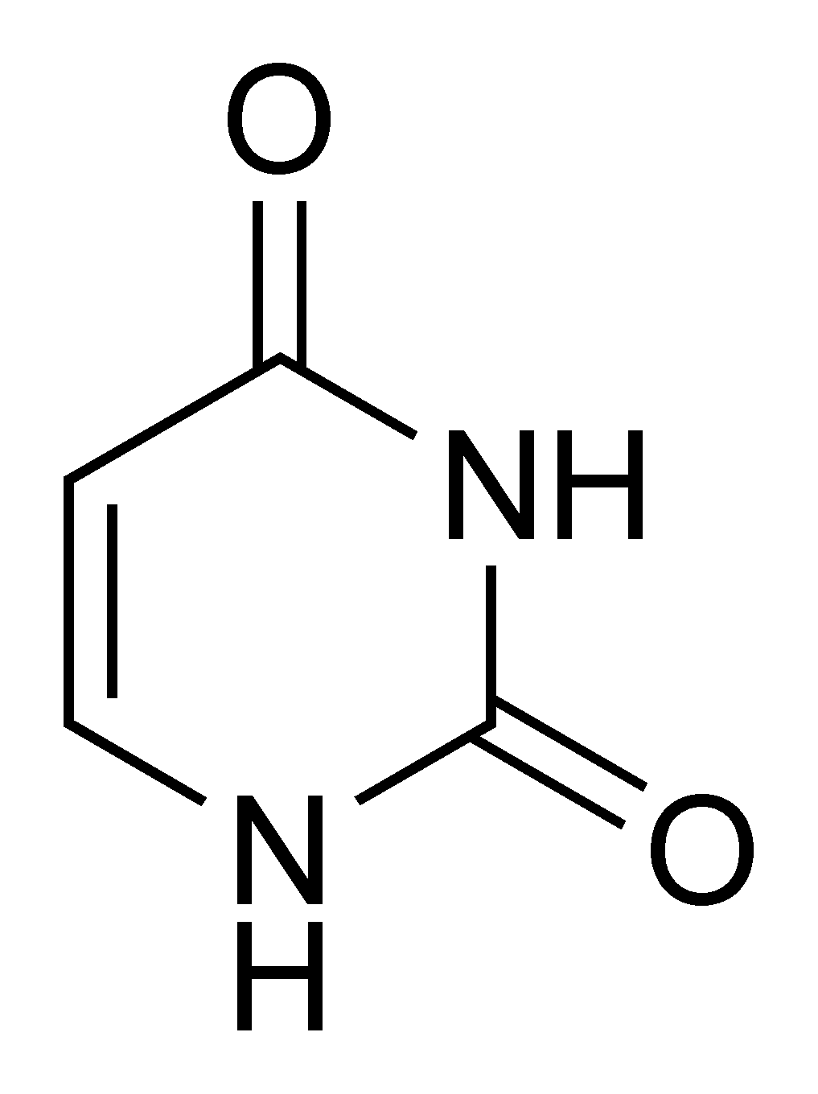
Background
Gene regulation
Bisulphite conversion
uracil

Slide 4
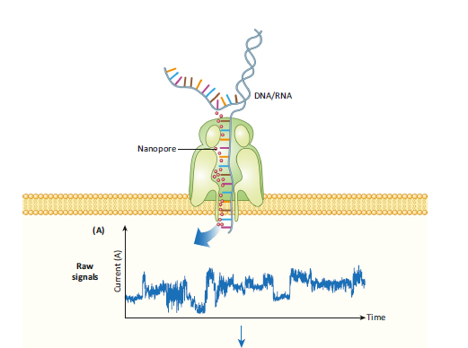
Nanopore sequencing

Slide 5
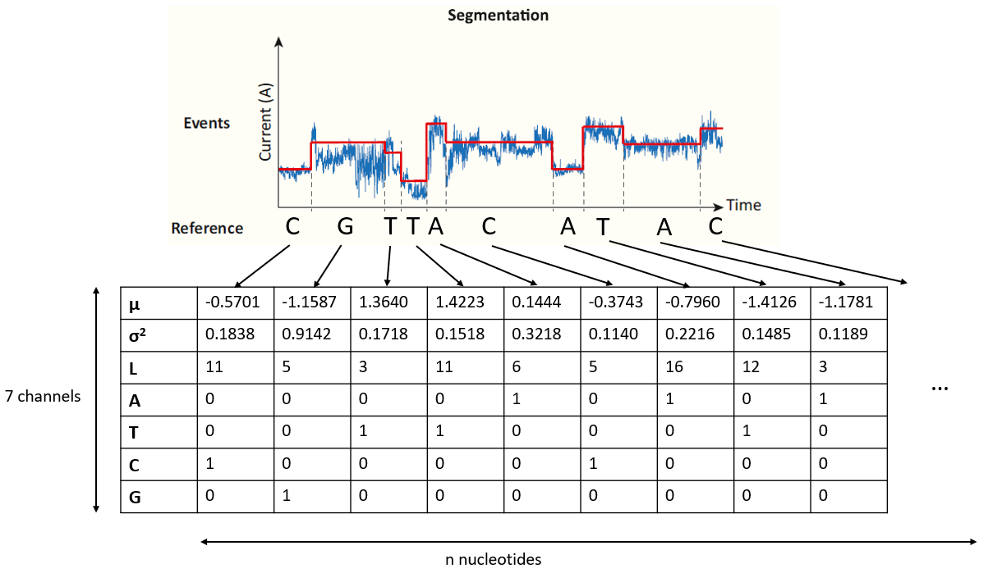
Data
E. coli
H. sapiens
M.SssI
Short reads
Natural
WGBS data
Long reads
Notes:
Waarom deep learning

Slide 6
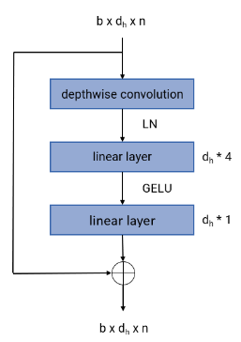
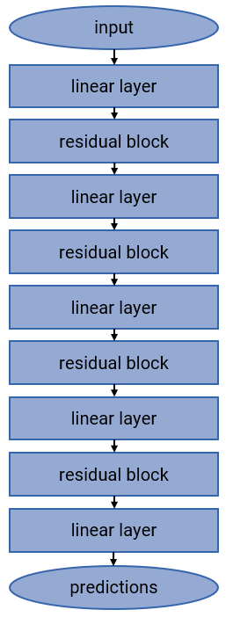
Convolutional neural network
E. coli H. sapiens
Hidden dimension
96 16
192 32
384 64
768 128
Parameters
6 687 073 190 353

Slide 7
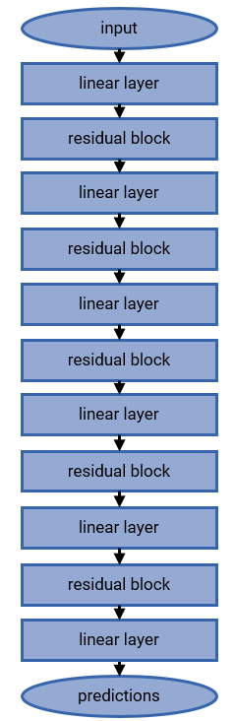
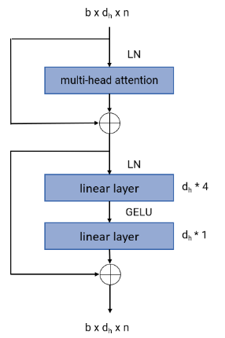
transformer
E. coli
Hidden dimension
96
192
192
384
384
Parameters
4 826 785

Slide 8
Results
- E. coli
- H. sapiens
model | AUC ROC | AUC PR | Accuracy | Precision | Recall
Convolutional | 0.99333 | 0.99177 | 0.95218 | 0.94268 | 0.94248
Transformer | 0.99882 | 0.99838 | 0.97994 | 0.97541 | 0.97645
model | AUC ROC | AUC PR | Accuracy | Precision | Recall
Convolutional | 0.97890 | 0.99757 | 0.96420 | 0.97442 | 0.98673
Notes:
Vermeld literatuur, verschil met literatuur (volledige read), slide over calibratie, verwijzen naar dataset

Slide 9
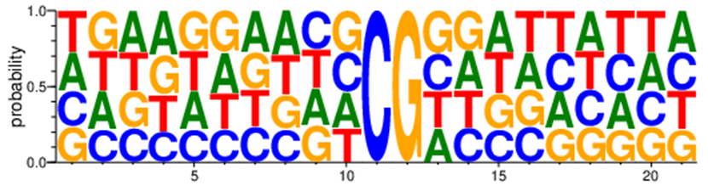
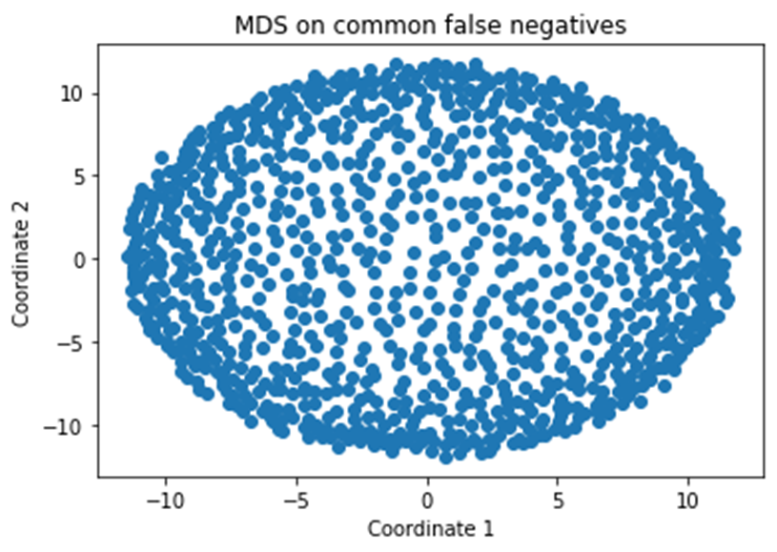
clustering

Slide 10
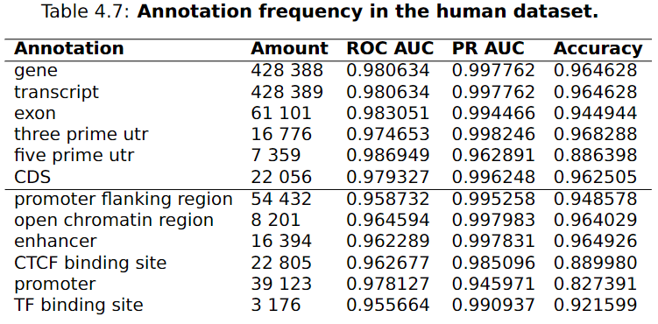
annotation
Notes:
highlighten

Slide 11
conclusion
Transformers
No sequence context with different performance
Differently annotated regions have different performance

Slide 12
yari.vanlaere@ugent.be

Slide 13
clustering
E. coli
TP1 FN2
TP2
FN1
TN1 FP2
TN2
FP1
FNc
TPc
FPc
TNc
H. sapiens
TP | FP
FN | TN
Notes:
Minder over zeggen, meer over calibratie

Slide 14

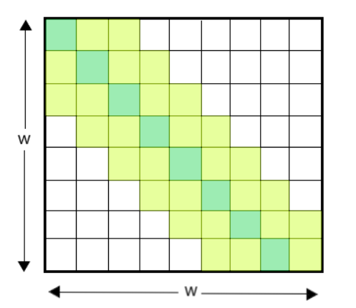
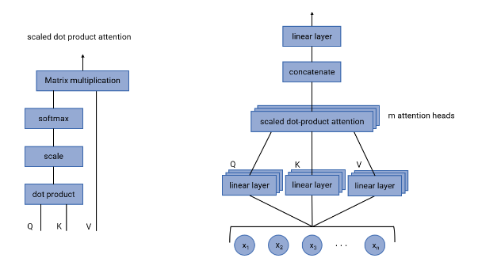

Slide 15
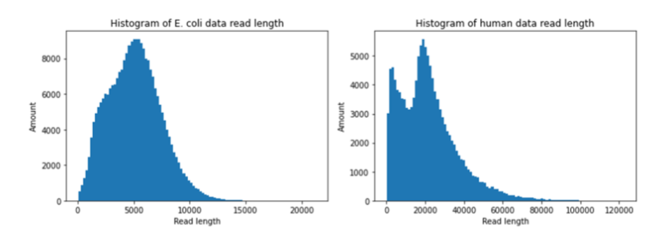

Slide 16
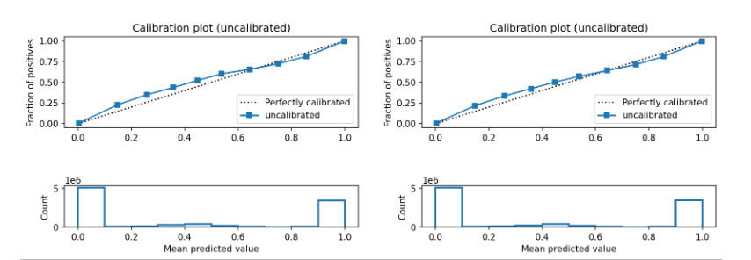

Slide 17
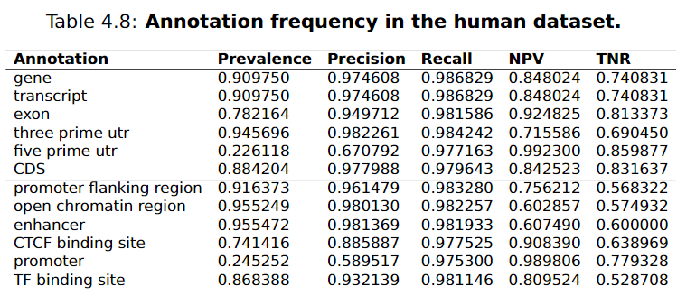

Slide 18
