Slide 1
(1.)Difference between shape argument & [group_idx] And (2.)The difference between whether there's pm.Deterministic() or not.
13. Pumps* — ISYE 6420 - BUGS to PyMC (areding.github.io)
https://areding.github.io/6420-pymc/unit5/Unit5-PumpsMCMC.html?highlight=pm%20beta
Pumps (multibugs.org)
https://www.multibugs.org/examples/latest/Pumps.html

Slide 2
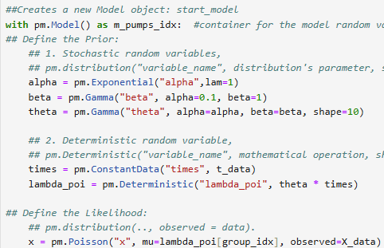
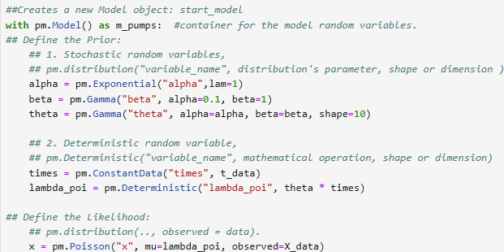
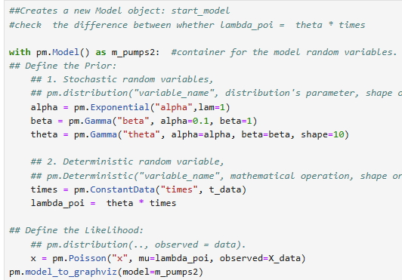
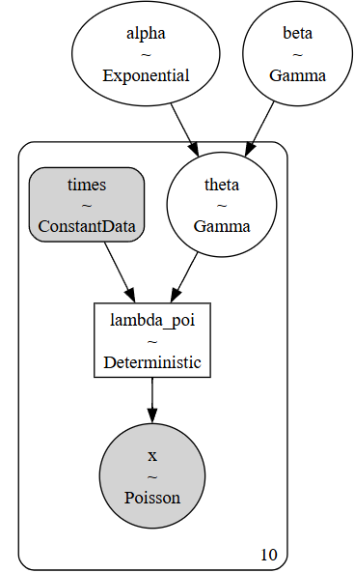

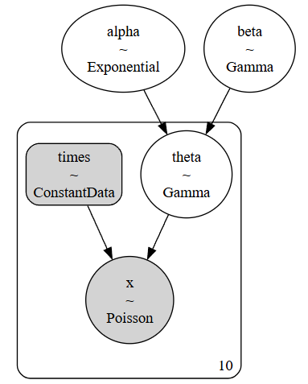
[group_idx]
x

Slide 3
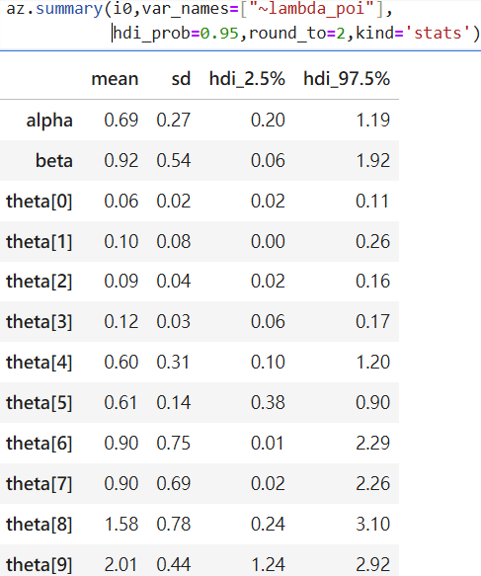
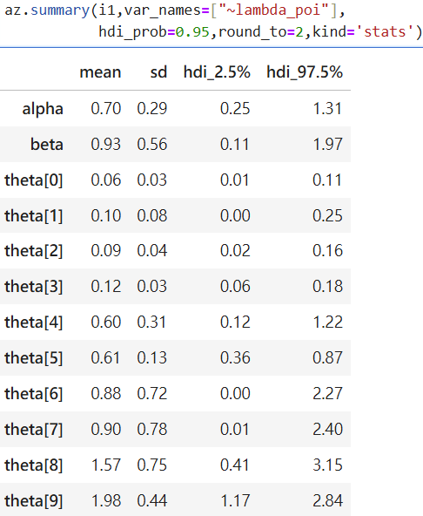
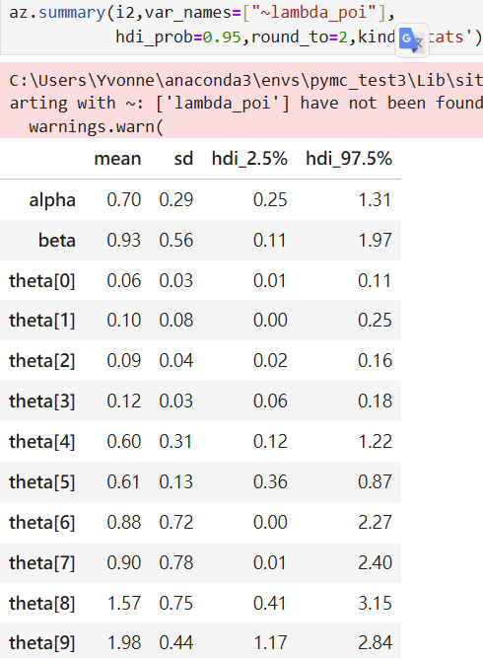
Slightly different
Same

Slide 4
補充
1. [有防呆] (shape argument & [group_idx])
Test:
Set prior's shape=5 < likelihood data(number of sample=10) and didn’t given group_index (mu=lambda_poi[group_idx])
Output:
ValueError: Incompatible Elemwise input shapes [(5,), (10,)]

Slide 5
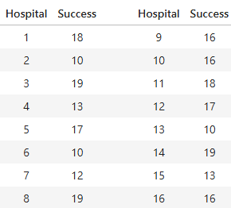

Beta-Binomial model
Coordinates in PyMC & InferenceData Objects – Christian Luhmann – Python, math, etc. (cluhmann.github.io)
https://cluhmann.github.io/inferencedata/
hierarchical_models_sports_analytics/Hierarchical_Models_Sports_Analytics.ipynb at main · fonnesbeck/hierarchical_models_sports_analytics (github.com)
https://github.com/fonnesbeck/hierarchical_models_sports_analytics/blob/main/Hierarchical_Models_Sports_Analytics.ipynb

Slide 6
