Slide 1

X AI
YVO KELLER | HS 2024

Slide 2
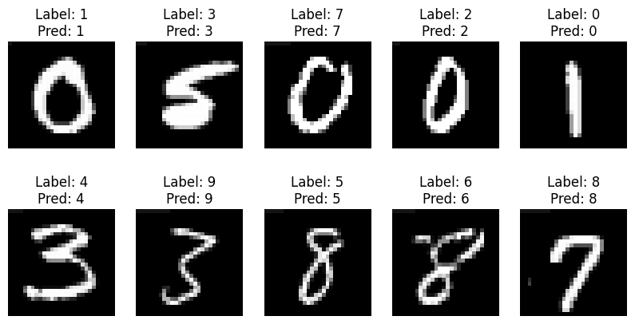
Problem

Slide 3
Model
Simple Convolutional Neural Network
SimpleCNN(
(conv1): Conv2d(1, 32, kernel_size=(3, 3), stride=(1, 1), padding=(1, 1))
(conv2): Conv2d(32, 64, kernel_size=(3, 3), stride=(1, 1), padding=(1, 1))
(pool): MaxPool2d(kernel_size=2, stride=2, padding=0, dilation=1)
(fc1): Linear(in_features=3136, out_features=128, bias=True)
(fc2): Linear(in_features=128, out_features=10, bias=True)
)

Slide 4
Goal: Utilize XAI methods to understand the model’s behaviour

Slide 5
Grad-CAM
Why?
Visually intuitive results
Can leverage spatial structuture of feature maps
Produces visual explanations for CNN decisions
How?
Compute gradients of the target class flowing into the last conv layer
Weighted combination of each channel by its gradient weight
ReLU and bilinear interpolation to overlay on input image

Slide 6
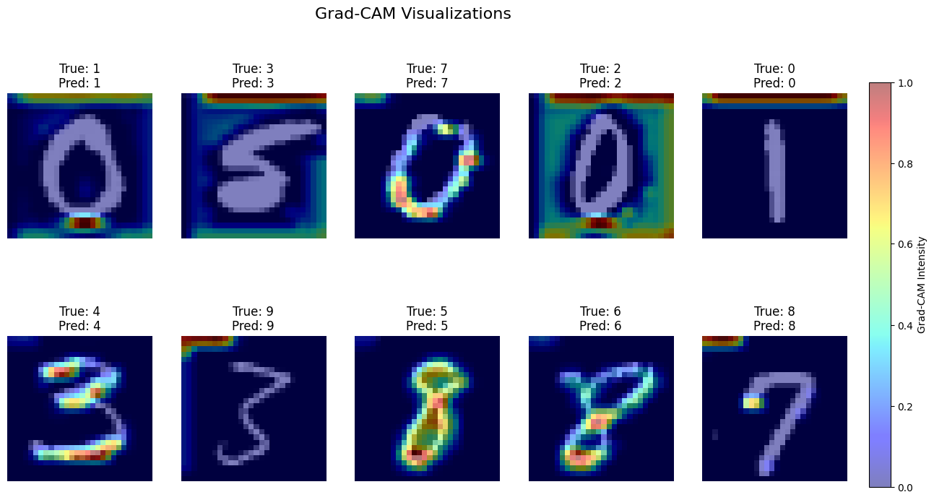

Slide 7
Hypothesis: Top left area of the images provides the relevant information

Slide 8
Integrated Gradients
Why?
Can produce more fine-grained pixel-level attributions
Pinpoint how each pixel shifts model from no signal to final pred.
How?
Interpolate steps between baseline and actual input image
Compute gradients of target logit with regards to input pixels
Average gradients and overlay on original image

Slide 9
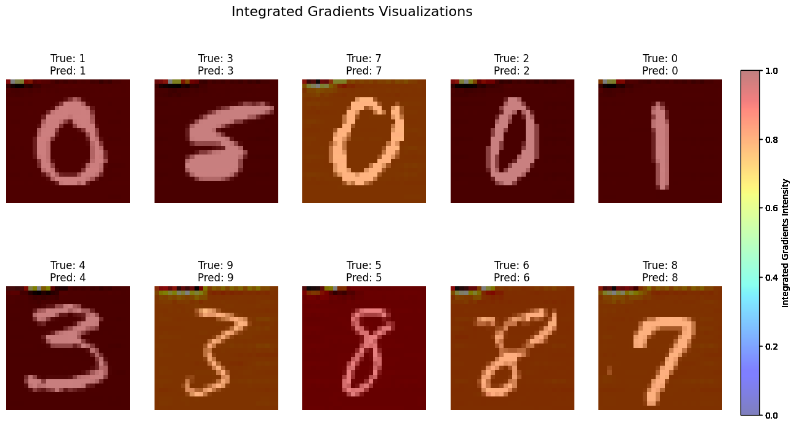

Slide 10
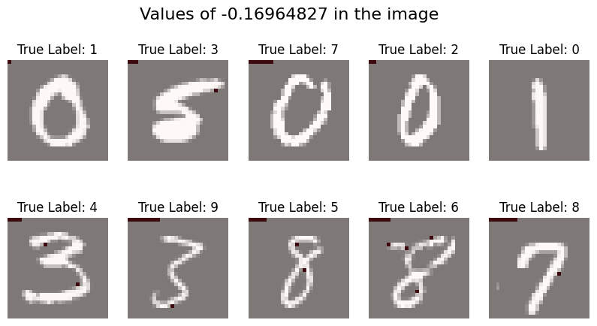
Solving the Riddle
Pixel Values of First Image
1 [[-0.16964827 -0.42421296 -0.42421296 -0.42421296 -0.42421296 -0.42421296 -0.42421296 -0.42421296 -0.42421296 -0.42421296]]

Slide 11
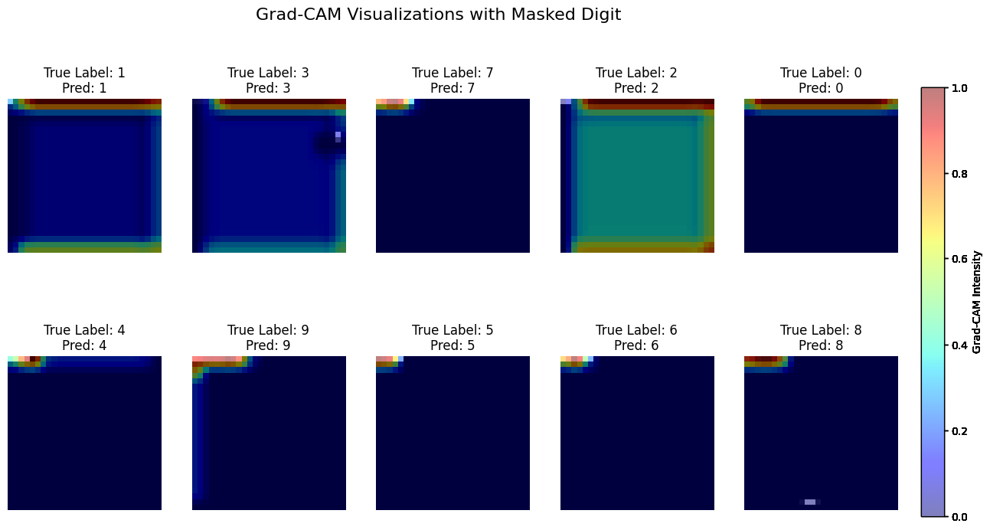
Digging Deeper: Masking Digit

Slide 12
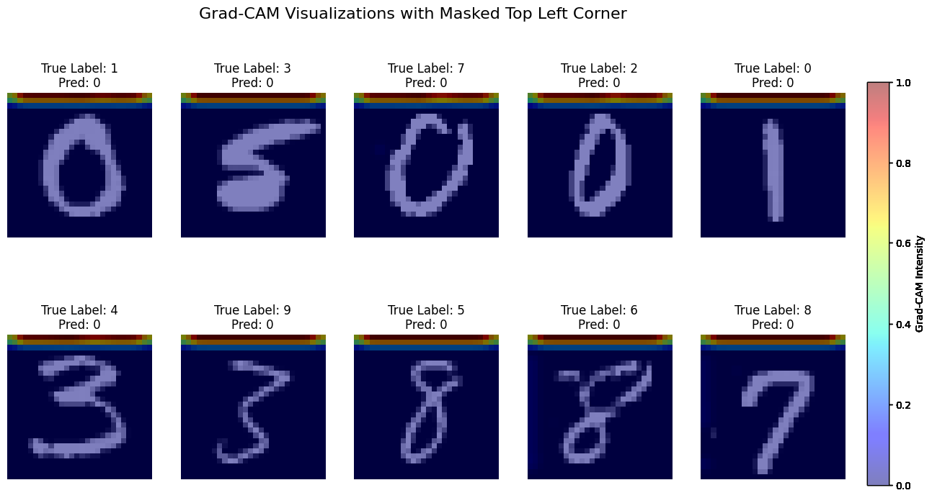
Digging Deeper: Masking AOI

Slide 13
Conclusion

