Slide 1


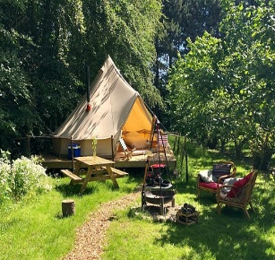


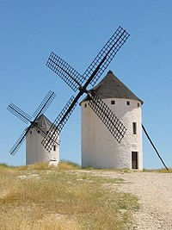

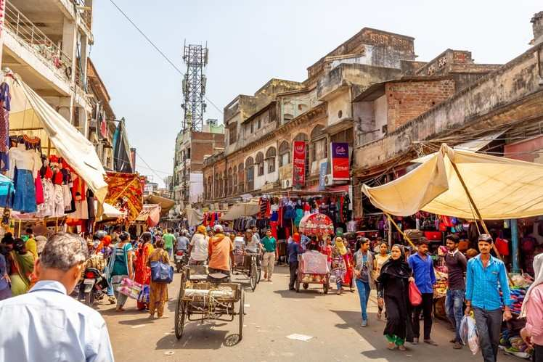
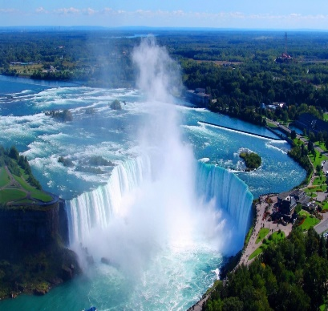
0
-1
4...6
-1
+10
0
-4
1...3
+3
-1
0
-1
1...3
0
4...6
0
-1
-2

Slide 2
0
-1
4...6
-1
+10
0
-4
1...3
+3
-1
0
-1
1...3
0
4...6
0
-1
-2

Slide 3
0
-1
4...6
-1
+10
0
-4
1...3
+3
-1
0
-1
1...3
0
4...6
0
-1
-2

Slide 4

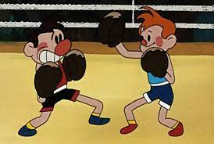


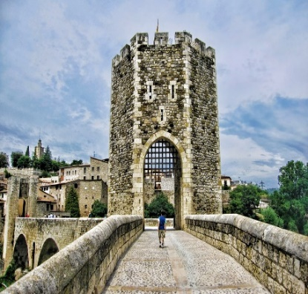

-1
-1
0
0
0
0
0
-1
0
0
-4
+2
0
0
0
-1
-4
-1

