Slide 1


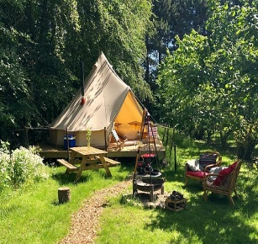


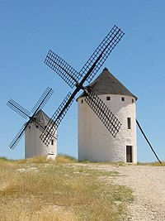


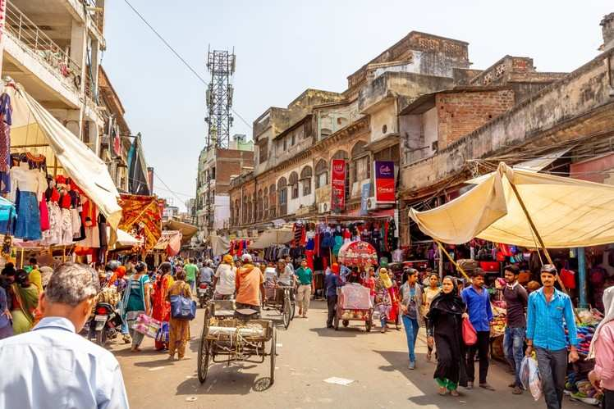
0
-1
4...6
-1
+10
0
1...3
-4
-1
-1
4...6
0
+3
0
-1
1...3
-2
-1
-1

Slide 2

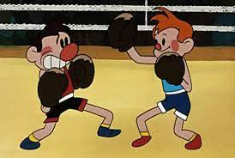



-1
-1
-1
-1
0
-4
Top
mid
-1
0
-1
+2
-1
-1
0
4...6
0
1...3
-1
-4

