Slide 1
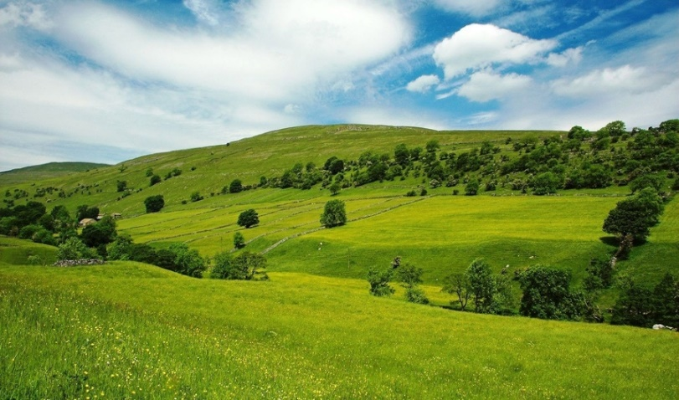

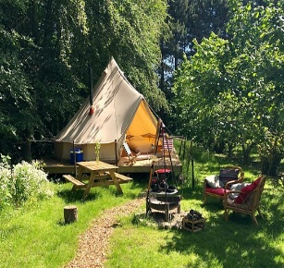


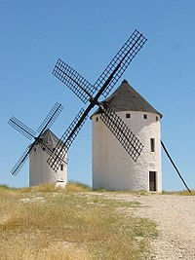

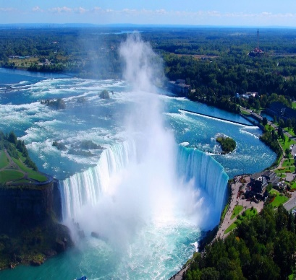
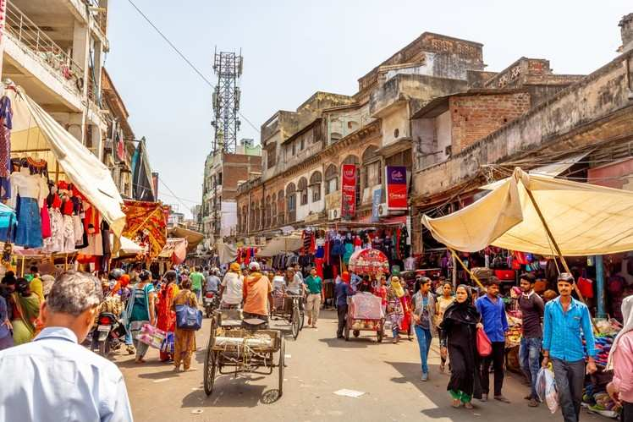
-1
-1
0
4...6
0
+10
-4
1...3
-1
Top
left
0
-1
4...6
+3
0
-1
1...3
0
-2
-1
-1

Slide 2
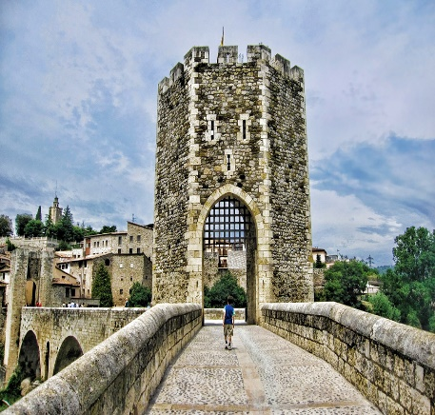
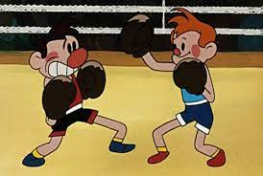



-1
-1
-1
-1
0
-4
Top
mid
-1
0
-1
+2
-1
-1
0
4...6
0
1...3
-1
-4

