Slide 1
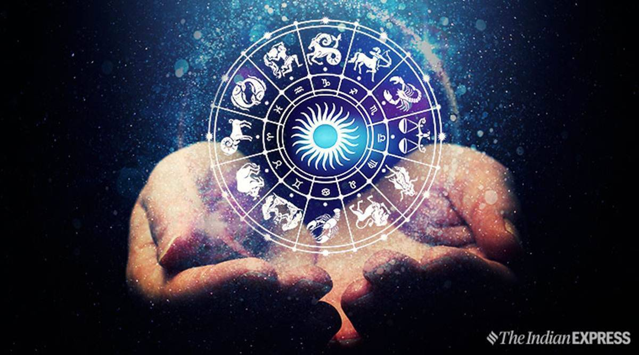
What’s your sign?
Set Stellarium to your birth date.
What constellation was the Sun in?
Save a screenshot of the Sun’s location.
Look at the table. What is your sign?
From Stellarium, when is the Sun actually in your horoscope sign?
APRIL FOOLS’!!!!!
Aries | Mar 21 – Apr 19 | Libra | Sep 23 – Oct 22
Taurus | Apr 20 – May 20 | Scorpio | Oct 23 – Nov 21
Gemini | May 21 – Jun 20 | Sagittarius | Nov 22 – Dec 21
Cancer | Jun 21 – Jul 22 | Capricorn | Dec 22 – Jan 19
Leo | Jul 23 – Aug 22 | Aquarius | Jan 20 – Feb 18
Virgo | Aug 23 – Sep 22 | Pisces | Feb 19 – Mar 20

