Slide 1
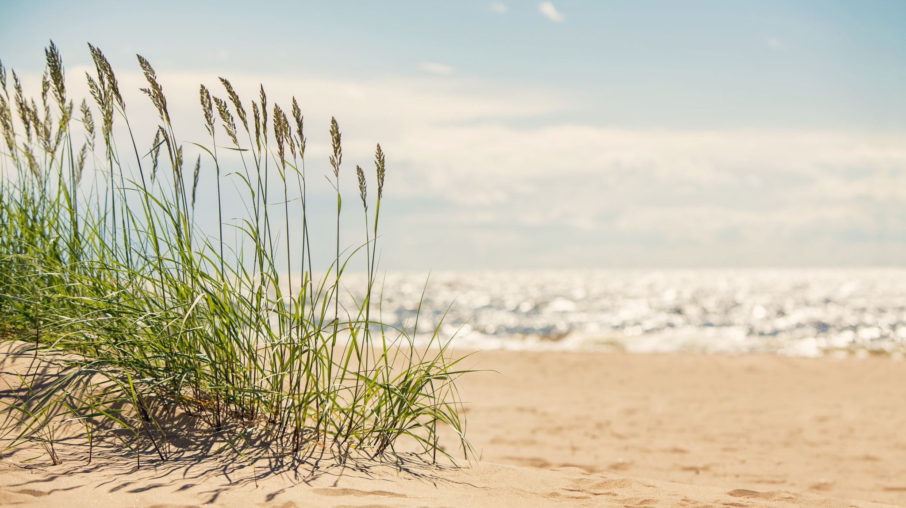
Happy summer solstice!
21 June 2022

