Slide 1
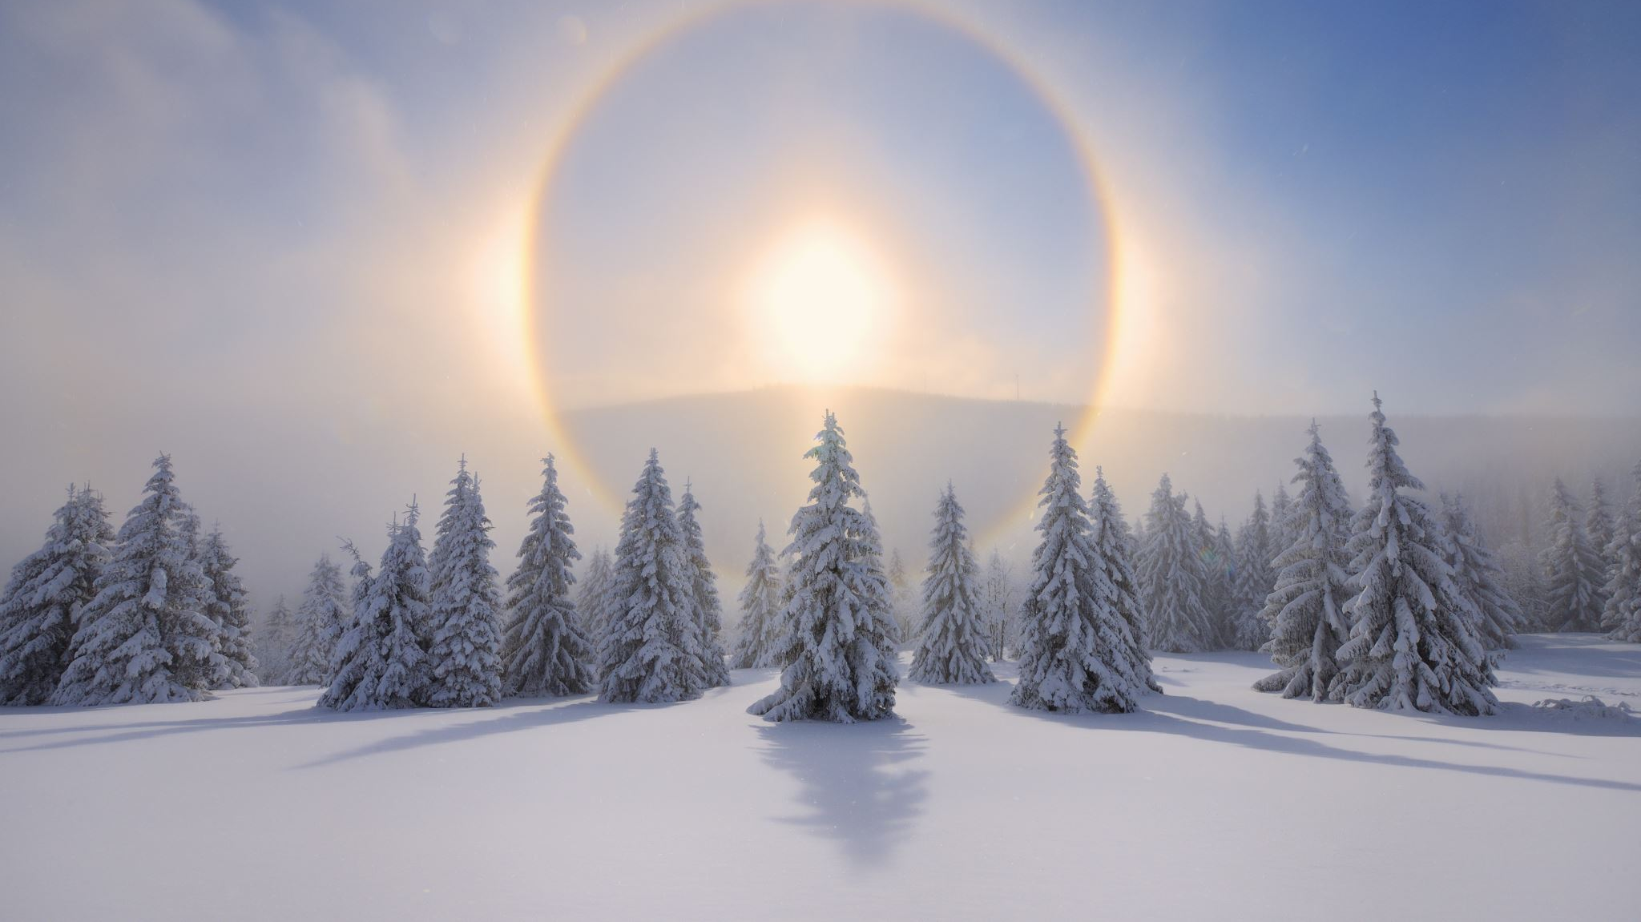
Happy winter solstice!
21 Dec 202x

