Slide 1

Price vs. Payoff
// AI BUILDER · SESSION 3 · COLLEGE DATA
What three New York-area colleges return per tuition-dollar, and what to check before trusting a low price
Yvonne Martinez
For prospective students & families
October 2026
Notes:
Introduce the question: does a higher price buy a better result? The deck covers the national research on whether college pays, then compares Rutgers University-Newark, CUNY Hunter College and New York University against 200 schools in the College Scorecard data, and ends with four numbers families can use to compare any options.

Slide 2



The national picture, three schools, one checklist
// AGENDA
01
The national picture
Slides 3–7
College pays on average, but net price, program and completion decide it
02
Three schools, three catches
Slides 8–12
NYU’s value, Hunter’s completion rate, Rutgers-Newark’s state baseline
03
What to check
Slides 13–14
Completion and debt, then four numbers to compare any options
Sources: BLS, NCES, College Board, Georgetown CEW, NY Fed, College Scorecard
Notes:
Walk through the three parts: first the national research on whether college pays and what decides the payoff, then three New York-area schools from the College Scorecard data (one catch each), then the checklist and the four numbers to compare before committing.

Slide 3
A bachelor’s degree still pays: about 63% more per week than a high school diploma
WEEKLY EARNINGS PREMIUM
Weekly earnings
Unemployment
+63%
High school
$966
High school
4.3%
Bachelor’s
$1,578
Bachelor’s
2.8%
$1,578 vs. $966 a week (BLS, 2025)
The gap shows up for young workers too: full-time workers ages 25–34 with a bachelor’s earned $66,600 a year versus $41,800 for high school completers, 59% more (2022 dollars).
Sources: BLS, Education Pays (2025, 11-month average excluding October); NCES, Condition of Education
Notes:
BLS 2025: median usual weekly earnings were $1,578 for bachelor's holders and $966 for high school graduates, about 63% more; unemployment was 2.8% versus 4.3%. NCES, ages 25-34, full-time year-round, 2022: $66,600 versus $41,800, 59% more. The BLS 2025 figures are 11-month averages that exclude October. This is the starting point: on average, the degree pays. The next slides explain why an average is not a guarantee.

Slide 4
Most families don’t pay sticker price: public four-year net tuition is about $2,300
Published tuition and fees
Estimated net tuition and fees
$2,300
$11,950
−81%
Public four-year, in-state
Private nonprofit four-year
$16,910
$45,000
−62%
Public two-year, in-district
$4,150
covered
grant aid covers tuition and fees on average
Source: College Board, Trends in College Pricing and Student Aid (2025–26 published prices; net price estimates, first-time full-time students)
Notes:
College Board 2025-26: published tuition and fees are $11,950 at public four-year colleges (in-state), $45,000 at private nonprofit four-year colleges and $4,150 at public two-year colleges. Estimated net tuition and fees after grant aid are about $2,300 at public four-years (81% below sticker) and $16,910 at private nonprofits (62% below). At public two-years, first-time full-time students have on average received enough grant aid to cover tuition and fees since 2009-10. Net price excludes living costs and varies by family income. Each row shows the gap between sticker price (dark grey dot) and net price (petrol dot). The point for families: compare net price, not sticker price.

Slide 5

At 30% of colleges, more than half of students earn less than a high school graduate ten years out
COLLEGES AFFECTED
Ten-year value by program type
Certificate
$120,000
30%
Associate’s
$141,000
of colleges
Bachelor’s
$71,000
1,233 of about 4,500 ranked
The order flips over a career: at 40 years, bachelor’s programs lead with a median value of $864,000. The payoff depends on the program and the time horizon.
Source: Georgetown CEW ROI database (1,233 colleges); median net present value by degree level, A First Try at ROI (2019)
Notes:
Georgetown CEW's ROI database ranks about 4,500 colleges. At 1,233 of them (30%), more than half of students earn less than a high school graduate 10 years after enrolling; the ring shows that 30%. By degree level, the 2019 report's medians of net present value at 10 years are $120,000 for certificate-focused institutions, $141,000 for associate's and $71,000 for bachelor's institutions. At 40 years bachelor's institutions lead at $864,000. The medians are read from a figure in the report, and the report is from 2019, so treat the dollar values as dated and the pattern as the point. Bachelor's programs take longer to complete and carry about twice the debt of certificate programs.

Slide 6

Finishing is the swing factor: only 64% of bachelor’s students graduate within six years
64 of every 100 students finish
Six-year graduation rate by school type
All four-year institutions
64%
Public
63%
Private nonprofit
68%
Private for-profit
29%
Ask each school for its graduation rate before comparing prices.
Source: NCES, six-year graduation rate, first-time full-time bachelor’s students who started in fall 2014 (graduating from the same school)
Notes:
NCES: among first-time, full-time bachelor's-seeking students who started at four-year institutions in fall 2014, 64% had graduated by 2020 from the same institution: 63% at public, 68% at private nonprofit and 29% at private for-profit schools. The dot grid shows 64 of 100 students finishing. The rates count only graduation from the school where students started, so students who transfer and finish elsewhere are not counted. A low graduation rate means many students pay and borrow without finishing. The point: completion is the biggest swing factor in whether the cost pays off.

Slide 7



Even a finished degree carries risk: 42% of recent graduates are underemployed
UNEMPLOYMENT
UNDEREMPLOYMENT
LOAN DELINQUENCY
5.6%
42%
10.3%
unemployed
underemployed
90+ days late
recent graduates, about, Q2 2026
of recent graduates, Q2 2026
of student-loan balances, Q1 2026
In Q1 2026 about 2.6 million borrowers, more than 120 days past due, were moved to the Education Department’s default resolution group.
Sources: NY Fed, Labor Market for Recent College Graduates (Q2 2026); NY Fed household debt report, Q1 2026
Notes:
NY Fed, Q2 2026: recent-graduate unemployment about 5.6% and underemployment 42%, slightly up from the prior quarter. NY Fed household debt data, Q1 2026 (reported May 12, 2026): 10.3% of student-loan balances were 90 or more days overdue, up from 9.6% at the end of 2025, and about 2.6 million borrowers more than 120 days past due were transferred to the Education Department's Default Resolution Group. Each ring fills to the percentage shown. I read the delinquency figures through a news report of the NY Fed release; check the release before quoting them formally. The point: the average payoff is real, but it is not guaranteed for each graduate or borrower.

Slide 8
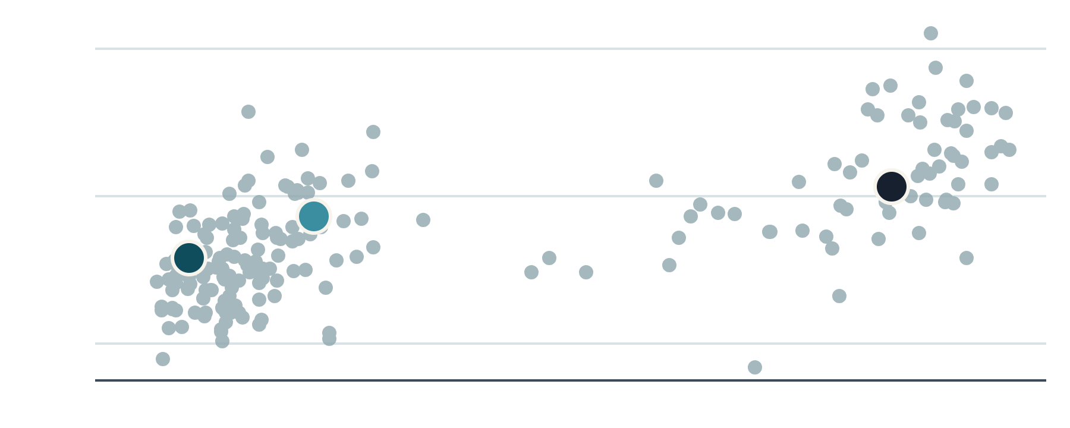
A $7,382 college returns more than six times as much per tuition-dollar as a $62,796 one
// PRICE VS. PAYOFF
CUNY Hunter College · $7,382 tuition
Each dot is one of 200 schools
$2.14
$120K
earnings per $1 of four-year tuition
$80K
NYU
Rutgers-Newark
New York University · $62,796 tuition
Hunter
$0.33
$40K
$0
$25K
$50K
$75K
earnings per $1 of four-year tuition
Across: in-state tuition per year · Up: 10-year median earnings
Three colleges compared with 200 schools · Source: College Scorecard, in college-analysis.xlsx
Notes:
Open with the contrast. Hunter (in-state tuition $7,382) returns $2.14 of 10-year median earnings per dollar of four-year tuition; NYU (tuition $62,796) returns $0.33. The dataset average is $1.11 in-state. The chart plots all 200 schools: tuition across, earnings up. Hunter sits at low cost with mid earnings and NYU at high cost with high earnings; most schools sit in between. That is 196 grey dots plus the 3 highlighted schools; one school has no tuition figure, so it is not plotted. Tuition figures are sticker prices, not aid.

Slide 9
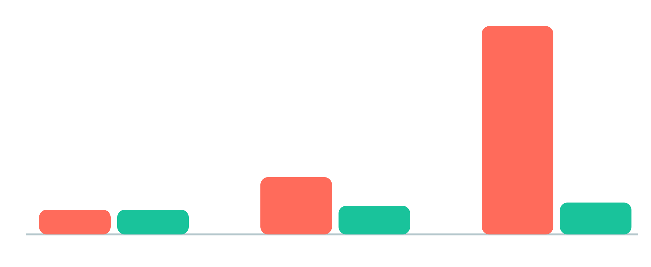
Tuition differs 8.5x, but earnings differ only 31%
Index, Hunter = 100
Tuition
10-yr earnings
8.5x
$62,796
NYU tuition vs. Hunter ($62,796 vs. $7,382)
$17,250
1.3x
$7,382
$63,163
$74,479
$82,509
CUNY Hunter
Rutgers-Newark
NYU
NYU earnings vs. Hunter ($82,509 vs. $63,163)
Hunter and Rutgers-Newark at in-state tuition · Earnings: median 10 years after entry, federal-aid recipients · Source: College Scorecard
Notes:
Both measures are indexed to Hunter = 100 so tuition and earnings can share one axis. Tuition rises to 234 at Rutgers-Newark and 851 at NYU (about 8.5x). Ten-year earnings rise only to 118 and 131 (NYU about 31% above Hunter, a $19,346 gap). Hunter and Rutgers-Newark are in-state rates; NYU charges one rate to everyone.

Slide 10



NYU is the 16th hardest school to get into, yet ranks 176th of 199 on value
ADMISSION RATE
10-YEAR EARNINGS
RETURN PER TUITION-$
9.2%
48th
176th
admitted
of 200
of 199
16th most selective of 200
$82,509 median, top quarter
$0.33 per $1 vs. $1.11 average
The 55 schools charging over $50,000 a year average $87,174 in earnings, $4,665 more than NYU. Its 88.0% completion rate does beat that group’s 86.2%.
Admission ring = rate; other rings = percentile among schools · Value uses sticker price, not aid · Source: College Scorecard
Notes:
NYU is elite on selectivity and earnings but poor on value. The first ring is the 9.2% admission rate (16th most selective of 200). The second ring fills to the 76th percentile for earnings of $82,509 (48th). The third ring fills to about the 12th percentile for return per tuition-dollar of $0.33 (176th of 199, dataset average $1.11). Fair caveats: this is sticker price, many students get aid, and NYU completion (88.0%) is above its price tier (86.2%).

Slide 11



Hunter’s bargain has a catch: only 58.8% of students finish
RETURN PER TUITION-$
DEBT BURDEN
STUDENTS WHO FINISH
18th
17.4%
58.8%
of 199
of earnings
finish
$2.14 per $1 vs. $1.11 average
22nd lowest of 200 · tick = average 30.3%
153rd of 200 · tick = average 72.5%
Top-20 value and a light debt load sit next to a bottom-quarter completion rate. The data shows the pattern, not the reason, so ask the school why.
Value ring = percentile among 199 schools · Debt burden = median debt ÷ 10-yr median earnings · Source: College Scorecard, in college-analysis.xlsx
Notes:
Hunter ranks 18th of 199 on return per in-state tuition-dollar ($2.14), which is the 91st percentile and what the first ring shows. It has the 22nd-lowest debt burden (17.4% of earnings against a 30.3% average, shown by the tick on the second ring). But its 58.8% completion rate ranks 153rd of 200 and sits below the 72.5% average (tick on the third ring). The data cannot say why, so the advice is to ask the school.

Slide 12

Rutgers-Newark beats the average school but not its own state
102 of 200 schools trail their own state
Average of all 200 schools
$70,114
Rutgers-Newark graduates
$74,479
98
102
Typical New Jersey bachelor’s holder
$80,114
Below state average (102), incl. Rutgers-Newark
Above state average (98)
Rutgers-Newark falls $5,635 short of its state baseline, 131st of 200, in the slightly larger half of schools that trail theirs. Debt is the pressure point: $21,500 median, the highest of the three schools.
10-year median earnings vs. state bachelor’s median (Census) · Source: College Scorecard, in college-analysis.xlsx
Notes:
VISUAL: left, three horizontal bars (200-school average $70,114; Rutgers-Newark $74,479, highlighted; New Jersey bachelor's holder $80,114), bars start at zero. Right, a pie chart of all 200 schools split by whether their graduates' earnings are above or below their own state's bachelor's average: 102 below (51%, Rutgers-Newark is one) and 98 above (49%). The pie shows Rutgers-Newark is in the larger group, not an outlier. Rutgers-Newark's $74,479 beats the 200-school average of $70,114 but trails the New Jersey bachelor's average of $80,114 by $5,635 (131st of 200). After adjusting for New Jersey's cost of living, earnings fall to $68,455, below the adjusted average of $69,617. Debt of $21,500 is the highest of the three schools.

Slide 13
Before calling a school a bargain, check completion rate and debt burden
SCHOOL
FINISH RATE
DEBT BURDEN
CUNY Hunter
58.8%
17.4%
Ask every school for both numbers
NYU
88.0%
24.8%
What share of students finish?
How much do graduates borrow compared with what they earn?
Rutgers-Newark
65.7%
28.9%
Average, 200 schools
72.5%
30.3%
Finish rate = completion rate (higher is better). Debt burden = median debt ÷ 10-year median earnings (lower is better). Sticker prices ignore aid.
Earnings are for graduates who received federal aid · Source: College Scorecard, in college-analysis.xlsx
Notes:
Close on the two numbers families can ask any school for. Completion rate: Hunter 58.8%, NYU 88.0%, Rutgers-Newark 65.7%, average 72.5%. Debt burden (median debt divided by 10-year median earnings): Hunter 17.4%, NYU 24.8%, Rutgers-Newark 28.9%, average 30.3%. Bars are drawn to scale (finish rate out of 100%, debt burden out of 40%). Remind the audience that sticker price ignores financial aid and the earnings data covers federal-aid recipients.

Slide 14




Compare at least three options before committing, using four numbers
01
02
03
04
Net price
Graduation rate
Earnings after ten years
Debt vs. earnings
What you pay after grants, not the published price.
The share who finish at that school; low rates raise the risk.
Typical borrowing compared with what graduates earn.
What graduates of that program earn a decade out.
Next step: look up your shortlist in the U.S. Department of Education’s College Scorecard and line the four numbers up side by side.
Sources: BLS; NCES; College Board; Georgetown CEW; NY Fed; U.S. Department of Education College Scorecard
Notes:
Close with the action. Pick three options (schools or programs), then compare net price, graduation rate, earnings ten years out for the specific program, and debt compared with earnings. The earlier slides showed why each matters: the average premium is real (slide 3), net price differs from sticker (slide 4), the payoff depends on the program (slide 5), finishing is the swing factor (slide 6), and risk remains after graduating (slide 7).

