Slide 1
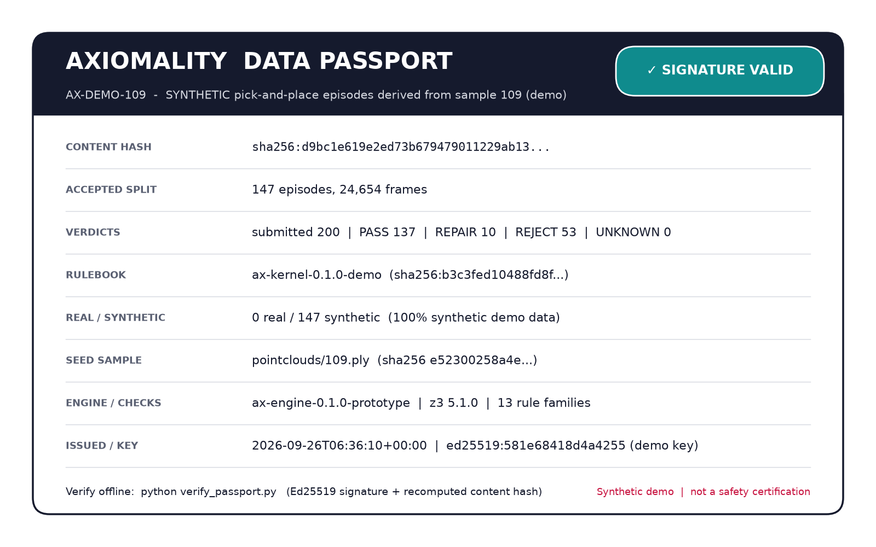
AXIOMALITY
We inspect robot training data
before labs pay for it,
and sign the result.
The inspection record a lab accepts at intake: a verdict per episode, a reason for every reject, and a signed passport anyone can verify offline. Prototype runs on public data; no customers yet.
Working prototype · see slide 5
Real prototype output: a signed passport over synthetic episodes seeded from the company’s measured scan geometry
41 real episodes
Signed
Offline
In your VPC
checked across DROID and two other public datasets; found a stuck arm, an over-limit joint, a mis-documented field
Change any covered value and verification fails (demo key today)
Buyers verify with a public key, no call to us
The engine runs where the data lives; we never hold it
Notes:
30-second open: robot data is now bought and sold, and almost none of it is inspected by a neutral party. We are the inspection layer. The prototype runs today; slide 5 has the numbers.

Slide 2
PROBLEM
Labs buy robot data blind; vendors can’t prove what they sold
Acceptance today is a sample video and a spot check
Vendors
Missing: an inspection
Labs
Teleop fleets, data factories and synthetic generators sell hours at $50–200/h. Good vendors can’t prove they are better than bad ones.
No per-episode verdict · no reason for a reject · no record both sides trust
Robot foundation-model teams pay by the hour, then discover problems during training, weeks later and after the compute is spent.
89%
58,000+
$50–200 / h
48%
of visual-AI teams blame data for model failures (Voxel51, 2026)
datasets on the LeRobot hub; none validated or signed
teleop data, sold with no record of what is usable
of visual-AI teams cite data-quality problems (Voxel51, 2026)
What goes wrong is not exotic: mislabeled objects, phases out of order, a gripper that “grasps” while open, objects that teleport or float, clocks that run backwards. Rule scripts catch the easy half. The other half needs to know what the scene means.
Sources: Voxel51 State of Visual AI (2026); Hugging Face (May 2026); DreamVu, Robot Training Data Companies: The 2026 Landscape; Open X-Embodiment (2023).
AXIOMALITY · September 2026 · Confidential
2

Slide 3



WHY NOW
In 2026 robot data became a traded commodity, with no inspector
Vendors are scaling, generators are flooding training, and buyers are writing big checks
Vendors scaled
Generators arrived
Buyers are spending
Scale: physical-AI engine past 150k hours; neutrality questioned after Meta
Mecka: ~$500M round in talks (Sep 2026)
XDOF: ~$1.2B valuation (Sep 2026)
Build AI: ~1M hours of factory video released free (Apr 2026)
World Labs’ Atlas (Sep 2026) turns phone video into robot-camera data
NVIDIA’s data-factory blueprint scores generated clips for free
More synthetic data means more data entering training that no one inspected
$18.6B physical-AI venture funding in Q2 2026 alone
Physical Intelligence (~$11B), Skild ($14B), Generalist ($3B), Figure ($39B) spend heavily on data
Our hypothesis: buyers want a neutral referee at intake
Regulation is a later tailwind, not the reason: EU AI Act obligations for AI embedded in machinery apply from 2 Aug 2028 (Reg. 2026/1744).
Sources: Scale AI; press reports on Mecka and XDOF (Sep 2026); Build AI (Apr 2026); World Labs (Sep 2026); NVIDIA (Mar 2026); PitchBook Q2 2026; company announcements.
AXIOMALITY · September 2026 · Confidential
3

Slide 4



PRODUCT
Episodes in; a verdict per episode and a signed passport out
Three check families. On today's public data only the first runs fully; next, we derive object state from video so the other two run on real data.
Is the record intact?
Scripts do this; so do we
Valid failures are kept
Monotonic clocks, dropped frames, NaNs, joint limits, required metadata
A cup that really slips is valuable failure data, not bad data. We never rewrite a real failure into a success.
Is the motion possible?
Needs scene geometry and relations
Interpenetration, unsupported objects, teleports, gripper-to-object distance
Signed, offline-verifiable
Does the story contradict itself?
Needs a rulebook proven contradiction-free
The passport binds the data hash and rulebook version. Seller, buyer or anyone else verifies with a public key.
Task-phase order, gripper state vs contact events, object class vs affordance
Verdict | Meaning | What happens
Accept | All three checks pass | Billable and trainable
Repair | Correctable recording defect (e.g., timestamps out of order) | New derived version; original kept
Reject | Violates a rule; frame and rule ID attached | Back to the vendor as a re-collect list
Unknown | Inputs needed for the check are missing | Says exactly what is missing; never counted as a pass
Runs in your environment
Data never leaves the customer’s VPC. We ship the engine and the rulebook; we never own the data.
AXIOMALITY · September 2026 · Confidential
4

Slide 5
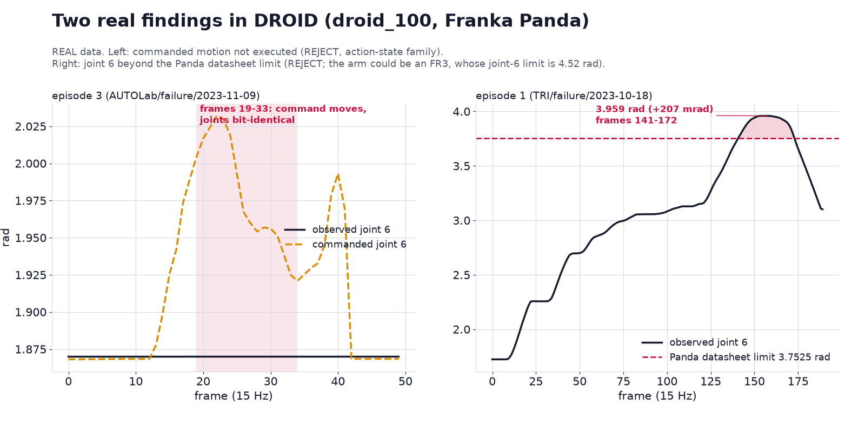
DEMO · REAL DATA
On real DROID data: a stuck arm, a mis-documented field, a possible arm mismatch
Could a script find these? Yes. We add doing it on every batch, signing the result, and listing what we could not check. 41 episodes from DROID, Jaco Play, NYU ROT.
Stuck arm / frozen stream
DROID ep. 3, frames 19–33: the commanded joint position moves (median 0.133 rad) while the measured joints stay bit-identical; frames 43–49 are duplicated rows. A policy trained on it learns that commands do nothing.
Joint past its limit
DROID ep. 1, frames 141–172: joint 6 reaches 3.959 rad, 207 mrad past the Panda datasheet limit. It may be an FR3 (limit 4.52 rad); the passport records that ambiguity.
Field doesn’t match its docs
DROID’s action field is documented as six joint velocities; in all 2,551 frames it equals the commanded Cartesian pose. 8 of 14 episodes carry no language instruction.
Dataset | Episodes / frames | Accept* | Repair | Reject | Not checked | Passport
DROID (Franka) | 14 / 2,551 | 5 | 1 | 8 | Timing, semantic | Verified offline
Jaco Play (Kinova) | 13 / 879 | 13 | 0 | 0 | Timing, semantic | Verified offline
NYU ROT (xArm) | 14 / 440 | 14 | 0 | 0 | Timing, semantic | Verified offline
Real, public data (OXE public bucket). *Accept covers checkable families only: these datasets record no timestamps or object state. On DROID the structural baseline agrees with the engine on 8 of 14 accept/reject calls; the stuck-arm and joint-limit episodes are ones DROID itself labels as failures.
AXIOMALITY · September 2026 · Confidential
5

Slide 6
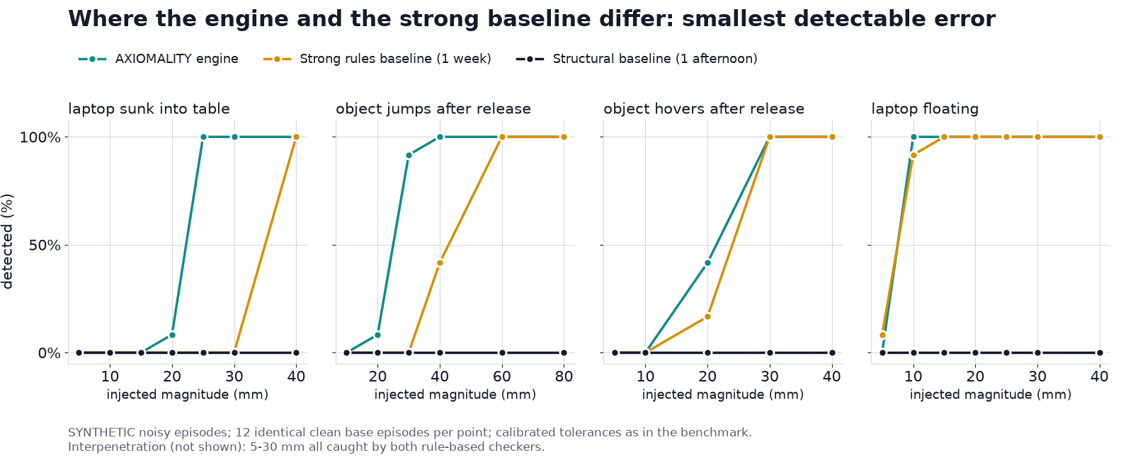
DEMO · SYNTHETIC BENCHMARK
Checks are copyable; a neutral, signed record is not
Noisy synthetic data, 3 task variants, 20 per error class; no checker reads the injection key; precision 1.00 for all three
What we don’t hide
Our own strong baseline, written after the engine, matches its recall. Knowing what to check is not a moat: any team that knows the error list can write the checks.
Where the engine still wins
Finer detection: sinks from 25 mm (baseline 40 mm), post-release jumps from 30 mm (baseline 60 mm). Exact repair of out-of-order clocks. UNKNOWN instead of false rejects. Every verdict cites a versioned, hash-bound rule.
 | AXIOMALITY engine | Our strong baseline | Structural (afternoon)
Recall | 92% | 92% | 41%
False rejects (140 clean) | 0 | 0 | 0
Out-of-order clocks restored exactly | 20 / 20 | 0 (discarded) | 0 (discarded)
Missing inputs | Returns UNKNOWN | Rejects | Rejects
Per episode | 14 ms | 1.4 ms | 0.6 ms
So where is the moat
A neutral issuer, re-checkable verdicts, passports that verify offline, and an error library that grows across customers: things no single buyer or seller builds for itself.
Internal prototype, synthetic data; the same team wrote the injector, the engine and the baselines. Full results and code: prototype/results/benchmark_v2.md, reproducible in one command.
AXIOMALITY · September 2026 · Confidential
6

Slide 7
HOW IT WORKS
Versioned, hash-bound, consistency-checked rules: anyone can re-derive a verdict
A VLM judge gives you a plausibility score. We give you a trail anyone can re-check.
Top level · TUpper (ISO/IEC 21838-4:2023)
 | VLM judge / learned scorer | AXIOMALITY verdict
Output | A score per clip | Accept / repair / reject / unknown per episode
Reason | Opaque | Frame index + rule ID + evidence
Re-checkable by a third party | Re-runnable with the same weights; no rule-level reason | Yes: same rulebook + data hash reproduce the verdict
Missing inputs | Still returns a score | Returns “unknown” and lists what is missing
Improves by | Retraining | Adding a rule, proven consistent before release
One of three top-level ontologies with an ISO part, alongside BFO and DOLCE; our founder is a core contributor
Physical world
Objects, parts, shape, measurement, materials, process
Robot manipulation
Affordances, contact events, task phases, joint limits, object permanence
Your episodes
Frames, sensors, lineage; LeRobot / RLDS / MCAP
Rulebook self-check (in the prototype)
The error library we keep (planned, not in the prototype)
30 rules: 24 proven jointly consistent with Z3 on a bounded 14-frame model (one success, one slip); 9 are decided by Z3 per episode on synthetic data; 6 are numeric. Real-data mode runs numeric checks only today.
Rejects cluster into candidate rules; each is proven consistent with the rest before release, and older batches are re-verified. The moat hypothesis: the rulebook stays consistent and citable at hundreds of rules across task families.
Sources: ISO/IEC 21838-4:2023; ISO/IEC 24707 (Common Logic); COLORE, University of Toronto; Z3.
AXIOMALITY · September 2026 · Confidential
7

Slide 8
COMPETITION
Everyone scores data; we found no one signing neutral per-episode verdicts
No one signs per-episode physics and logic checks for robot data. The tools where data lives are our rails, not rivals.
↑ Signed, re-checkable evidence
vs. NVIDIA
AXIOMALITY
Cosmos Evaluator scores plausibility; it does not sign, does not give rule-level reasons, and lives in one stack. A stack vendor cannot credibly be the neutral referee. We take its score as one input.
Lab in-house pipelines
vs. in-house QA
Vendor self-QA (Scale, Mecka)
In-house QA needs no signature today. It does once one intake gate must hold vendor, in-house and synthetic data to one standard. That gate is where we aim; vendors are the first door.
Applied Intuition Dana
Pebblous (KR) data certification
NVIDIA Cosmos Evaluator (free)
Rails, not rivals
Instance, Shotwell (YC)
Foxglove, Rerun and the LeRobot hub are where data lives. The passport ships as their “verified” badge.
Score only
Self or vendor-run ←→ Neutral third party
Placement is AXIOMALITY’s assessment from public product documentation (2025–26).
AXIOMALITY · September 2026 · Confidential
8

Slide 9
BUSINESS MODEL
Vendors pay per certified dataset; buyers verify for free
Revenue scales with robot-data volume that changes hands, not with consulting hours
Paid pilot
Per certified hour
In-VPC license
$25k–50k · 8–12 weeks
Target 5–8% of data price
Annual
One vendor, one task family, their own batch; blind bake-off against their current scripts; credited to year one
Vendor pays to ship with a passport; buyer verifies free with the public key, which pulls the next vendor in
Large vendors and labs run the engine in their own environment with rulebook updates
Market = robot data changing hands × inspection take rate (model)
What makes it venture scale
Scenario | Hours traded / year | Avg price | Data spend | Take rate* | Inspection revenue pool
Today’s pace | 1M | $100/h | $100M | 5% | $5M
Industry target | 10M | $100/h | $1B | 6% | $60M
Synthetic + real, 2030 | 10M real + 100M synthetic | $100/h real, $5/h synthetic | $1.5B | 8% | $120M
Third-party inspection of traded data alone is a $5–120M pool. Venture scale needs the intake gate for all training data, in-house and synthetic included; the lab bake-off tests exactly that. Later: the same passport becomes OEM compliance evidence (EU 2028).
Model, not a forecast. Inputs: ~10M-hour industry estimate of data needed; teleop pricing $50–200/h (DreamVu); Scale 150k+ h (2025). *Take rates are hypotheses the pilots test; synthetic volume is an assumption.
AXIOMALITY · September 2026 · Confidential
9

Slide 10
GO-TO-MARKET
Start with challenger vendors who need to beat Scale on trust
The buyer is the vendor’s head of data ops; the proof is a blind bake-off on their own batch
Target accounts (not customers) | Type | Why they need a passport
Mecka | Teleop data vendor | Scaling fast; needs to prove quality to lab buyers
XDOF | Data pipeline + teleop | Selling to labs at a $1.2B valuation; trust is the product
Build AI | Egocentric video | Free data needs a quality story to monetize premium tiers
Human Archive | Egocentric data vendor | Seed-stage; differentiation against larger suppliers
Lightwheel | Synthetic / sim data | Synthetic data needs independent acceptance
Labs buying data | Model developer intake | Accept passports at intake; verification is free
Blind bake-off
Same batch through four baselines: the vendor’s scripts, simple rules, VLM + rules, our engine.
Expert ground truth built independently; the customer holds a blind set.
Metrics: critical false-accepts, good-data false-rejects, unknown rate, review hours per 1,000 episodes.
If simple rules match us, we narrow to the error classes they miss.
Then flip the buyer side
Once one lab accepts passports at intake, every vendor selling to that lab has a reason to ship with one.
Accounts are targets chosen from public information; none is a customer or partner today.
AXIOMALITY · September 2026 · Confidential
10

Slide 11



TRACTION
What’s built, and three things you can check by Dec 31
Everything on this slide can be demonstrated live
Working prototype
Foundations
By Dec 31, 2026
Real data: 41 episodes, 3,870 frames from DROID, Jaco Play and NYU ROT; in DROID it found a stuck arm, an over-limit joint and a mis-documented action field
Noisy synthetic benchmark: 92% recall, 0 false rejects; ties our own strong baseline, which could close the remaining detail gaps in about a day
A signed passport for every real dataset, verified offline; change any field and it fails
One command reproduces everything (run_v2.py)
Company knowledge kernel: formal axioms built on the ISO/IEC 21838-4 top-level ontology
100,000 measured 3D asset packages from a prior spatial-computing company, proof we can capture and annotate real geometry
13 granted patents; consumer spatial app shipped on Apple Vision Pro
One paid pilot or signed LOI with a data vendor
One lab’s written intake requirement to accept passports
Rerun on DROID / LeRobot data against a strong hand-written baseline and Cosmos Evaluator; a third party holds the key. If our margin is under 10 points, we narrow to the error classes rules miss
Prototype code and results are in the data room and can be run in one command.
AXIOMALITY · September 2026 · Confidential
11

Slide 12
TEAM
People who write machine-checked rulebooks, and have shipped at scale
Formal methods, applied AI, robot perception and 3D capture
Founder & CEO
CTO & Chief Scientist
Core contributor to ISO/IEC 21838-4, the TUpper top-level ontology; member of the Industrial Ontologies Foundry; University of Toronto AI doctorate and researcher
Consistency proofs and model construction for first-order axiom systems; 21 papers, invited AAAI talk, one English-language monograph
Founding team of a cross-border DTC company backed by Accel and others: >$50M revenue in year one, 100+ people
Founded a spatial-computing company with one of the first AR apps on Apple Vision Pro; 13 granted patents
McMaster University AI doctorate; former AI scientist at a top-tier tech company and startup chief scientist
Perception & Robotics Lead
Harbin Institute of Technology doctorate in mechatronics; former director of the perception center at XPeng
3D Capture & Simulation Lead
10+ years as art director in games and stage production; led a city-scale VR reconstruction
Hiring now
A robot-learning lead who has trained VLA policies at scale, and a U.S. founding GTM lead for data vendors.
AXIOMALITY · September 2026 · Confidential
12

Slide 13



AXIOMALITY
Every robot dataset that changes hands
ships with a passport.
1
Vendors ship with passports
2
Labs accept them at intake
3
Synthetic suppliers certify every generated episode
4
OEMs reuse them as compliance evidence
Two intros
12 minutes
December 31
One robot-data vendor and one lab procurement lead, for a blind bake-off on their own batch
Corrupt any of our episodes yourself; watch the verdict, then the passport, change
Check the three commitments on slide 11, one by one
© 2026 AXIOMALITY · Confidential

