Slide 1

NCAA Men’s Basketball March Madness Predictions with Machine Learning
Yvon Kadeoua
Notes:
15 minute presentation (Each person talks for 5 minutes)

Slide 2
THE TOURNAMENT

Slide 3
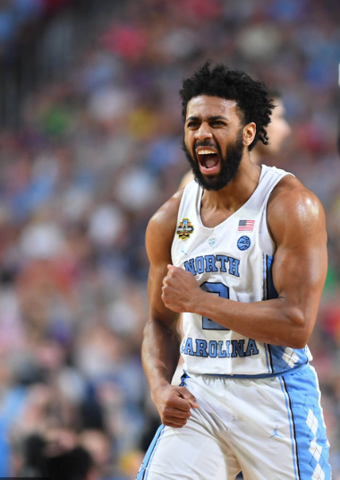
MARCH MADNESS
The tournament consist of several rounds
68 teams
The first 4(teams with the lowest seeds)
The first round( the round of 64)
The second round(The round of 32)
Sweet 16
Elite 8
Final 4
4 regions, 16 teams each
Each team seeded 1-16
2017 Champion: North Carolina Tar Heels
(#1 seed in the South Region)

Slide 4
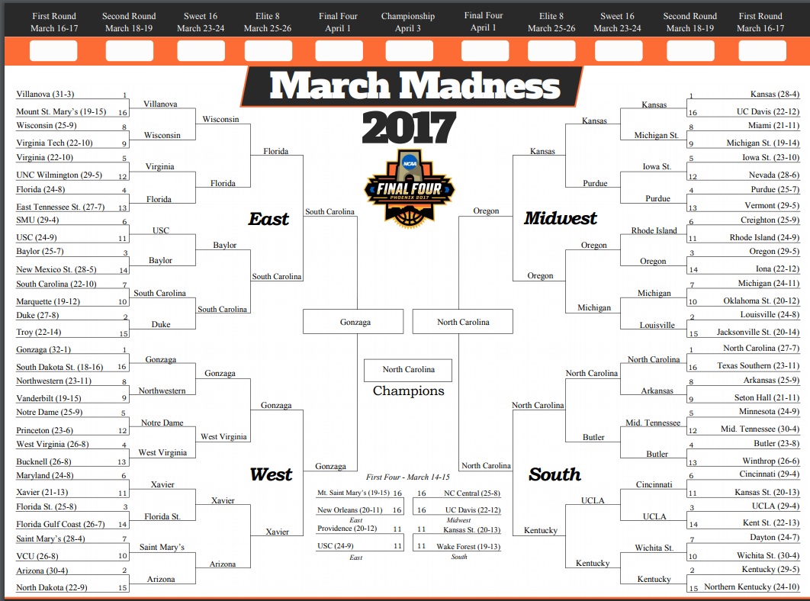
THE BRACKET

Slide 5

19 millions brackets were submitted to ESPN
9.2 quintillion possible brackets
The majority of fans submit 2 different brackets
Nobody has ever submitted a perfect bracket
The approximate retail value of all prizes on ESPN is $22,950
Warren Buffett offers $1 million for life for a perfect Sweet 16 field

Slide 6
Overview of March Madness Project
And Questions of Interest
Can we use NCAA historical data and Machine Learning to predict the games outcome?
Based on the probabilities can we predict what team will move forward?
How accurate can these statistical results be compared to the brackets?

Slide 7
PREVIOUS WORK
Most previous work have been developed in the context of Statistical Modeling rather than Machine learning
Existing work which employs machine learning suffered from poor feature selection
Models built based on Efficiency metrics and Las Vegas Point Spreads

Slide 8
HOW I PLAN TO FIX THIS:
Compute moving averages and the “4 factors”
Analyze a wide range of feature selection methods
Pick relevant features
Analyze a broad range of Machine Learning techniques
Select the model with the best accuracy scores

Slide 9
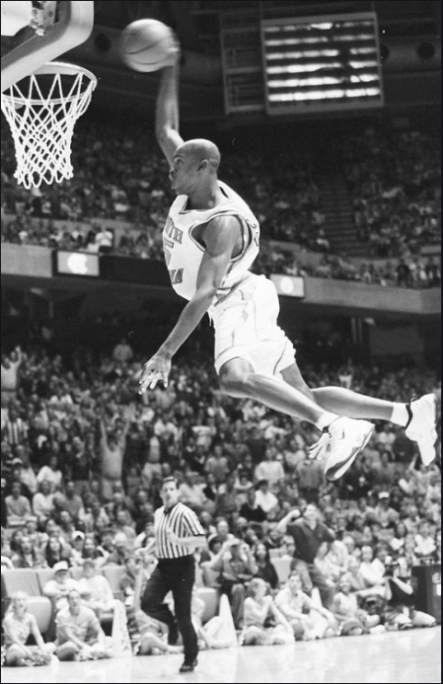
THE DATA
field goals made
field goals attempted
three pointers made
three pointers attempted
free throws made
free throws attempted
offensive rebounds
defensive rebounds
Assists
turnovers committed
Steals
Blocks
personal fouls committed
offensive and defensive efficiencies
Effective field goal percentage
Turnover percentage
Offensive Rebound Percentage
Free throw rate

Slide 10
SELECTED FEATURES
Defensive efficiencies
Effective field goal percentage
Free throw rate
free throws attempted
defensive rebounds
turnovers committed
Steals
personal fouls committed

Slide 11
MODELS
Adaptative Boosting
Gradient Boosting
Neural Network
Support Vector Machine
Random Forest

Slide 12
LEARNING TECHNIQUES
Trained model for classification for picking loser and winner for each matchup and determining the likelihood for each outcome

Slide 13
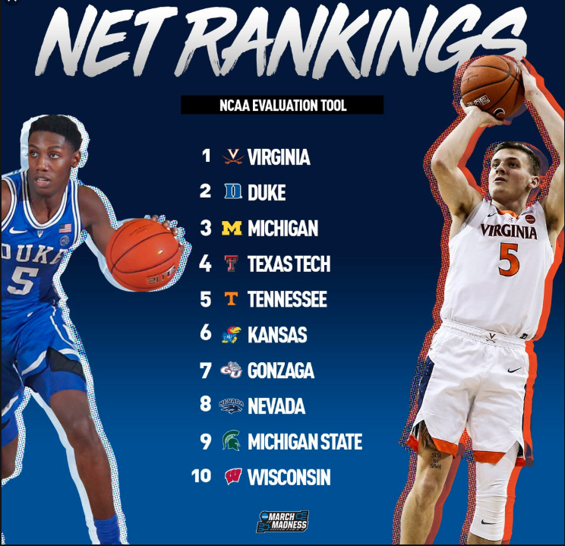
METHOD OF EVALUATION
Accuracy scores
Create Brackets
Bracket scores

Slide 14
ACCURACY SCORE
Neural Network | 0.87
Random Forest | 0.87
Gradient Boosting | 0.87
Adaptative Boosting | 0.85
SVM | 0.79
Model | Acc | AUC
Random Forest | 0.87 | 0.94
Neural Network | 0.87 | 0.93
Gradient Boosting | 0.87 | 0.93
Adaptative Boosting | 0.85 | 0.92
SVM | 0.79 | 0.82

Slide 15
BRACKET SCORES
Neural Network | 270
Gradient Boosting | 230
Adaptative Boosting | 210
Random Forest | 200
SVM | 200

Slide 16
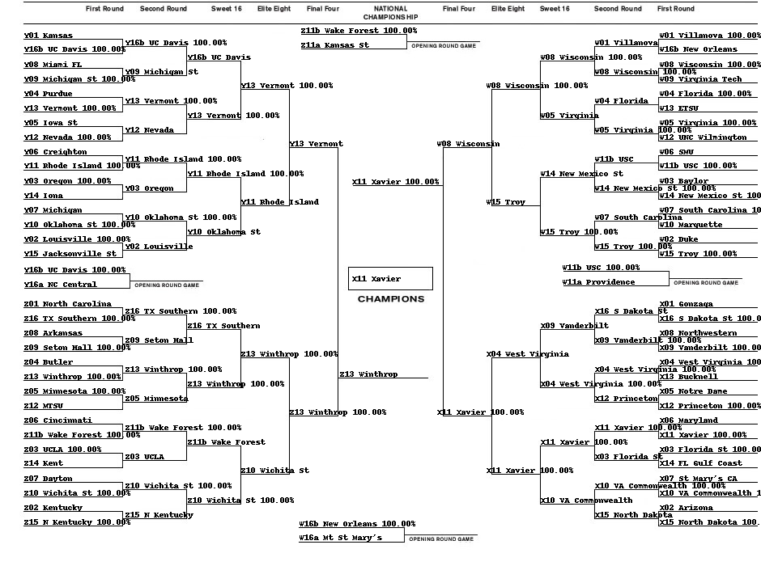
Random Forest Bracket

Slide 17
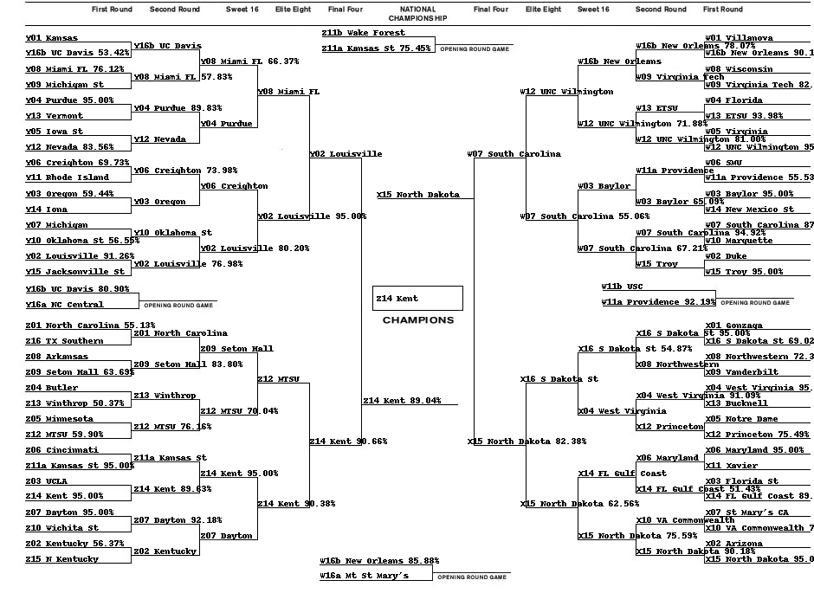
Neural Network Bracket

Slide 18
Conclusion
Can we use NCAA historical data to predict the games outcome?
From my analyses, we can still attempt to predict the outcome
Can we predict what team will move forward?
Yes, we can predict the likelihood that a team will move forward
How accurate can these results be used to create brackets?
These results can be used to create brackets. But, as we all know, March Madness is essentially madness, and we can never be confident in our selections

Slide 19
Obstacles and Future Work
Poor model performance due to poor feature selection
Other successful work have used rolling averages
Time constraint

Slide 20
Reference
Andrew Lavandoski and Jonathan Lobo, “Predicting the Men’s Basketball Tournament with Machine Learning”, CS 2750: Machine Learning, April 2017
Z. Shi, S. Moorthy, A. Zimmermann, “Predicting NCAAB match outcomes using ML techniques – some results and lessons learned”, October 2017
Trevor Hastie, Robert Tibshirani and Jerome Friedman, The Elements of Statistical Learning: Data Mining, Inference, and Prediction., 2nd edition, Springer, 2009

