Slide 1
SAHAYAK
A Prototype for Public Problem Reporting & Resolution
Rubric R1 - Evaluation 1 | Project Based Learning
Objectives & Methodology
Tools & Formulas Identification
Module Identification
High Level Design
Low Level Design
Communication & Presentation
Project Design Report
Academic Year: 2026-27 | Department of Engineering

Slide 2
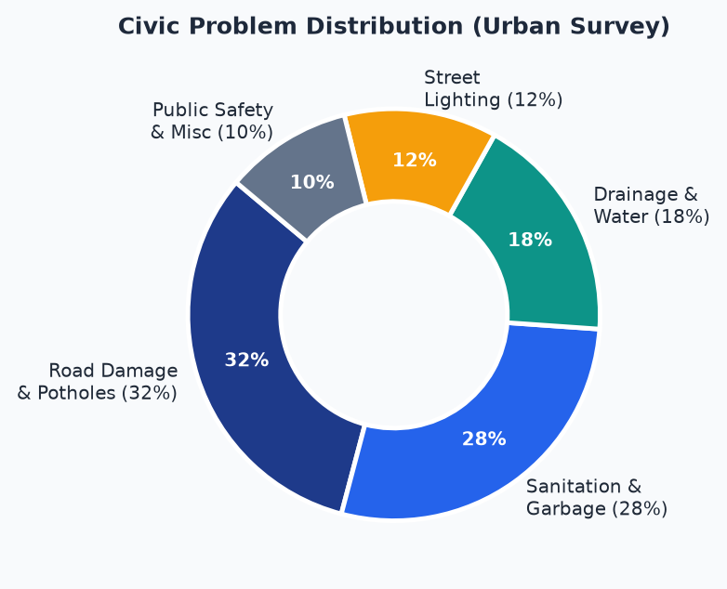
Objectives & Methodology of Project Proposal
Background, Problem Definition & Project Objectives
Background
Civic Problem Distribution (Survey Data)
• Public issues (roads, garbage, drains) stay unresolved for months
• No single citizen platform - complaints via informal channels
• No tracking system; no deadline; no responsible authority assigned
• 32% of urban complaints relate to road damage & potholes
Problem Definition
• Road damage, pollution, poor sanitation & crime left unattended
• Complaints delayed by middlemen & unclear inter-dept ownership
• No fixed SLA for reviewing, approving or prioritizing reports
Objectives of SAHAYAK
• Provide a direct platform for citizens to report public problems
• Ensure every problem is reviewed & approved within 48 hours
• Prioritize problems based on severity and community support
• Increase transparency and accountability in governance
• Enable community participation in problem resolution
SAHAYAK | Project Based Learning | 2026-27

Slide 3
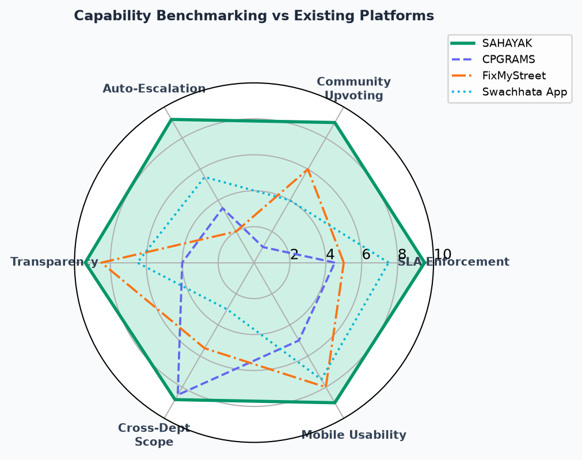
Identification of Necessary Tools & Formulas
Literature Survey, Platform Benchmarking & Core Priority Algorithm
Platforms Studied (Literature Survey)
Capability Benchmarking vs Existing Platforms
CPGRAMS (Govt of India)
Grievance routing structure; dept-wise complaint tracking model
FixMyStreet (UK)
Geo-tagged reporting; image-based civic issue filing workflow
MyGov / Swachhata App
Sanitation issue reporting; forwarding to concerned department
Core Tools & Priority Algorithm
• Priority Formula: P(t) = W_base + alpha x log2(1+U) [U = community upvotes]
• Escalation Trigger: P(t) >= 100 automatically escalates to senior dept
• Stack: React/HTML frontend, Node.js / Flask backend, PostgreSQL
• Geo-tagging via Browser Geolocation API + image upload
• SLA Engine: cron-job timer triggers 48 hours after submission
• Auth: JWT-based role system (citizen / authority)
SAHAYAK | Project Based Learning | 2026-27

Slide 4
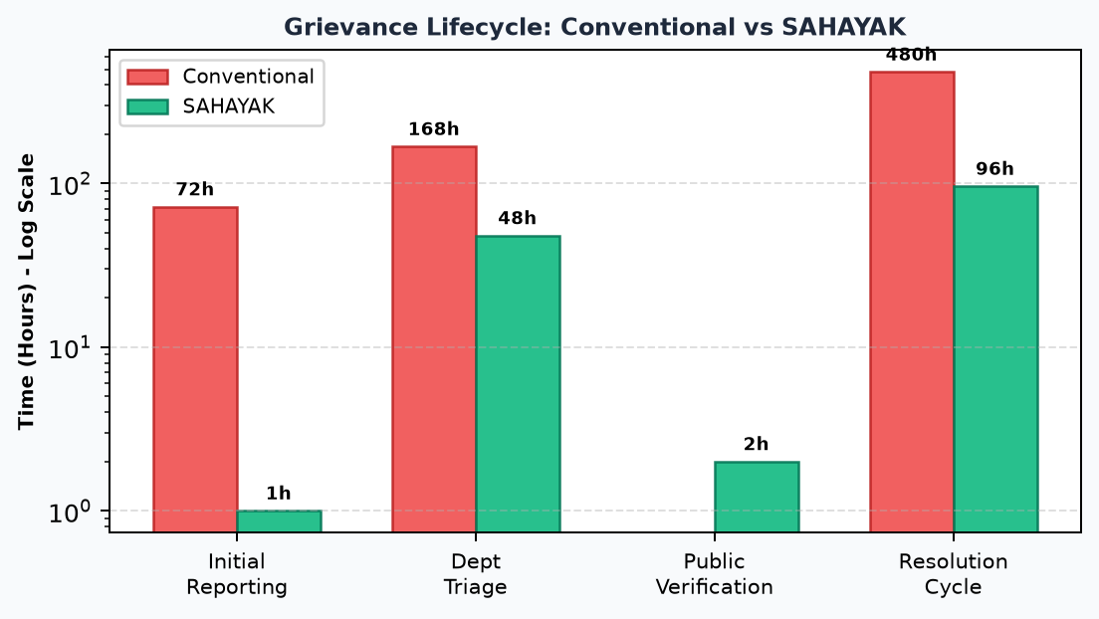
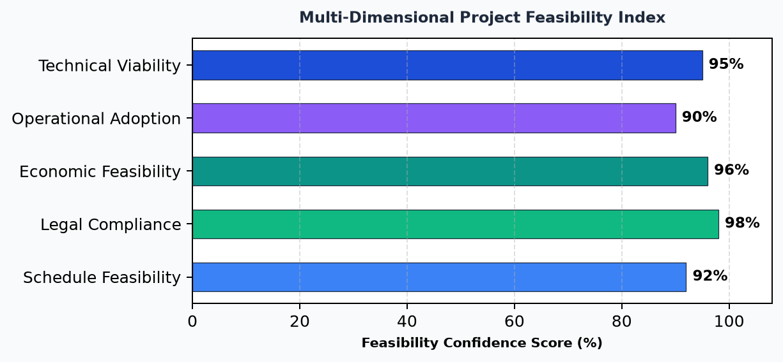
Identification of the Modules
5 Core System Modules & Multi-Dimensional Feasibility Analysis
M1
Citizen Reporting Module
Processing Time: Conventional vs SAHAYAK
Report submission with image, location & description
M2
Authority Dashboard
Review, approve, reject & assign priority to complaints
M3
SLA & Escalation Engine
48-hour timer; auto-escalate overdue complaints
M4
Community Engagement
Upvote/reshare; dynamic priority score computation
M5
Notification & Tracking
Real-time status updates visible to citizen & authority
Feasibility Confidence Index
SAHAYAK | Project Based Learning | 2026-27

Slide 5
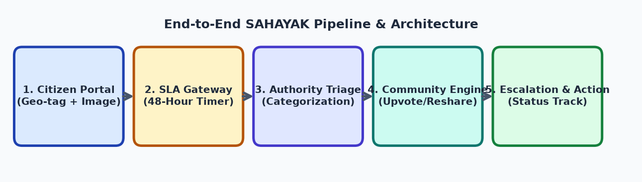
Working with High Level Design
System Architecture, Data Flow & End-to-End Pipeline
End-to-End SAHAYAK Pipeline & Verification Architecture
Technology Stack
Citizen Complaint Lifecycle
Frontend
React.js / HTML5 + CSS3 (Responsive Design)
• 1. Citizen submits complaint (description + image + GPS location)
• 2. SLA Gateway records timestamp - 48h countdown begins
• 3. Authority reviews - approves / rejects - assigns priority
• 4. Community upvotes - priority score recalculated in real-time
• 5. Status publicly visible (Pending > In-Progress > Resolved)
• 6. No action within SLA - automatic escalation triggered
Backend
Node.js (Express) or Python (Flask) REST API
Database
PostgreSQL - complaints, users, audit logs
Auth
JWT-based role authentication (citizen / authority)
Hosting
Cloud VM (AWS/GCP) + Nginx reverse proxy
SAHAYAK | Project Based Learning | 2026-27

Slide 6
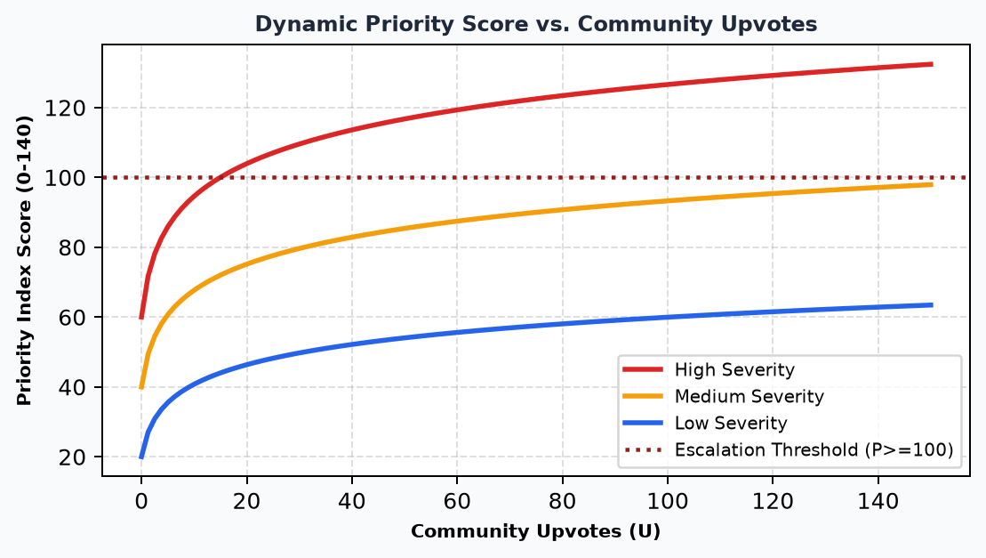
Working with Low Level Design (Per Module)
Database Schema, SLA Logic & Priority Algorithm Specification
Database Schema (Key Tables)
Dynamic Priority Algorithm: P(t) = W_base + alpha x log2(1+U)
complaints
id, user_id, title, description, image_url, lat, lng, status, priority, sla_deadline
users
id, name, email, password_hash, role [citizen | authority], created_at
upvotes
id, complaint_id, user_id, created_at --> triggers priority recalculation
escalations
id, complaint_id, reason, escalated_at, new_assignee_id
audit_log
id, complaint_id, action, actor_id, timestamp
SLA Enforcement Logic
• On submission: sla_deadline = created_at + 48 hours
• Cron job runs every 30 min - checks all pending complaints
• If NOW() > sla_deadline AND status = Pending - ESCALATE
• Status changes to 'Escalated'; senior authority notified
• Priority re-scored in real-time after each community upvote
SAHAYAK | Project Based Learning | 2026-27

Slide 7
Communication (Presentation)
Demo Walkthrough, User Roles & Expected Outcomes
Citizen Flow
Authority Flow
Expected Outcomes
• Register & log in to SAHAYAK platform
• Fill complaint form: title, category, image, GPS
• Submit - receive complaint ID & 48h SLA confirmation
• Upvote other complaints to boost their priority
• Track own complaint status in real-time dashboard
• Reshare complaints on community feed for visibility
• Log in as municipal / police / ward authority
• View inbox of pending complaints sorted by priority
• Approve or reject complaints within 48-hour SLA window
• Assign department & update progress status
• Receive automatic escalation alerts for overdue items
• View analytics on resolution rates & dept backlogs
• >=90% complaints acknowledged within 48 hours
• Community-driven priority fast-tracks urgent issues
• Full audit trail for every complaint lifecycle event
• Citizens gain trust via visible accountability
• Authorities get structured, prioritized workload view
• Data-driven governance: metrics per department
48-Hour SLA Guarantee
Community Upvoting
Auto-Escalation Engine
Geo-tagged Reporting
Role-Based Access
SAHAYAK | Project Based Learning | 2026-27

Slide 8
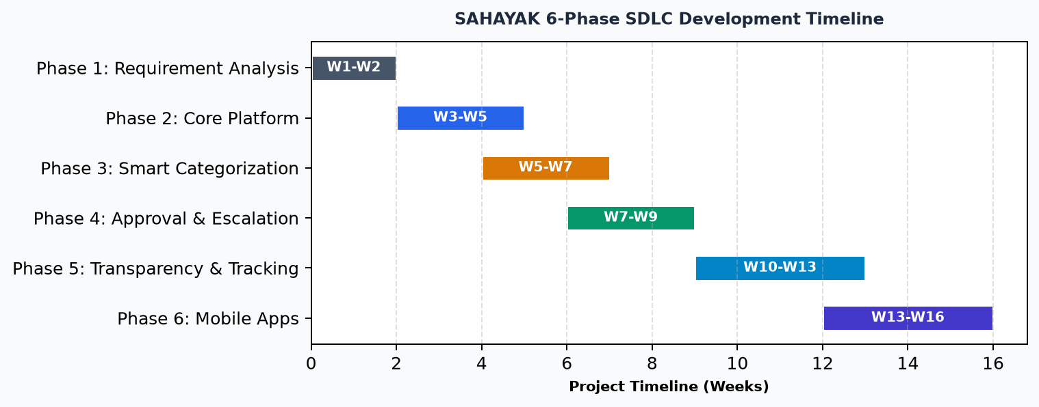
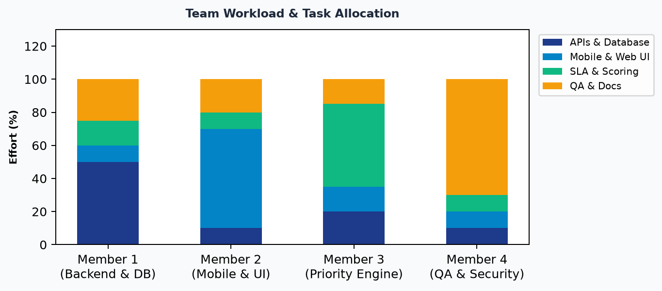
Project Design Report
Development Roadmap, SDLC Phases, Team Workload & Conclusion
6-Phase SDLC Development Gantt Chart
Team Workload Distribution
Phase Details
Phase 1
Requirement Analysis - problem scope, existing system study, SRS
Phase 2
Core Platform - citizen registration, authority login, submission form
Phase 3
Smart Categorization - category-based routing, severity tagging
Phase 4
Approval & Escalation - 48h workflow, upvote-based priority
Phase 5
Transparency & Tracking - public status, notifications, dashboards
SAHAYAK | Project Based Learning | 2026-27
Phase 6
Mobile Applications - Android & iOS apps, voice reporting, AI

Slide 9
Rubric R1 Evaluation -
1
Objectives & Methodology: Problem defined; 48h SLA & community priority objectives established
SAHAYAK
2
Tools & Formulas: P(t)=W_base+alpha*log2(1+U); CPGRAMS, FixMyStreet, Swachhata benchmarked
A step toward accountable,
transparent civic governance
3
Module Identification: 5 core modules designed with feasibility scores >= 90%
4
High Level Design: 5-stage pipeline architecture; full tech stack specified
Key Benefits:
5
Low Level Design: DB schema (5 tables), SLA cron logic & priority algorithm per module
• Faster acknowledgment of public problems
• More transparency in complaint handling
• Greater authority accountability
• Citizens have a say in urgency decisions
• Scalable solution for smarter governance
6
Communication / Presentation: Clear citizen & authority workflows; outcome KPIs defined
7
Project Design Report: 6-phase SDLC Gantt chart + team workload distribution presented

