Slide 1


Slide 2
PROJECT REPORT

Slide 3
PROBLEM
India has the largest population of illiterate adults in the world. Around 287 million, which is 37% of the global total. Many people didn’t have proper income due to illiteracy.
One of the main reason for illiteracy is lack of interest and enthusiasm.
Source: Wikipedia

Slide 4
Statistics
Literacy rate in India is 74.04%.
In rural India,
• The literacy rate of Females is 56.8%
• The literacy rate of Males is 72.3%2.
2. In urban India,
•The literacy rate of Females is 74.8%
•The literacy rate of Males is 83.7%
Source: Wikipedia

Slide 5
Knowledge Cart
Y V SRAVAN KUMAR REDDY
T V PREMCHAND
V AKHIL
BL.EN.U4CSE17524
BL.EN.U4CSE17523
BL.EN.U4CSE17138

Slide 6
ABSTRACT

Slide 7
AIM
To make learning and gaining knowledge a continuous and entertaining process for each and every student or a learner.

Slide 8
What’s it about?
Based on ‘learn to earn concept’.
Connection is established directly between the seller and the student.
Seller will sell all kind of stationary products.
A student can gain credits by answering simple questions.
Credits can be used to purchase stationary products from the seller through the application.

Slide 9
Tables (Relations)
Student
Question
Seller
Product
Order

Slide 10
Functions

Slide 11
Student:
Can sign up and sign in using KC SNo. and Password.
Can answer to the questions, by which they can gain credits.
Using the credits, they can buy/purchase stationary items.
Can edit/update/modify their details.
Questions:
Only accessed by Database Administrator.
Questions are given with four options, in which one option can be the answer.
Correct answers lead to credits.
Store Manager:
Can sign up and sign in using KC MNo. and Password.
Can sell stationary products and credits earned can be transferred to their bank account.
Product details can be added and modified by seller.

Slide 12
Products:
All details and specifications of products are present in Product Database.
Orders:
Details of orders placed by student and respective product details also.
Orders placed by student-i can only be seen by student-i.

Slide 13
Attributes (1.Student)
Attribute | Attribute Value Type
sno | Primary Key
spwd | -
sfn | -
smn | -
sln | -
semail | Unique
sphno | Multi-valued
sdob | -
sgender | -
sdno | -
scolony | -
scity | -
szip | -
scredits | -

Slide 14
Attributes (2.Question)
Attribute | Attribute Value Type
qsno | Primary Key
qno | Unique
question | -
qmarks | -
qcrtans | -
otwo | -
othree | -
ofour | -

Slide 15
Attributes (3.Seller)
Attribute | Attribute Value Type
mno | Primary Key
mpwd | -
mname | -
mloc | -
memail | Unique
mphno | Multi-valued
mdno | -
mcolony | -
mcity | -
mzip | -
mbname | -
maccno | -
macntname | -
mifsc | -
mcredits | -

Slide 16
Attributes (4.Product)
Attribute | Attribute Value Type
pno | Primary Key
pname | -
pcat | -
pspec | -
pbrnd | -
pcost | -
pqty | -

Slide 17
Attributes (5.Order)
Attribute | Attribute Value Type
ono | Primary Key
ocost | -

Slide 18
Tables after normalization
student
question
seller
product
order_sno
student_question
student_product
seller_product
order_product
student_sphno
seller_mphno

Slide 19
Software Applications used
HTML
CSS
MySQL
php
Sublime Text
Microsoft Visual Studio Code
XAMPP

Slide 20
HOW DOES IT WORK?

Slide 21
Modules
Login module
Student Sign Up form module
Seller Sign Up form module
Student homepage
Seller homepage
Products module
Questions module
Results module
Credits and Banking module/Payments
Customer Care module/Chat with us
Orders module
Cart module

Slide 22
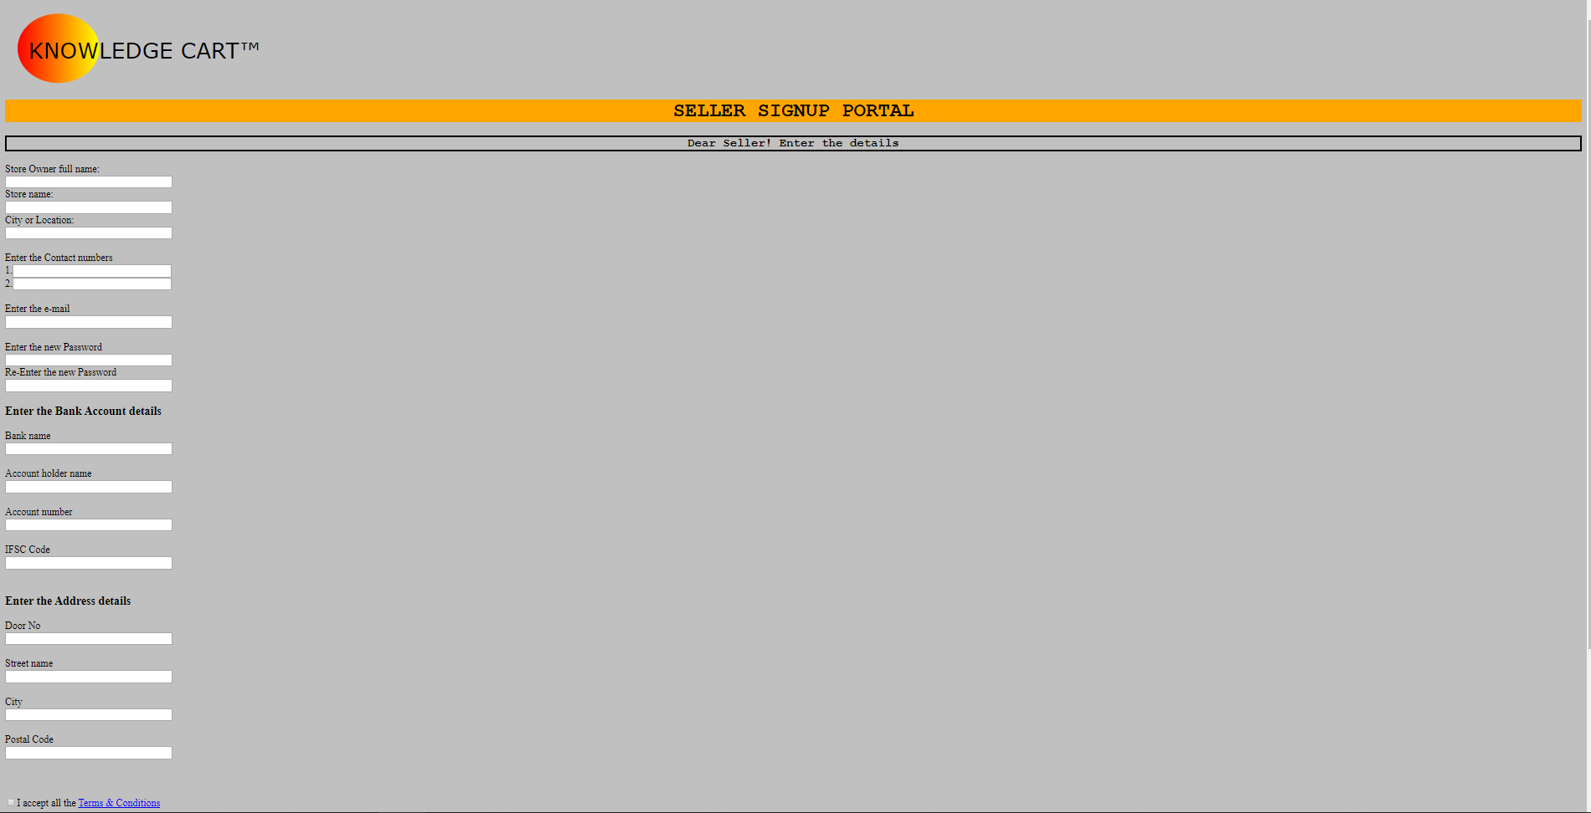
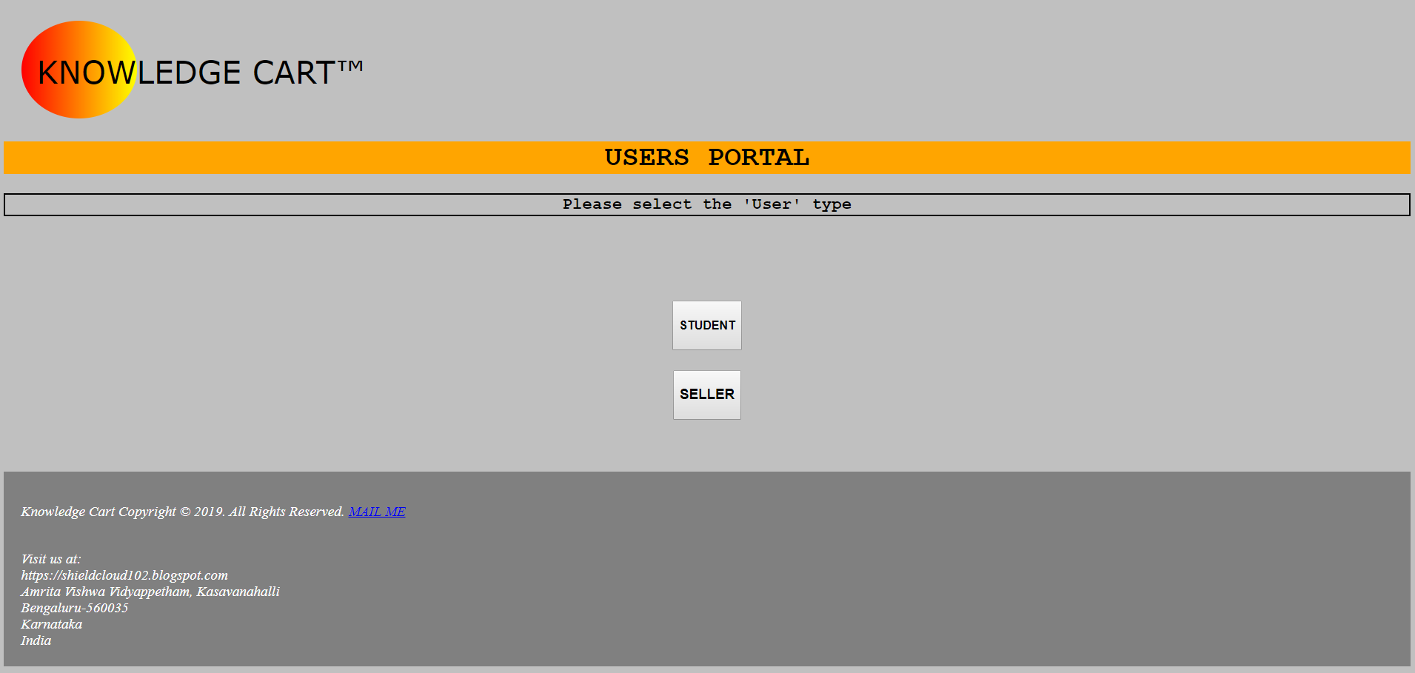
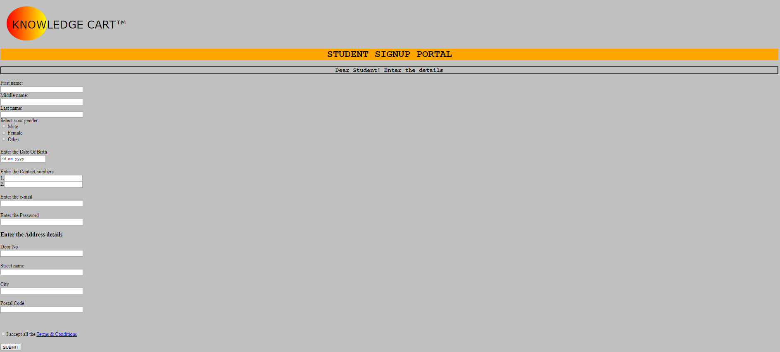
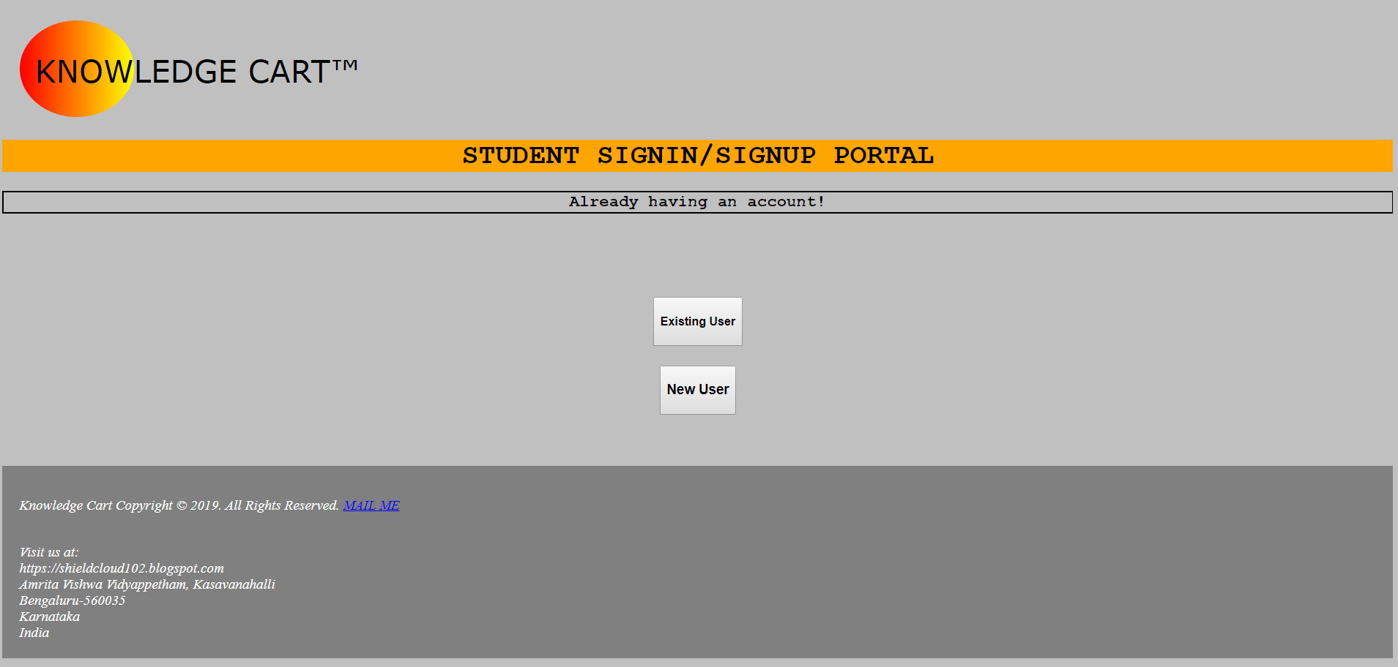
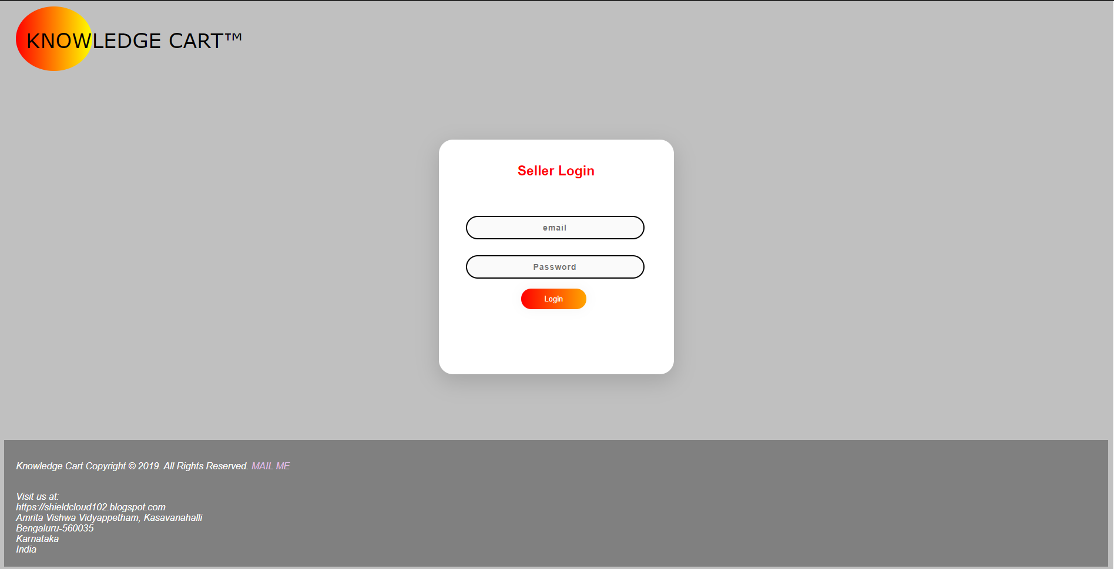

PROCESS

Slide 23
1

Slide 24
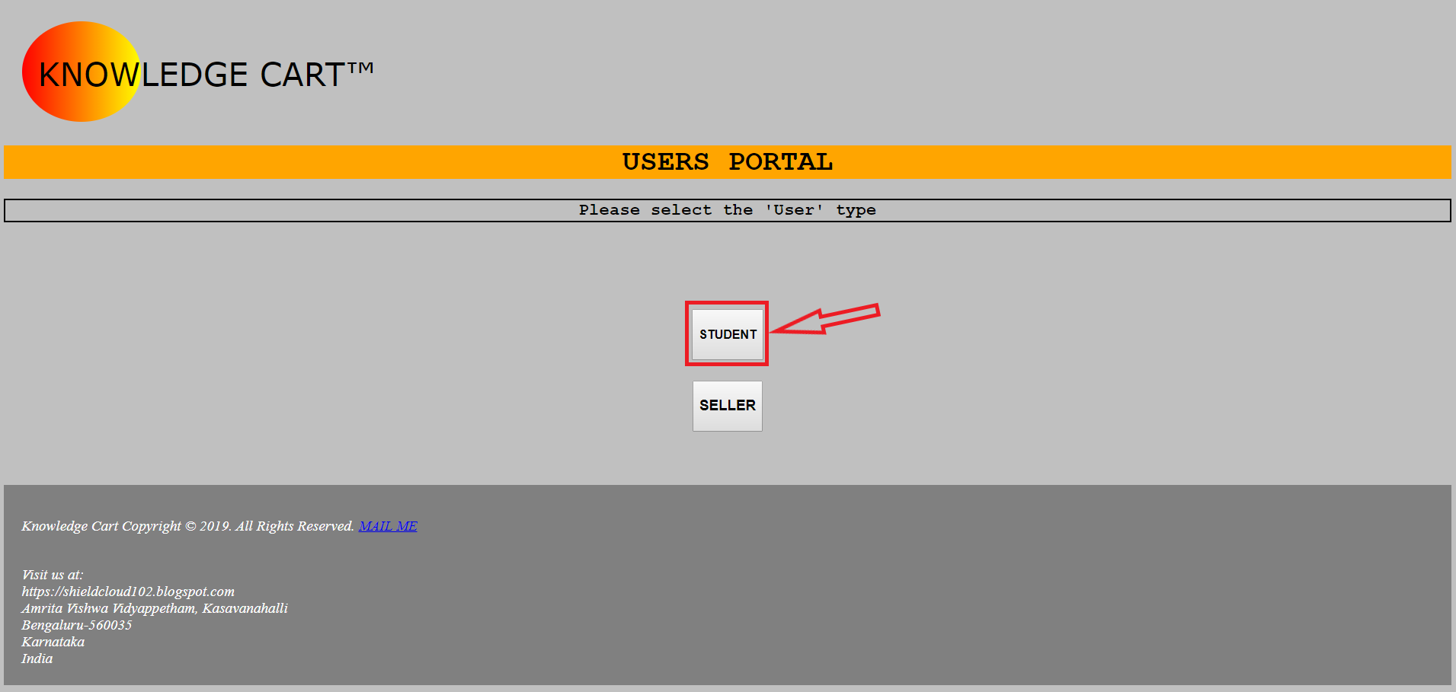
2

Slide 25
3

Slide 26
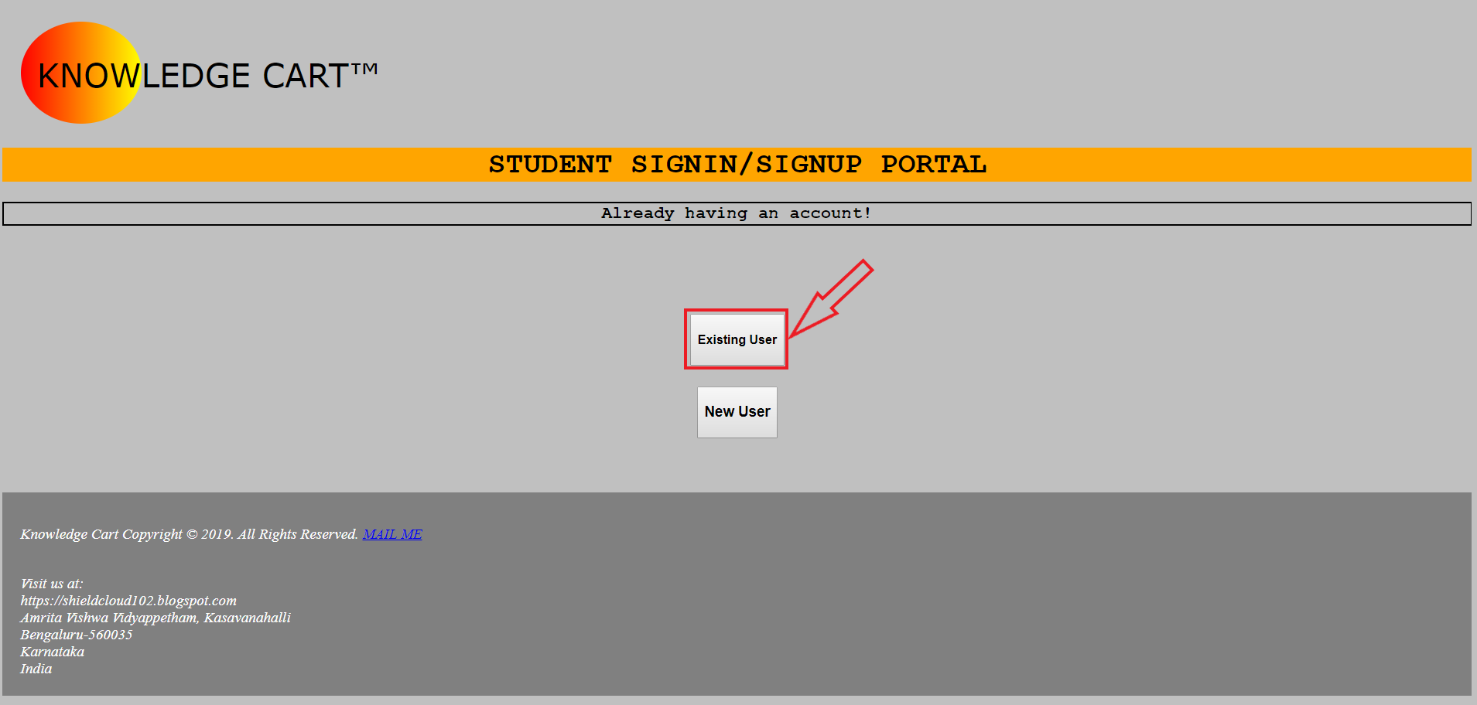
4

Slide 27
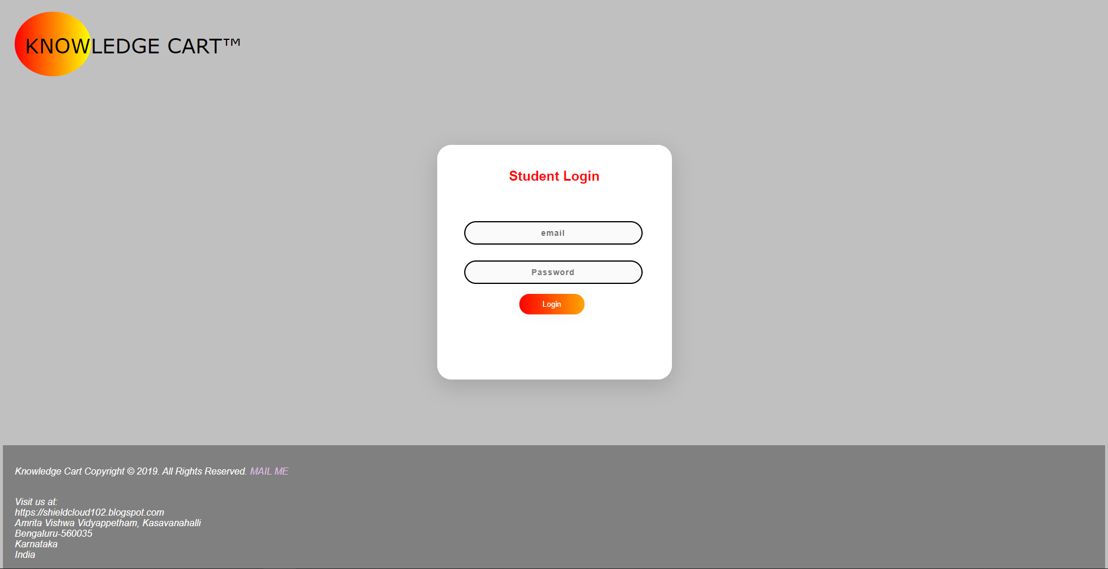
5

Slide 28
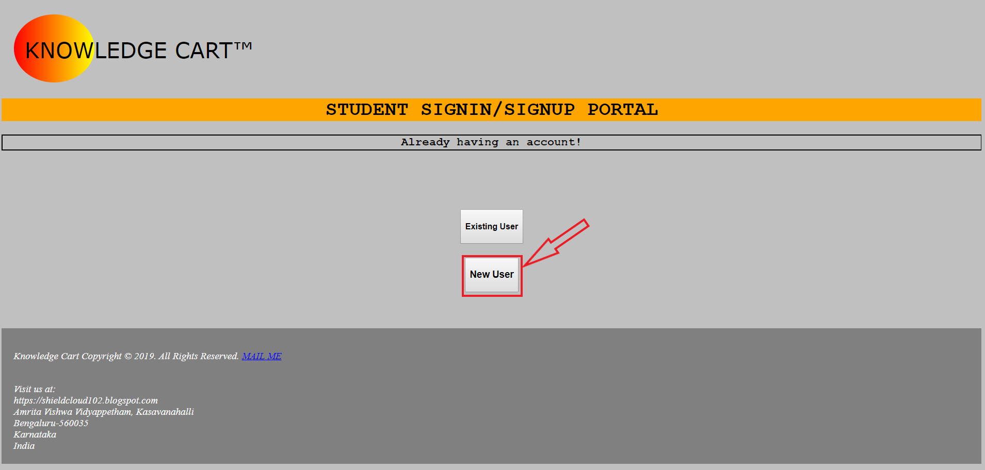
6

Slide 29
7

Slide 30
8

Slide 31
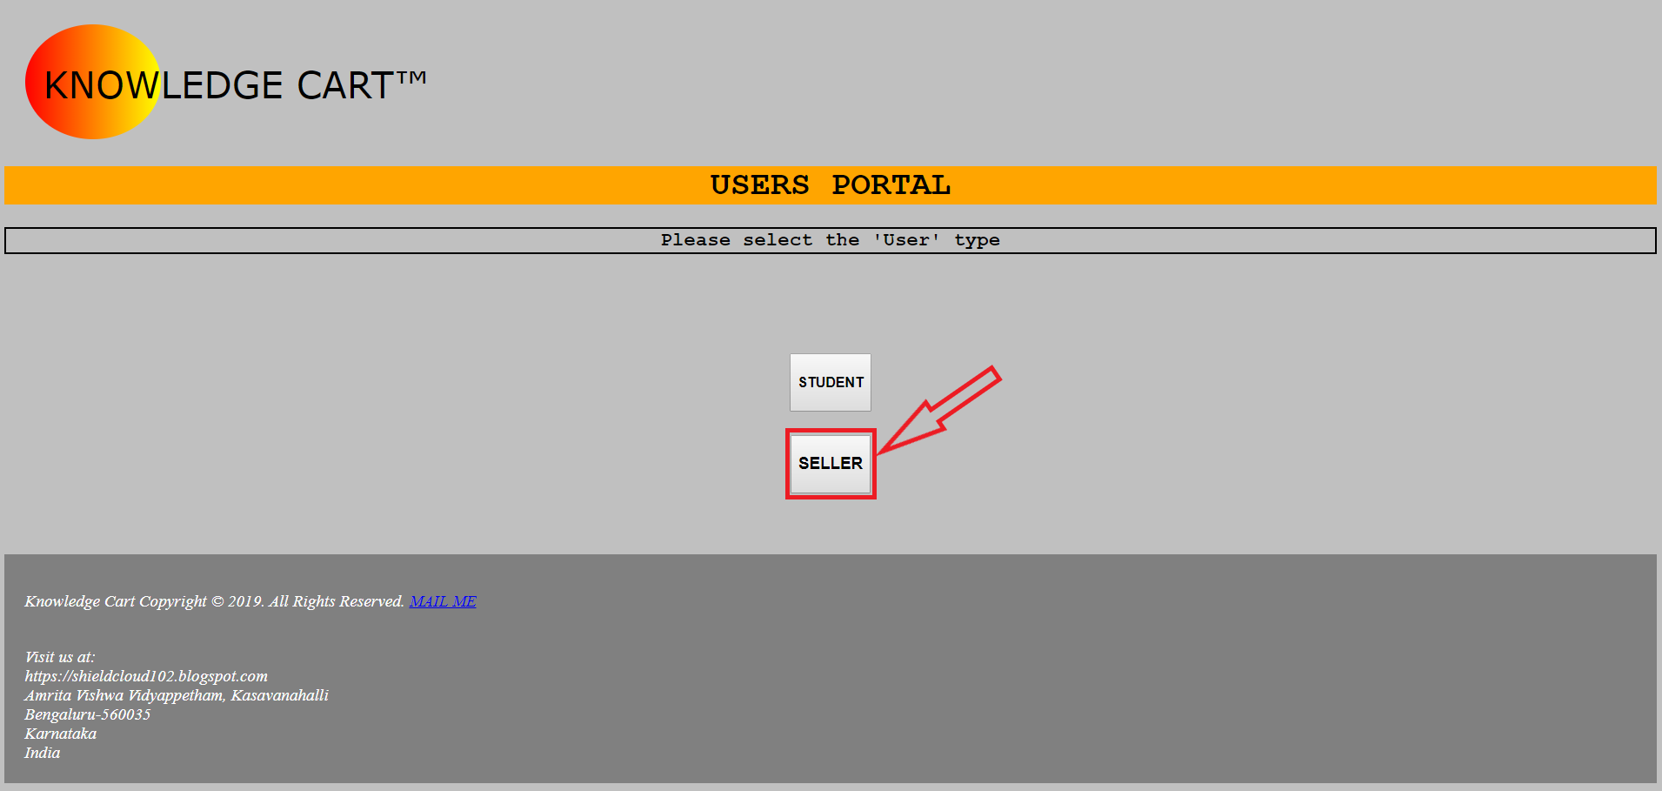
9

Slide 32
10

Slide 33
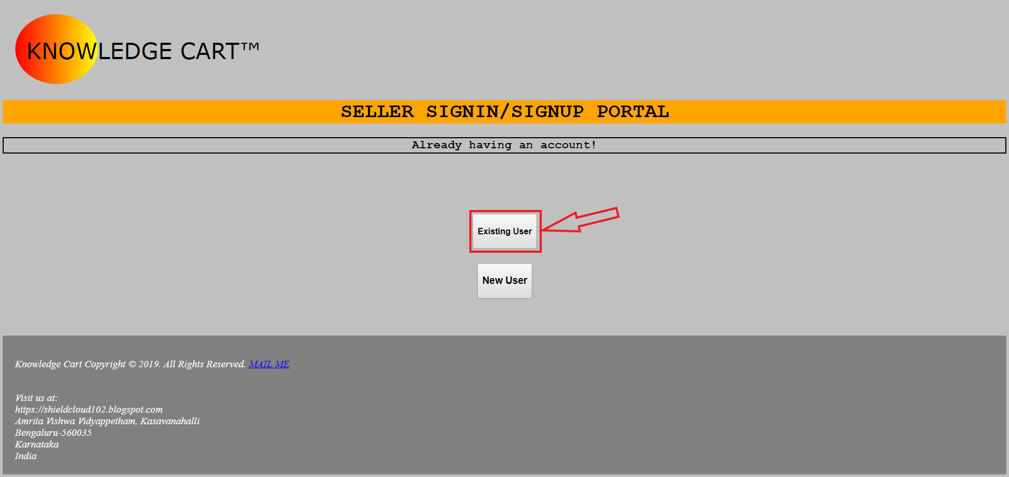
11

Slide 34
12

Slide 35

13

Slide 36
14

Slide 37
THANK YOU

