Slide 1
Financial Analytics and Information Delivery Telegram Chatbot
Team Members Panel Number: 04
Project Advisor: Dr. Thangam S. (Associate Professor),
Department of Science and Engineering
S.no | Reg.No | Name of the Student | Section
1 | BL.EN.U4CSE17524 | Y V Sravan Kumar Reddy | CSE-C
2 | BL.EN.U4CSE17541 | Ajith Pai | CSE-C
3 | BL.EN.U4CSE17551 | T Yeswanth Sai | CSE-C
4 | BL.EN.U4CSE17073 | M Sai Surya Teja | CSE-B

Slide 2
INDEX
Introduction
Problem Definition
Justification
Software/Tools Requirements
Literature Survey
Work Model
Dataset
Implementation
Output
Conclusion
Future Enhancement
Gantt Chart
References

Slide 3
Introduction
A recent survey by Scripbox, an online mutual funds platform, found that 72% Indians are unaware of how much to put aside or invest in order to achieve financial freedom.
Personal finance include risk profiling and investment instruments like stock market.
In Stock Market Prediction, the aim is to predict the future value of the financial stocks of a company.

Slide 4
Problem Definition
To develop an automated chatbot interface that will help the user in assisting with their risk profile, financial information, stock suggestions, and stock value predictions.
Chatbot platform: Telegram

Slide 5
Justification for the proposed problem
Motivation and Need
The survey found that 72% of Indians are unaware of how to achieve financial planning and 76% Indians say they need more education, support in financial planning.
56% of Indians lack the knowledge in risk management. Hence, there is a need for a system giving financial information and analytics.
Though there is wealth of information available online, Individuals should seek out professional advice, educate themselves about the basics of investment planning, returns and financial goal which cost a hefty amount.
Our system plans to help in self assessment of individual risk profile and stock predictions for about 30 trading days at no fee involved.

Slide 6
Software/Tools Requirements
Operating system: Linux 16.4, Windows 8.1 or higher
Python: 3.8 or higher
Chrome browser: 86 or higher
Chrome Web driver: 86.0.4240.22 or higher (Similar to Chromium version)
TensorFlow: 2.0 or higher
Boosting and Machine Learning Algorithms

Slide 7
Literature Survey
S. No | Author | Title | Inference | Open Problem
1 | Zhaoxia Wang, Zhiping Lin | Stock Market Prediction Analysis by Incorporating Social and News Opinion and Sentiment | Developed an Outlier Data Mining Algorithm for predicting fluctuations in Stock Market. The stock trend can be predicted using anomalies. | Stock price determined only upto 2-3 days,but effect of the news sentiments can last for many days. It is also an interesting question which is worthy of further research.
2 | Meghna Mishra, Ajay Prakash Yadav | Stock Price Prediction using Machine Learning Algorithms | Focuses on categorising various methods used for predictive analysis in different domains to date, their shortcomings. | This model does not predict how much influence the news has, It goes on pure mathematical and pattern.

Slide 8
Literature Survey
S. No | Author | Title | Inference | Open Problem
3 | Sukhman Singh, Jitendra Sharma, Tarun Kumar Madan | Stock Market Forecasting Using Machine Learning: Today and Tomorrow | Portraying distant machines learning algorithms such as support vector machine, deep learning, random forest, ensemble methods and a few hybrid methods which were used to build prediction model and stock prices for different stock exchanges. | Extraction of Sentiment data or the financial news related can be preprocessed them as per the model and predefined values can be made more efficient.
4 | Sujay Lokesh, Siddharth Mitta, Shlok Setia, Manisha Sudhir | Risk Analysis and Prediction of the Stock Market | It uses the stock market dataset for training the model, sentiment analysis on tweets and risk calculation to overcome the existing barrier and making the riches of stock market investment available for all. | The system can be made such that it can learn over time the habits of the user such as his or her investing schedule, preferences and willingness to take risk.

Slide 9
Work model
Initialize the Telegram Chatbot with the API and basic commands
Prepare the stocks information dataset using Web Scraping techniques
Initialize the flow for scraping the stock details
Create an LSTM model and include the boosting algorithms for predictions
Sourcing the basic details for risk profile test
Program the chatbot for performing the actions according to the user commands

Slide 10
Dataset
Source of data set: Self-made (Using Web Scraping Technique)
The dataset created with several attributes about the financials of the stocks listed in the NSE-National Stock Exchange. The specific dataset was not available on the internet. Hence, creation of such dataset becomes prime importance.
Web sources for scraping: Tickertape and Yahoo financials.

Slide 11
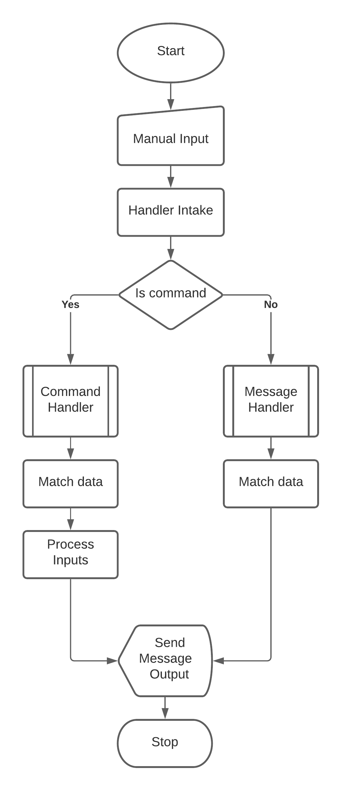
Implementation
Bot Working Model

Slide 12
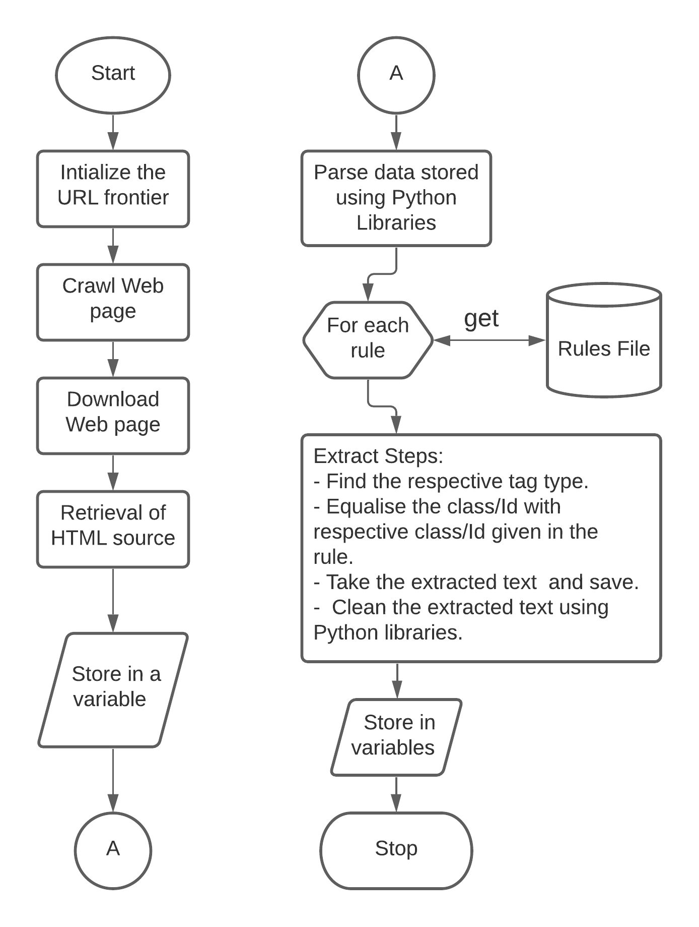
Implementation
Web scraping Model

Slide 13
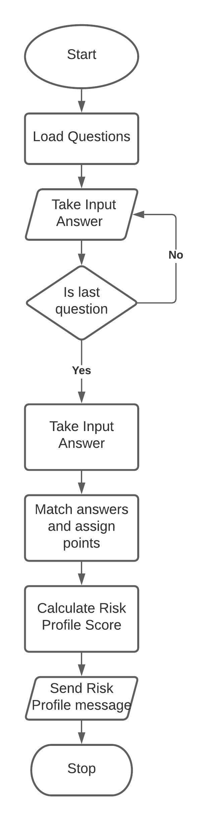
Implementation
Risk Profile Test Model

Slide 14
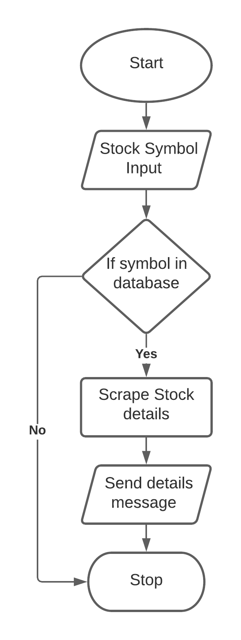
Implementation
Stock details model

Slide 15
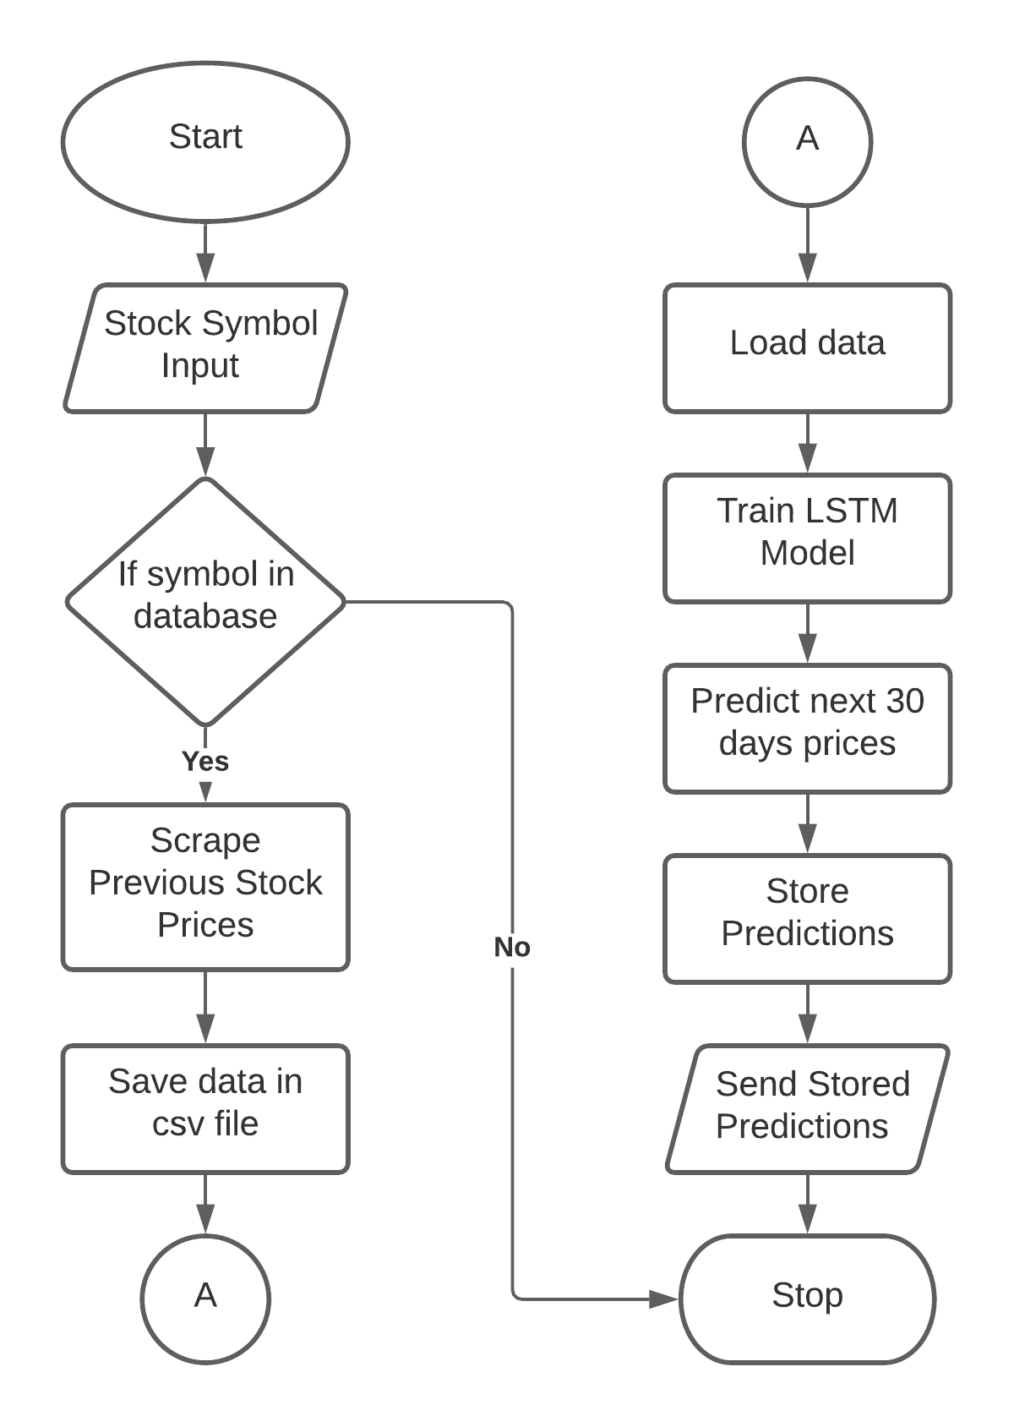
Implementation
Stock price prediction model

Slide 16
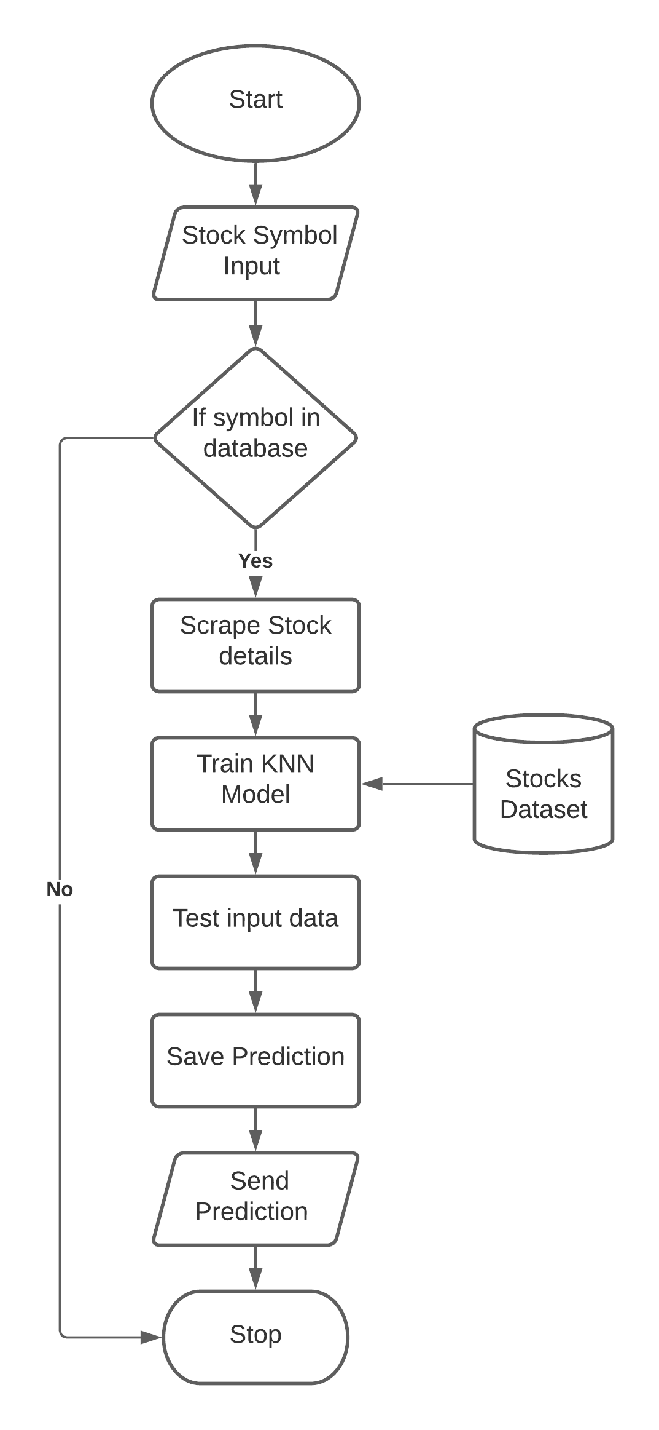
Implementation
Stock suggestion model

Slide 17
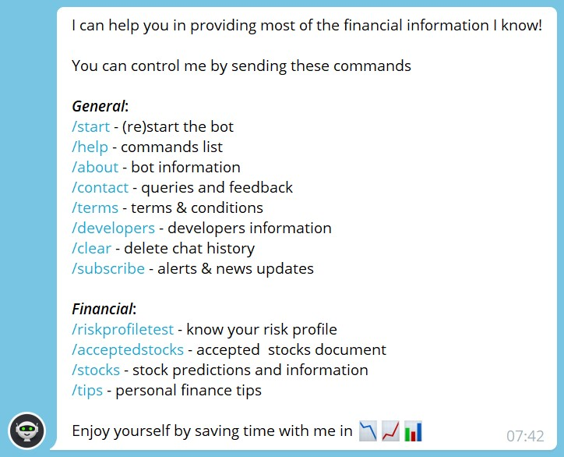
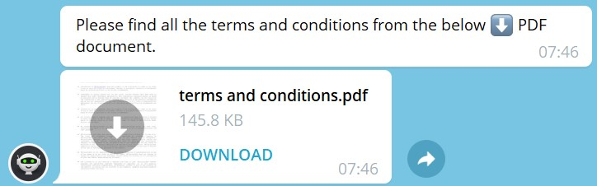
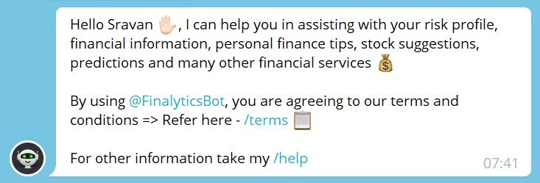
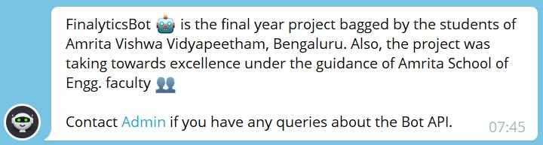
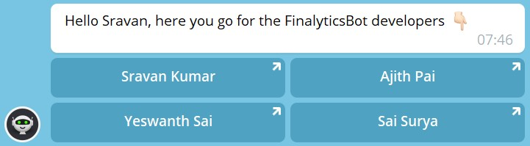
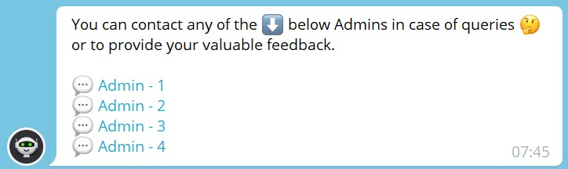


Output
Commands List (General):
/start - (re)start the bot
/help - commands list
/about - bot information
/contact - queries and feedback
/terms - terms & conditions
/developers - developers information
/clear - delete chat history
/subscribe - alerts & news updates

Slide 18
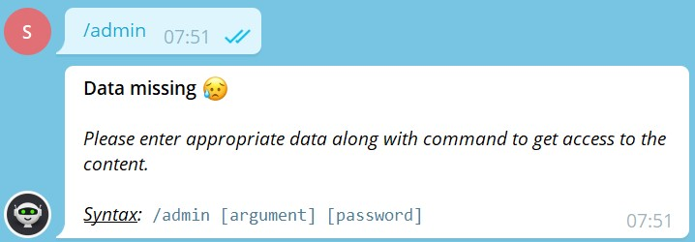
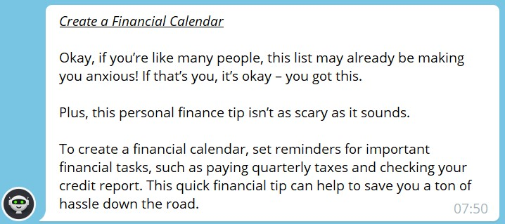
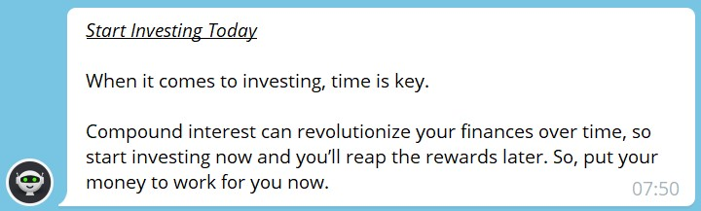
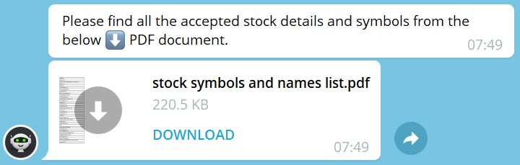
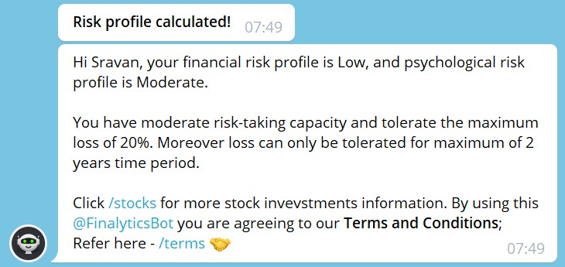
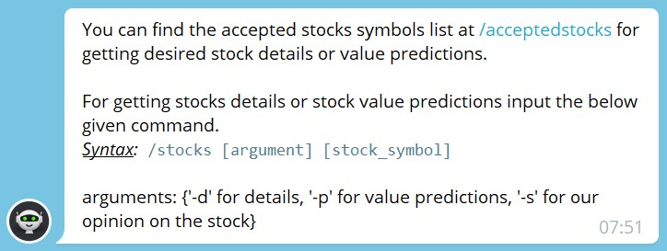
Output
Commands List (Financial):
/riskprofiletest - know your risk profile
/acceptedstocks - accepted stocks document
/stocks - stock predictions and information
/tips - personal finance tips

Slide 19
Conclusion
The main aim of the proposed research study is to bring out the model from the existing pool, having the highest accuracy and minimal error with appropriate metrics for the stock market prediction and information retrieval. The aim of providing a very affordable and approachable system for financial planning, risk profiling and stock prediction in one platform as a one point destination for financial information and analytics is achieved.

Slide 20
Future Enhancement
We want to connect the whole chatbot to an online server for use as an individual entity and individual application rather than on telegram. This way we can serve a greater number of customers simultaneously. Our aim is to build an application to create enough revenue streams through in-app services as well as advertisements to make a profitable entity hand in hand with an optimal solution-oriented approach to give the users financial guidance at the least possible rates in accordance with the financial advisory market.

Slide 21
Gantt Chart
Literature Survey- 10/3/2021
Project Approval- 23/3/2021
Dataset Creation- 7/4/2021
Chat bot coding- 14/4/2021
Bot testing- 19/4/2021
Bot deployed- 21/4/2021
Review 2- 29/4/2021
Suggested changes- 4/5/2021
Stock analysis – 10/5/2021
Test and deploy- 15/5/2021
Final review

Slide 22
References
[1] D. Bhuriya, G. Kaushal, A. Sharma and U. Singh, “Stock Market Prediction Using A Linear Regression,” in International Conference on Electronics, Communication and Aerospace Technology, 2017.
[2] Zhaoxia Wang, Zhiping Lin, “Stock Market Prediction Analysis by Incorporating Social and News Opinion and Sentiment” International conference on data mining workshops, 2018.
[3] Meghna Mishra, Ajay Prakash Yadav, “Stock Price Prediction using Machine Learning Algorithms”, International conference on recent Innovations in Electricals, Electronics & Communication Engineering, 2018.

Slide 23
References
[4] Sukhman Singh, Jitendra Sharma, Tarun Kumar Madan, “Stock Market Forecasting Using Machine Learning: Today and Tomorrow”, international conference on Intelligent computing, instrumentation and control technology, 2019
[5] Ashish Sharma, Dinesh Bhuriya, Upendra Singh, “Survey to Stock Market Prediction Using Machine Learning Approach”, International Conference on electronics, Communication and Aerospace Technology, 2017.

Slide 24
THANK YOU

