Slide 1
Webpage Specific Chatbot

Slide 2
Index
Problem Statement
Proposed Solution
Abstract
Tools and Technologies
Input and Output
Procedure
Samples
References

Slide 3
Problem Statement
To develop a software program that will allow the user to save his time and improve efficiency in information extraction and data retrieval from an unstructured/structured data source.
Data Source: Web pages

Slide 4
Proposed Solution
Our project aim is to make the user feel natural and comfortable to analyze the webpage, and the information contained in it. It’s an interactive platform for a user with a computer. Here, the webpage URL is taken as input, and the output can be the answers (both text and audio output) for the questions asked by the user and some interactive sentences.

Slide 5
Abstract
Webpages are the sources of information in this vast internet world. Nowadays, for extracting some data, the webpages are becoming the key player. There are so many webpages containing information related to a specific categorized topic. Also, the text present on those webpages is vast and expressive. It takes minutes, hours, and even days to read and analyze the data.

Slide 6
Tools and Technologies
Python modules and libraries
Docx
Google Translator
NLTK
Newspaper
NumPy
Pyttsx3
Speech Recognition
String
Winsound

Slide 7
Input and Output
Input:
Webpage URL
Output:
Chat environment for real-time interactions between user-agent and system bot along with the translated forms of summarized web content and chat history saved in a structured file.

Slide 8
Procedure
Summary
BOT: ------------------
YOU: ---------------------------
BOT: ------------------
YOU: ---------------------------
BOT: ------------------
YOU: ---------------------------
BOT: ------------------
YOU: ---------------------------
BOT: ------------------
YOU: ---------------------------
Webpage Link
Tokenization
Lemmatization
Normalization

Slide 9
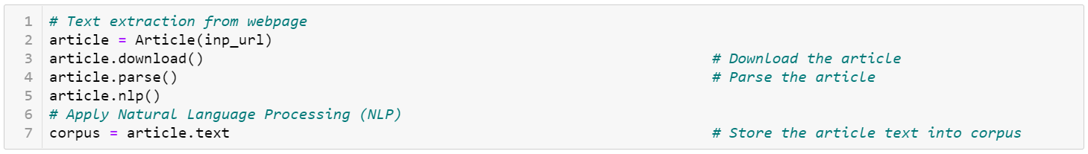
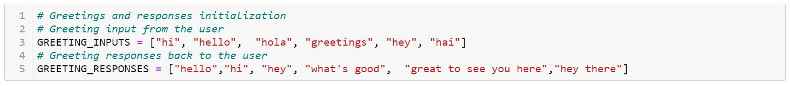
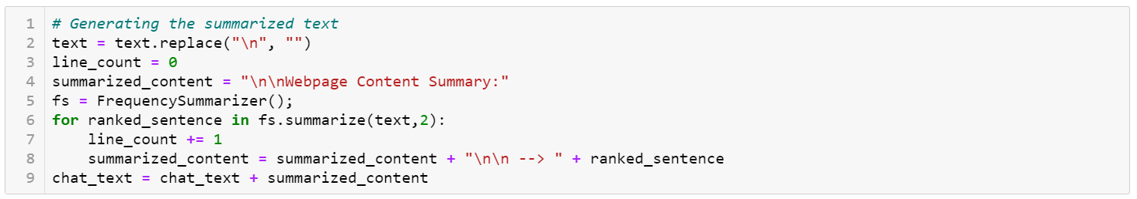
Sample - Code

Slide 10
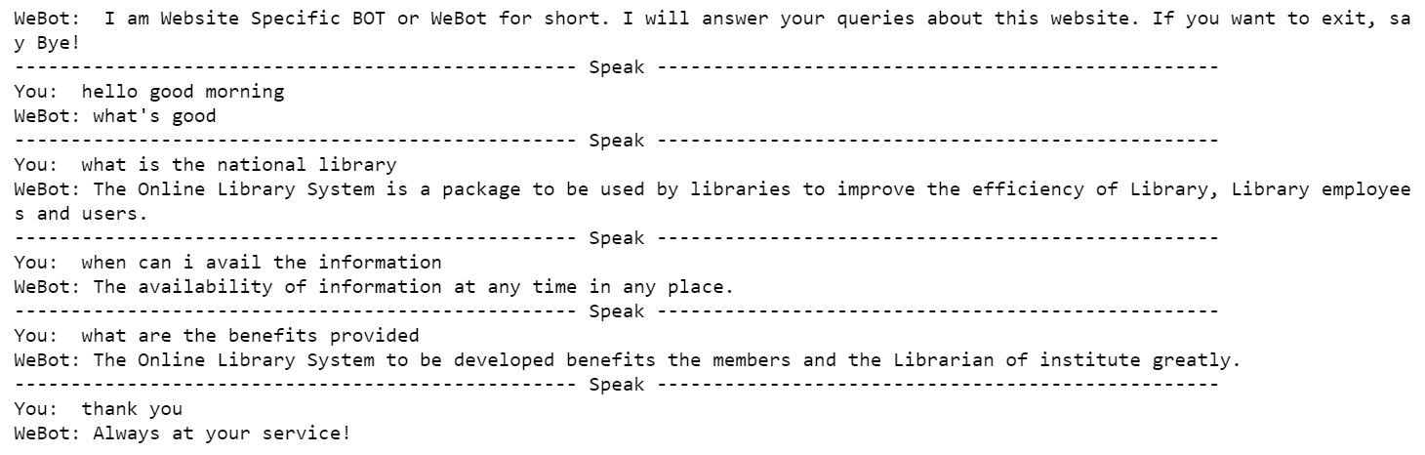
Sample - Outputs

Slide 11
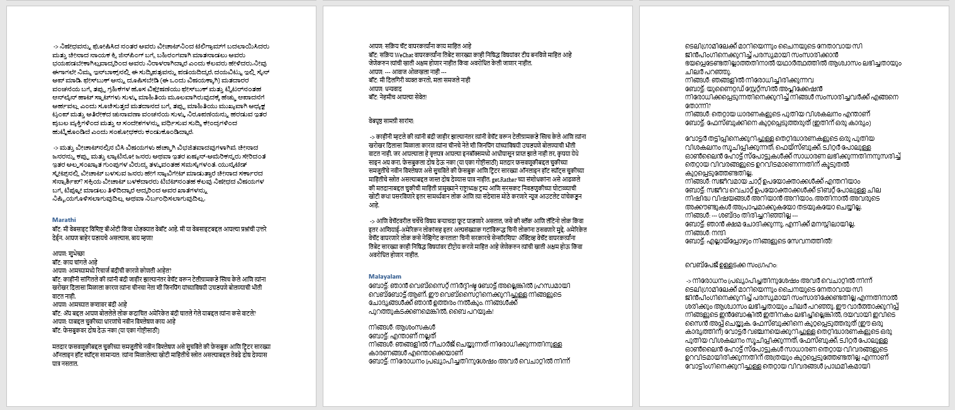
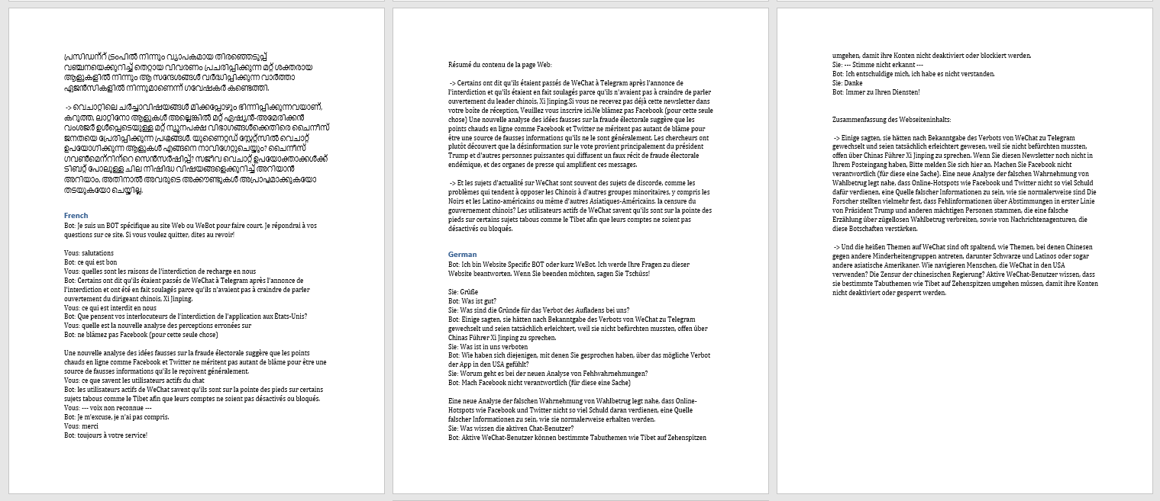
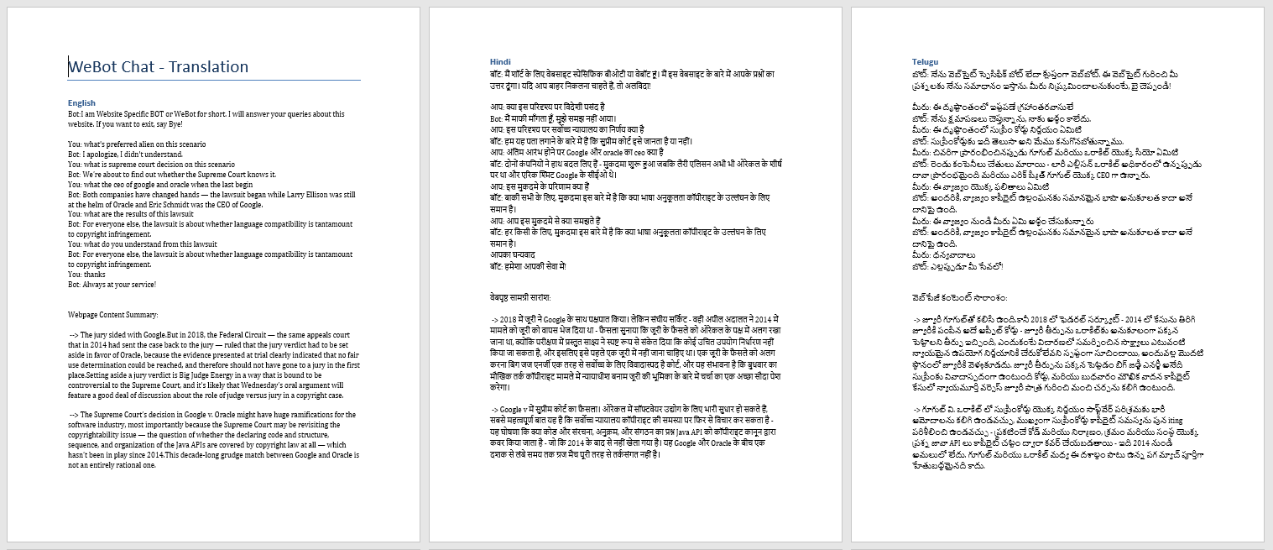
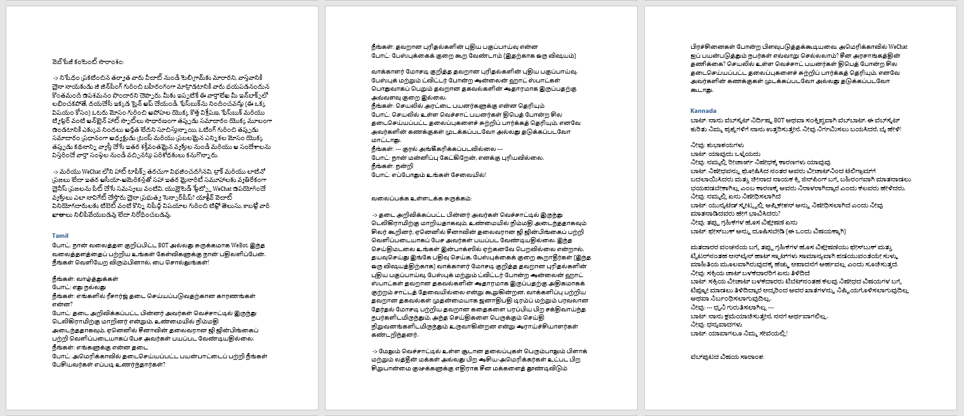
Sample - Outputs

Slide 12
References
Robin, J., 1994. Revision-based generation of natural language summaries providing historical background: corpus-based analysis, design, and implementation. Ph.D. Thesis, Columbia University.
Web Scraping with Python -- collecting data from the modern web by Ryan Mitchell
Salton, G., Singhal, A., Mitra, M., and Buckley, C. 1997. Automatic Text Structuring and Summarization. Information Processing and Management, 33(2), 193-207. Reprinted in Mani, I., and Maybury, M., eds., Advances in Automatic Text Summarization, MIT Press, pp. 341-355.
Sparck-Jones, K., and Galliers, J., 1996. Evaluating Natural Language Processing Systems: An Analysis and Review. Lecture Notes in Artificial Intelligence 1083. Springer-Verlag
Munzert, Simon. Automated Data Collection with R: A Practical Guide to Web Scraping and Text Mining. Chichester, West Sussex, United Kingdom: John Wiley & Sons Inc, 2015.

Slide 13
Thank you!

