Slide 1
DREES
An Open Source “Dose Response Explorer System”
Issam El Naqa, Gita Suneja, Patricia Lindsay, Andrew Hope, James Alaly, Jeffrey Bradley, Divya Khullar, Aditya Apte, Joseph O. Deasy
BIOR, WUSTL

Slide 2
Overview
An open-source-code Matlab-based tool for:
Modeling tumor control probability (TCP) and normal tissue complication probability (NTCP)
Evaluating robustness of models
Graphing the results for purposes of outcomes analysis for practitioners, training for residents, and hypothesis-testing for further research

Slide 3
Motivation & Objectives
Motivation
  Cornerstone of treatment planning is the need to balance tumor control probability (TCP) with normal tissue complication probability (NTCP)
Objective
  Physicians and scientists need a tool that is straightforward and flexible in the study of treatment parameters and clinical factors

Slide 4
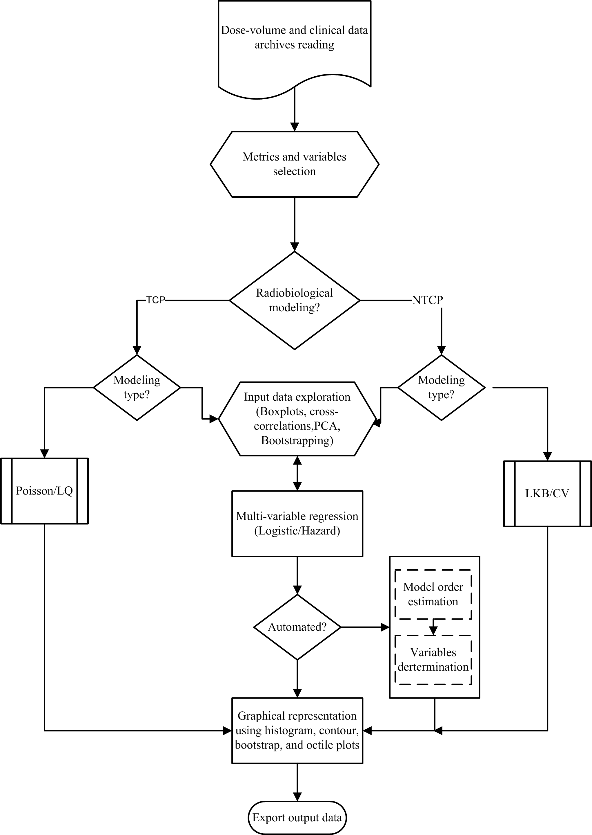
Overview (contd.)

Slide 5
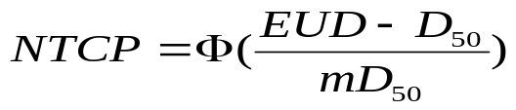
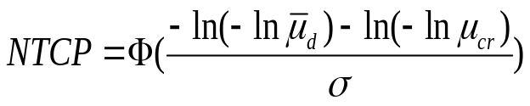
Modeling Method I: Analytical
NTCP
  Lyman-Kutcher-Burman (LKB) Model (Lyman 1985, Kutcher and Burman 1989)
  Critical Volume Model (Niemierko and Goitein 1993)
TCP
  Poisson Statistics
  Linear-quadratic (LQ) Prediction

Slide 6
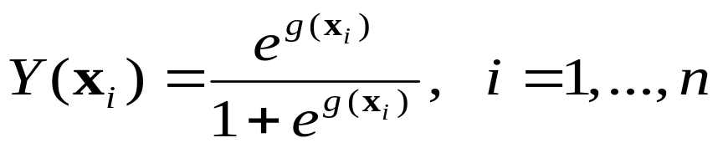
Modeling Method II: Multimetric
Logistic regression – additive sigmoid model
Two types of data exploration
  Manual
  Automated
      Determining Model Order by Leave-one-out-Cross-Validation (Ref.: “Multi-Variable Modeling of Radiotherapy Outcomes: Determining Optimal Model Size,” Deasy et al., poster SU-FF-T-376 )
      Model parameters estimated by forward selection on multiple bootstrap samples

Slide 7
Exploratory Data Analysis
Graph/Plot | Description/Function
Self-correlation | Color-washed Spearman’s cross-correlation image of selected variables and observed outcome.
Matrix plot | Observe trends, outliers.
Scatter | User selects abscissa and ordinate variables Provides user with visual cues about the discrimination ability of certain factors.
Survival curves | Use Kaplan-Meier estimates.
PCA | Dimensionality reduction technique useful to observe patterns in dataset.
Nomograms | Give optimal cutoff for selected variable. For non-actuarial analysis, it is the point corresponding to maximum change in curvature on ROC curve For actuarial analysis, it is the most significant percentile using log-rank test.
Notes:
Scatter plot – provides user with visual cues about the discrimination ability of certain factors

Slide 8
Prediction Data Analysis
Graph/Plot | Description/Function
Histogram | Cumulative plot of observed response (bar graph) and model-predicted response (line graph)
Contour | Demonstrates the effect of the model variables on shaping the predicted outcome
Octile | Patients are uniformly binned into 8 groups Helps visualized goodness of fit of model
ROC | Assess prediction power of model

Slide 9
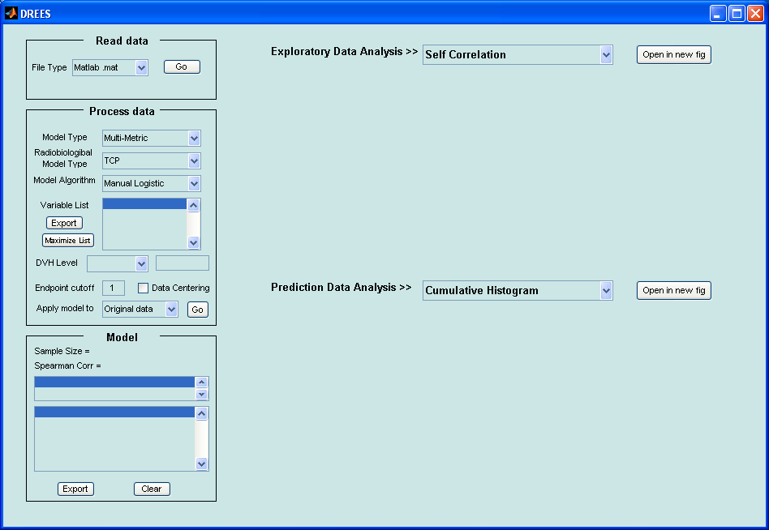
Quick start
Add DREES folder along with all the subfolders to Matlab path
To invoke the GUI type-in the command “DREES” in Matlab command window. You should see the following window appear. Now you are all set.

Slide 10

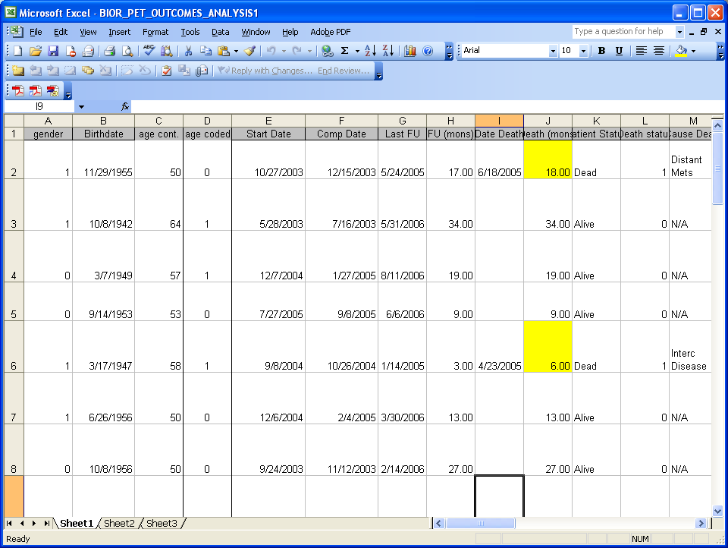
Loading data into DREES
DREES can read data from .mat or excel file
.mat file must store ddbs structure array with each field being a metric. It must contain a field named outcome indicating endpoint.
Excel file should contain data stored as shown in accompanying figure. DREES automatically omits non-numeric data during reading from excel file. It is user’s responsibility to convert non-numeric data (eg: groups) to numeric before reading into DREES.

Slide 11
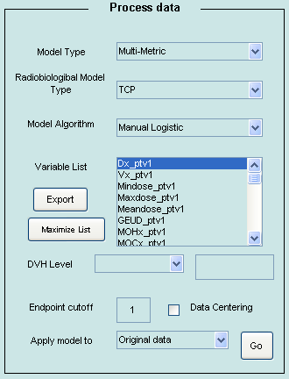
Modeling data within DREES
After reading the data into DREES, select the model Type and the modeling Algorithm.
Select the metrics you are interested in modeling. Multiple metrics can be selected by holding down Ctrl or Shift key.
Endpoint cutoff refers to the event identifier.
Hit ‘Go’ to model the selected metrics.

Slide 12
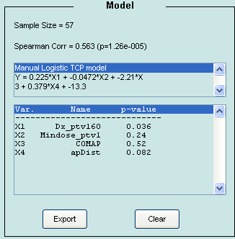
Display Model

Slide 13
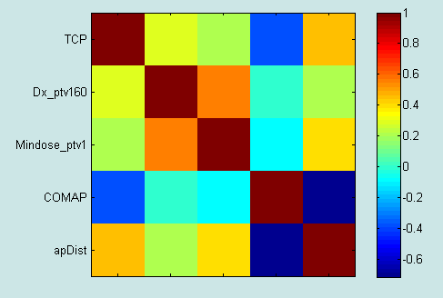
Exploratory data Analysis – Self Correlations

Slide 14
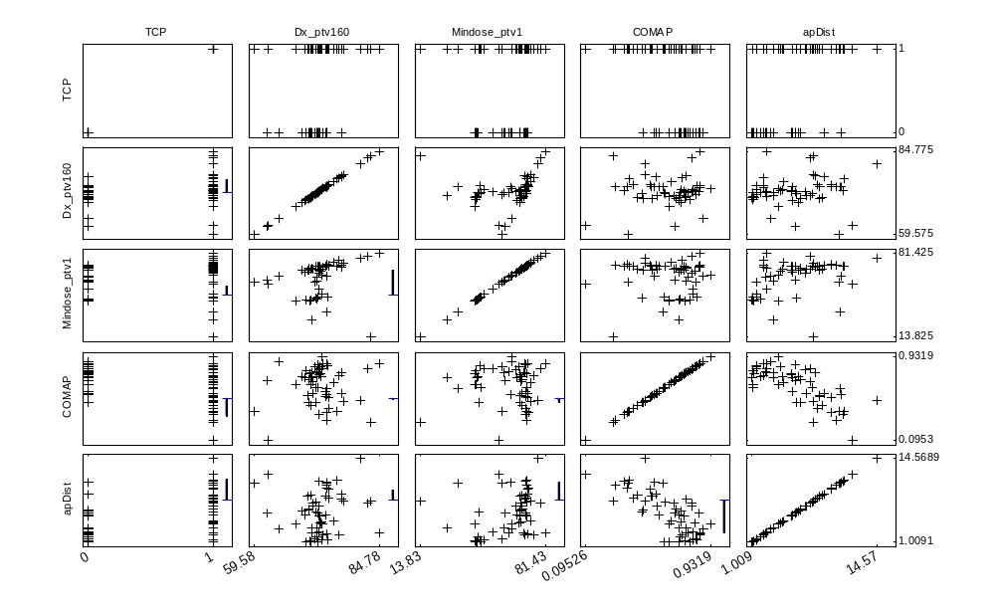
Exploratory data Analysis – Matrix plot

Slide 15
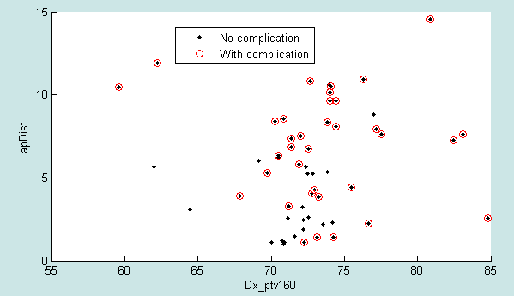
Exploratory data Analysis – Scatter plot

Slide 16
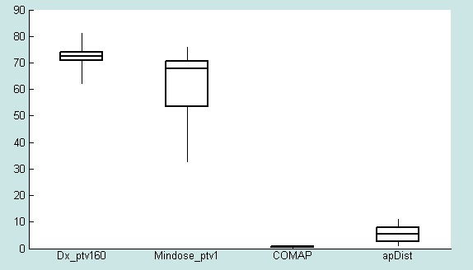
Exploratory data Analysis – Box plot

Slide 17
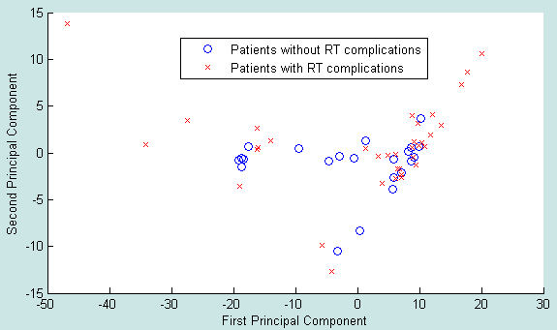
Exploratory data Analysis – PCA

Slide 18
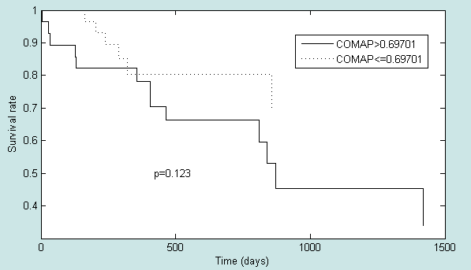
Exploratory data Analysis – Survival Curve

Slide 19
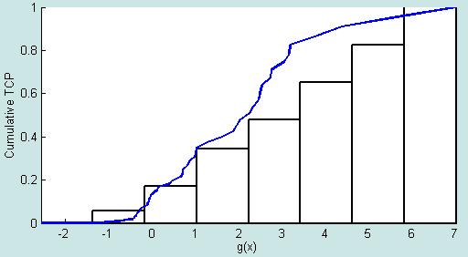
Prediction data Analysis – Cumulative Histogram

Slide 20
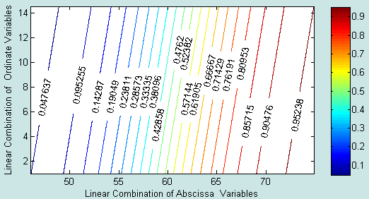
Prediction data Analysis – Contour plot

Slide 21
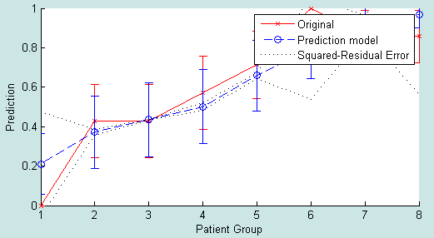
Prediction data Analysis – Octile plot

Slide 22
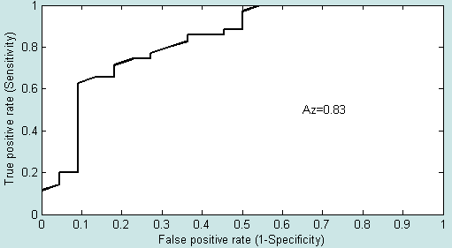
Prediction data Analysis – ROC plot

Slide 23
Conclusion
User-friendly software tool to analyze dose response effects of radiation
Incorporates treatment and clinical factors, as well as biophysical models
Various graphical representations
Software Available at http://radium.wustl.edu/drees/
Paper (El Naqa et al) can be downloaded at http://www.iop.org/EJ/abstract/0031-9155/51/22/001

