Slide 1
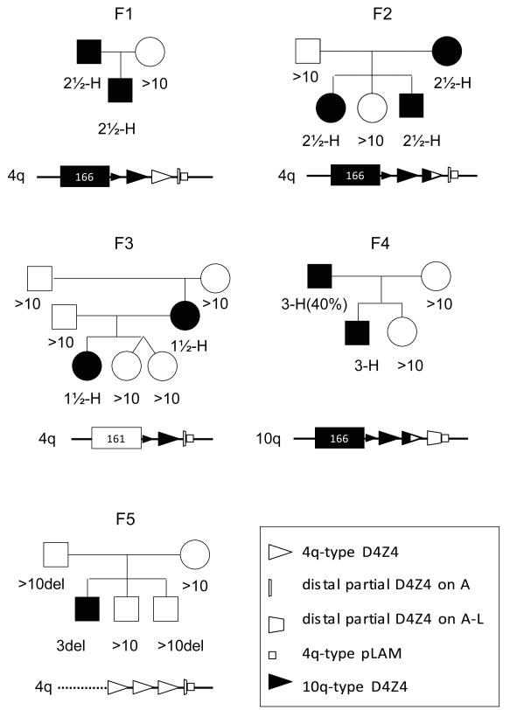
Clicker question Frequency DC
Which family do you think prompted the authors to discover the “unifying model”?
F1
F2
F3
F4
F5

Slide 2

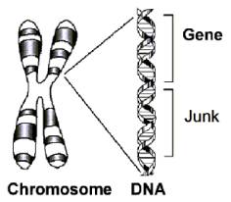
What do these have in common?
Image: http://stevemorse.org/genetealogy/dna.htmhttp://www.timeskuwait.com/Times_Tastes-that-you-can-really-taste
Notes:
http://stevemorse.org/genetealogy/dna.htm
http://www.timeskuwait.com/Times_Tastes-that-you-can-really-taste

Slide 3
A Unifying Genetic Model for Facioscapulohumeral Muscular Dystrophy
Lemmers et al 2010
Team 1: Michael Lai, Sanghoon Park, Jacob Potter, Alexander Radaoui, Miranda Sill, Noah Smith, Qetsiyah Wang, Yiwen Xie

Slide 4
Facio-scapulo-humeral
Face Upper Back Upper Arms

Slide 5
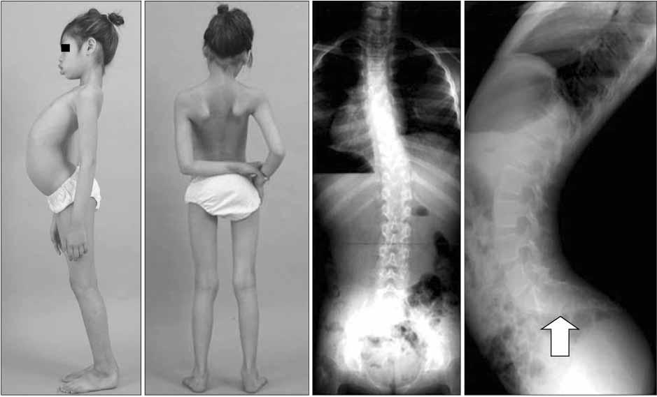
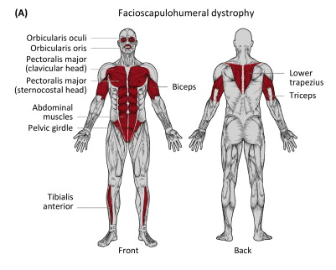
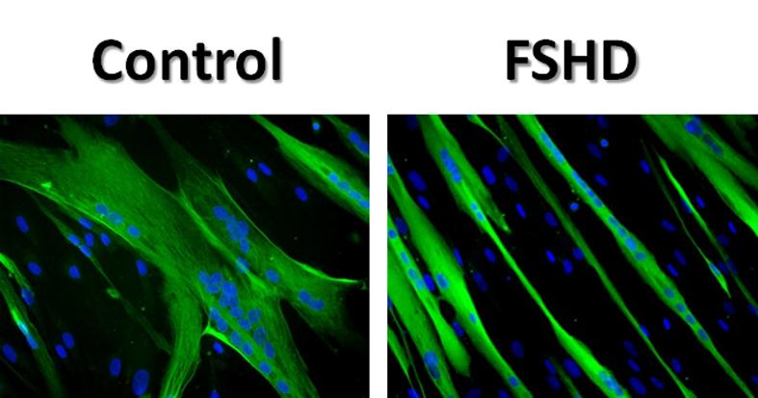
Phenotypic Changes of FSHD
Image: Science Lek et al. (Trends in Molecular Medicine)
http://u1046.edu.umontpellier.fr/version-anglaise-2/team-iii-leader-jacques-mercier/team-iii-research-topic-continued/
Notes:
1:20,000
3rd most common MD
95% manifestation by age 20
Asymmetric weakening
20% wheelchair bound
Uncommon to affect heart (arrhythmias are common) and respiratory muscle
Hearing loss, visual problems

Slide 6
What genetically is behind FSHD?

Slide 7
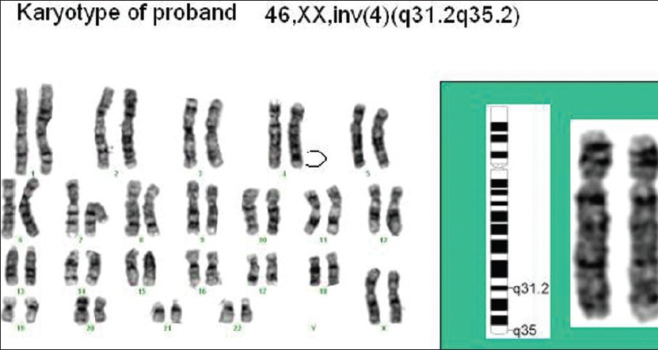
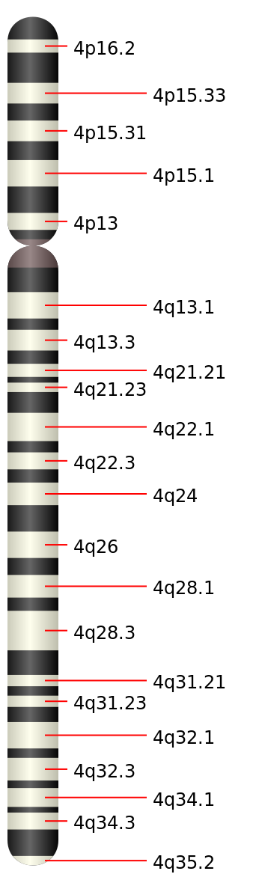
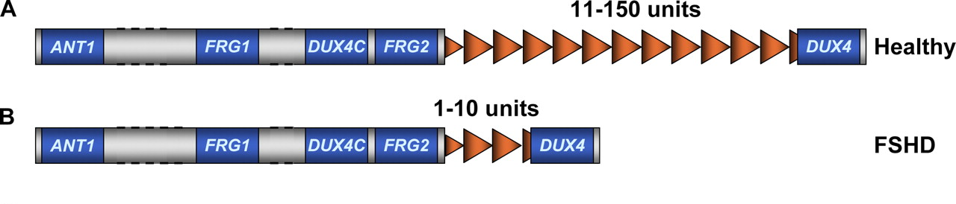
FSHD Linked to Genetic Mutation of Chromosome 4
Image: https://is.muni.cz/el/1431/podzim2011/Bi7690/FSHD__Southern_blot.txt
http://wiki.ggc.usg.edu/wiki/Facioscapulohumeral_Muscular_Dystrophy_(FSHD)
http://www.ijhg.com/article.asp?issn=0971-6866;year=2012;volume=18;issue=2;spage=238;epage=240;aulast=Lall
Notes:
1)
Known region
Autosomal dominant
2)
Sub telomeric
4q35
3)
ORF D4Z4
RTU: DUX4
Homeobox
Embryonic
Healthy only expressed then
11-150
Diseased actively transcribed adult stages
1-10

Slide 8
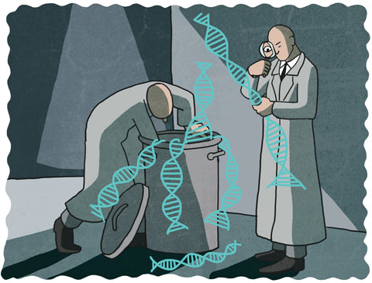
“Junk” DNA Has Functionality in Gene Expression
Image:http://mappingignorance.org/2015/06/26/not-so-junk-dna-micrornas-and-schizophrenia/
Notes:
http://mappingignorance.org/2015/06/26/not-so-junk-dna-micrornas-and-schizophrenia/
Archaic idea from 70s about how non protein coding sequences are junk, in this case they prove to have a function and as it turns out help explain the inheritance model for FSHD

Slide 9
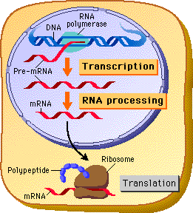
What Regulates Protein Synthesis?
Can it be transcribed?
Will it survive to translation?
How can we express a gene of interest in different cells?
Image:http://www.phschool.com/science/biology_place/biocoach/transcription/tctlpreu.html
Notes:
In diseased

Slide 10
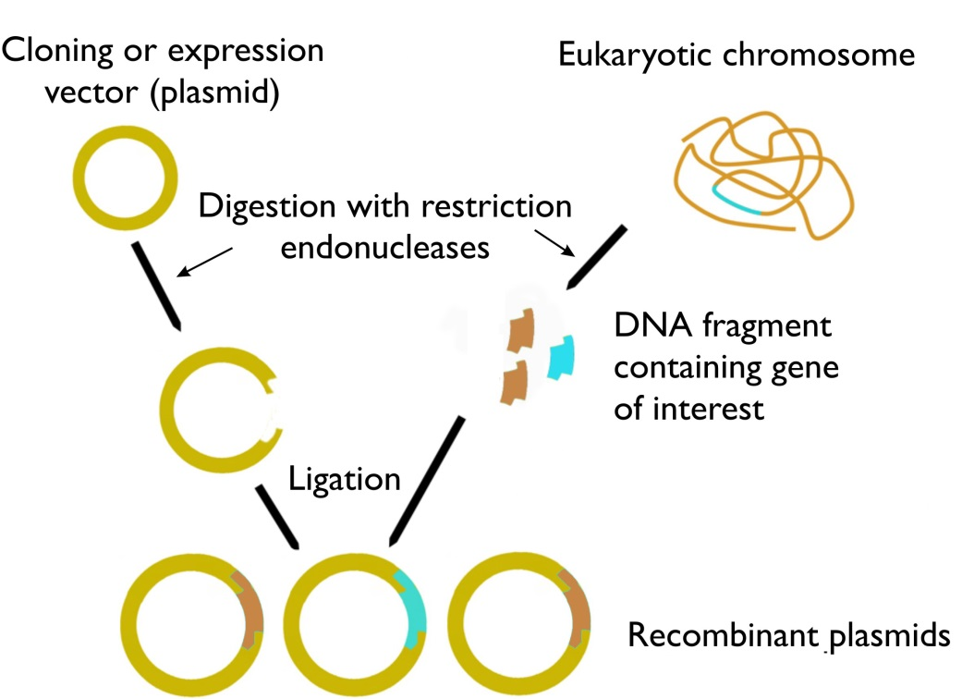
Expression Vectors

Slide 11
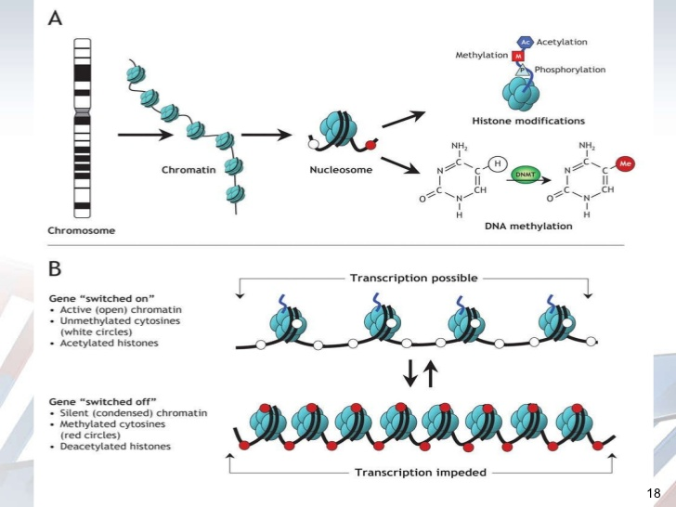
The presence and impact of methyl groups on transcription

Slide 12
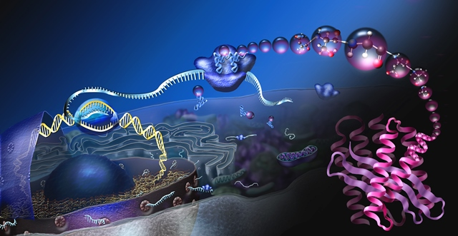
Technical Background
Lemmers et al. (2010) Science

Slide 13
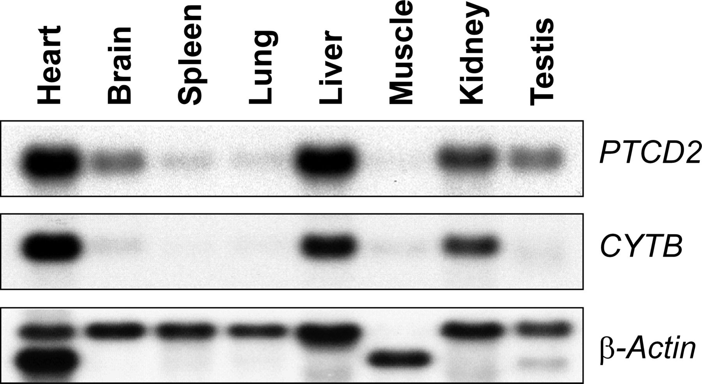
What can you conclude from the following image?
CYTB is expressed in the spleen.
PTCD2 is only expressed in the heart and liver.
Overexpression of PTCD2 and CYTB is prevalent in the heart and liver.
B-actin is overexpressed in Heart cells.
Notes:
http://www.biochemj.org/content/416/1/15

Slide 14
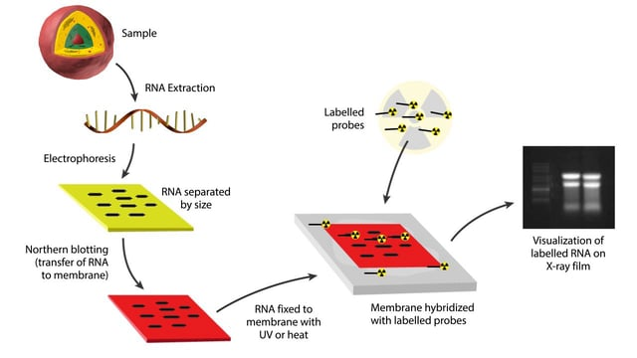
Northern Blot
Extract RNA
Prepare samples and run on a gel to separate by size
Blot the signals onto nitrocellulose membrane
Use to probe (antibody) to tag RNA.
Expose the film to luminescence

Slide 15
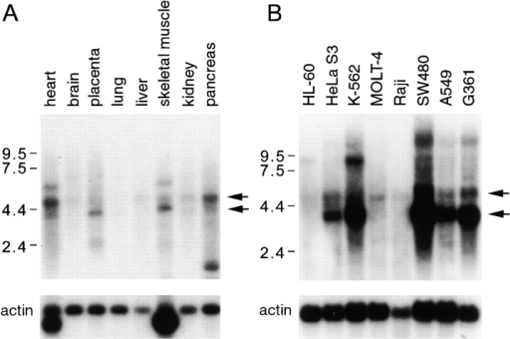
Notes:
https://openi.nlm.nih.gov/detailedresult.php?img=PMC2193003_JEM981850.f7&req=4

Slide 16
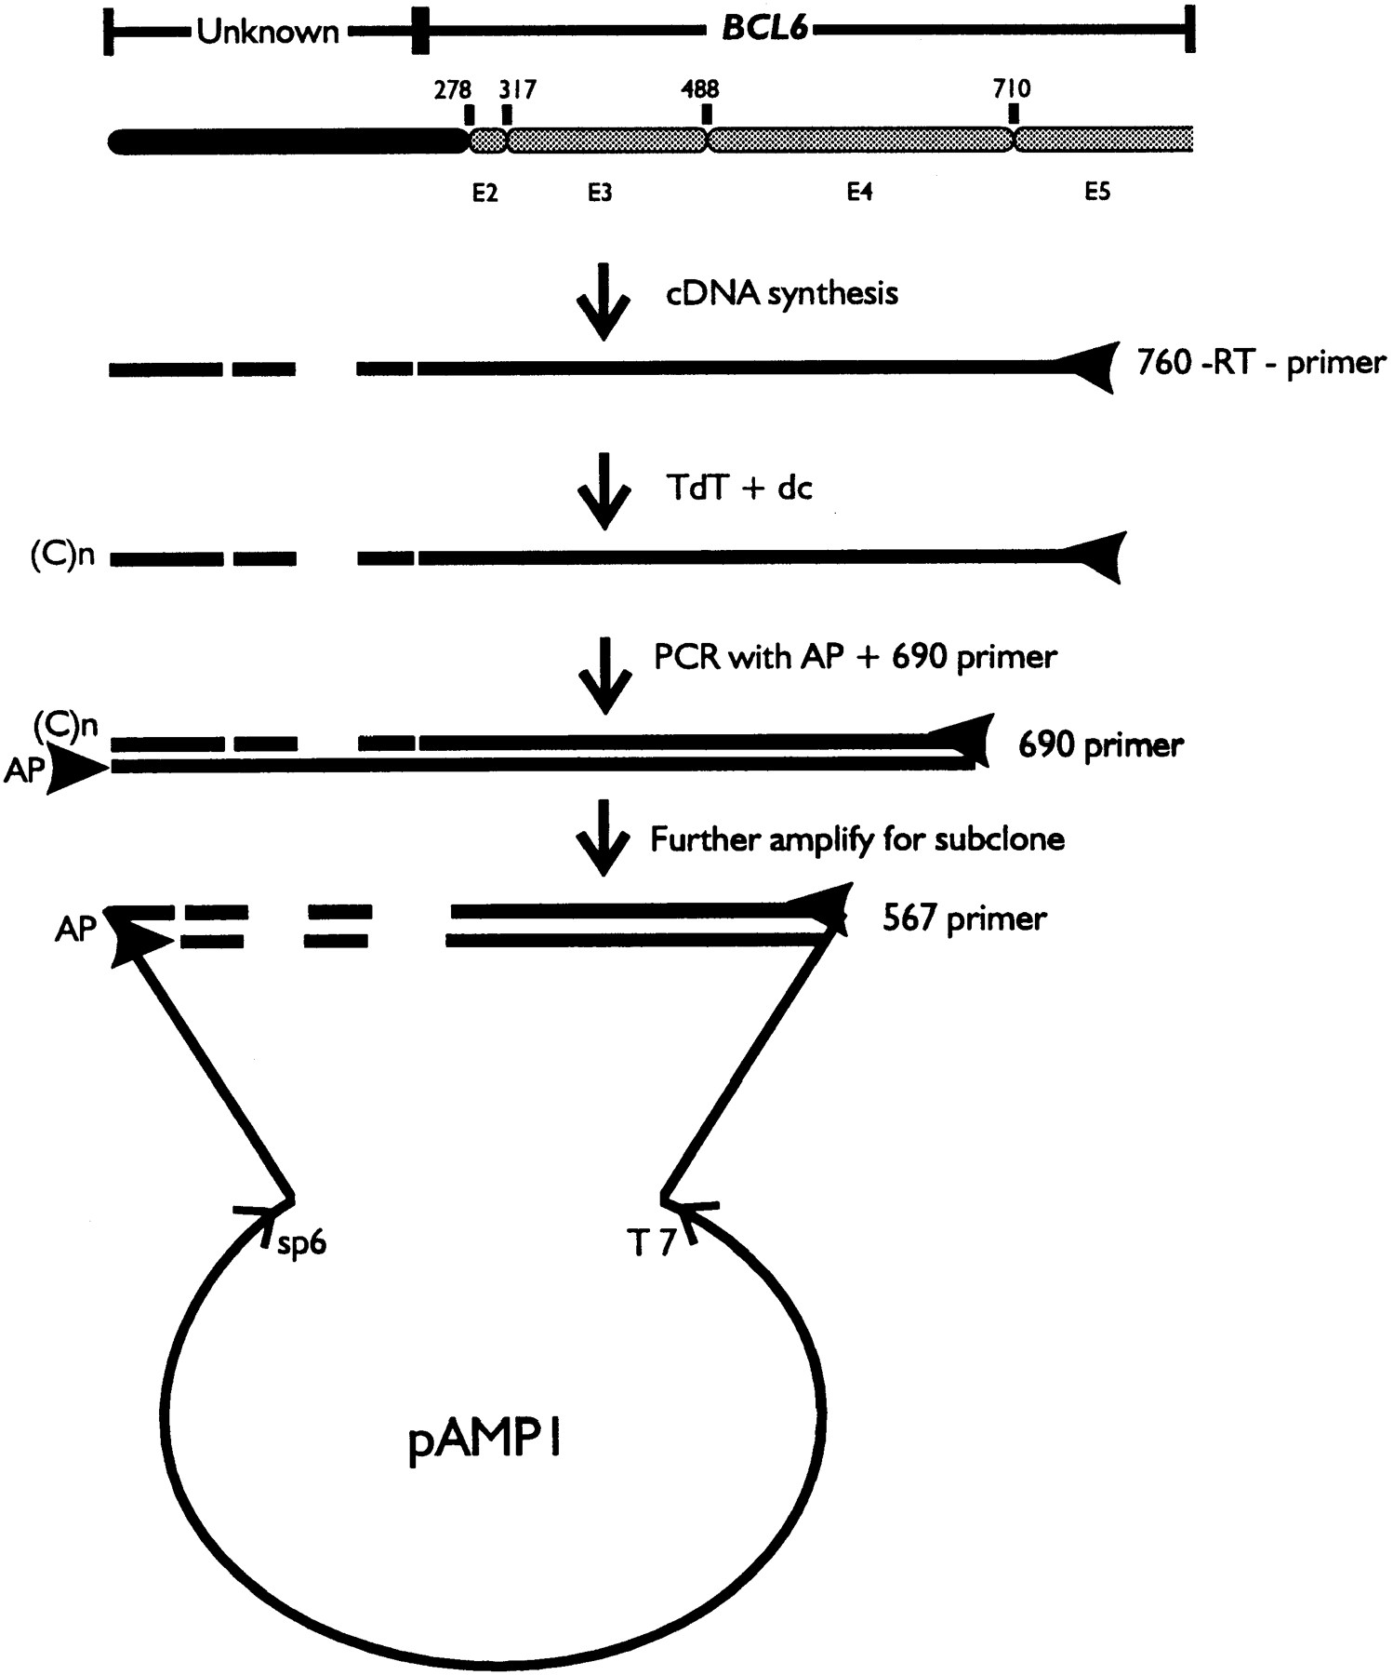
RACE → Rapid Amplification of cDNA Ends
Notes:
http://www.bloodjournal.org/content/91/2/603?sso-checked=true

Slide 17
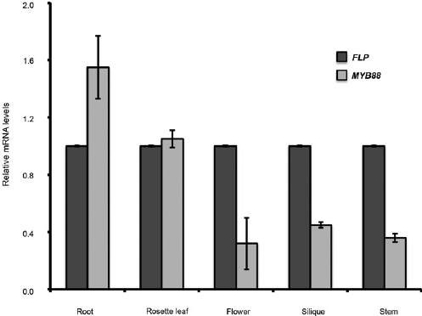
Notes:
https://www.researchgate.net/figure/281825082_fig6_FIGURE-6-RT-PCR-data-showing-that-both-FLP-and-MYB88-were-expressed

Slide 18
Big Picture: FSHD Is Caused by A Gain of Function Mutation
Mechanism of pathogenic mutation
Gain of function mutation through
Hypomethylation
Polyadenylation
Results in functional gene product
accessible DNA
Protected mRNA
Junk DNA debunked

Slide 19
Clicker question Frequency DC
Consider Figure 2A from Lemmers et al. Which statement is TRUE?
A. F1, F3 and GFP are positive controls.
B. F1, F3 and GFP are negative controls
C. F1, F3, 4A161a and 4A161b are positive controls.
D. F1, F3, 10A166a and 10A166b are positive controls.
E. F1, F3, 10A166a and 10A166b are negative controls.

Slide 20
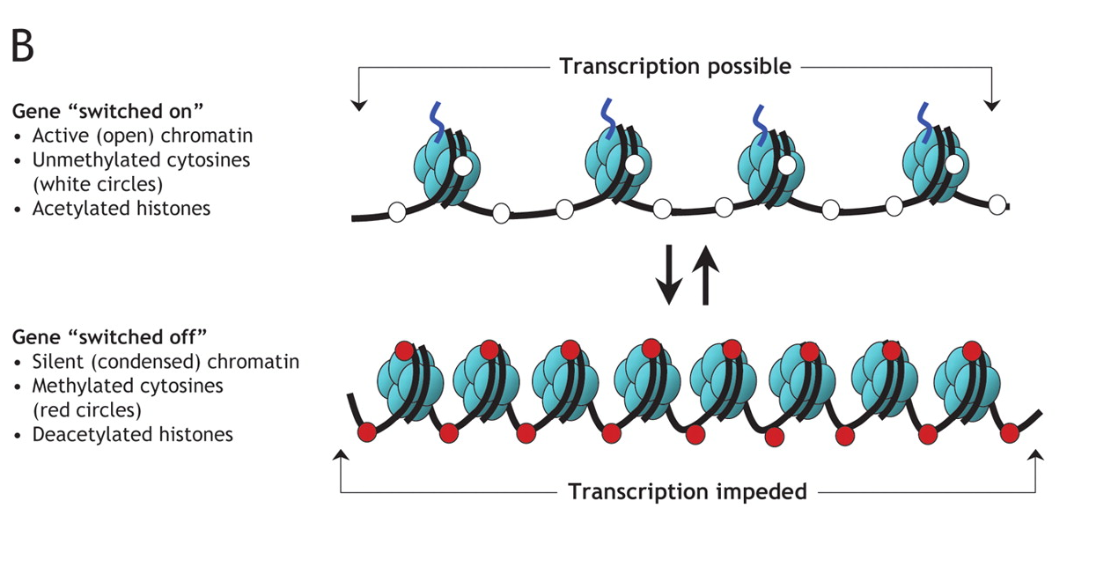
Truncation of D4Z4 Region Causes Chromatin Loosening
D4Z4
DUX4 Repetition
Unit repetition
11-100
Healthy
1-10
Pathogenic
Image:https://voer.edu.vn/m/basic-principles-of-genetics/16798649

Slide 21
Specific pLAM Sequences Cause Addition of a Poly(A) Tail
pLAM sequence required for poly(A) tail formation
Chromosome 4A: ATTAAA sequence permissive to poly(A) 4A
Chromosome 4B: pLAM not present
Chromosome 10 (non-permissive): ATCAAA
Chromosome 10A (non-permissive):ATTTAA
Poly A tail allows for stabilization of RNA
Lemmers et al. (2010) Science

Slide 22
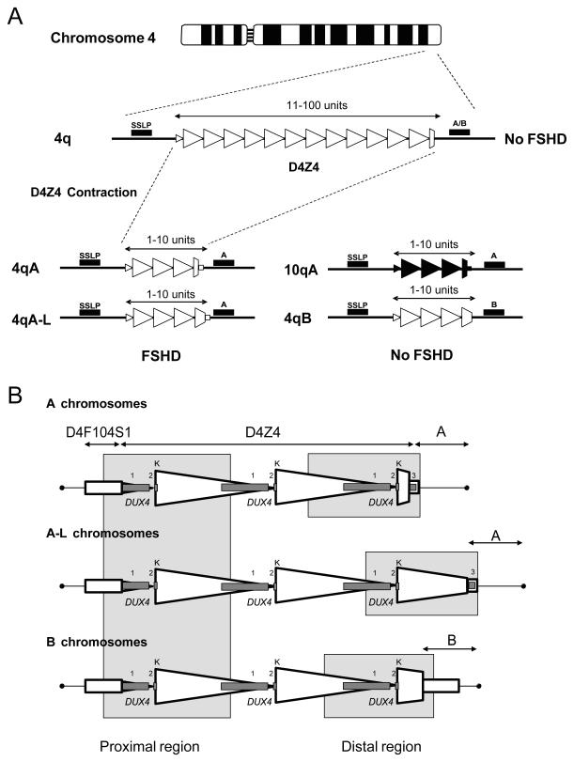
Figure 1A: The Number of Tandem Repeats Influences Presences of FSHD
Lemmers et al. (2010) Science

Slide 23
Clicker Question: If you have 7 tandem repeats in the D4Z4 reading frame will you contract FSHD?
A: Yes
B: No
C: Not Enough Information

Slide 24
Figure 1B: Mutations to DUX4 and pLAM Sequence are both Necessary for FSHD Development
Lemmers et al. (2010) Science

Slide 25
D4Z4 A Closer Look
Proximal Region
Distal Region

Slide 26
What is the Difference Between the A Chromosomes and B Chromosomes?
A Chromosomes
A-L Chromosomes
B Chromosomes

Slide 27
Clicker Question
What is the role of the pLAM sequence?
A) Preventing polymerase to synthesize further
B) Adding poly(A) tails to the transcribed RNA
C) Giving an additional codon causing the protein to misfold
D) Exposing the D4Z4 sequence to be transcribed

Slide 28
What does the pLAM sequence really do?

Slide 29
Figure 1 Highlights the Significance of Sequence Location on Chromosome 4.
What causes transcription
-Hypomethylation
Protection of RNA post transcriptionally
-PolyA tail addition
Lemmers et al. (2010) Science

Slide 30
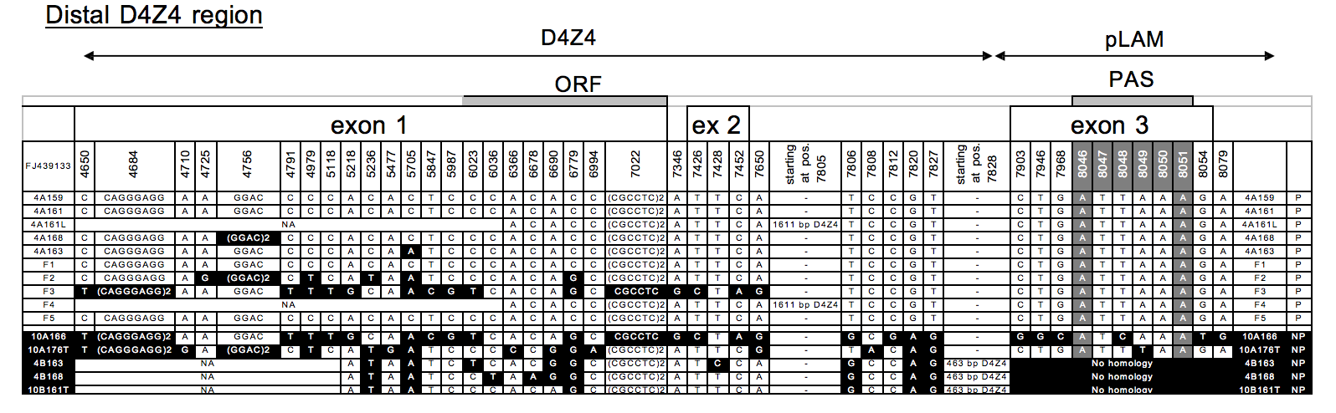
What is unique about 4A 161?
-4A 161 is expressed permissive, but 4B163 and 10A 166 chromosomes are not
-The DUX4 poly(A) signal ATTAAA is present on the permissive 4A 161 chromosome
-ATCAA sequence on chromosome 10q is not a poly (A) signal
Lemmers et al. (2010) Science

Slide 31
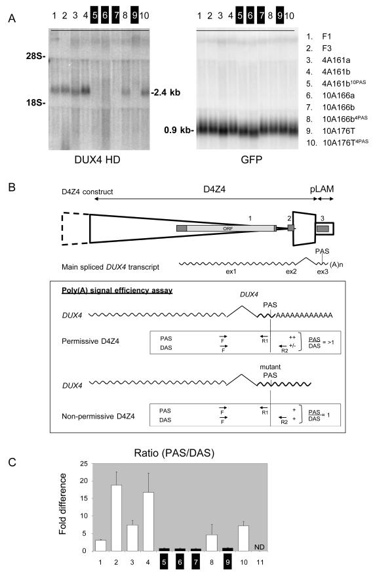
Figure 2: Poly A Tail Presence Regulates Expression of DUX4 in Myoblast Cells
Lemmers et al. (2010) Science

Slide 32
Figure 2 qRT-PCR － polymorphisms on pLAM affect distal DUX4 transcription
PAS: reverse primer Proximal to Adenylation Signal
DAS: right primer Distal to Adenylation Signal
R2 recognizes transcripts that have not been cleaved and polyadenylated
Toxic gain of function
Lemmers et al. (2010) Science

Slide 33
Figure 2
Fold Difference indicates the difference between the signal strength.
Nonpermissive Chromosomes
- PAS/DAS ratio is approximately equal to 1; fold difference approaches to 0.
- All transcripts without poly(A) tail degrade rapidly.
Permissive Chromosomes
- PAS/DAS ratio is bigger than 1.
- Contain polyadenylation efficiencies 4 -16 times higher than mutant poly(A) tail
d. The distal sequence with poly(A) signal directly affect whether FSHD express or not
Lemmers et al. (2010) Science

Slide 34
Clicker Question
Permissive chromosomes for FSHD, present much higher polyadenylation efficiencies than nonpermissive chromosomes. What does this “gain-of-function” contribute to FSHD?
Increases the stability of the distal DUX4 gene transcript.
Prevents the degradation of the mutated mRNA.
Decreases the ratio of PAS:DAS approaching to 1
A and B
All of the above

Slide 35
Conclusions of Figure 2
Nonpermissive chromosomes: PAS/DAS =1
Permissive chromosomes: PAS/DAS >1
Poly(A) signal expressed in permissive chromosome prevented the degradation from the DUX4 mRNA.
Highly efficient polyadenylation increased the stability of the distal DUX4 transcripts.
Gain-of-function characteristic involves in FSHD pathogenesis.
Lemmers et al. (2010) Science

Slide 36
Figure 3. Pedigrees of families affected by FSHD with unusual hybrid D4Z4 repeat structures
Lemmers et al. (2010) Science
Notes:
Figure 3 sums up this whole paper really well, if you are confused, hopefully this figure will clarify everything
patients shown here all had unique deletions or unusual mixtures of 4-type and 10-type subunits
There were 5 main families where each family had one or more individuals with FSHD
F1-4 had the unique mixtures of 4-type and 10-type subunits
F5 is different from F1-4, has unusual deletion
Patients in these families all presented typical FSHD symptoms, including asymmetrical facial weakness, asymmetrical shoulder muscle weakness, abdominal weakness/atrophy, and upper extremity muscle atrophy

Slide 37
Clicker Question
What would be the expected symbols to show a son with FSHD, a daughter without FSHD, and a son without FSHD?
White square, black circle, black square
Black square, white circle, white square
White circle, black square, black circle
Black circle, white square, white circle
None of the above
Notes:
B
Males (squares)
Females (circles)
Black (affected)
White (not affected)

Slide 38
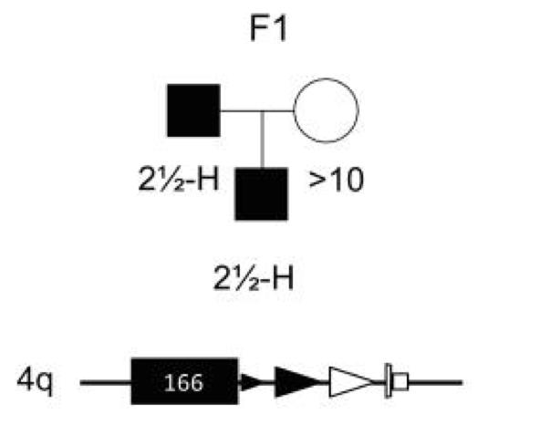
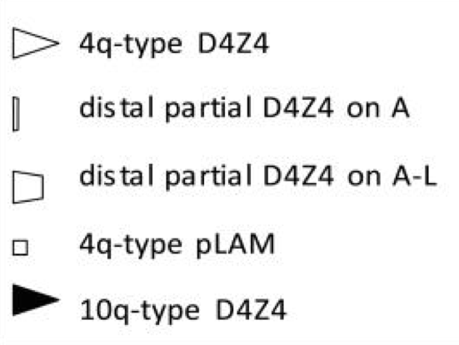
Figure 3 F1. Pedigree showing FSHD after crossover between chromosomes 4q and 10q
Lemmers et al. (2010) Science
Notes:
Father and son affected by FSHD
Has 10-type sequence on chromosome 4 with 1.5 10q-type D4Z4 repeats and 1 4q-type D4Z4 repeat
Includes a distal partial D4Z4 unit and the 4q-type pLAM sequence (important)
The FSHD seen here is produced from a crossover between chromosomes 4q and 10q
Since there are 10-type sequences and 10-type D4Z4 repeats, which shouldnt be pathogenic, why is FSHD seen?
Answer must lie in the regions that are 4-type further downstream from the 10-type D4Z4 units

Slide 39
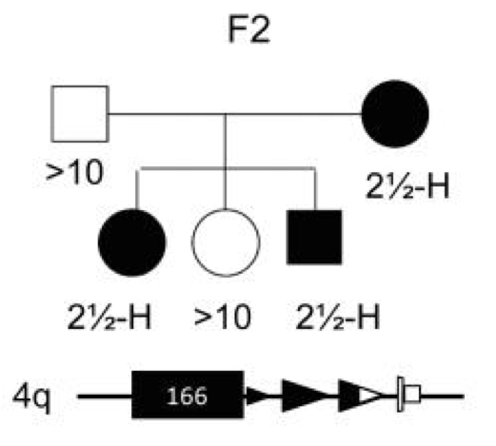
Figure 3 F2. Pedigree showing FSHD after crossover between chromosomes 4q and 10q
Lemmers et al. (2010) Science
Notes:
Mother, son, and daughter affected by FSHD
Similar to family 1, but difference is that mother in this family is affected by FSHD
Also a 10-type sequence on chromosome 4 with slightly larger 10q-type D4Z4 repeat compared to Fam 1 and slightly smaller 4q-type D4Z4 repeat
Includes a distal partial D4Z4 unit and the 4q-type pLAM sequence
Compared to F1, this shows that proportion of 10-type D4Z4 repeats to 4-type D4Z4 repeats does not affect pathogenesis
Patients in this family also produced from a crossover between chromosomes 4q and 10q

Slide 40
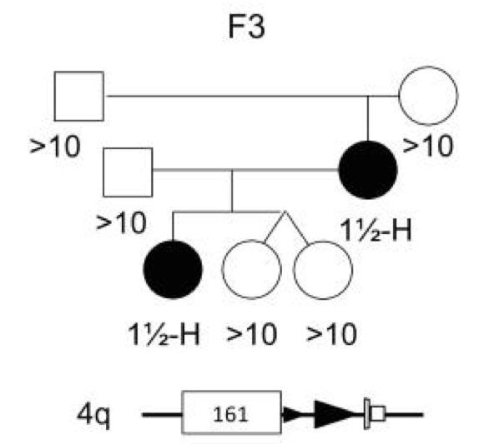
Figure 3 F3. Pedigree showing FSHD as a result of meiotic rearrangement between chromosomes 4q and 10q
Lemmers et al. (2010) Science
Notes:
Mother and daughter affected by FSHD
Mutation created by meiotic rearrangement between chromosomes 4q and 10q
1½ 10-type repeat units (black triangle) on a “permissive” 4A161 chromosome with distal D4Z4 on A unit and 4q-type pLAM sequence
All repeats were 10q-type D4Z4 repeats, further shows the type of D4Z4 repeat does not affect the pathogenesis of this disease since no 4-type D4Z4 repeats here at all
but the distal units caused the expression of the disease

Slide 41
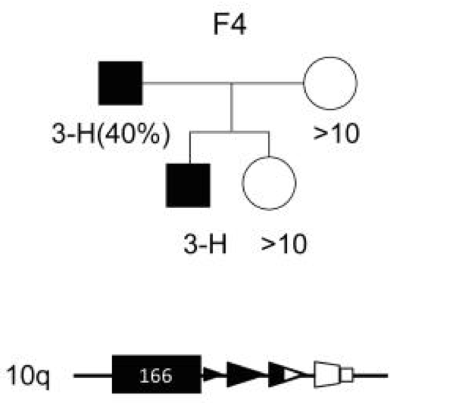
Figure 3 F4. Mosaic FSHD patient with mitotic contraction on chromosome 10q produces offspring with FSHD
Lemmers et al. (2010) Science
Notes:
Father and son affected by FSHD
Starts with 2½ 10-type repeats and ends with 1½ 4-type units, including distal partial D4Z4 unit on A-L and a 4q-type pLAM sequence
The FSHD observed here due to mitotic rearrangement - meaning this mutation occurred during cell division and embryogenesis of father
This is especially unfortunate for the son bc the mutation occurred in the cell where the father’s gametes are derived from
Most surprising about F4 is that this repeat array was found on chromosome 10, and has majority 10-type D4Z4 repeats
shows the importance of distal 4q sequences in the pathogenesis of FSHD and insignificance of sequences located upstream from the distal 4q sequences
Even when the chromosome affected was chromosome 10, the fact that it has a distal partial 4-type D4Z4 unit and the corresponding 4-type pLAM, FSHD was observed

Slide 42
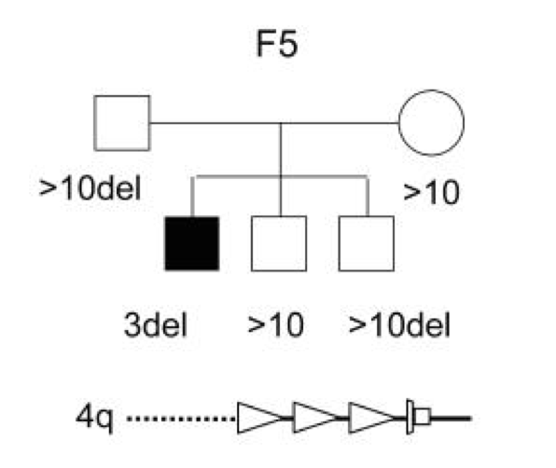
Figure 3 F5. Proximal region to D4Z4 not required for FSHD
Lemmers et al. (2010) Science
Notes:
Son affected by FSHD
Shows contraction of D4Z4 repeats, in addition to deletion of a region proximal to the D4Z4 repeat
Since the distal D4Z4 and pLAM sequence are present, FSHD was still observed
Shows proximal region to D4Z4 is not required for FSHD
Shows 2 things are necessary for FSHD: 1) the contraction of D4Z4 repeats correct distal sequence 2) the 4-type pLAM unit
Parents and siblings with the proximal region deletion still did not have FSHD because they had greater than 10 D4Z4 repeats

Slide 43
Figure 3. FSHD1 families with complex pathogenic chromosomes share the commonality of terminal 4qA repeat units and adjacent 4-type pLAM sequence
Lemmers et al. (2010) Science
Notes:
Looking back at the bigger picture, all affected members had contracted D4Z4 repeats that started with 10-type units and ended with 4-type units
Specifically a terminal 4qA/A-L repeat and adjacent 4q-type pLAM sequence
Conclusion: sequence previously referred to as “junk” (sequences after the coding region) is actually crucial for FSHD expression

Slide 44
Conclusions

Slide 45
A Backwards Paper
What brought the investigators to examine the genetics of this disease?
Notes:
Paper seemed jarring starting with a conclusion figure, only to explain itself later

Slide 46
Figure 3 F3: Something unusual is going on here
Lemmers et al. (2010) Science
Notes:
This disease was known to have autosomal dominant inheritance in the past, but an unusually large number of sporadic cases would develop.
It was probably this family that they based the premise for the research for this paper
Here it is somewhat striking to see a de novo case develop simply from meiotic rearrangement, but it gave clear data to base their tests around.

Slide 47
Figure 3. Pedigrees of families affected by FSHD with unusual hybrid D4Z4 repeat structures
Lemmers et al. (2010) Science
Notes:
From the brief sequences listed below and the presence of the disease they were able to solidify a testable hypothesis
Figure 5 is also a great point for this article, by removing the proximal region, they are able to identify the key elements for disease presentation

Slide 48
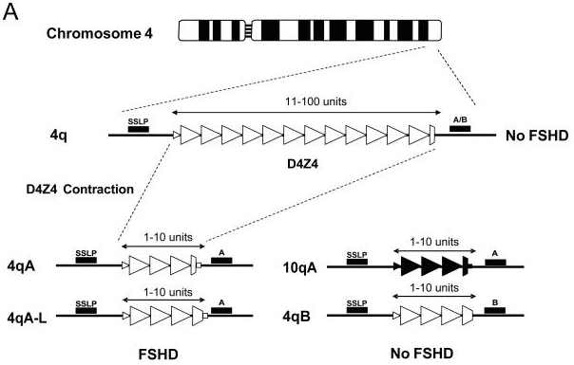
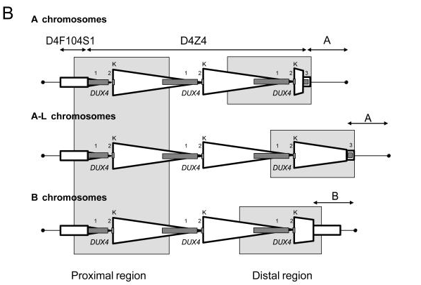
Figure 1: An Analysis of the Disease
Notes:
Here they outline the genetics of the disease
It was previously known that a contraction of the D4Z4 Repeats would lead to more active transcription of DUX4, which is present in muscle cells presenting the disease
However, DUX4 is not stable by itself, it needs to polyadenylated, which is provided by a signal called pLAM
The presence of pLAM creates a terminology they named permissive, which is the second component required for the disease
They used the information gleaned from the last two figures to create their hypothesis: That both D4Z4 contraction and presence of pLAM are requisite for the disease.

Slide 49
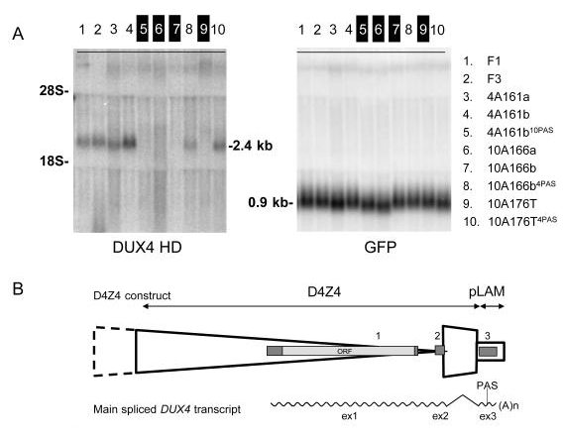
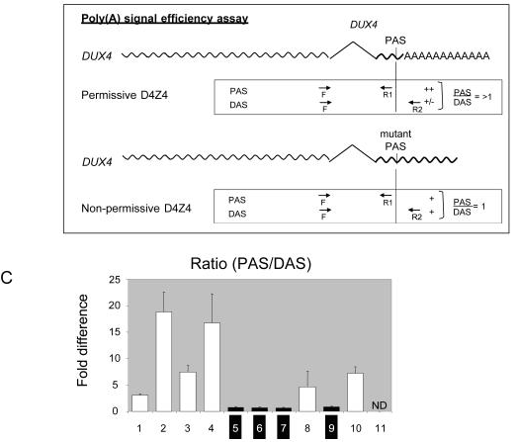
Fig 2: The Actual Data
Notes:
So far in this paper, they had not presented any real evidence of their claim, so they attempt to prove the necessity of the pLAM sequence
As a reminder: Lanes 1,2,3,4 are positive controls, 5,6,7,9 are negative controls, 8 and 10 are the actual tests
Because of a cleavable Poly A signal sequence, they were able to measure amplification of a primer sequence by a ratio
Here they showed in their two test lanes that sequences containing expressed Dux4 and the pLAM were able to successfully produce polyadenylated RNA
Because of the previous belief that Dux4 was a psuedogene, this sequence that would stabilize its transcripts lends support to their conclusions
Is this concrete evidence?

Slide 50
Conclusions
Both a contraction in D4Z4, and presence of pLAM are required for FSHD1
pLAM, a PAS, is required to increase the stability of DUX4 RNA
Meiotic rearrangements with chromosome 10 and 4 can generate FSHD1
Lemmers et al. (2010) Science
Notes:
pLAM defines permissive background, D4Z4 contraction allows for greater transcription
Meiotic rearrangements are not the only thing, but can allow for spontaneous generation of the disease

Slide 51
Clicker Question: The Conclusions
In your opinion, do you think that they provide concrete evidence underlying the nature of the disease?
Heck Yeah! They gave definitive evidence!
Eh, their evidence supported their hypothesis, but I’m not convinced
No way! The jury’s still out on this one!
I don’t know what’s going on in this paper...

Slide 52
Criticisms of the Paper
Personally, I would have picked B: I would have been more convinced if they expressed this in mice to prove it. I also would have liked more data
Do you have any gripes with the method in this paper?
Lemmers et al. (2010) Science
Notes:
Additionally, while I/We had gripes about this paper, they were later proved to be unsound, since this is now the disease model

Slide 53
Why does this all matter?
FSDH is a rare disease, but common MD
The full mechanism of this disease is unknown: piece of the puzzle
The information about FSHD1 genetics can lead to better detection
In the post CRISPR age, may lead to eventual treatments
Lemmers et al. (2010) Science

Slide 54
Howell questions

Slide 55
Clicker question Frequency DC
Consider Figure 2A from Lemmers et al. Which statement is TRUE?
A. F1, F3 and GFP are positive controls.
B. F1, F3 and GFP are negative controls
C. F1, F3, 4A161a and 4A161b are positive controls.
D. F1, F3, 10A166a and 10A166b are positive controls.
E. F1, F3, 10A166a and 10A166b are negative controls.

Slide 56
Clicker question Frequency DC
Which family do you think prompted the authors to discover the “unifying model”?
F1
F2
F3
F4
F5

Slide 57
Questions/Comments?

