Slide 1
Clinical and epidemiological features of 36 children with COVID-19 in Zhejiang, China
Jiaying Ning, Yanhao Li, Liucheng Shi, Qetsiyah Wang

Slide 2
Outline
Introduction
Study Design + Method
Results + Analysis
Strengths + Limitations
Conclusion + Policy implementation

Slide 3
Coronavirus Disease 2019
Originated from Wuhan, China in December 2019
By March 1,2020,
Spreading Rapidly and Globally
Notes:
INTRO
80981 confirmed cases in China
44067 confirmed cases in 117 countries

Slide 4
Motivation
Concern/Problem:
lack of investigation of clinical and epidemiological features of paediatric patients with Covid-19 .
A comprehensive investigation of is urgently in need for prevention and treatment of Covid-19 in children.
Why Important
Pneumonia is the leading cause of mortality in children
Children can share different clinical and epidemiological features from adult
Example:Distinctive immunological response to viral infection
Notes:
INTRO
By March 1st, no study has been done to comprehensively investigate a cohort of paediatric patients with Covid-19 and their distinctive clinical feature

Slide 5
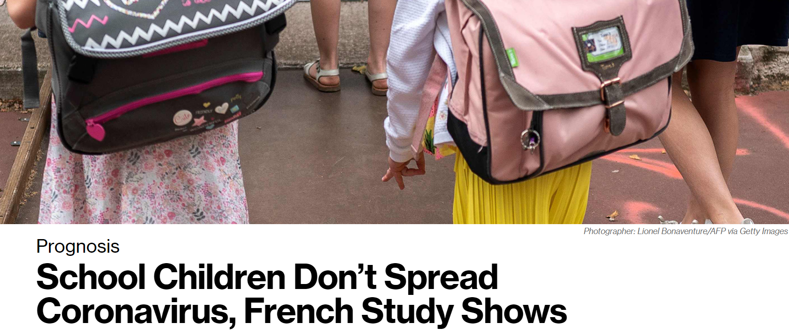

Slide 6
Study Population
Children and adolescents
Milder symptoms
Asymptomatic
Community transmission mode
Few studies
Adults
Notable diseases
Easy identification
Higher mortality rate
Many studies
Research question: Are children immune to Covid-19?
What are the clinical features associated with pediatric patients compared with other groups?

Slide 7
Eligibility / Accessibility
36 pediatric patients from three hospitals located in Zhejiang Province
900 km from Wuhan
Cases at hand
Age 0-16
Ten(28%) patients were asymptomatic
All participants enrolled with PCR- confirmed COVID-19
History of exposure to epidemic area - 33%
Family members with COVID-19 - 89 %
Both - 22%

Slide 8
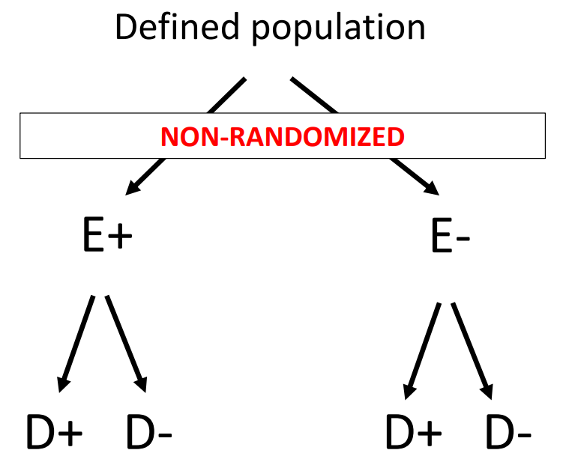
Study Design: Cohort Study
“We did an observational cohort study at three hospitals...”
Really? How do we define cohort study?
Subjects are defined according to their exposure levels and followed over time to determine disease occurrence

Slide 9
Study Design: Case-series Study
...of these cases… was either by close contact with family members with COVID-19 (32 [89%]) or a history of exposure to epidemic areas (12 [33%]), or both (eight [22%])...
Study that tracks subjects with a known exposure or examines their medical records for exposure and outcome.
Pros: time-saving, easy to conduct (outbreak)
Cons: especially vulnerable to selection bias (internal validity)

Slide 10


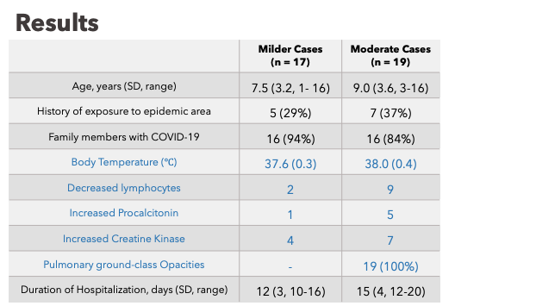
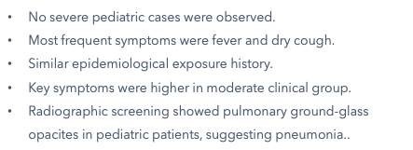

Slide 11
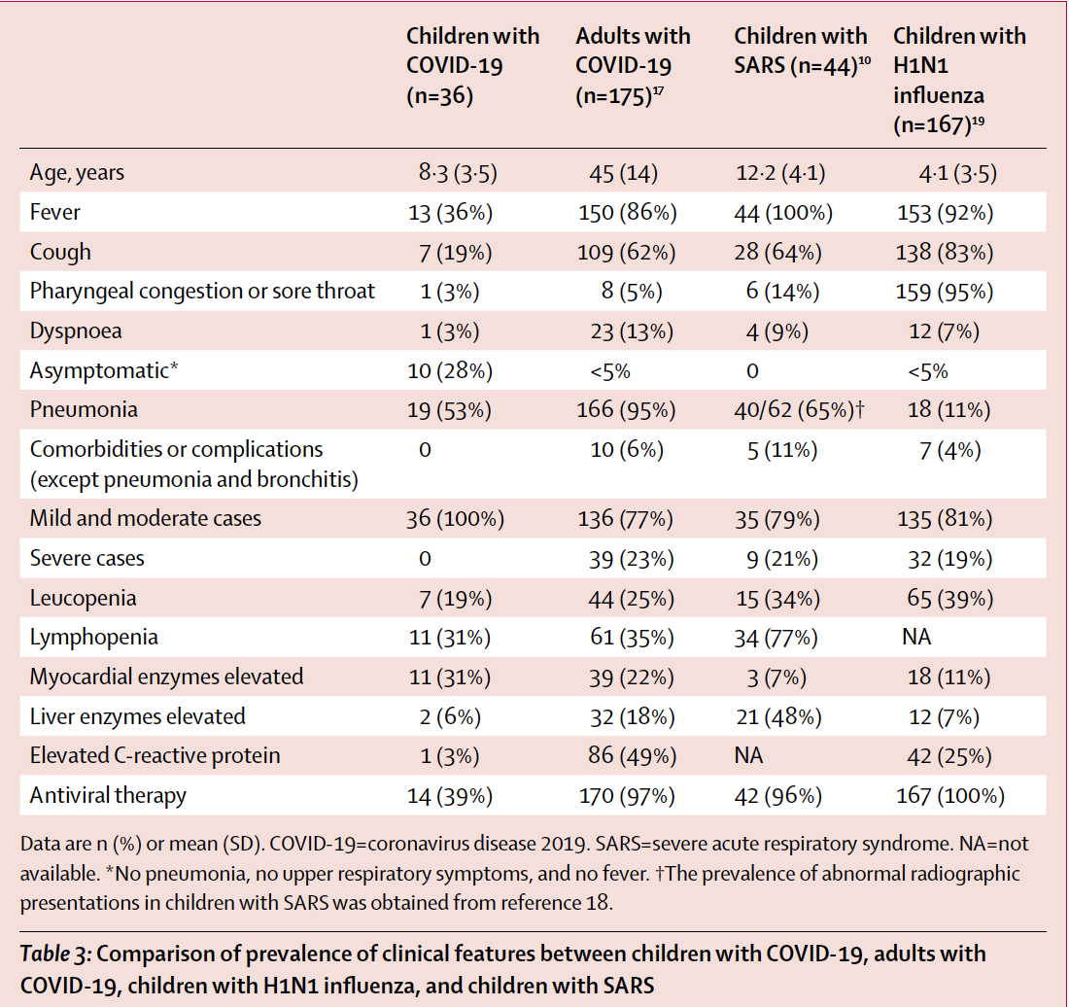
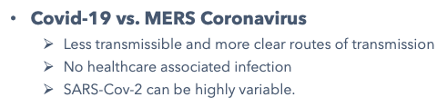
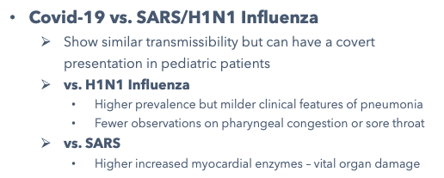

Slide 12
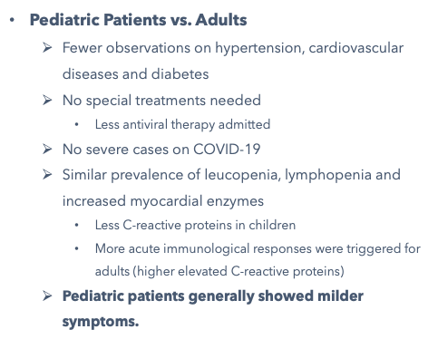

Slide 13
Strength
Limitation
Provide early report of detailed and comprehensive information on paediatric patients
Comparable group between adult and children
Result consistent within the study and with several reports on children with Covid 19
Problem with Generalization
Small Sample Size
All diagnosed with Covid-19 in the beginning of study
Vague Exposure Definition

Slide 14
Conclusion
Fever, cough, pneumonia were the most common signs
children have milder clinical manifestations -- possibly due to special interaction between immune system and respiratory system
Nearly half of paediatric patients were asymptomatic
Application
Identification for infected children is challenging
Children might serve as the facilitators of viral transmission -- social distancing

Slide 15
Q & A
1. Do you think the current result of study have good generalizability? Why?
2. Mentioned in the article, asymptomatic children can be potential threats for the community-infection? What is a underlying problem you think resided in this study?
3. What kind of selection bias would you consider in this study?
4. Should the investigators have reported the RR and RD?

