Slide 1
Design a simulation study to compare variable selection methods
Liucheng Shi, Qetsiyah Wang, Ling Tuo, Ruwen Zhou

Slide 2
Data Simulation

Slide 3
About X
Predictors | Criteria
Strong signals (S_1)
Weak-But-Correlated signals (S_wbc)
Weak and independent signals (S_3)

Slide 4

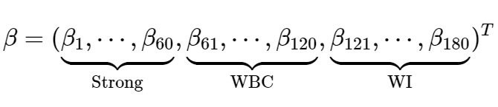
About Y

Slide 5

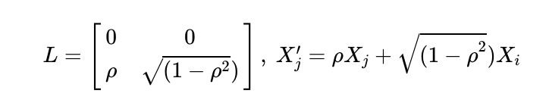
Weak But Correlated
Cholesky decomposition:
Denote Xj is the n × 1 column vector, uncorrelated sequence Xj’

Slide 6
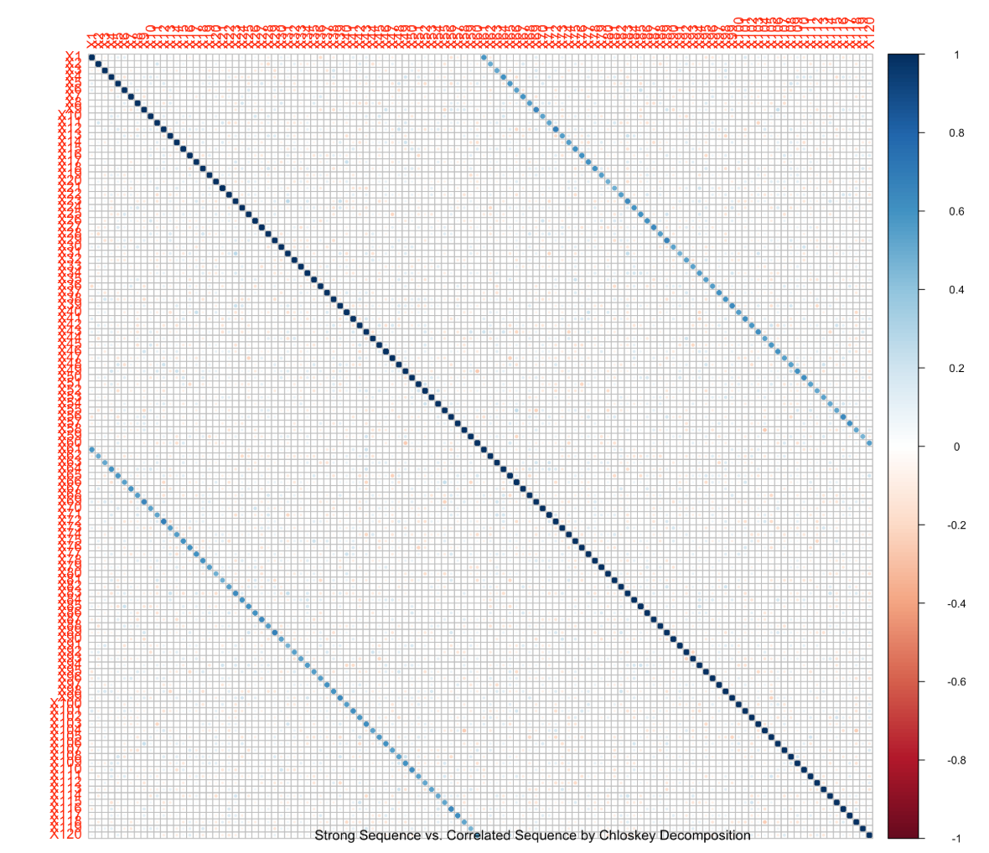
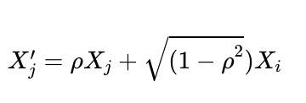
Weak But Correlated
Notes:
Following the algorithms of the Choleskey decomposition, weak-but-correlated sequence are generated by using one of predictors from the strong sample in order as x1 in the formula, and one wbc predictor as X2 that would have no contribution to newly generated correlated sequence.

Slide 7
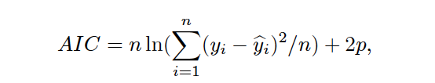
Stepwise Forward Method
One of Automatic Search Procedure
Start with the empty model. Enter the first predictor with the lowest p-value < Alpha-to-Enter
Add a new variable, rerun the regression model and compare p-value
Continue the procedure until new additional variable does not yield a desired p-value with the pre-specified significance level. (p-value > Alpha-to- Enter)
Akaike Information Criterion (AIC)
Identify BEST SUBSET
Choose the model with the smallest value

Slide 8
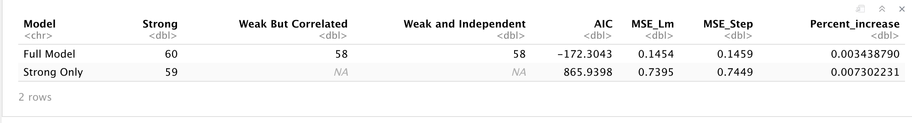
Stepwise Forward Method
Full Model vs. Strong only
Full Model
Delete 2 WBC and 2 WI
MSE increases 0.3%
Variable selection does not fit initial expectation
Strong Only Model
Delete 1 variable
MSE increases 0.7%
4x higher than Full Model
Weak predictors have contributions
Notes:
Full model: aic. -170; all strong 2 wbc, 1wi, decrease 1.7% from lm
Mention AIC

Slide 9
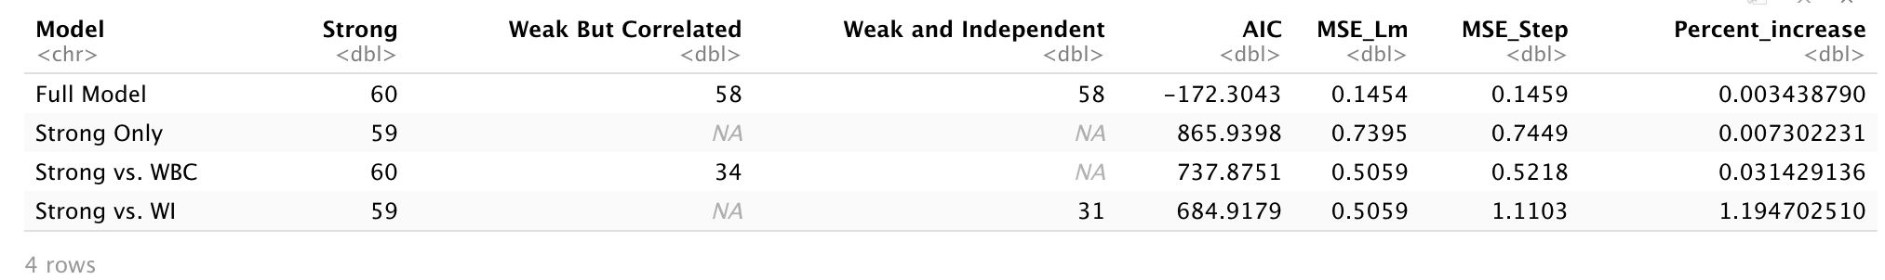
Stepwise Forward
Strong vs. WBC
94 out of 120 variables
Keep all Strong predictors
MSE increases 3% after Stepwise
Multicollinearity
vs. Strong only Model
MSE-Step decreases 30%
Lm-MSE decreases 32%
Enhance the GoF
Multicollinearity
Inflate the variance of regression coefficients
Result in insignificant regression model
vs. Stepwise Forward
Hard to differentiate highly correlated variables
Not ideal variable selection
Notes:
Strong versus wbc: multicollineraity impacts the variable selection efficacy.

Slide 10
Stepwise Forward Method
Strong vs. WI
90 out of 120 variables
Delete 1 Strong predictors
MSE increases 19% after Stepwise
vs. Strong only Model
MSE increases 49%
Lm-MSE decreases 32%
No impact of collinearity and independence due to weak coefficients
Preserve undesired Predictors
MSE increases
Abuses of P-value
Inflate the type-I error
Too blind for choosing the best subset
Too dependent on p-value
May abandon useful variables

Slide 11
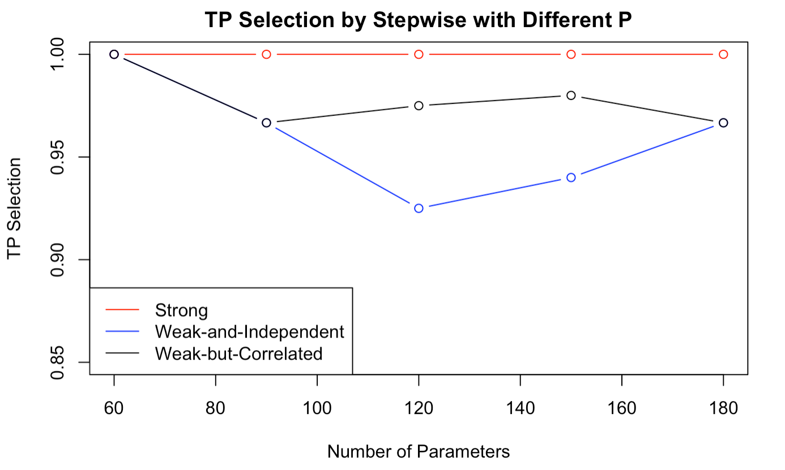
Different Number of P
No impact on strong predictors
Weak-but-Correlated Predictors
Maintain variable selection
Weak-and-Independent Predictors
Starting with p = 120, more WI are preserved in the final model
Type-I error increases
Notes:
However, for WBC, the selection trend is very strange.

Slide 12
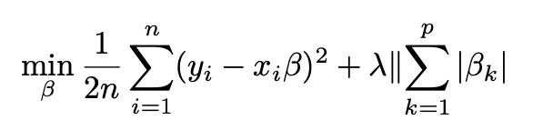
LASSO
LASSO (least absolute shrinkage and selection operator) is a regression analysis method that performs both variable selection and regularization in order to enhance the prediction accuracy and interpretability of the resulting statistical model. It estimates the model parameters by optimizing a penalized loss function
We use 10-fold CV and taking MSE as measurement to acquire better fitted model and optimal λ. Though lambda.min is related to the minimum mse, it reserves redundant variables. In this case, we choose lambda under one standard error, which gives the better fitted model with less predictors.

Slide 13
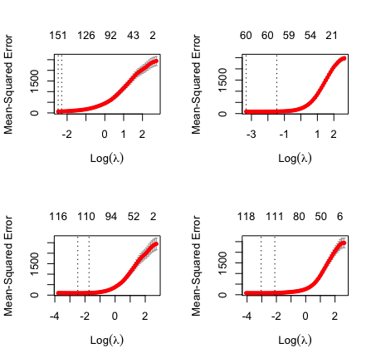
LASSO Regression
Full model -- 60 strong signals, 60 weak-but-correlated signals and 60 weak-and-independent signals:
All the strong signals are left, 13 wbc predictors and 21 wi predictors are dropped.
Strong only model -- 60 strong:
no predictor is dropped.
Strong and wbc model -- 60 strong + 60 wbc:
12 wbc predictors are dropped.
Strong and wi model -- 60 strong + 60 wi:
9 wi predictors are dropped.
Full model
Strong only
Well distinguished strong and weak predictors in high dimensional data.
Strong&wbc
Strong&wi

Slide 14
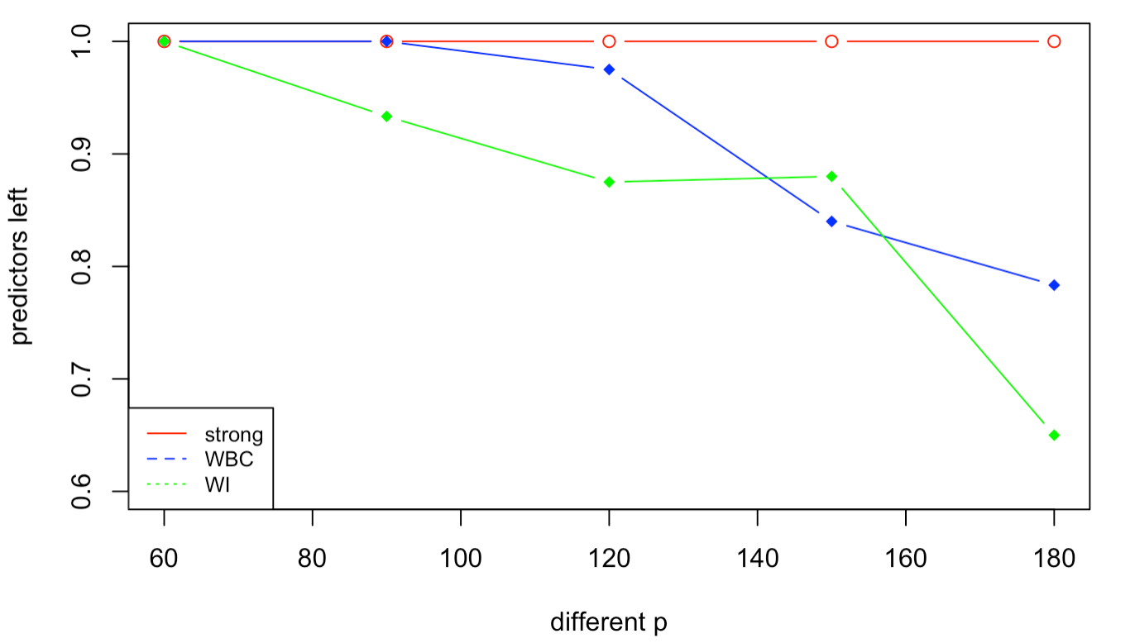
Different Number of P
We chose different p from 60, 90, 120, 150, 180. We found that, as dimension increases, LASSO is able to deal with higher dimensional data, distinguish between strong and weak signals more accurately and dropped more weak predictors.

Slide 15
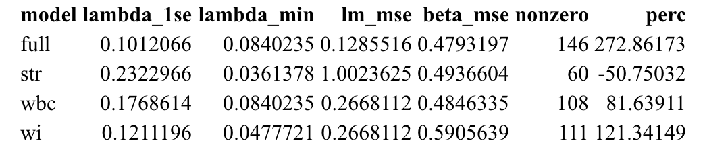
Summary of Lasso Method
From the result of LASSO regression, we believe that it can well distinguish strong and weak predictors by leaving all the strong predictors and eliminating more weak predictors.
Among these three signals, weak-and-independent signals are the least related with our estimation while we found that weak-but-correlated signals impact more on the estimate of strong predictors. It indicates that although involving weak predictors can reduce MSE, i.e. increase accuracy of beta estimation and improve the model, there’s no need to keep them as much as possible (especially wi).

Slide 16
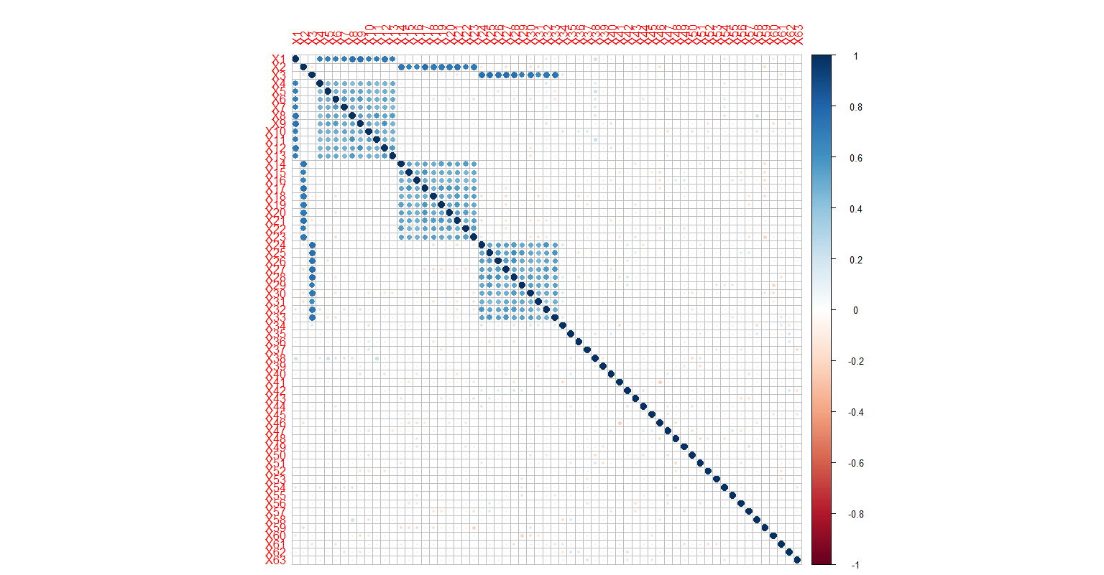
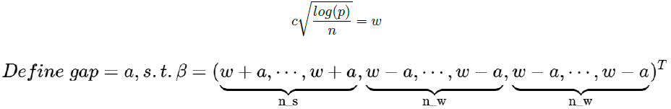
Extreme beta comparison

Slide 17
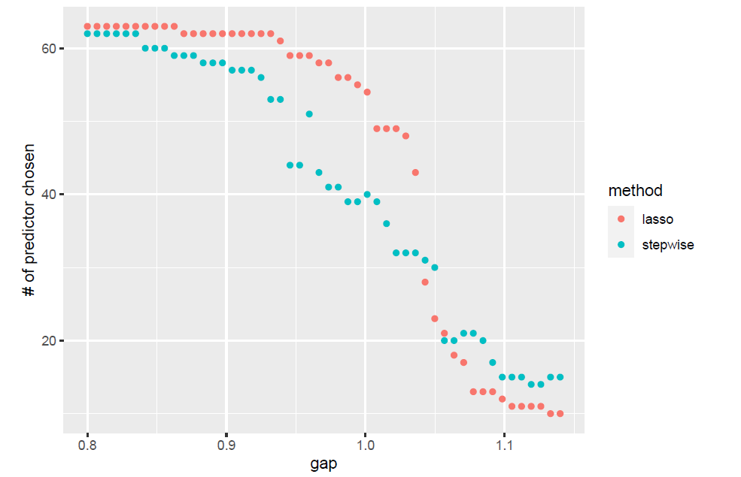
Extreme beta comparison
Lasso outperformed AIC.

Slide 18
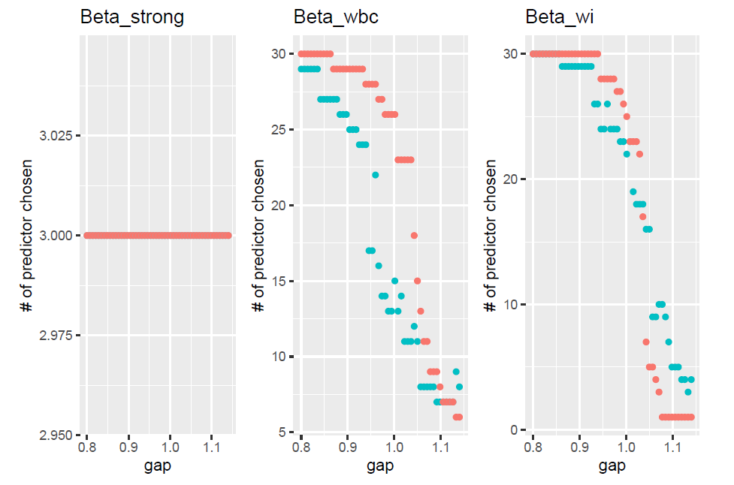
Extreme beta comparison
Lasso is more optimal to detect and preserve wbc signals.
Stepwise Forward tends to preserve more WI signals implying its selection nature.

Slide 19
Results

Slide 20
Comparison between Stepwise and LASSO
LASSO model is more statistically significant than stepwise model and better distinguished strong and weak predictors.
LASSO uses a tuning parameter to penalize the number of parameters in the model. It uses a complicated iterative process, which is done by cross validation so as to minimize the MSE of prediction to choose this parameter.
When p > n, stepwise model left all parameters and caused over-fitting. Overfitting is remedied using split sample cross validation and therefore, LASSO can estimate models in which p > n.
We calculated the MSE between linear model and models after variable selections. Although the MSE of models are not always decreasing after variable selections, comparing between LASSO and Stepwise method, LASSO contributes more on reducing MSE.
When p > 120, due to inflated type-I error, Stepwise tends to preserve more WI predictors, decreasing the efficacy of variable selection. While Lasso eliminates more WI when p> 120.

Slide 21
Thanks for Watching

