Slide 1
The master’s dungeon survival
Yanzhi Wang

Slide 2
Introduction
1. Game Genre
2D Dungeon Exploration and Adventure
2. Game Content (Gameplay)
①. The game will be released on Android platform with dual joystick control, the left joystick controls movement while the right joystick controls bullet direction.
②. The game progresses through dungeon exploration with multiple levels. Each level will have several rooms with random monster spawns or teleport points. After defeating each boss, players can proceed to the next level until they reach the final boss and complete the game.

Slide 3
Introduction
3. Game Features (Distinctive Elements)
①. Equipment system with three types of equipment: accessories, armor, and shoes. Accessories increase attack power, armor increases maximum health, and shoes increase movement speed. Equipment can have five different qualities: white, green, blue, purple, and orange.
②. Attribute system with seven different attributes: health, attack power, defense (damage reduction), attack speed, health recovery speed, critical hit rate, and critical hit damage. Players can upgrade these attributes using gold obtained from killing monsters.
③. Shop system with 36 different types of equipment, including accessories, armor, and shoes with five qualities each. Each equipment has unique attributes and descriptions. The attribute system and shop system are independent. The attribute system uses gold for upgrades while the shop system uses weapon fragments obtained from dismantling weapons. Players cannot buy equipment at the beginning, but once they obtain the equipment, they will permanently unlock the purchase option. The shop system is not reset when starting a new game.

Slide 4
Introduction
4. Backpack system: Items picked up in the game scene will be stored in the backpack, where players can view detailed properties and descriptions of weapons they possess. Each weapon can be either used or dismantled, with dismantling yielding weapon shards. Shards can be used to purchase unlocked items in the shop.
5. Map system: Different maps are generated for each level, and each game session starts with a new scene. Monsters in the scene are randomly generated based on the current level. The map also includes a mini-map that marks explored rooms and helps players find unexplored rooms.
6. Instance system: Two instances, Heaven and Hell, are set up for players to earn gold. Monsters in Heaven have less health and lower attack power, while those in Hell have more health and higher attack power. Instances are randomly generated in game rooms, with one to three trial rooms per level. Players who enter a trial room will be randomly teleported to Heaven or Hell. After killing ten monsters, a portal will appear, allowing players to choose to continue fighting or return to the game room.

Slide 5
Introduction
7. Monster system: There are over 20 different types of monsters, each with its own state machine, including stealthy monsters, predators, hunters, ranged monsters, and various bosses.
8. Multiple systems work together: Upgrading equipment and learning skill points can help players quickly increase their attributes.
9. Support for switching between 40 different weapons (easter egg).

Slide 6
Game structure design
I. Introduction to Game Modules
1. UI Module:
Displays the player's current health and gold, detailed player information, and an enlarged mini-map that can be clicked on.
Includes equipment system module, skill point allocation system module, backpack system module, shop system module, one-click weapon switch module, and settings module.
Features dual joystick operation module and three skill modules for "Dash", "E" and "Flash".
Scene transition and prompt display, as well as monster health bar display.
2. Player Module:
Implements player movement, shooting, and interaction with scene objects, as well as the performance of three different skills.
3. Map Module:
Implements random room refresh for different rooms, loading of different monsters, determining Boss rooms, and random appearance of two trials - Heaven and Hell. Controls the opening and closing of doors, increasing the number and strength of monsters with each level, teleportation between different floors and implementation of the mini-map and camera following.

Slide 7
Game structure design
I. Introduction to Game Modules
4. Equipment Module:
Implements equipment configuration using XML tables, including equipment ID, name, attributes, quality, introduction, price, and location of image resources. Also controls equipment drop and the probability of drop quality.
5. Monster Module:
Implements the monster's animation state machine and manages different monsters. Configures different monster alert range, attack range, attack distance, health, attack power, probability of dropping equipment after death, and implements various types of melee or ranged monsters with different abilities, such as patrol monsters, predators, and stealthy attackers.
6. Sound Manager Module:
Implements different sound effects and background music for different states, and adjusts sound effect volume.

Slide 8
Game structure design
II.Implementation of color interpolation for scene transition screen effects
1. Color interpolation is used to create a sense of scene transition.
2. Animation state machines are used to control the Player, Monster, and Gun weapon animations.
3. Polymorphism is achieved through overloaded techniques for bullets and monsters.
4. Room random generation is implemented using duplicate checking algorithms, and the final room is determined using a doubly-linked list search.
5. Pooling techniques are used to recycle pre-fabricated objects like bullets, rather than constantly creating and destroying them. Note that when using pooling techniques for scene transitions, the parent object of the loaded prefab should be set to DontDestroyOnLoad.

Slide 9
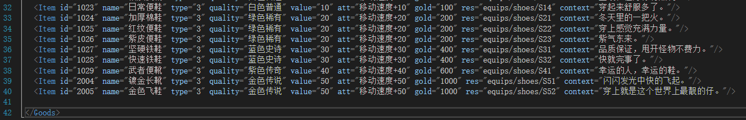
Game structure design
6. Three player skills are implemented with special effects.
7. XML is used to configure equipment.
8. A selection algorithm is used to count the number of unlocked equipment on the final settlement screen.
9. The camera follows a controllable range, and a mini-map is implemented.
10. The standard MVC design pattern is used to ensure consistent data display and control in the scene, ensuring rigorous overall logic, real-time updates to player states, and long-term data retention.
11. Systems and features such as the point allocation system, backpack system, store system, and settings interface are implemented.

Slide 10
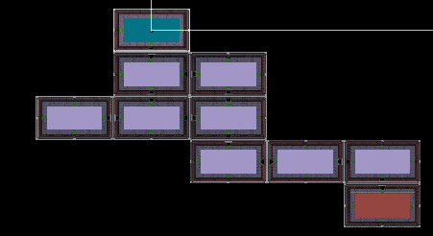
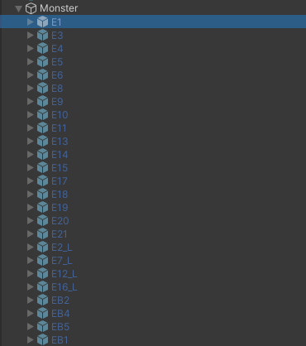
Game realization difficulties
I. Difficulties
1. Random room generation 2. Different state machines for monsters

Slide 11
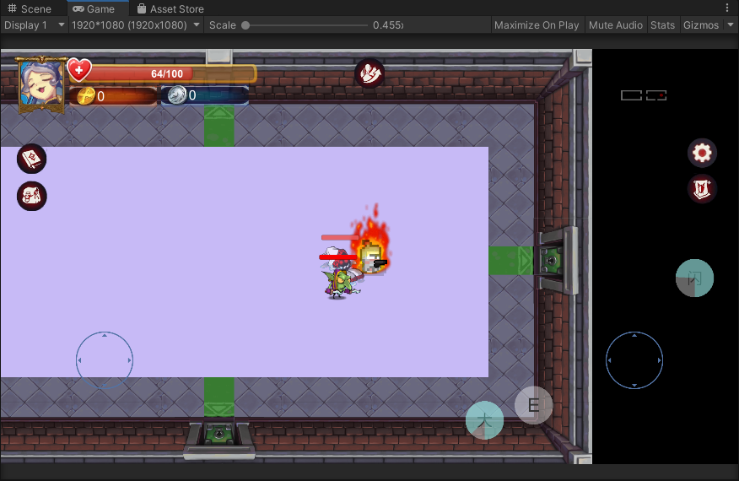
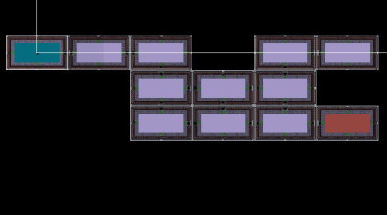
II. Algorithm Solution (Implementation approach)
1. To generate rooms, a fixed distance is chosen randomly in the up, down, left, and right directions each time. A while loop is used to search for a suitable location to place the room. If a position that has already been generated is encountered, the loop will continue until all rooms have been placed in appropriate positions.
2. To implement different monster state machines, the virtual keyword is added to a pre-existing Monster script using method overloading. This allows for customization of the monster behavior through modification of its state machine.
III. Effect display and Realization
(Translation note: This section heading is incomplete and it's unclear what the intended content is, so it cannot be translated without additional context.)

Slide 12
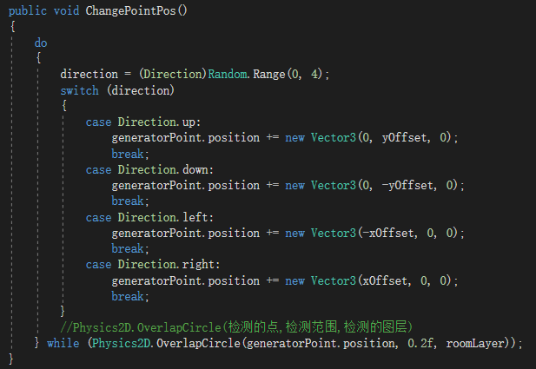
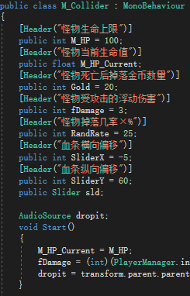
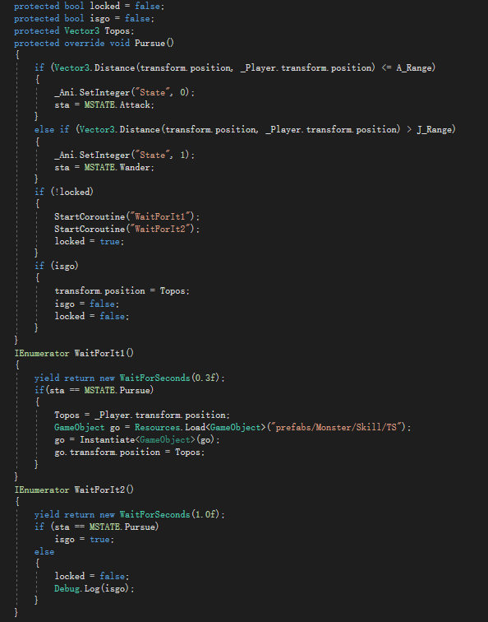
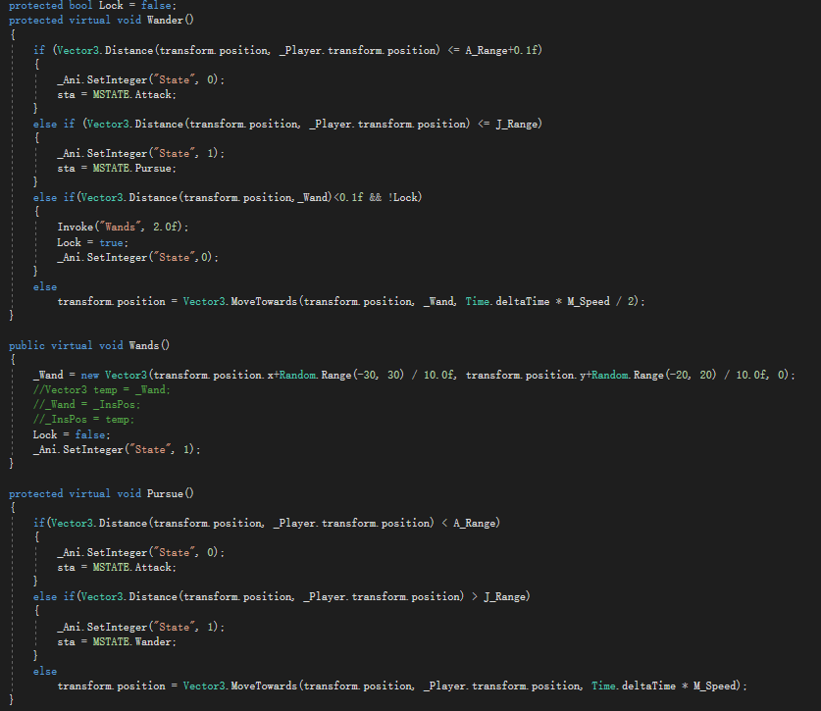

Slide 13
Project Reflection
1. Achievements and Shortcomings
Through this project, I realized my long-standing wish to independently develop a relatively complete game. I learned a lot from the entire development process on how to deal with small issues that may arise during game development, such as the inter-calling of different data and problems caused by the initialization order of different scripts.
There is still much about the use of Unity that I do not know and understand. I have only mastered the basics of Unity, and there is still a long way to go before I become proficient. I need to continue to strengthen my learning.

