Slide 1
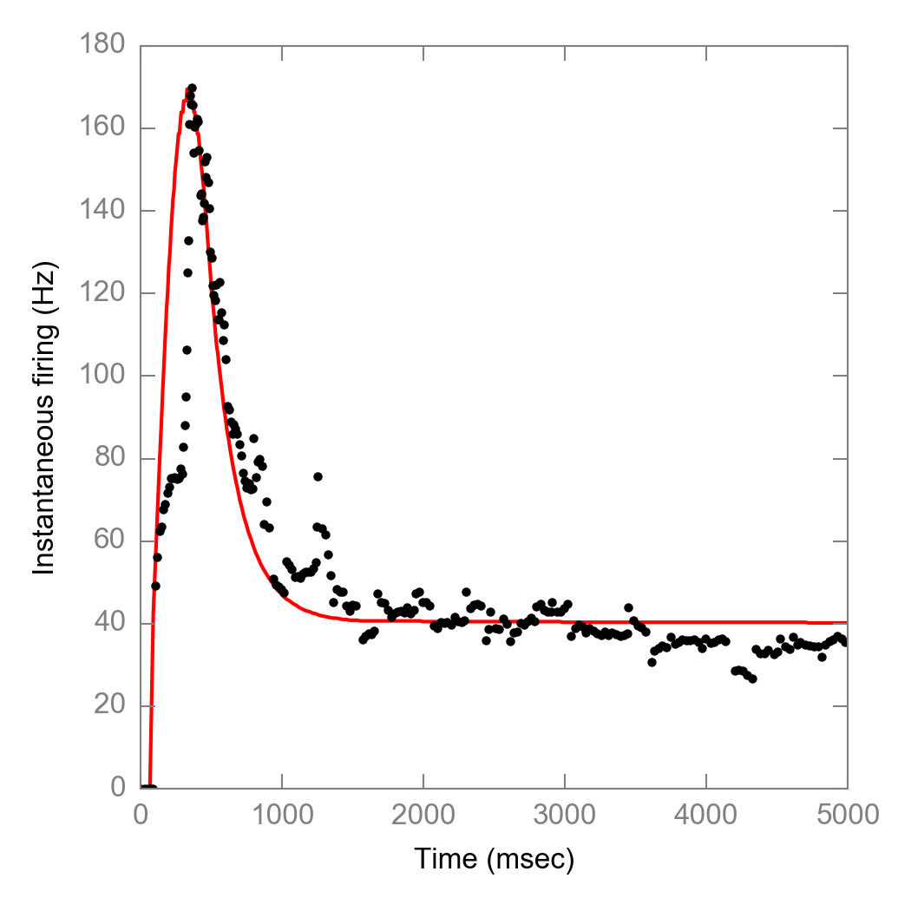
Approach #0: Original
Constraints
Tau_nr = 8 ms
Tau_mc = 200 ms
From Adrienne’s data
Outcome
Too rapid decay in early hold

Slide 2
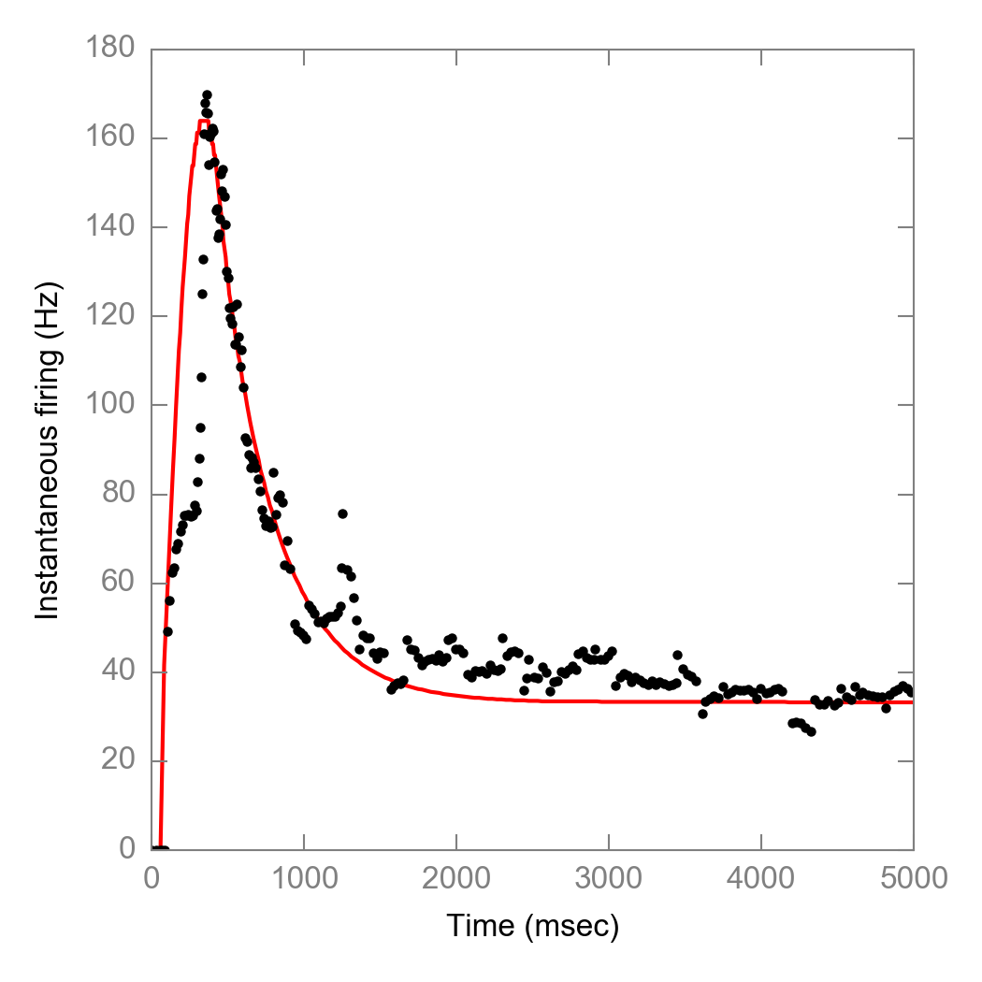
Approach #1: Let taus freely move
Constraints
Keep two time constants
One for neurite
Another for MC
Outcome
Tau_nr = 23 ms
Tau_mc = 365 ms
Good outcome, but neurite time constants does not match recording

Slide 3
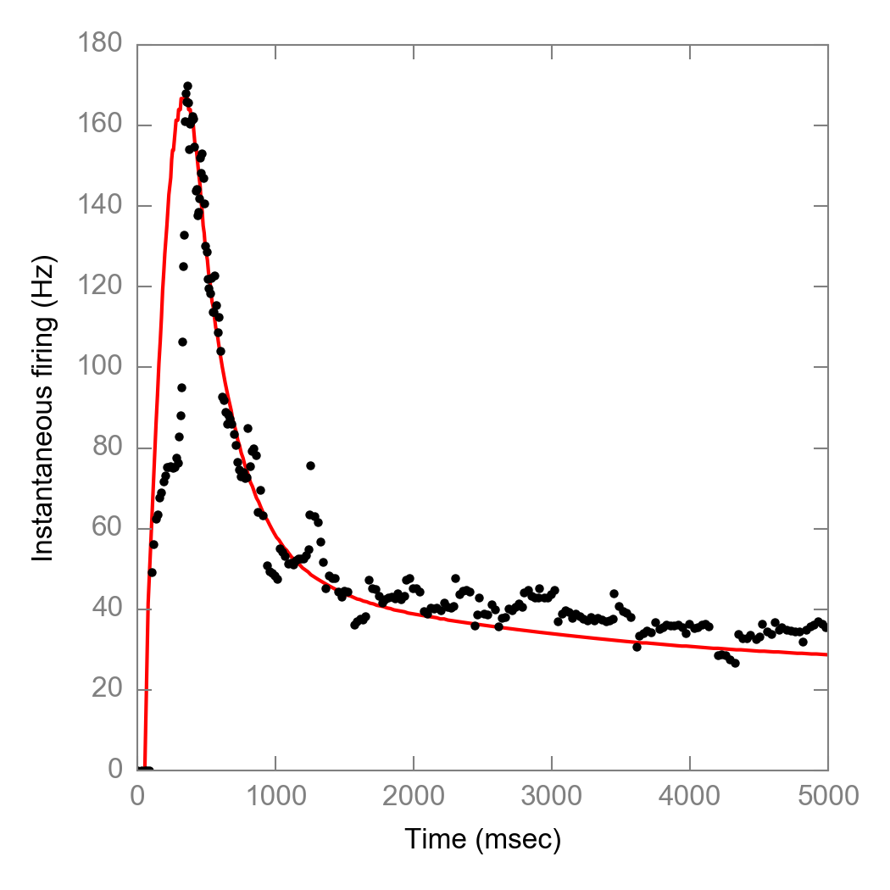
Approach #2: Add USA term (from fitting)
Constraints
Fix Tau_nr = 8ms
Let Tau_mc to freely move
Add another USA term
Outcome
Tau_nr = 8 ms (fixed)
Tau_mc = 274 ms
Tau_usa = 2254 ms
Drawback: tau_mc not directly from fitting; tau_usa too long.

Slide 4
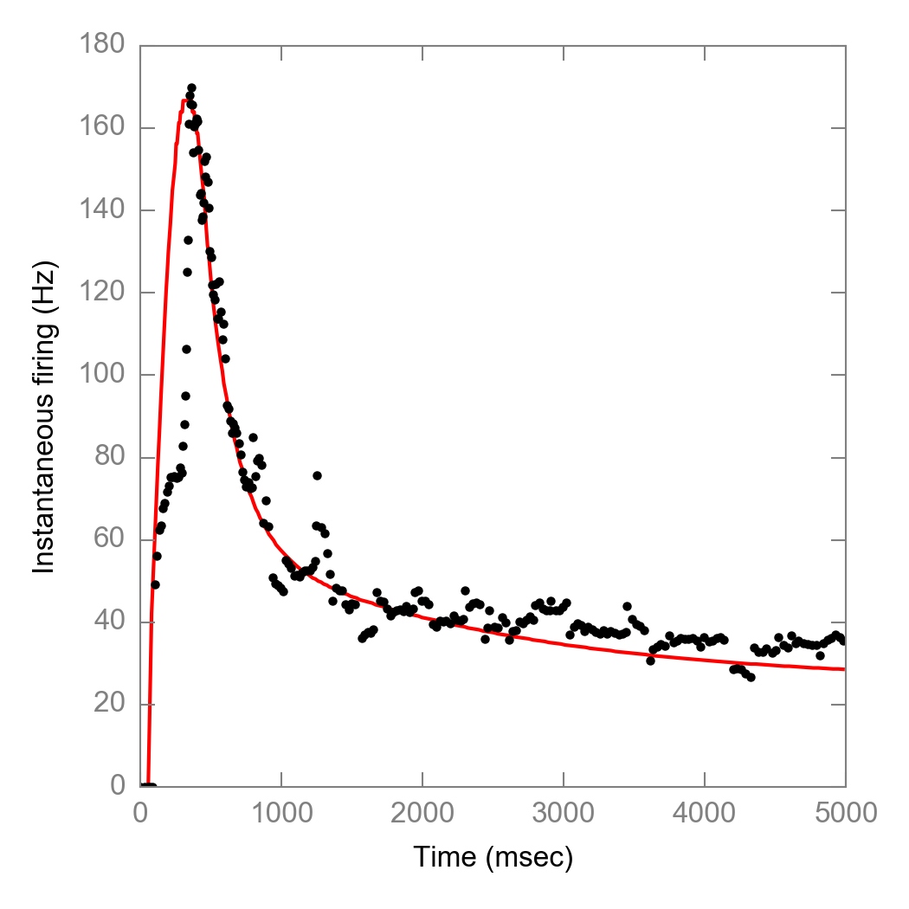
Approach #4: Add USA term (from literature)
Constraints
Fix Tau_nr = 8ms
Add another USA term
Outcome
Tau_nr = 8 ms (fixed)
Tau_mc = 200 ms (fixed)
Tau_usa = 1832 ms (fixed, Delmas et al., 2011)
Shawn likes this approach the best.

