Slide 1
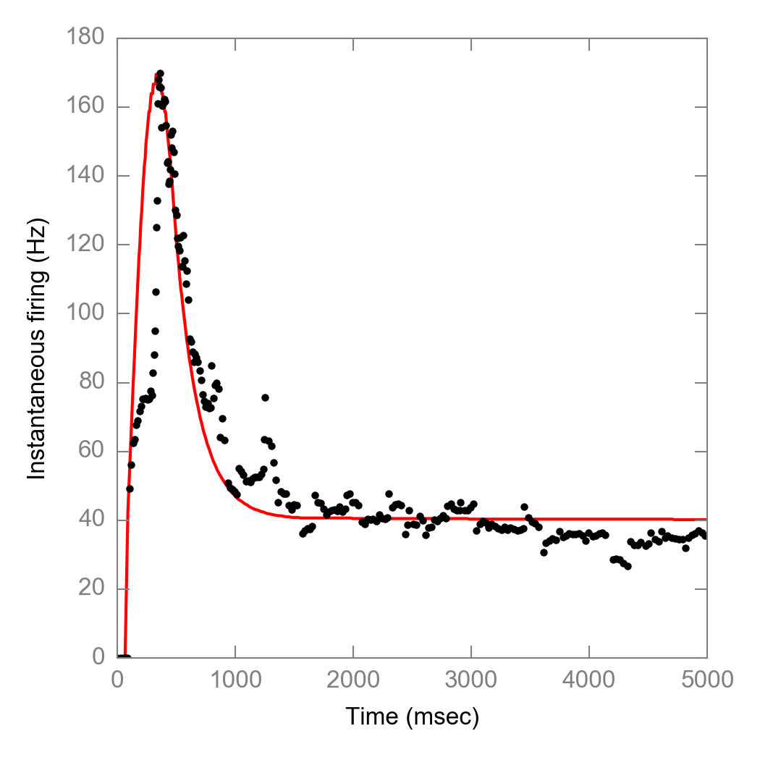
Approach #0: Original
Constraints
Tau_nr = 8 ms
Tau_mc = 200 ms
From Adrienne’s data
Outcome
Too rapid decay in early hold

Slide 2
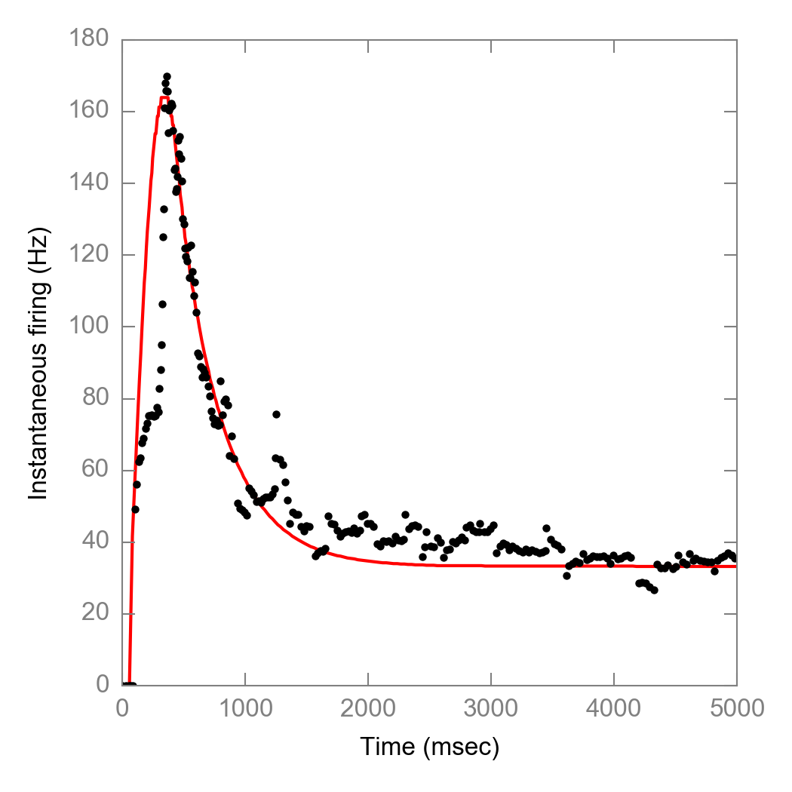
Approach #1: Let taus freely move
Constraints
Two terms
Neurite + MC terms
Outcome
Tau_nr = 23 ms
Tau_mc = 365 ms
Neurite time constants does not match recording

Slide 3
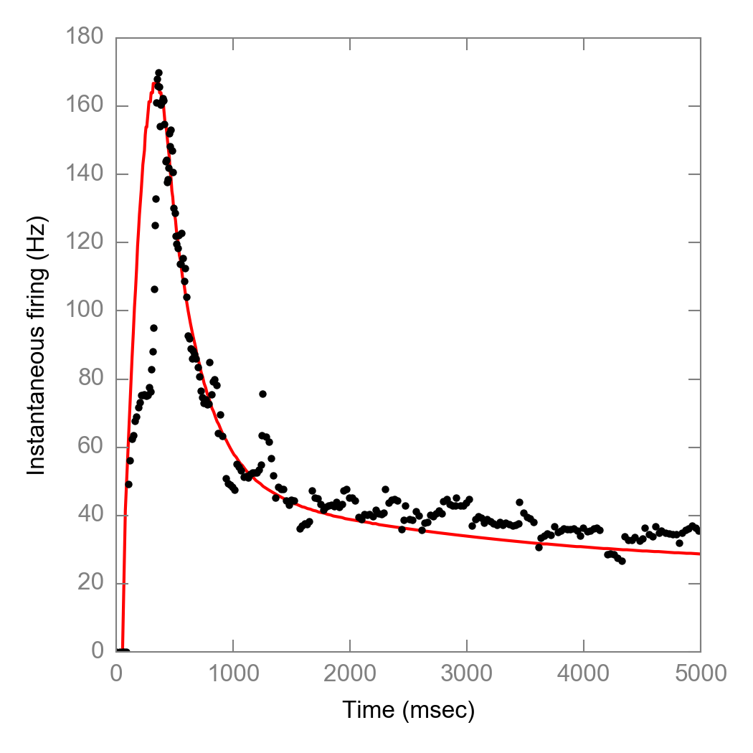
Approach #2: Add USA term (from fitting)
Constraints
Fix Tau_nr = 8ms
Add another USA term
Outcome
Tau_nr = 8 ms (fixed)
Tau_mc = 274 ms
Tau_usa = 2254 ms

Slide 4
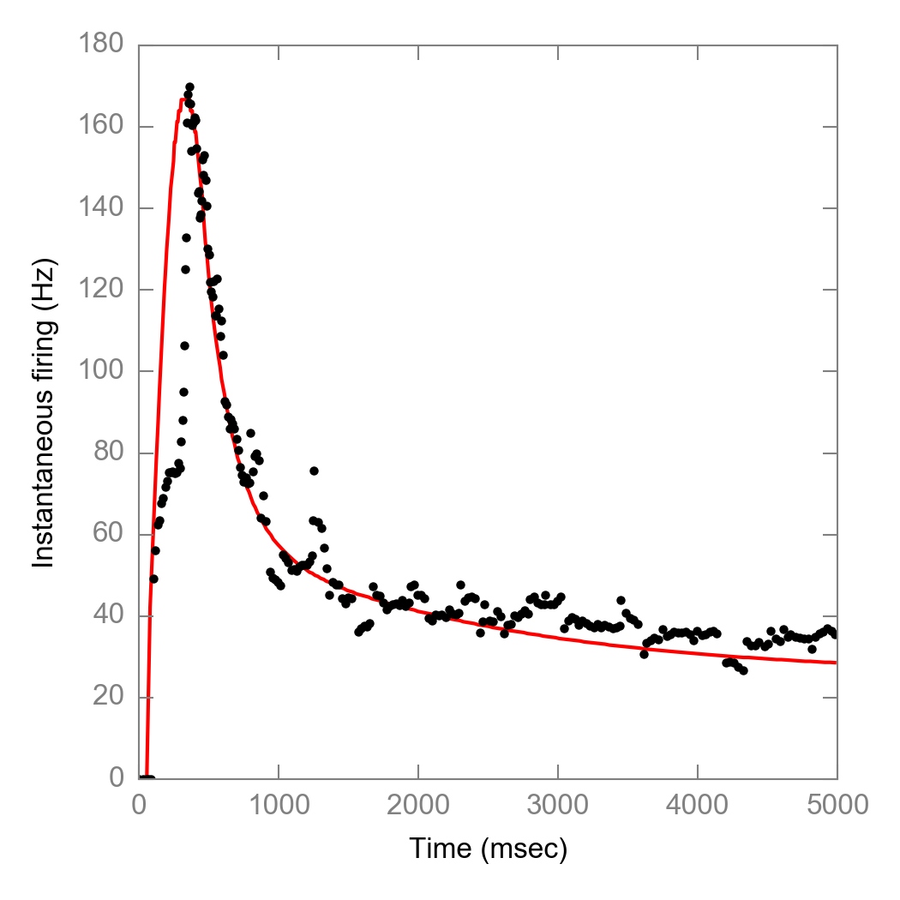
Approach #4: Add USA term (from literature)
Constraints
Fix Tau_nr = 8ms
Add another USA term
Outcome
Tau_nr = 8 ms (fixed)
Tau_mc = 200 ms (fixed)
Tau_usa = 1832 ms (fixed, Delmas et al., 2011)

