Slide 2
Outline
Form factor studies at Jefferson National Accelerator Facility
Spin-exchange optical pumping (SEOP)
³He polarimetry
Development of hybrid cells
Polarized ³He target cells incorporating metal

Slide 3
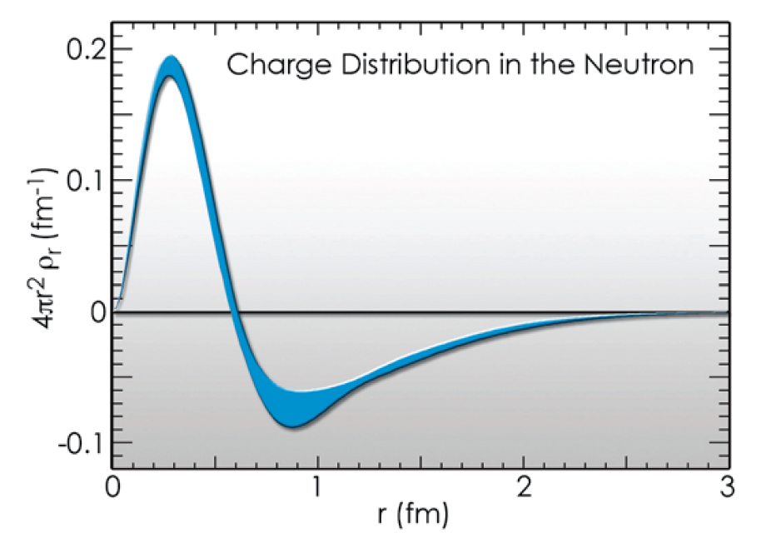
Elastic form factor of neutron
The Fourier transform of elastic form factor provides information of the charge distribution inside neutron.
Core is positive and “proton like”
Core is surrounded by negative pion cloud

Slide 4
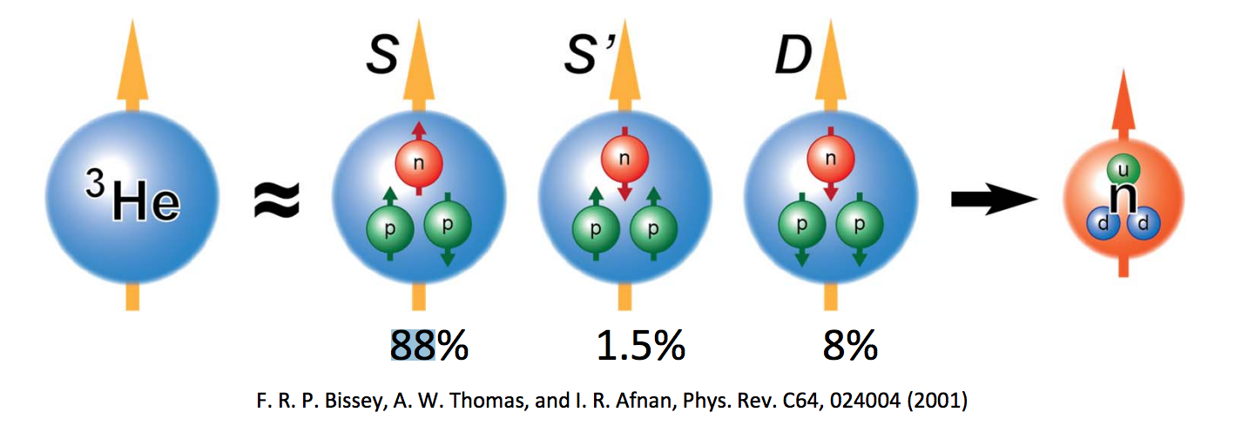
³He Target for studying neutron
Free neutrons are unstable, they decay in less than 15 minutes
To first order approximation, a ³He nucleus has two protons with paired spins, and a single neutron that accounts for most of the nuclear spin.
Notes:
Some notes

Slide 5
Effective luminosity
In a double-spin asymmetry experiment, the measured asymmetry is
where
with L and t being luminosity and experiment duration, respectively
Effective luminosity
Notes:
Double-spin: polarized electrons are scattered of off polarized 3He atoms
N: the number of detected events
I_{beam}: electron beam current
e: the charge of the electron
[He]: He density
l: length of the target chamber

Slide 6
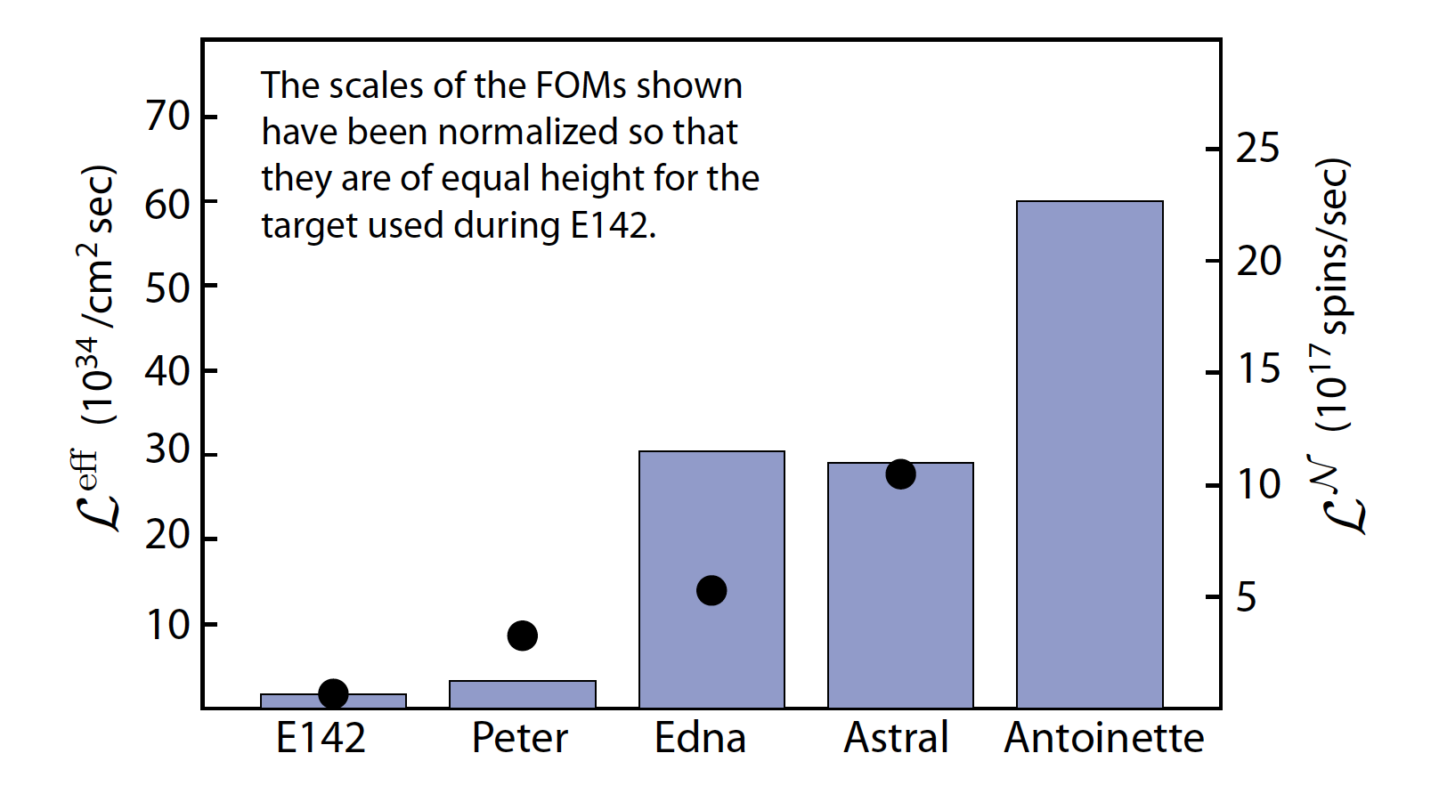
The performance of polarized ³He targets have increased by a factor of 30 since slac e142
Demonstrated by simulated beam test

