Slide 2
Outline
Form factor studies at Jefferson National Accelerator Facility
Spin-exchange optical pumping (SEOP)
³He polarimetry
Development of hybrid cells
Polarized ³He target cells incorporating metal

Slide 3
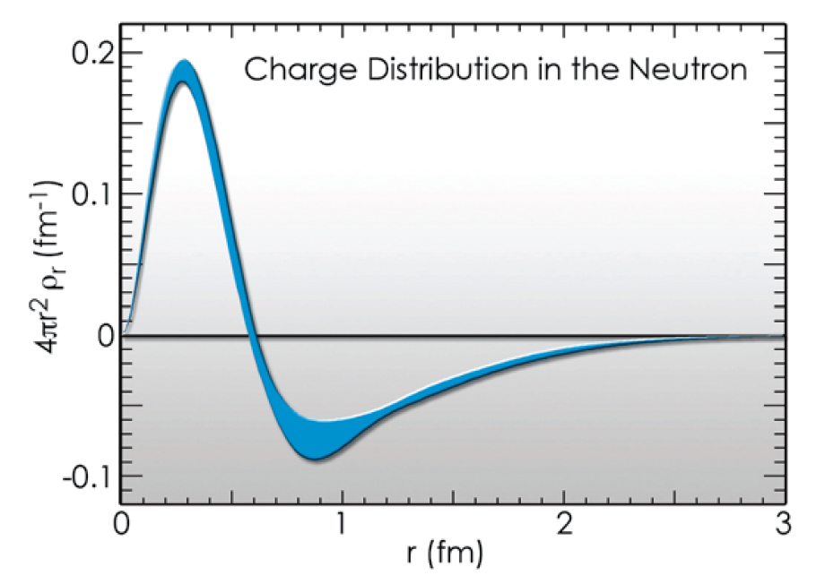
Elastic form factor of neutron
The Fourier transform of elastic form factor provides information of the charge distribution inside neutron.
Core is positive and “proton like”
Core is surrounded by negative pion cloud

Slide 4
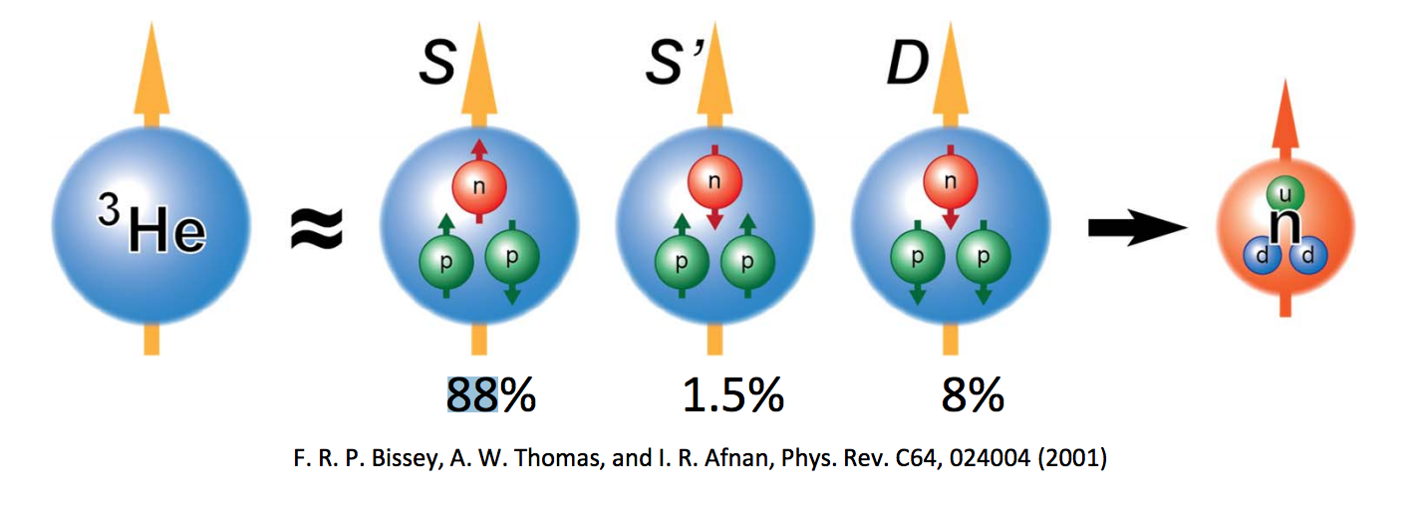
³He Target for studying neutron
Free neutrons are unstable, they decay in less than 15 minutes
To first order approximation, a ³He nucleus has two protons with paired spins, and a single neutron that accounts for most of the nuclear spin.
Notes:
Some notes

Slide 5
Effective luminosity
In a double-spin asymmetry experiment, the measured asymmetry is
where
with L and t being luminosity and experiment duration, respectively
Effective luminosity
Notes:
Double-spin: polarized electrons are scattered of off polarized 3He atoms
N: the number of detected events
I_{beam}: electron beam current
e: the charge of the electron
[He]: He density
l: length of the target chamber

Slide 6
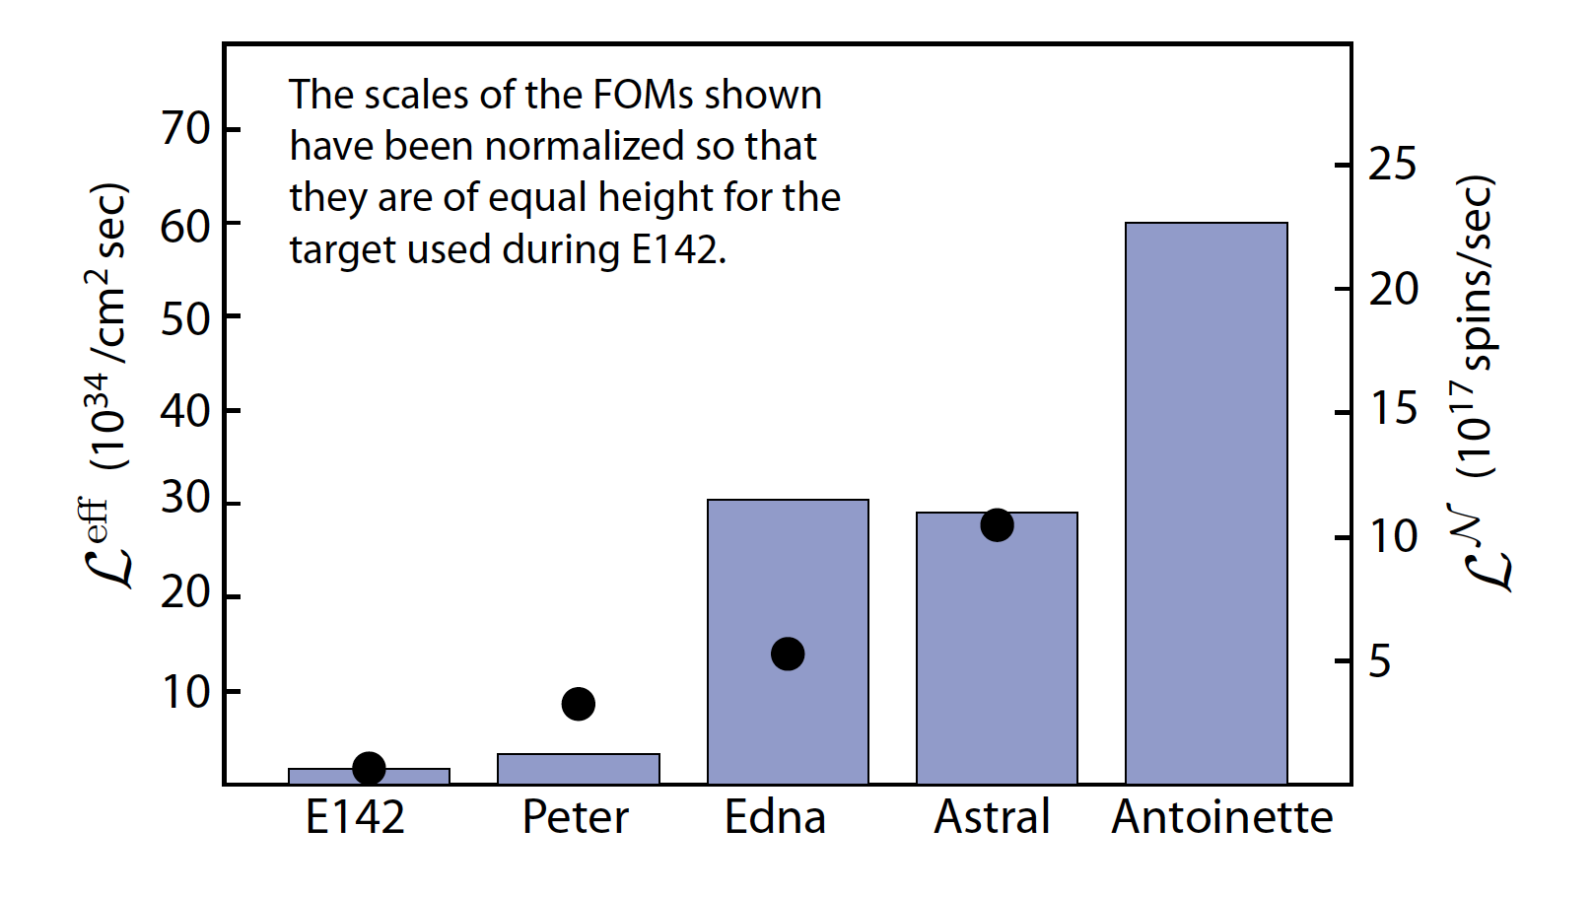
The performance of polarized ³He targets have increased by a factor of 30 since slac e142
Demonstrated by simulated beam test

Slide 7
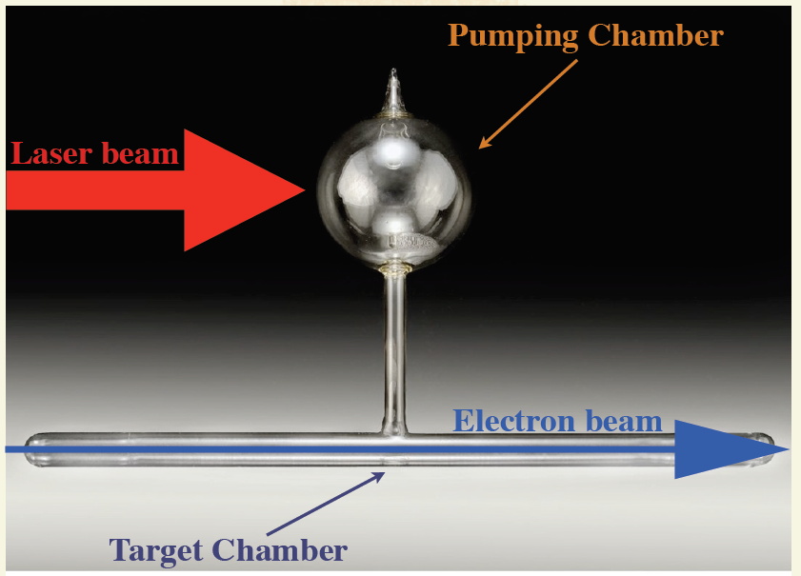
Traditional ³He target cell
Forced-Air Oven
Transfer Tube

Slide 8
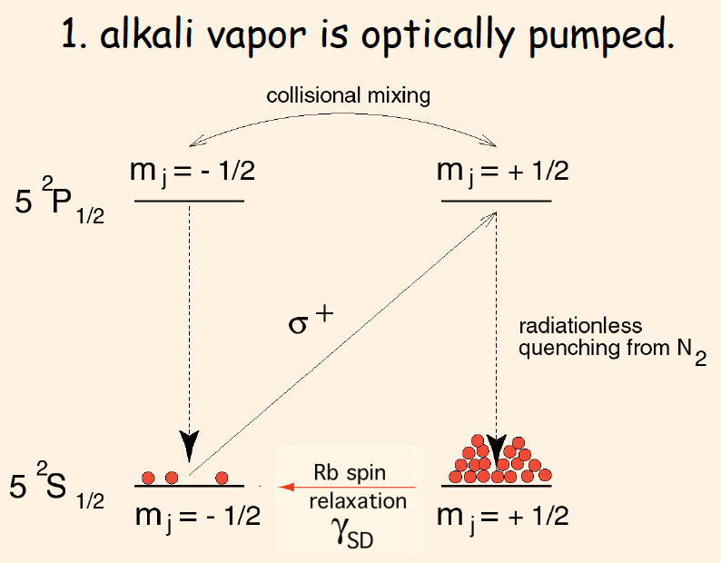
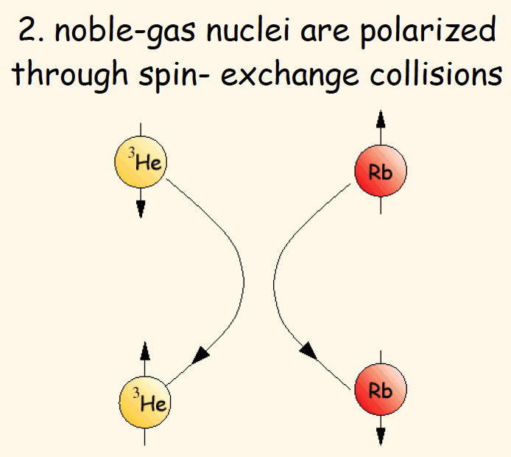
SPIN-exchange optical pumping (seop)

Slide 9
³He spin Relaxation
The total relaxation of 3He nucleus spin polarization due to all processes except for spin exchange:
Dipolar relaxation rate at 23C
Static field inhomogeneity
Wall relaxation
Notes:
D: diffusion constant, \nablaBx and \nablaBy are the transverse magnetic field inhomogeneities, B0 is the holding field
\rho is the so-called relaxivity, S/V: surface to volume ratio

Slide 10
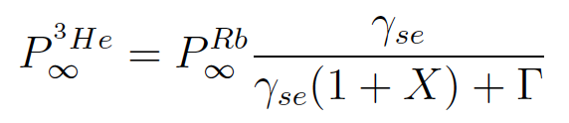
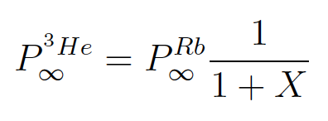
X Factor
E. Babcock et al. reported evidence of a previously unrecognized spin relaxation mechanism (leave citation here?):
With infinite laser power
More on this later.
Notes:
X appears to be temperature dependent and rougly proportional to alkali density. X limits the maximally achievable 3He polarization even with infinite laser power.

Slide 11
Adiabatic fast passage (afp)
Helmholtz Coil
Oven
Holding Field:
Target Cell
RF field:
x
y
z
In rotating frame:
RF Coil

Slide 12
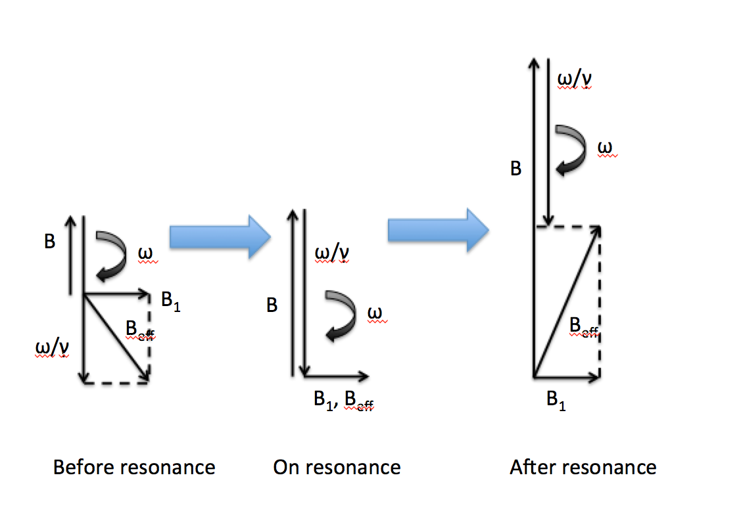
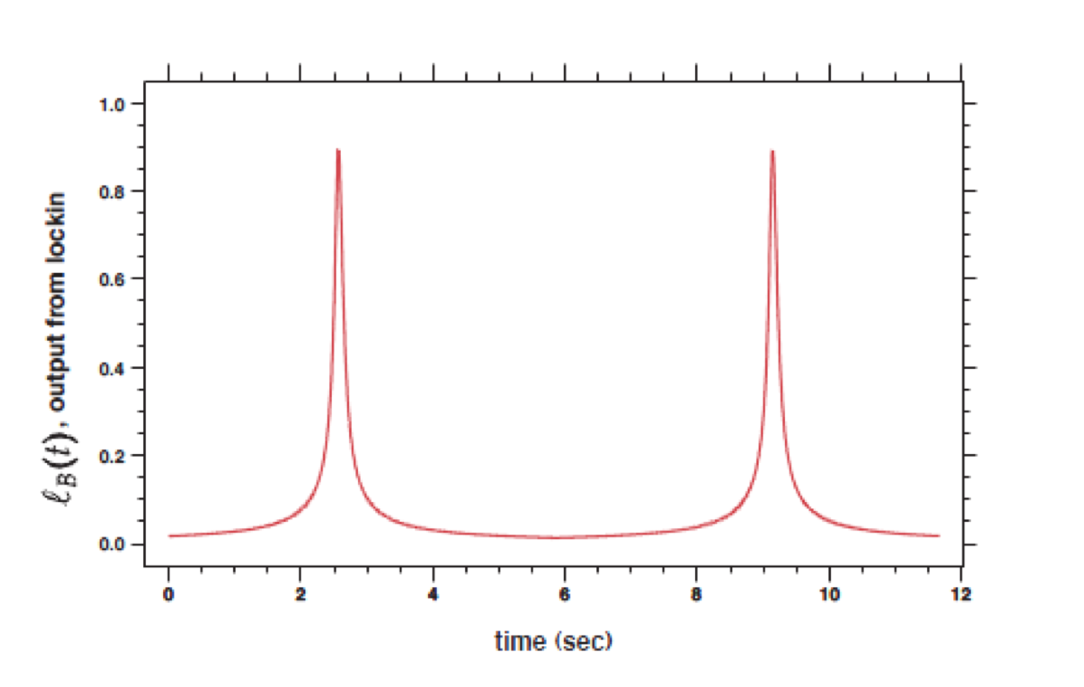
Adiabatic fast passage
During a field-sweeping AFP measurement

Slide 13
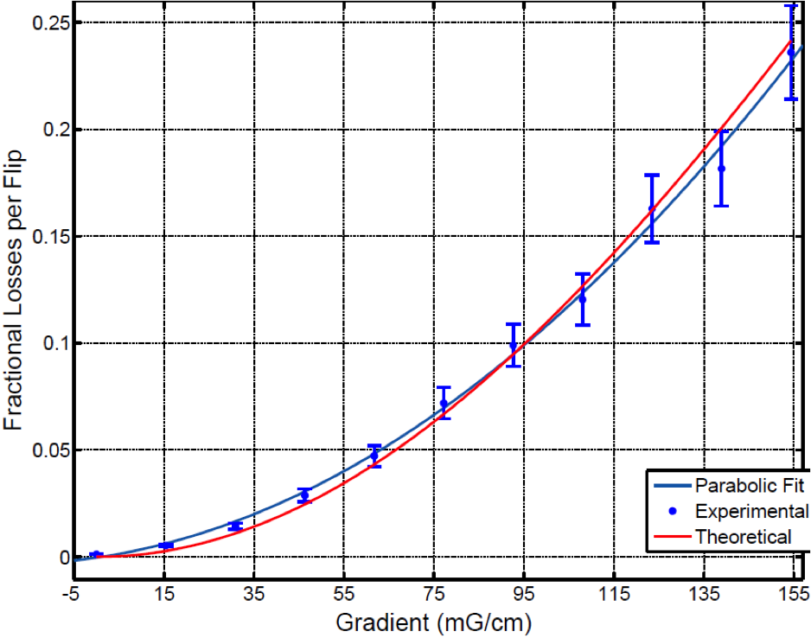
AFP losses
Longitudinal spin-relaxation rate on resonance
Fractional relaxation due to a single AFP flip
Measurements and theory agree extremely well

Slide 14
Pulsed nuclear magnetic resonance (pnmr)
A short pulse of RF field is applied on a small region of the target
The frequency of the pulse is equal to the Larmor frequency, so in the rotating frame

Slide 15
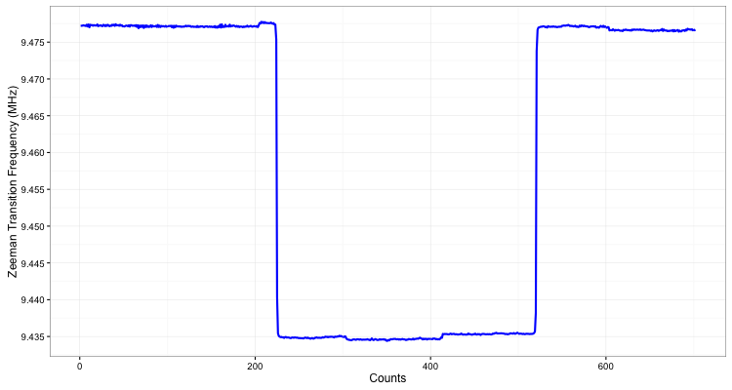
Electron paramagnetic resonance (epr)
The shift of Zeeman splitting of alkali metal is largely caused by Fermi-contact interaction
The effective field causing the shift is produced by polarized ³He multiplied by an enhancement factor
By flipping ³He spins, we can isolate the effective field from holding field and other ambient fields
Thus ³He polarization can be calculated using the frequency shift

Slide 16
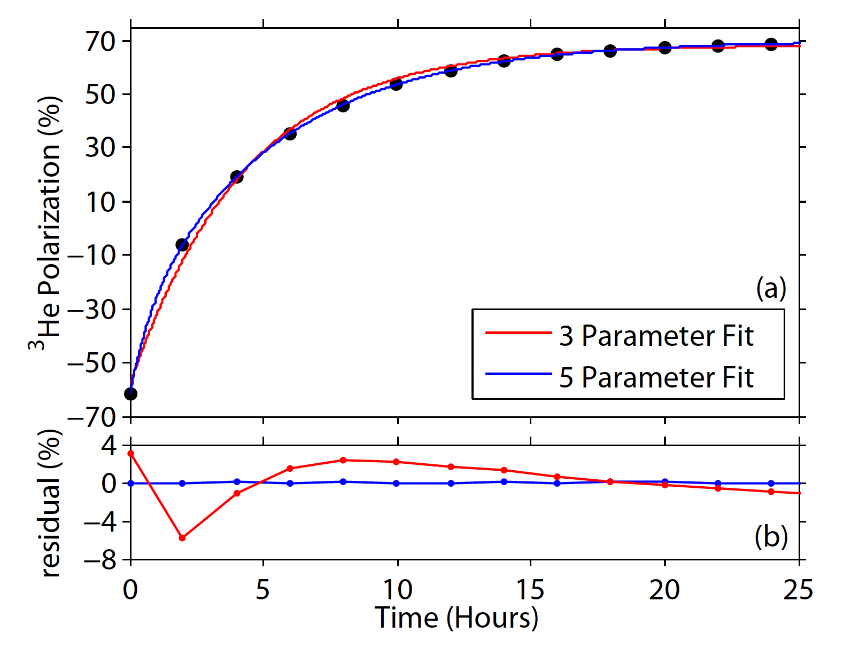
Spinup
Time evolution of polarization in a double-chambered cell:
Notes:
3 parameter fit is done with equation for single-chambered target cell
Y axis is polarization because the AFP signals have been calibrated with EPR

Slide 17
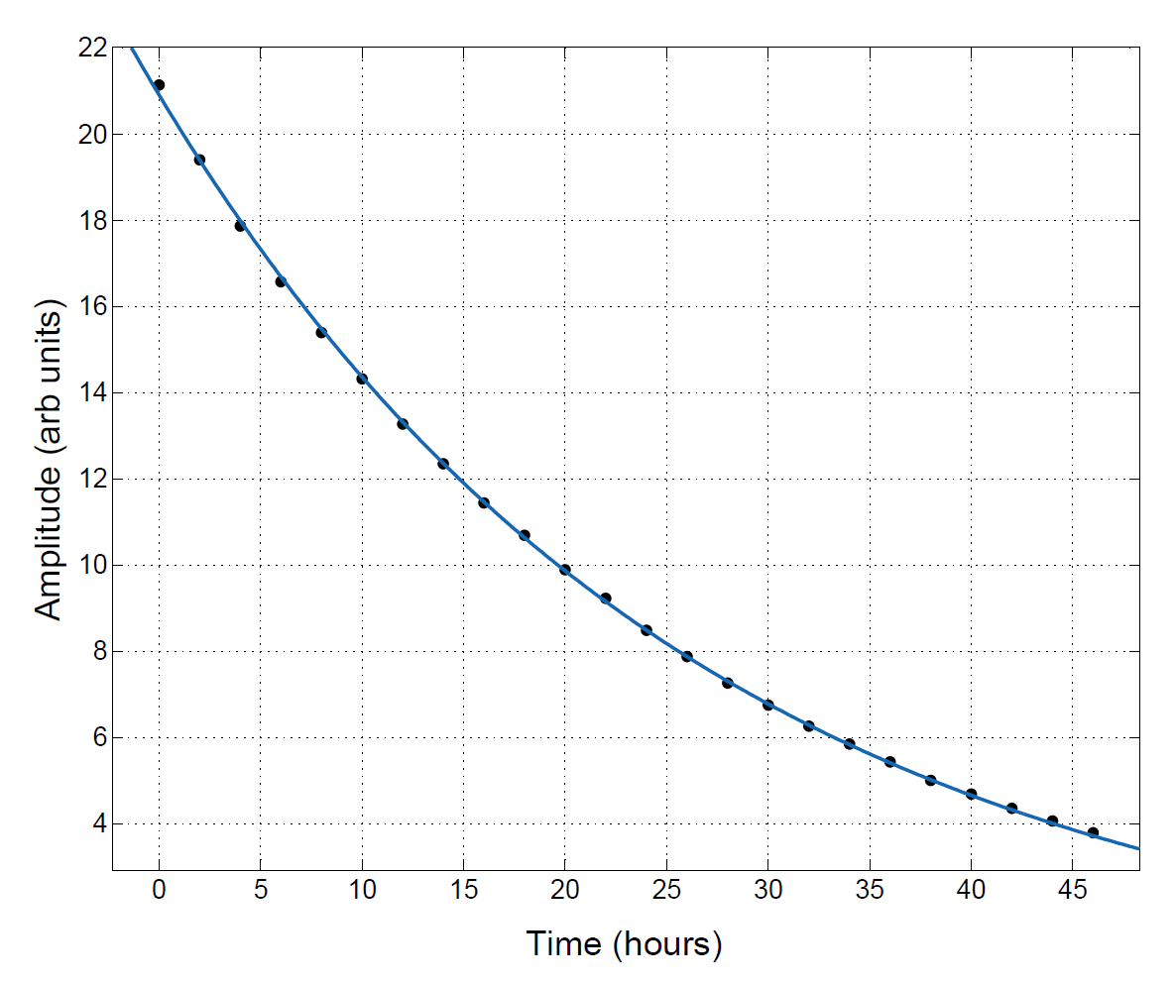
spindown
A spindown curve at room temperature
Exponential decay of nuclear polarization:
T₁ is the so-called life time.
Notes:
Y axis is raw amplitudes from AFP measurements.

Slide 18
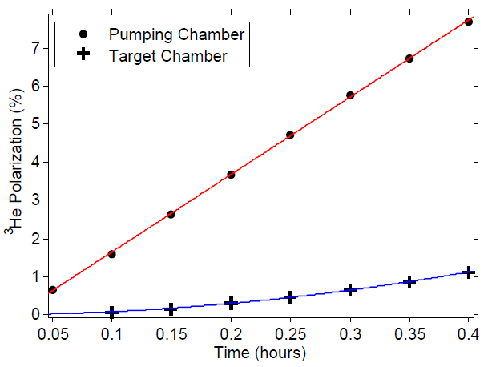
Initial spinup
By performing a Taylor expansion on the time evolution of polarization:

Slide 19
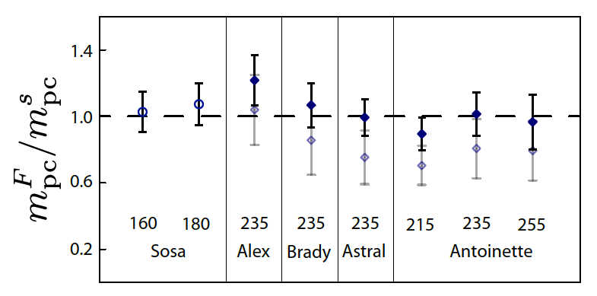
The k-³he spin-exchange rate constant
The quantity m_{pc} can also be measured with a technique based on Faraday rotation
Both mpc values should agree, fitting the ratio to one gives

Slide 20
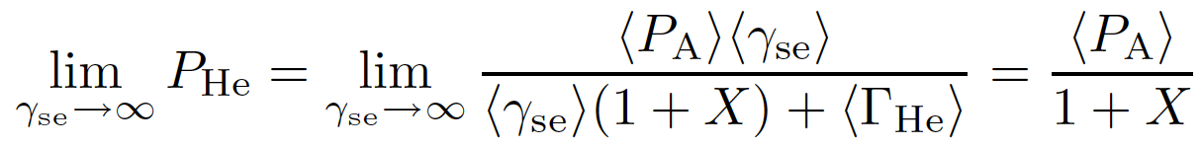
Maximum achievable ³He polarization
The so-called X factor characterizes a poorly understood temperature-dependent spin-relaxation mechanism that limits the maximum polarization
The relaxation mechanism described by the X factor has been observed to be roughly proportional to the spin-exchange rate, so it cannot be overwhelmed with infinite laser power.
Babcock, Chann, Walker, Chen and Gentile
PRL vol. 96, pg. 083003 (2006)

Slide 21
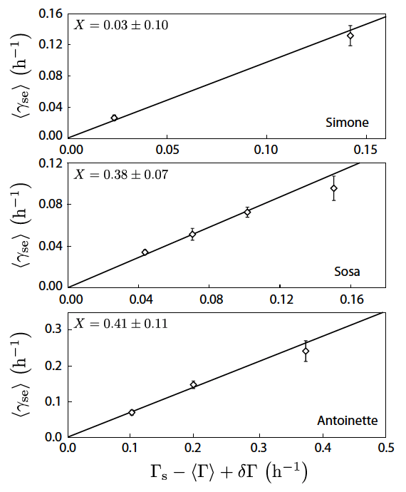
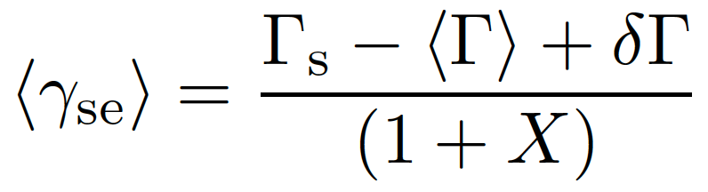
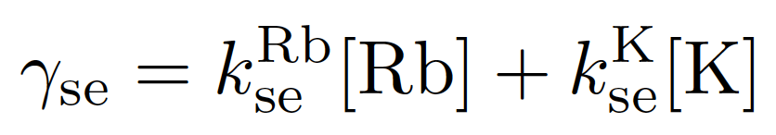
The x factor hot relaxation method
“The hot relaxation method” is a method of measuring the X factor by looking at spin-relaxation rates at different temperatures [1].
Measured with spinups and cold spindowns.
Determined with measured alkali densities and known spin-exchange coefficients
[1]E. Babcock, B. Chann, T. G. Walker, W. C. Chen, and T. R. Gentile, Phys. Rev. Lett. 96, 083003 (2006).

Slide 22
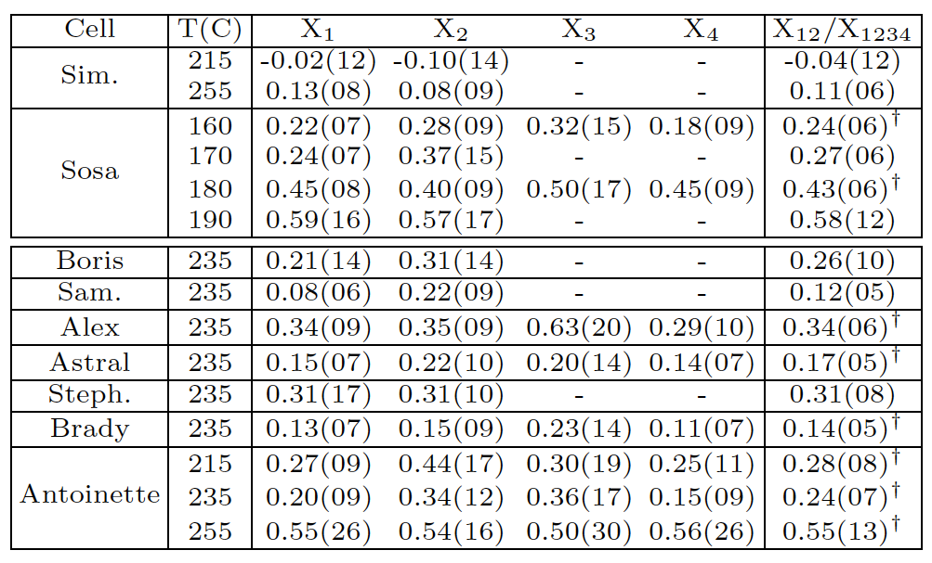
The x factor Single temperature methods
X factor can also be determined with data from a single temperature using various methods.

Slide 23
Errors and weighted average
Error for each determination of X:
To combine different determinations of X, a weighted average was obtained for which the weights are varied until the combined error is minimized

Slide 24
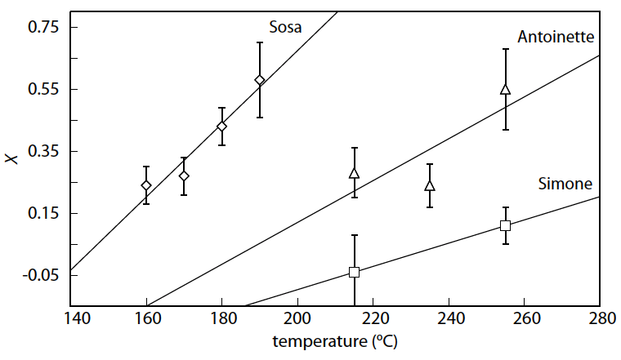
Possible temperature dependence
Our evidence suggests there may be temperature dependence in the X factor.

