Slide 1
Mini-Lecture: Understanding Java Classes & Objects
Real-life analogies to make OOP make sense

Slide 2
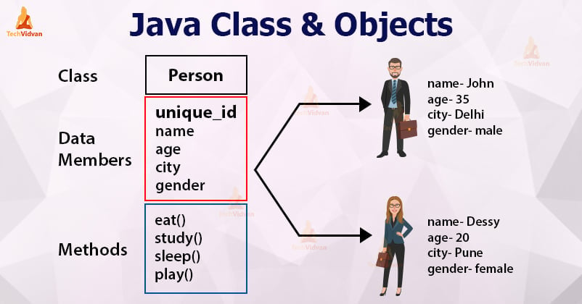
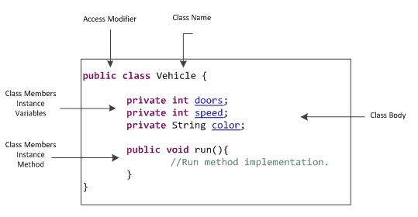
What is a Class?
Think of a class like a blueprint for a house. It has the instructions for how the house should look, but it’s not a house yet.

Slide 3
What is an Object?
An object is like the actual house built from that blueprint. You can live in it, paint it, or tear it down.
An Object & a Class sound similar.
So I’ve found the most bestest Youtube video to explain:
https://www.youtube.com/watch?v=72z4xQyGmbI

Slide 4
Constructors
Constructors are like setup crews. When a house (object) is built, the crew moves in furniture and paints the walls. that’s initialization.
It’s the initialization part he was talking about in the previous video.

Slide 5
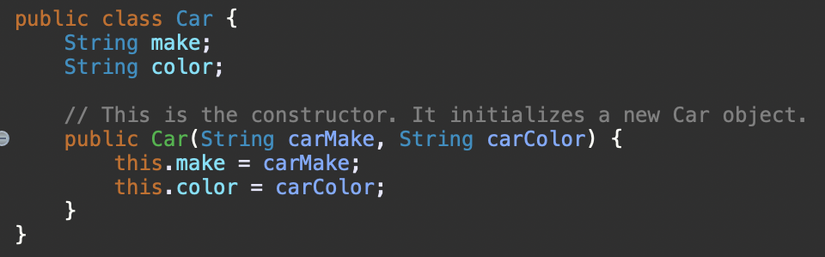
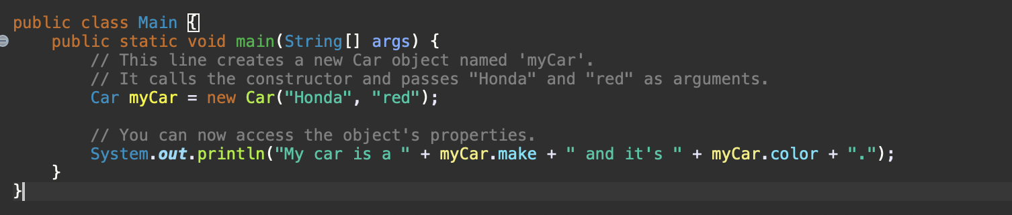
Constructors (Cont.)
<- This is the Car class, which is the blueprint:
<- This is how you use the constructor to create a specific object:
When you create a new object using the ‘new’ keyword, you are calling the class’s constructor.
E.g., ( Car myCar = new Car(); )
The constructor’s job is to set the initial values for the objects instance variables (color/make/model)

Slide 6
Mutators (Setters)
Mutators are like remote controls they let you change what's inside the object, like turning a TV volume up or changing your car’s temperature.

Slide 7
Accessors (Getters)
Accessors are like read-only dashboards. They let you see your speed, gas level, or thermostat setting without changing anything.

Slide 8
The 'this' Keyword
Think of 'this' as pointing to yourself. Like saying, 'I’m Joe’. you’re referring to your own name field.

Slide 9
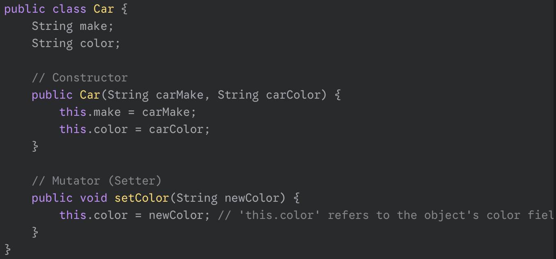
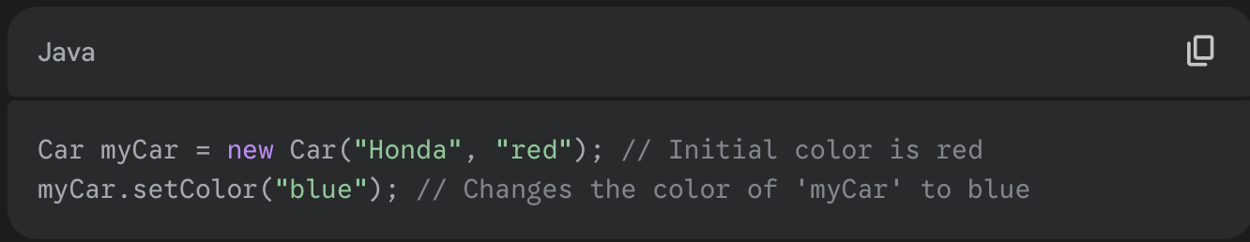
Mutators (Setters)
- In the ‘Car’ Class, we would add a ‘setColor’ mutator to change the car’s color after it’s been created:
- You would use the mutator like this:

Slide 10
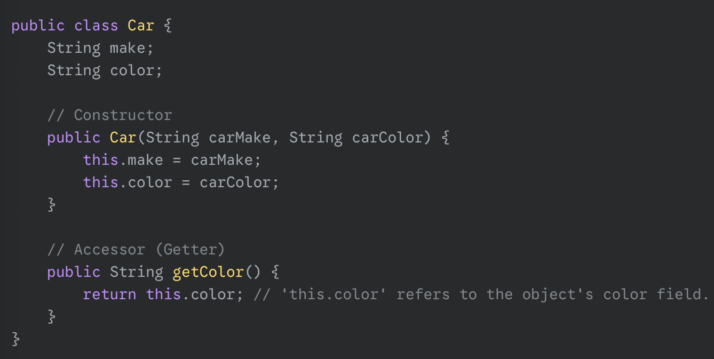
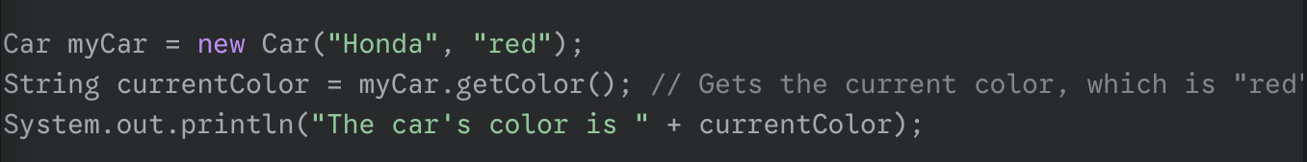
Accessors (Getters)
- We can add a ‘getColor’ accessor to our ‘Car’ class so we can find out its current color.
- You would use this accessor to get the value.

Slide 11
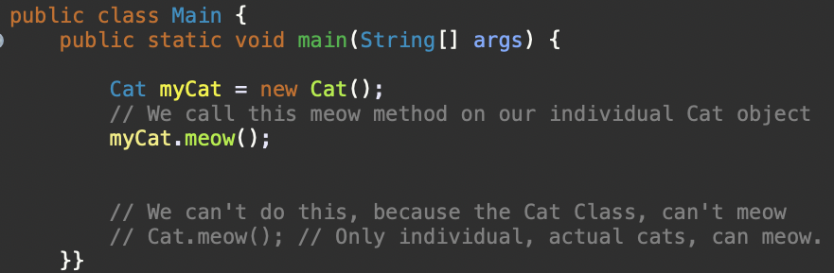
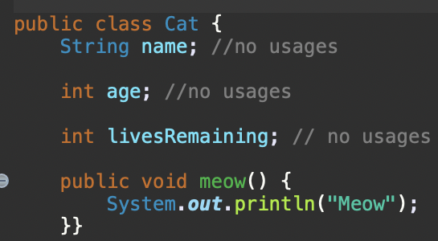
Static Fields
Static fields are like a building’s address directory. Shared info that belongs to the whole class, not just one apartment (object).
https://www.youtube.com/watch?v=-Y67pdWHr9Y

Slide 12
ArrayLists
An ArrayList is like a resizable backpack. You can add, remove, and look into your bag by position, but you can only store certain item types.

Slide 13
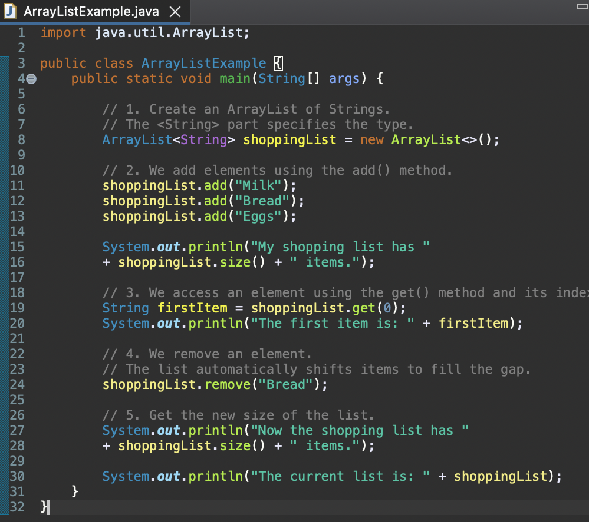
ArrayList Example

