Slide 1
Mini-Lecture: Understanding Java Classes & Objects
Real-life analogies to make OOP make sense

Slide 2
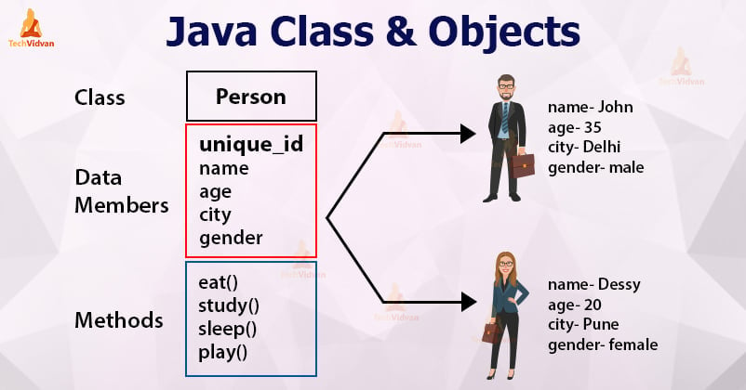
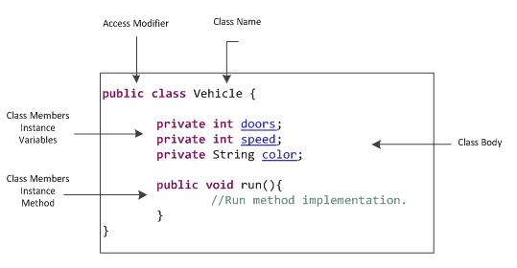
What is a Class?
Think of a class like a blueprint for a house. It has the instructions for how the house should look, but it’s not a house yet.

Slide 3
What is an Object?
An object is like the actual house built from that blueprint. You can live in it, paint it, or tear it down.
An Object & a Class sound similar.
So I’ve found the most bestest Youtube video to explain:
https://www.youtube.com/watch?v=72z4xQyGmbI

Slide 4
Constructors
Constructors are like setup team. When a house (object) is built, the team moves in furniture and paints the walls. that’s initialization.
It’s the initialization part he was talking about in the previous video.

Slide 5
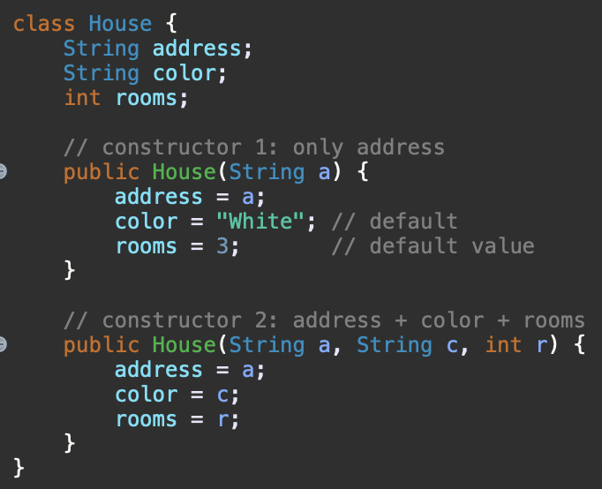
Constructor Overloading
New Student() -> creates a default student.
New Student(“Alice”, 2903) -> creates one with a real information.

Slide 6
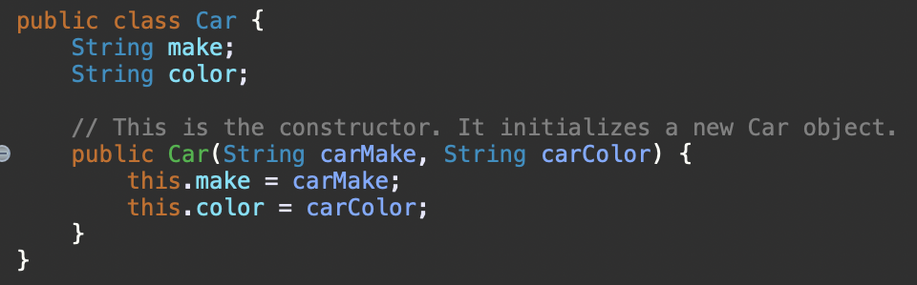
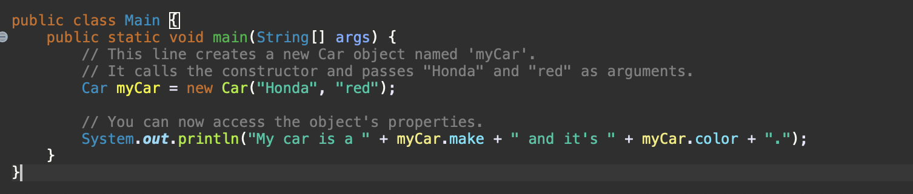
Constructors (Cont.)
<- This is the Car class, which is the blueprint:
<- This is how you use the constructor to create a specific object:
The constructor’s job is to set the initial values for the objects instance variables (color/make/model)
When you create a new object using the ‘new’ keyword, you are calling the class’s constructor.
E.g., ( Car myCar = new Car(); )

Slide 7
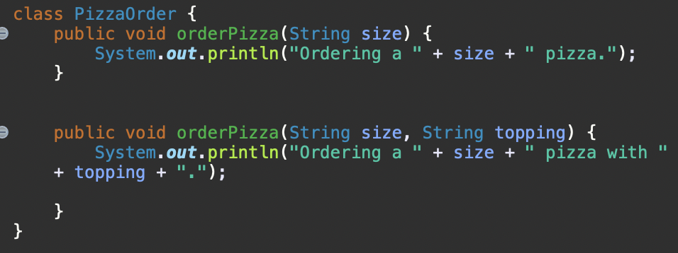
Method Overloading
When Ordering pizza, you call the same restaurant, but you give different details on what you want.
You can basically reuse the same method name, as long as the inputs are different

Slide 8
Mutators (Setters)
Mutators are like remote controls they let you change what's inside the object, like turning a TV volume up or changing your car’s temperature.

Slide 9
Accessors (Getters)
Accessors are like read-only dashboards. They let you see your speed, gas level, or thermostat setting without changing anything.

Slide 10
The 'this' Keyword
Think of 'this' as pointing to yourself. Like saying, 'I’m Joe’. you’re referring to your own name field.

Slide 11
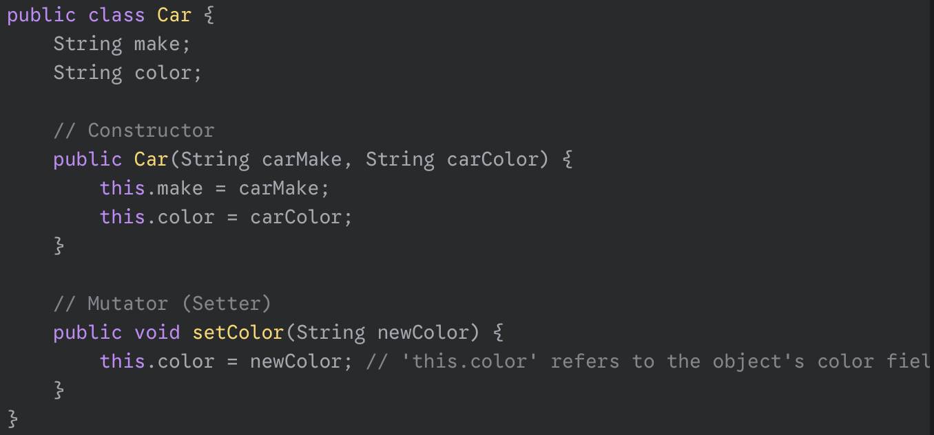
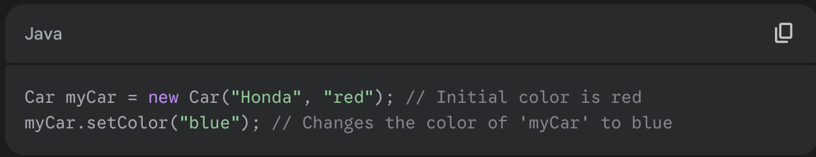
Mutators (Setters)
- In the ‘Car’ Class, we would add a ‘setColor’ mutator to change the car’s color after it’s been created:
- You would use the mutator like this:

Slide 12
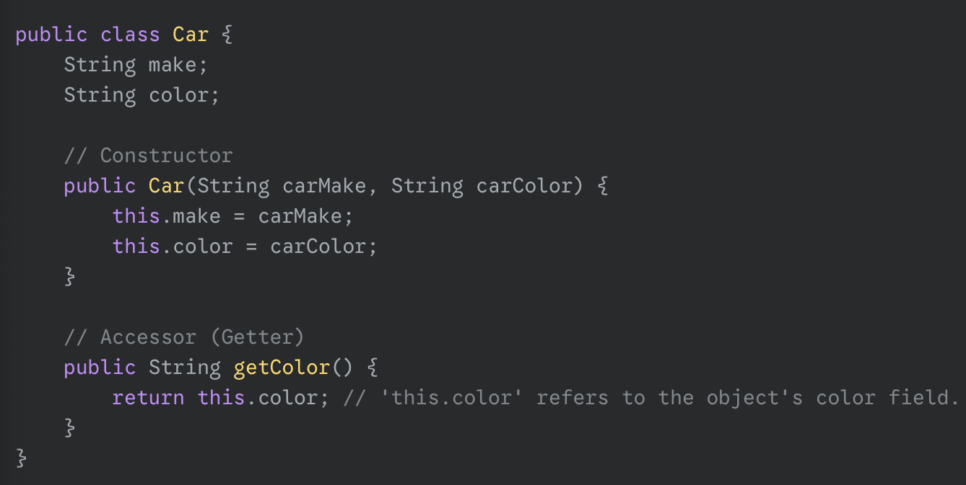
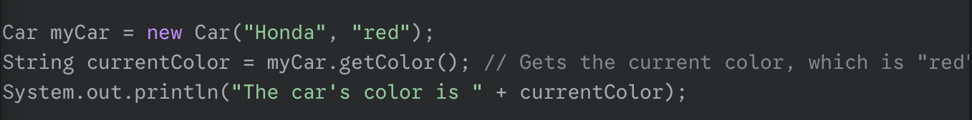
Accessors (Getters)
- We can add a ‘getColor’ accessor to our ‘Car’ class so we can find out its current color.
- You would use this accessor to get the value.

Slide 13
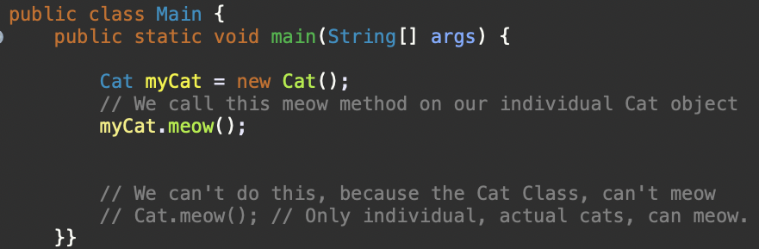
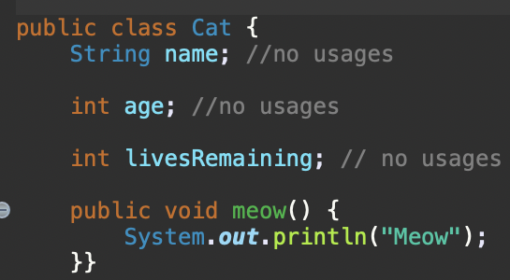
Static Fields
Static fields are like a building’s address directory. Shared info that belongs to the whole class, not just one apartment (object).
https://www.youtube.com/watch?v=-Y67pdWHr9Y

Slide 14
ArrayLists
An ArrayList is like a resizable backpack. You can add, remove, and look into your bag by position, but you can only store certain item types.

Slide 15
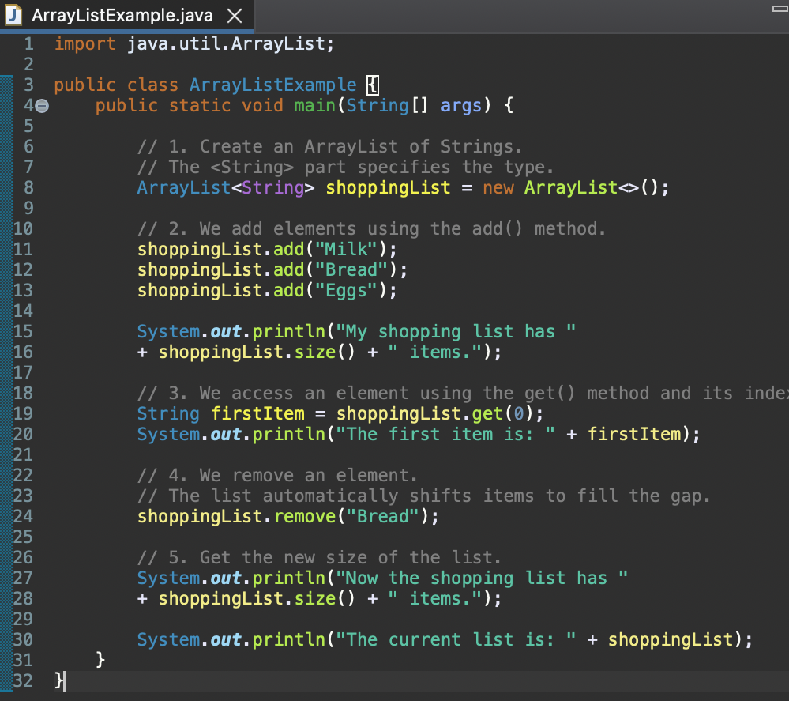
ArrayList Example

