Slide 1

Session 2
9/12/2025

Slide 2
Ch1. Overview of topics:
Classes
Objects
Constructors
Constructor overloading
Method
Method overloading
Mutators (Setters) / Accessors (Getters)
The ‘this’ Keyword
Static

Slide 3
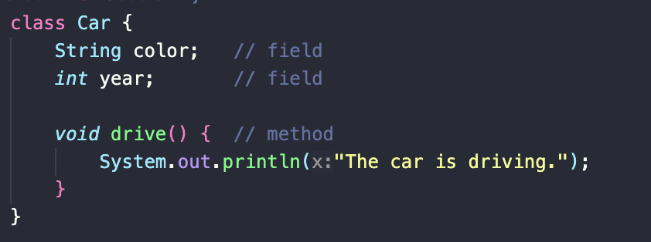
Class
A class is like a blueprint. An architect’s plan for building a house. It describes what the house would have (rooms, doors) and what it can do (open door, turn on lights). But it’s not a house yet.

Slide 4
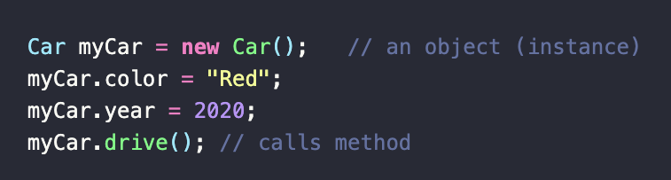
Object
An object is like the real house that is built from the blueprint. You can walk inside, paint it, live in it. Each object has its own unique values.

Slide 5
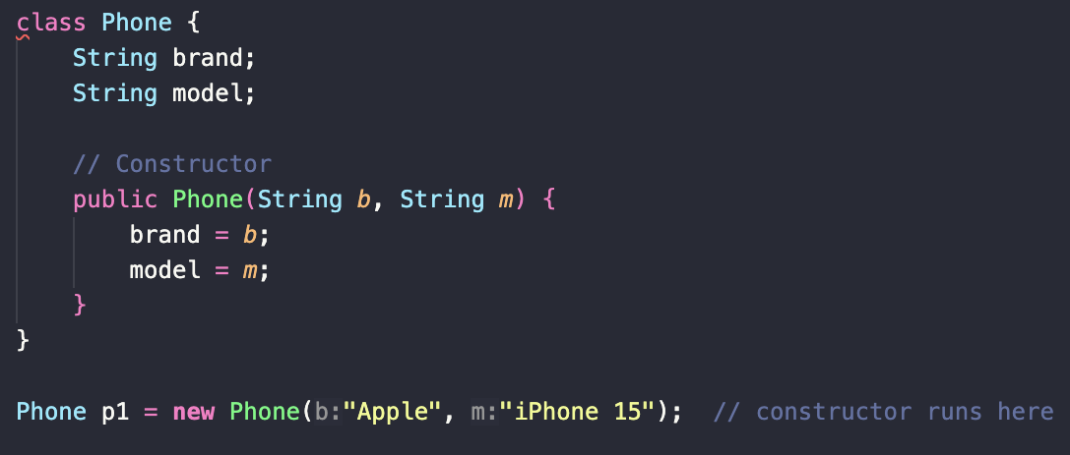
Constructor
The constructor is a special method:
It has the same name as the class.
It has no return type
Runs automatically when an object is created with the ‘new’ keyword.

Slide 6
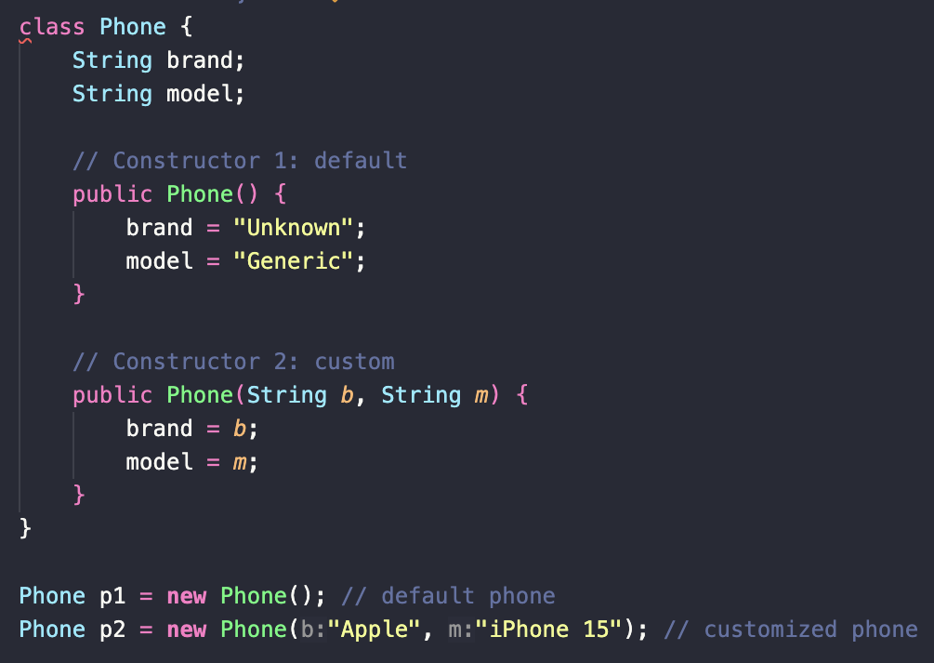
Constructor overloading
When you buy that phone, you can either:
Take the default version (“just give me whatever is in stock”).
Customize it (“I want the iPhone 15 in blue with 256 GB”).

Slide 7
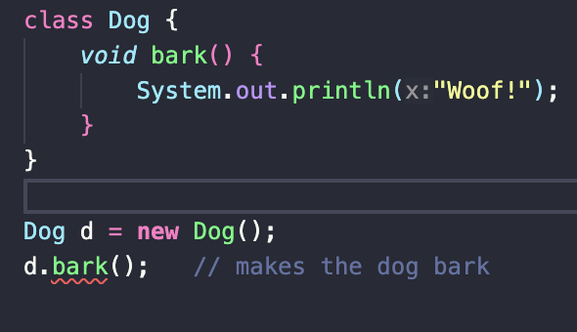
Method
An action your object can perform. Like ”drive” for a car, or ”bark” for a dog.

Slide 8
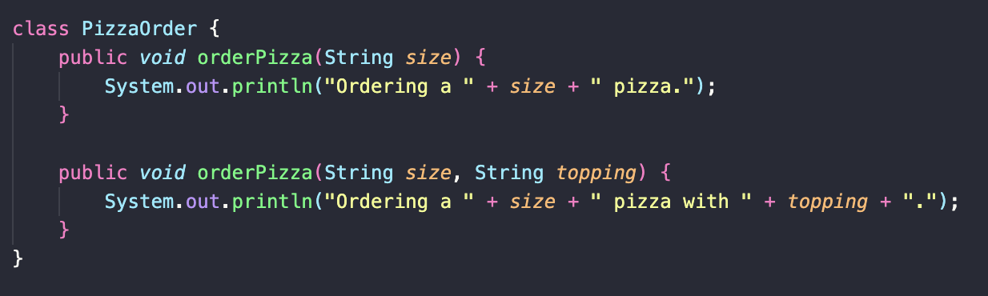
Method overloading
Same action as methods, but different details.
It’s like calling a pizza place. Sometimes you just say the size, other times you say size + topping.

Slide 9
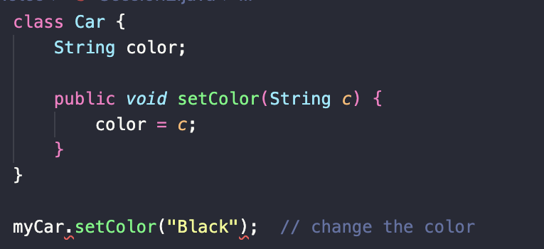
Mutators (setters)
A setter is like a remote control. You can use it to change something inside the object, like turning the volume up on a TV. Or setting a color to be black on a car.

Slide 10
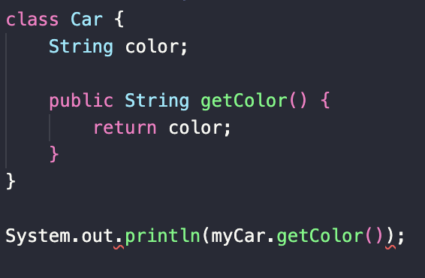
Accessors (Getters)
Getters are like the dashboard. They let you read information without changing it. Like checking your car’s speedometer. Or Checking what color your car is.

Slide 11
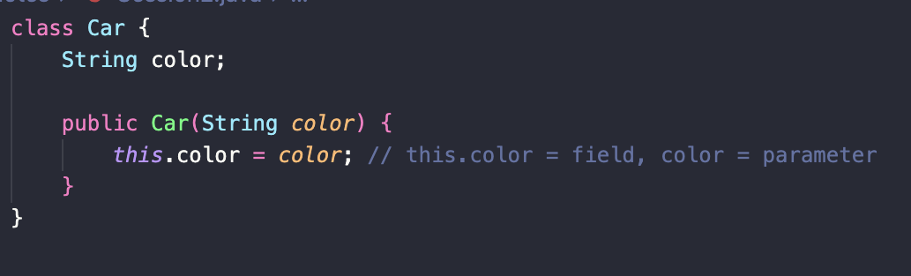
The ‘this’ Keyword
It’s like saying “I am Joe”/”I myself”. It points to the current object’s own fields.

Slide 12
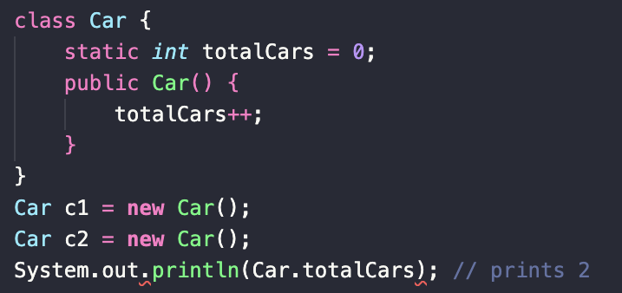
Static
A shared bulletin board in the dorm buildings. Everyone in the building (all objects of the class) can see and update it. Or increasing the number of cars needed for a Car company you work at.

Slide 13
Chapter 2 Overview of topics
Inheritance
Single Inheritance
Multilevel Inheritance
Hierarchical Inheritance

Slide 14
Inheritance
The idea behind inheritance:
One class can inherit fields + methods from another class.
Think of it as a family tree: Children automatically get traits from parents, but can also add their own

Slide 15
Inheritance analogy
Parent class (superclass): Animal -> all animals eat and sleep
Child class (subclass): Dog -> dogs eat, sleep, and bark.

Slide 16
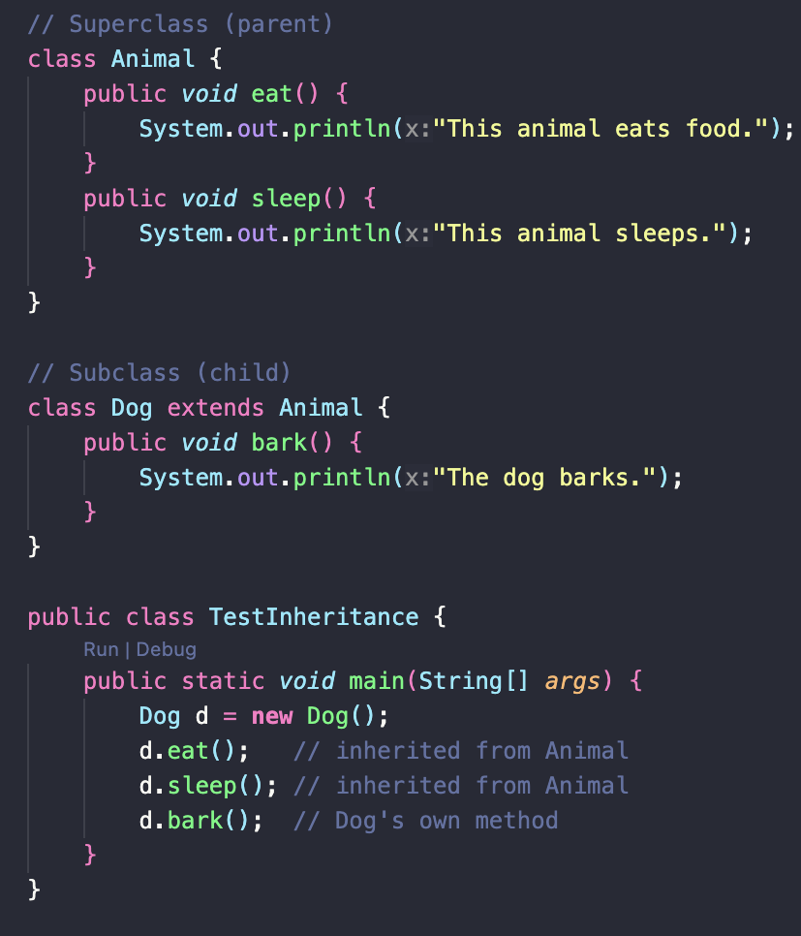
Inheritance code
Output:
This animal eats food.
This animal sleeps.
The dog barks.

Slide 17
Types of Inheritances:
Single inheritance
Multilevel inheritance
Hierarchical inheritance.

Slide 18
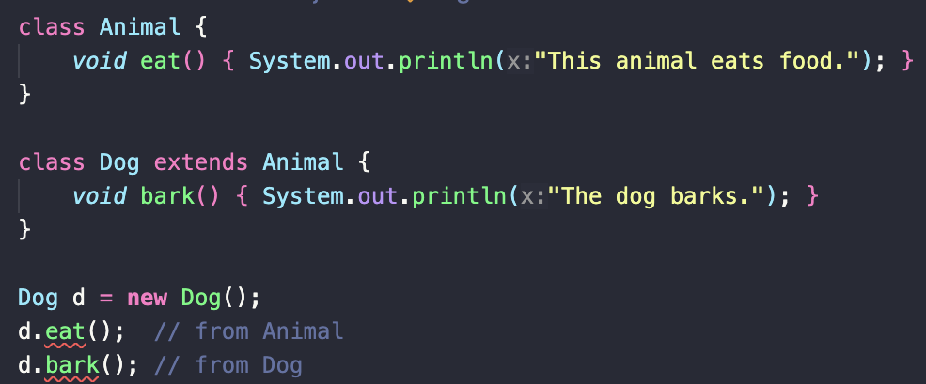
Single inheritance
One child inherits from one parent.
Analogy: You inherit traits from your mom.
Another analogy is Dogs inherit traits from the class Animal.

Slide 19
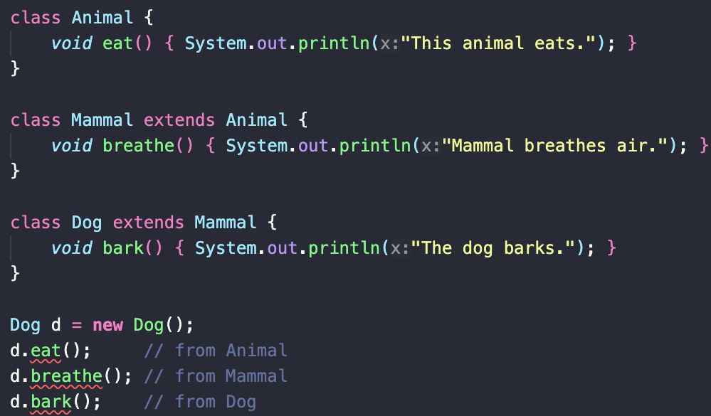
Multilevel Inheritance
A class inherits from a child class, forming a chain.
Analogy: Traits pass from grandparent -> parent -> child.

Slide 20
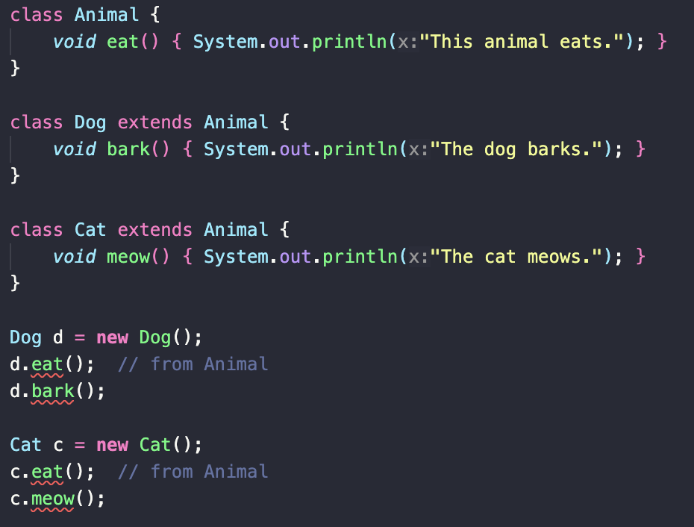
Hierarchical Inheritance
Multiple classes inherit from the same parent.
Analogy: Siblings inherit traits from the same parent.

