Slide 1
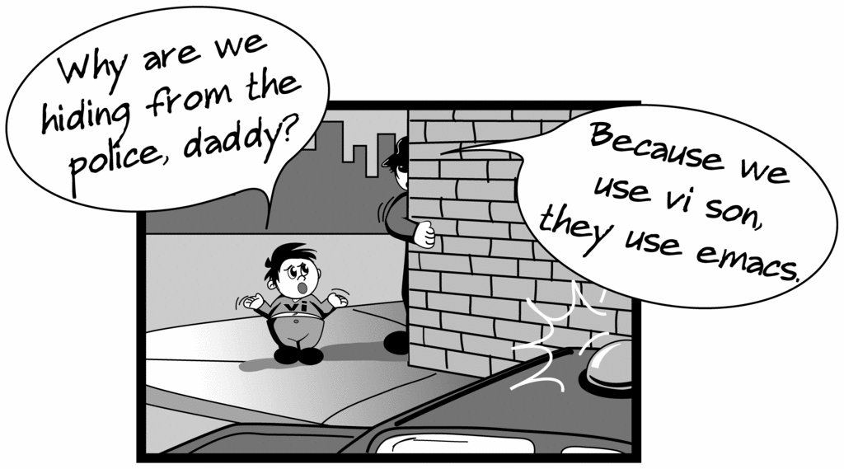
Creating files in Unix/Linux
Requires the use of an Editor
Various Editors:
nano / pico
vi
emacs

Slide 2
Vi editor
The VI editor is the most popular and classic text editor in the Linux family.
Below, are some reasons which make it a widely used editor –
1) available in almost all Linux Distributions
2) works the same across different platforms and Distributions
3) user-friendly.

Slide 3
Modes of Vi editor
Command Mode
Insert Mode
Escape Mode

Slide 4
Modes of Vi editor
Command Mode - vi starts in Command Mode.
vi interprets any characters we type as commands and does not display them in the window.
This mode allows us to move through a file, and to delete, copy, or paste a piece of text. To enter into Command Mode from any other mode, it requires pressing the [Esc] key. If we press [Esc] when we are already in Command Mode, then vi will beep or flash the screen.

Slide 5
Insert Mode - enables you to insert text into the file. –
-Everything that’s typed in this mode is interpreted as input and finally, it is put in the file.
-The vi always starts in command mode. To enter text, you must be in insert mode. To come in insert mode you simply type i. To get out of insert mode, press the Esc key, which will put you back into command mode.

Slide 6
Escape Mode
- enables you to perform tasks such as saving files, executing commands.
-invoked by typing a colon [:], while vi is in Command Mode.
-The cursor will jump to the last line of the screen and vi will wait for a command.

Slide 7
vi editing commands
i - Insert at cursor (goes into insert mode)
a - Write after cursor (goes into insert mode)
A - Write at the end of line (goes into insert mode)
ESC - Terminate insert mode
U - Undo all changes to the entire line
o - Open a new line (goes into insert mode)
dd - Delete line
3dd - Delete 3 lines.

Slide 8
D - Delete contents of line after the cursor
dw - Delete word
4dw - Delete 4 words
cw - Change word
x - Delete character at the cursor
r - Replace character
R - Overwrite characters from cursor onward

Slide 9
s - Substitute one character under cursor continue to insert
S - Substitute entire line and begin to insert at the beginning of the line
Make sure you press the right command otherwise you will end up making undesirable changes to the file.
You can also enter the insert mode by pressing a, A, o,

Slide 10
Moving within file
k - Move cursor up
j - Move cursor down
h - Move cursor left
l - Move cursor right

Slide 11
Saving and closing file
:w - Save the file but keep it open
:q - Quit without saving
:wq - Save the file and quit

Slide 12
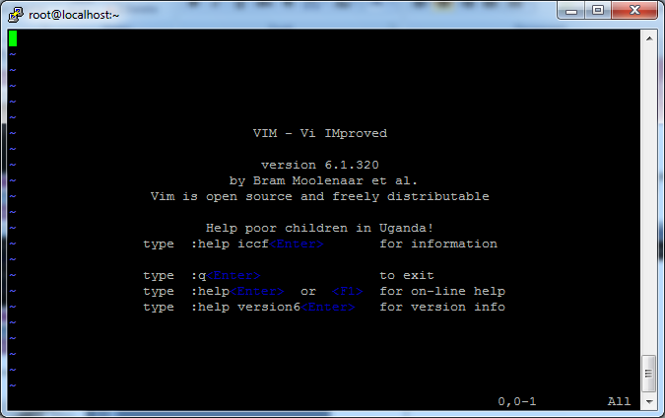
Editing a file using vi
Type “vi” at the prompt

Slide 13
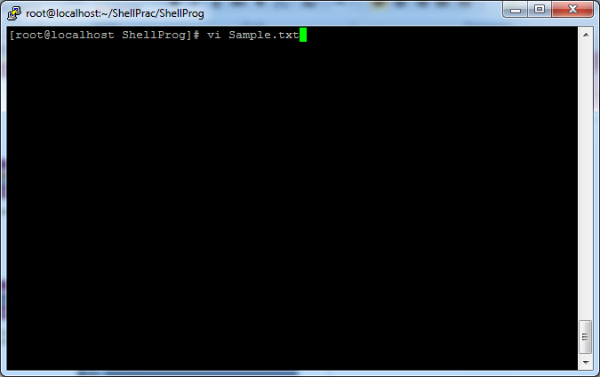
Create a file using vi
Type vi Sample.txt

Slide 14
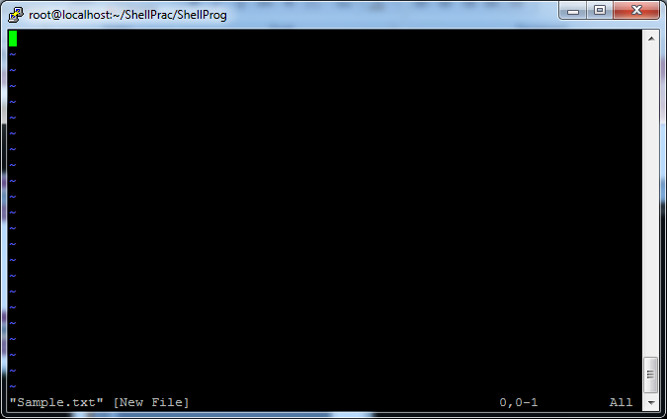
Create a file using vi
After Typing vi Sample.txt, File Created

Slide 15
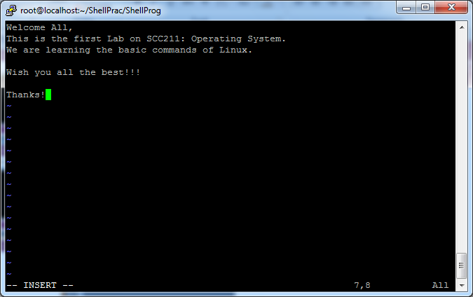
Insert text in a file using vi
To insert: Esc+ i

Slide 16
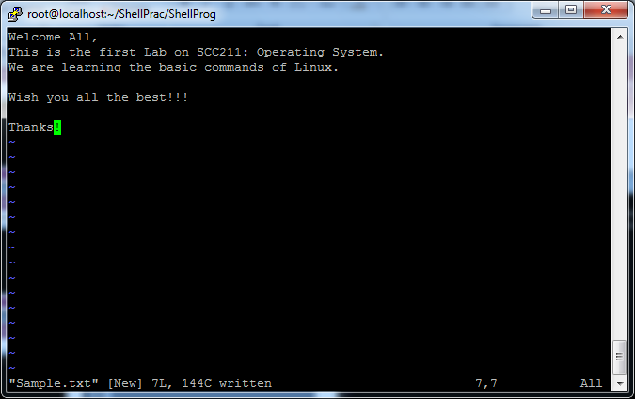
Insert text in a file using vi
To Save File: Esc+ : + w

Slide 17
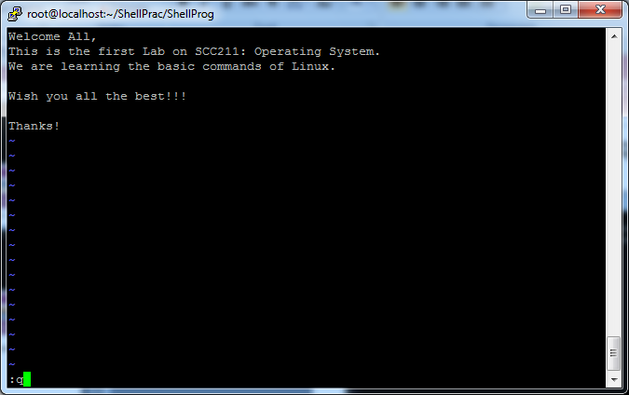
Insert text in a file using vi
To Quit File: Esc+ : + q

Slide 18
Displaying a file
Various ways to display a file in Unix
cat
less
head
tail

Slide 19
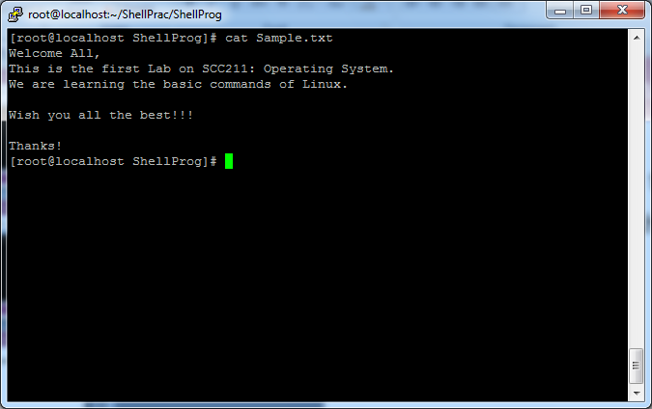
Command: cat
Dumps an entire file to standard output
Good for displaying short, simple files

Slide 20
chmod
There are three types of permissions: read (r), write (w), and execute (x).
To read a file is to view its contents. For example, a text file must have read permission for someone to read the text within.
If the user wants to add a sentence to that file, it needs write permission.
The execute permission enables someone to run a file, such as a shell script or a binary program file
The ls -l command displays the permissions assigned to a file.

Slide 21

user, group, and other.
Each file is associated with an owner and a group and assigned with permission access rights for three different classes of users:
The file owner.
The group members.
Others (everybody else)

Slide 22
operation
- Removes the specified permissions.
+ Adds specified permissions.
= Changes the current permissions to the specified permissions. If no permissions are specified after the = symbol, all permissions from the specified user class are removed.

Slide 23
Directories are special types of files that contain other files and directories.
Permission | Character | Meaning on Directory
Read | - | The directory’s contents cannot be shown.
 | r | The directory’s contents can be shown. (e.g. You can list files inside the directory with ls.)
Write | - | The directory’s contents cannot be altered.
 | w | The directory’s contents can be altered. (e.g. You can create new file ,delete file..etc.)
Execute | - | The directory cannot be changed to.
 | x | The directory can be navigated using cd.

Slide 24
The chmod command allows you to change the permissions on a file using either a symbolic or numeric mode or a reference file.
Symbolic (Text) Method
chmod [OPTIONS] [ugoa…][-+=]perm s FILE
The permissions (perms...) can be explicitly set using either zero or one or more of the following letters: r, w, x . Use a single letter from the set u, g, and o when copying permissions from one to another users class.

Slide 25
Numeric Method
The syntax of the chmod command when using numeric method has the following format
chmod [OPTIONS] NUMBER FILE...
When using the numeric mode, you can set the permissions for all three user classes (owner, group, and all others) at the same time.
the first digit represents the permissions of the file’s owner, the second one the file’s group, and the last one all other users.

Slide 26
Each write, read, and execute permissions have the following number value:
r (read) = 4
w (write) = 2
x (execute) = 1
no permissions = 0
The permissions number of a specific user class is represented by the sum of the values of the permissions for that group.

Slide 27
calculate the totals for all users classes. For example, to give read, write and execute permission to the file’s owner, read and execute permissions to the file’s group and only read permissions to all other users you would do the following:
Owner: rwx=4+2+1=7
Group: r-x=4+0+1=5
Others: r-x=4+0+0=4
Using the method above we come up to the number 754, which represents the desired permissions.

Slide 28
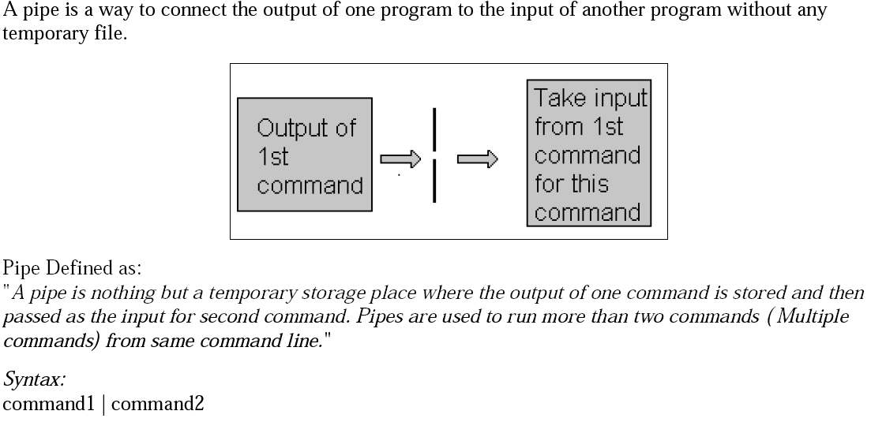
PIPES

Slide 29
A pipe is a form of redirection (transfer of standard output to some other destination) that is used in Linux and other Unix-like operating systems to send the output of one command/program/process to another command/program/process for further processing.
You can make it do so by using the pipe character ‘|’.
It can also be visualized as a temporary connection between two or more commands/ programs/ processes.
Pipes are unidirectional i.e data flows from left to right through the pipeline.
The pipe acts as a container which takes the output of ls -l and gives it to more as input. This command does not use a disk to connect standard output of ls -l to the standard input of more because pipe is implemented in the main memory.

Slide 30
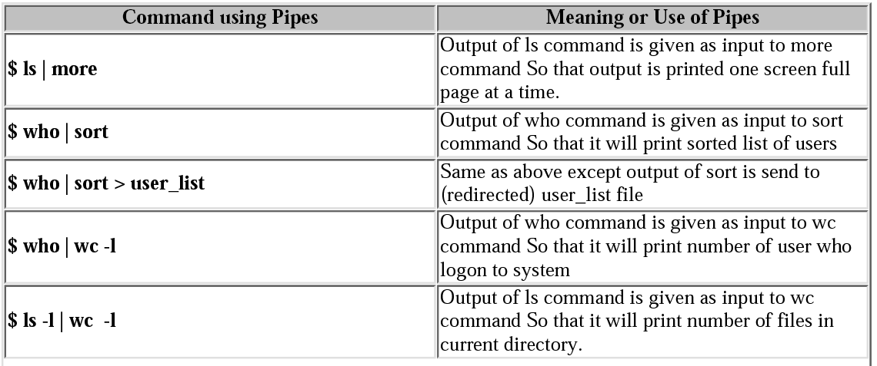
PIPE(Examples)

Slide 31
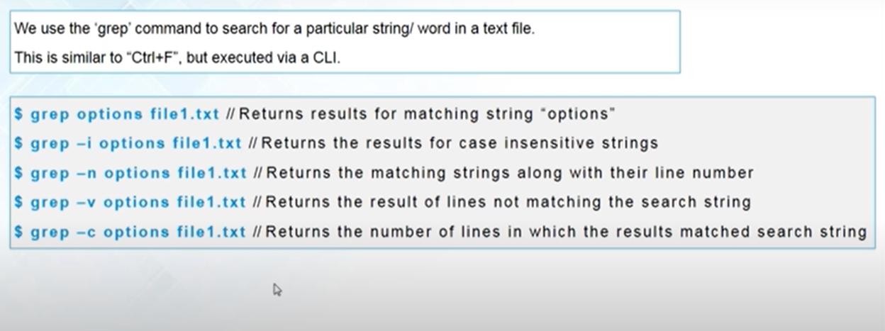
Grep Command
grep searches the named input FILEs for lines containing a match to the given PATTERN.

Slide 32
Shell Scripting

Slide 33
What is a shell?
The user interface to the operating system
Functionality:
Execute other programs
Manage files
Manage processes
Full programming language
A program like any other
This is why there are so many shells

Slide 34
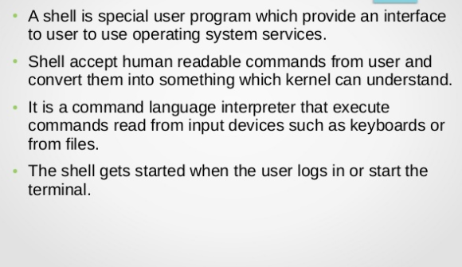

Slide 35
Most Commonly Used Shells
/bin/csh C shell
/bin/tcsh Enhanced C Shell
/bin/sh The Bourne Shell / POSIX shell
/bin/ksh Korn shell
/bin/bash Korn shell clone, from GNU

Slide 36
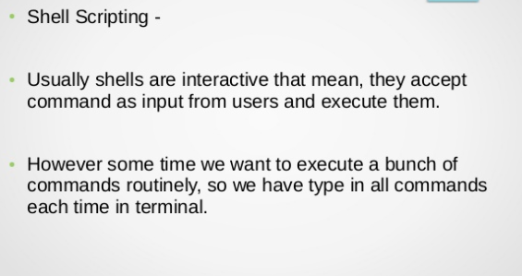

Slide 37
The shell is, after all, a real programming language, complete with variables, control structures, and so forth.
No matter how complicated a script gets, it is still just a list of commands executed sequentially.

Slide 38

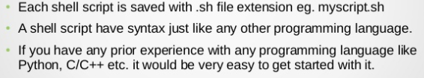

Slide 39
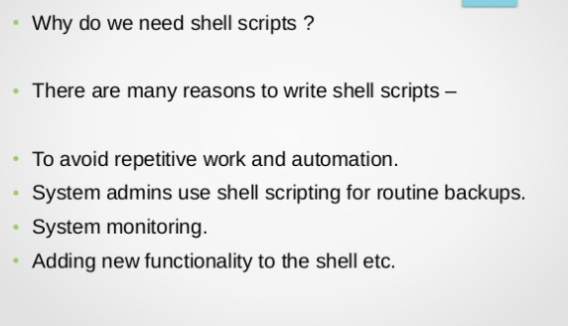

Slide 40
Shell Scripts
A shell script is a regular text file that contains shell or commands
Before running it, it must have execute permission:
chmod +x filename
A script can be invoked as:
./filename.sh

Slide 41
Shell Scripts
When a script is run, the kernel determines which shell it is written for by examining the first line of the script
If 1st line starts with #!pathname-of-shell, then it invokes pathname and sends the script as an argument to be interpreted
If #! is not specified, uses default shell
If a shebang is not specified the script will be parsed by whatever the default interpreter is used by that Shell. For example, the default interpreter for bash is bash and for zsh is sh.
The sequence of characters (#!) is called shebang and is used to tell the operating system which interpreter to use to parse the rest of the file.
Shebang Interpreter Directive

Slide 42
Simple Example
#!/bin/bash echo Hello World

Slide 43
Scripting vs. C Programming
Advantages of shell scripts
Easy to work with other programs
Easy to work with files
Easy to work with strings
Disadvantages of shell scripts
Slower
Not well suited for data structures

Slide 44
echo prints the rest of the line to the screen (standard output).

Slide 45
A variable is a character string to which we assign a value. The value assigned could be a number, text, filename, device, or any other type of data.

Slide 46
Variable Names
The name of a variable can contain only letters (a to z or A to Z), numbers ( 0 to 9) or the underscore character ( _).
By convention, Unix shell variables will have their names in UPPERCASE.
The following examples are valid variable names −
_ALI
TOKEN_A
VAR_1
VAR_2

Slide 47
Following are the examples of invalid variable names −
2_VAR
-VARIABLE
VAR1-VAR2
VAR_A!
The reason you cannot use other characters such as !, *, or - is that these characters have a special meaning for the shell.

Slide 48
Defining Variables
Variables are defined as follows −
variable_name=variable_value
For example −
NAME=“Amity Class"
The above example defines the variable NAME and assigns the value “Amity Class" to it. Variables of this type are called scalar variables. A scalar variable can hold only one value at a time.
Shell enables you to store any value you want in a variable. For example −
VAR1=“Amity Class"
VAR2=100

Slide 49
Accessing Values
To access the value stored in a variable, prefix its name with the dollar sign ($)
For example, the following script will access the value of defined variable NAME and print it on STDOUT −
#!/bin/bash
NAME=“Amity Class"
echo $NAME
The above script will produce the following value −
Amity Class

Slide 50
Read-only Variables
Shell provides a way to mark variables as read-only by using the read-only command.
After a variable is marked read-only, its value cannot be changed.
For example, the following script generates an error while trying to change the value of NAME −
NAME=“Amity Class"
readonly NAME
NAME=“AI Class"
The above script will generate error

Slide 51
Shell Variables
The value of a variable can be returned/used by adding a prefix $
Linux shell scripting are using two types of variables : System Defined Variables & User Defined Variables
a shell script doesn’t require you to declare a type for your variables
The value of a variable can be returned/used by adding a prefix $

Slide 52
To set:
name=value
To Read: $var

Slide 53
Variable Example
#!/bin/bash MESSAGE="Hello World" echo $MESSAGE

Slide 54
You can accept input from the keyboard and assign an input value to a user defined shell variable using read command.
The following script uses he read command which takes the input from the keyboard and assigns it as the value of the variable PERSON and finally prints it on STDOUT.
echo "What is your name?"
read PERSON
echo "Hello, $PERSON"

Slide 55
read multiple variables
read a b c
read -p "Prompt" variable1 variable2
Where,
-p "Prompt" : Display prompt to user without a newline.
variable1 : The first input (word) is assigned to the variable1.
variable2 : The second input (word) is assigned to the variable2.

Slide 56
Example
#! /bin/bash
read -p "Enter your name : " name
"Hi, $name. Let us be friends!"
Save and close the file. Run it as follows:
chmod +x filename.sh
./filename.sh

Slide 57
Example
#!/bin/bash
# read three numbers and assigned them to 3 vars
read -p "Enter number one : " n1
read -p "Enter number two : " n2
read -p "Enter number three : " n3
# display back 3 numbers - punched by user.
echo "Number1 - $n1"
echo "Number2 - $n2"
echo "Number3 - $n3"

Slide 58
Handling Passwords
The -s option causes input coming from a terminal do not be displayed on the screen.
#!/bin/bash
read -s -p "Enter Password : " my_password
echo
echo "Your password - $my_password"

Slide 59
Environmental Variables
NAME MEANING
$HOME Absolute pathname of your home directory
$PATH A list of directories to search for
$USER Your login name
$SHELL Absolute pathname of login shell
$TERM Type of your terminal
$PS1 Prompt

