Slide 1


Work Summary Report
IHPC Assignment on FL
7 May 2021 by Wang Yuan

Slide 2
Summary of works – an outlook of completion
Task assigned | Status, deviation, comments
Read the FL (federated learning) paper and understand its details. | Completed
Read the source code and understand the details and algorithm (the difference of FedSGD and FedAvg, IID and Non-IID data) . | Completed
Setup and run the code to perform the tests presented in the paper and analyze the testing results. | Code setup completed Selected tests¹ have been completed on MNSIT/CIFAR10 datasets due to limited timeline, computing resources² and dataset availability³
Prepare slides to summarize your work. | Completed
Remarks
Only CNN-related tests were performed, MLP-related tests were skipped for the time being.
The candidate only has one laptop PC with a 4GB laptop-level GPU (Nvidia GeForce GTX 1050).
Language datasets (for LSTM training) reported in the paper is not open-source. Besides, the language datasets used in the paper might also be too huge to learn in allowed timeline with the above GPU device.

Slide 3
Summary of works – detailed list down
Read and understood the vanilla FL paper provided.
Search, read, and understood the supplementary document of the paper.
Read the source code provided and performed test runs of the code in PyTorch.
Made necessary modifications and corrected errors for the original source code for more efficient running, logging and visualization of the test results.
Created CNN models¹ in PyTorch by following the descriptions in the paper, in order to
reproduce the experiment setup as close as possible,
improve performance of test runs.
Performed selected tests of most of the experiment categories presented in the paper using the created models and analyzed the test results and conducted parameter tuning to optimize the test performance (~350 test runs were conducted in total).
Created a Github repository to store the code, related Jupyter notebooks, and other essential files used and created during the assignment.
Remark
These models were created for performing tests due to the original models used in the provided source code differs from the ones reported in the paper. Moreover, the created models also outperform these original models in the source code in terms of test accuracy with identical training parameters.

Slide 4
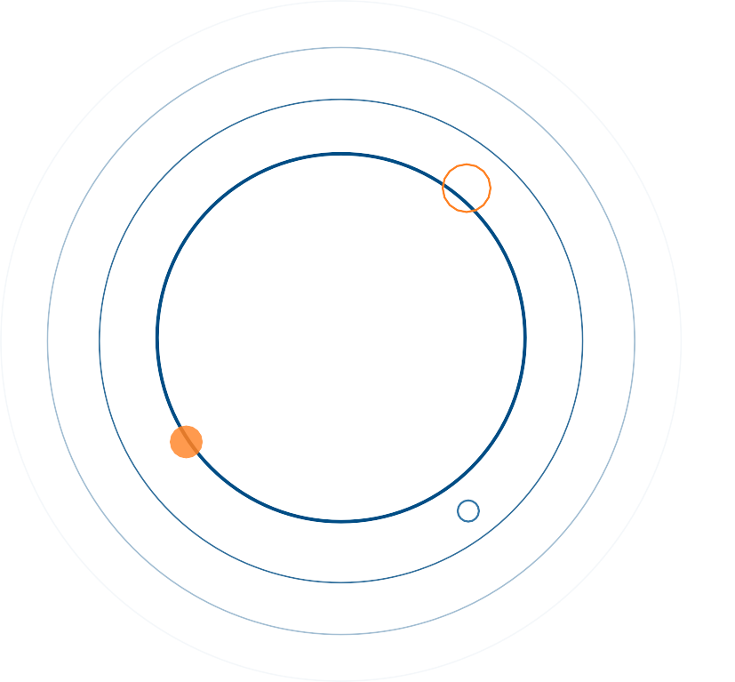




1
2
CONTENTS
3
4
Federated Learning - Algorithm
Experimental tests
Problems Encountered & Solutions
Concluding Remarks

Slide 5
1. Federated learning – problem statement
Deep learning, an non-convex optimization problem
Learning objective is usually formulated as empirical risk minimization in a finite-sum form
where
Distributed machine learning can be formulated as
where and ,
Federated learning (FL) especially focus on scenarios
Data can be accessed by each worker device/client is generated by the users of those devices.
Data can be added or delated by the device users during training, data never leave the local device.
Data generation rate can significantly differs from device to device due to variation in users’ activities
These setup leads FL to
Non-IID data distribution; and
Unbalanced amount of data.
Other key challenges of FL includes
Privacy preserving
Communication efficiency
System heterogeneity
and no longer holds for FL

Slide 6

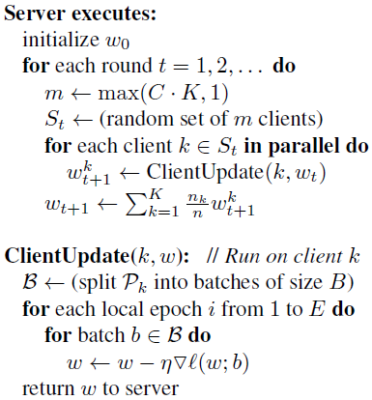






1. Federated learning – the paradigm and algorithm
Cloud server
Three key FL parameters:
Fraction of participant client (C)
Number of local epoch (E)
Number of local batch size (B)
Schedule
Coordinate
Aggregate
Clients
Participate
Train
Update
Algorithm | Local epoch (E) | Local batch size (B)
FedSGD | =1 (fixed) | All of locally stored data
FedAvg | >1 (tunable) | Less than number of local data (tunable)
. . . .

Slide 7
1
2
CONTENTS
3
4
Federated Learning - Algorithm
Experimental tests
Problems Encountered & Solutions
Concluding Remarks

Slide 8
2. Experimental tests – the general approaches
Experiment set | Purpose¹ and remarks | Approach | Dataset and model
Experiment 1 | Test the benefit of increasing parallelism: Experiment 1A use IID data Experiment 1B use non-IID data | Fix the number of local epoch E Fix the local batch size B Adjust the faction parameter C Use grid search to optimize the learning rate | MNIST dataset CNN model
Experiment 2 | Test the benefit of increasing local computation: Experiment 1A use IID data Experiment 1B use non-IID data | Fix the faction parameter C Adjust the number of local epoch E Adjust the local batch size B Use grid search to optimize the learning rate | MNIST dataset CNN model
Experiment 3 | Test the performance of FL against a baseline SGD implementation Experiment 3A tests accuracy-to-comm. rounds convergence Experiment 3B tests accuracy-to-minibatch convergence IID scenario for both experiments | Experiment 3A: Fix the all the FL parameter C, B, and E Experiment 3B: Fix local batch size B, compare SGD with several combinations of parameter C and E | CIFAR10 dataset CNN model
Remark
The purpose of these test is to evaluate and compare FL algorithms by reproducing the results in the provided FL paper, rather than achieving/benchmarking highest possible SOAT test accuracy on MNIST/CIFAR10.

Slide 9
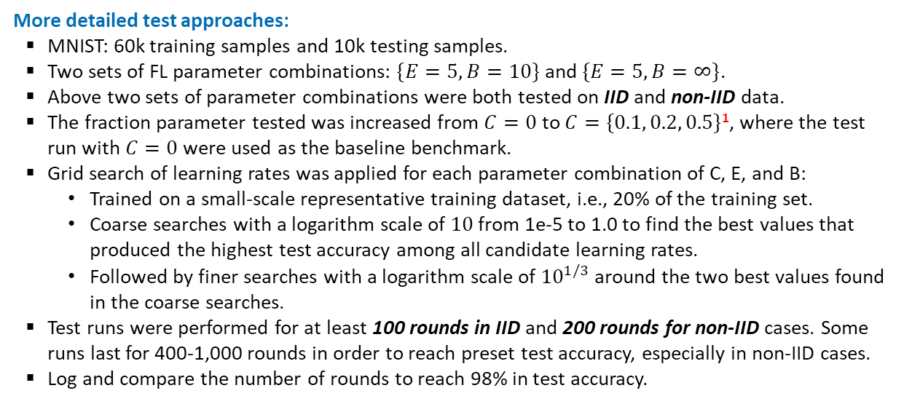
2. Experimental tests – Experiment set 1
More detailed test approaches:
MNIST: 60k training samples and 10k testing samples.
Two sets of FL parameter combinations: $\{E=5, B=10\}$and $\{E=5, B=∞\}$.
Above two sets of parameter combinations were both tested on IID and non-IID data.
The fraction parameter tested was increased from $C=0$ to $C=\{0.1, 0.2, 0.5\}$¹, where the test run with $C=0$ were used as the baseline benchmark.
Grid search of learning rates was applied for each parameter combination of C, E, and B:
Trained on a small-scale representative training dataset, i.e., 20% of the training set.
Coarse searches with a logarithm scale of $10$ from 1e-5 to 1.0 to find the best values that produced the highest test accuracy among all candidate learning rates.
Followed by finer searches with a logarithm scale of ${10}^{1/3}$ around the two best values found in the coarse searches.
Test runs were performed for at least 100 rounds in IID and 200 rounds for non-IID cases. Some runs last for 400-1,000 rounds in order to reach preset test accuracy, especially in non-IID cases.
Log and compare the number of rounds to reach 98% in test accuracy.
Remark
Unlike the FL paper, client fraction C=1.0 was skipped due to limited timeline and limited computing power. However, using C={0.0, 0.1, 0.2, 0.5} was sufficient to reproduce the fundamental observations and the core conclusions drawn in the paper.

Slide 10
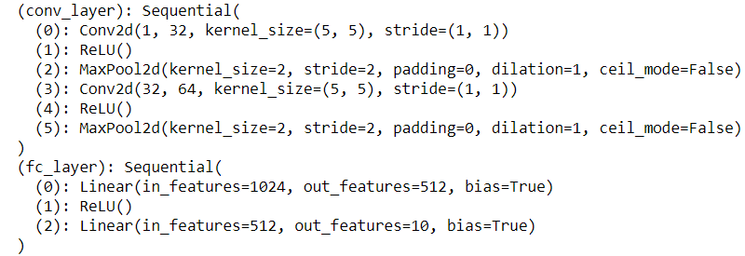
2. Experimental tests – Experiment set 1
The CNN model used in training and tests:
The model was created as per descriptions in the FL paper:
“A CNN with two 5x5 convolution layers (the first with 32 channels, the second with 64, each followed with 2x2 max pooling), a fully connected layer with 512 units and ReLu activation, and a final softmax output layer (1,663,370 total parameters).”
The model architecture created in PyTorch is shown below, which has about 600,000 trainable parameters
27x of the original model in the source code, 0.34x of the model described in the paper

Slide 11
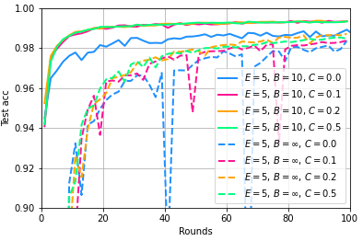
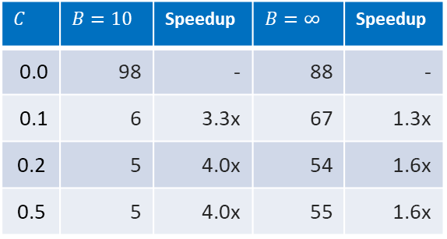
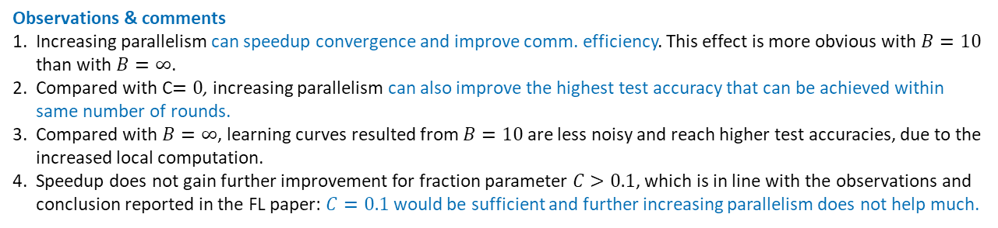
2. Experimental tests – Experiment 1A, increasing parallelism (IID)
Number of rounds for reaching 98% in test accuracy and speedup by increasing parallelism
$$C$$ | $$B=10$$ | Speedup | $$B=∞$$ | Speedup
0.0 | 98 | - | 88 | -
0.1 | 6 | 3.3x | 67 | 1.3x
0.2 | 5 | 4.0x | 54 | 1.6x
0.5 | 5 | 4.0x | 55 | 1.6x
Observations & comments
Increasing parallelism can speedup convergence and improve comm. efficiency. This effect is more obvious with $B=10$ than with $B=∞$.
Compared with C$=0$, increasing parallelism can also improve the highest test accuracy that can be achieved within same number of rounds.
Compared with $B=∞$, learning curves resulted from $B=10$ are less noisy and reach higher test accuracies, due to the increased local computation.
Speedup does not gain further improvement for fraction parameter $C>0.1$, which is in line with the observations and conclusion reported in the FL paper: $C=0.1$ would be sufficient and further increasing parallelism does not help much.

Slide 12
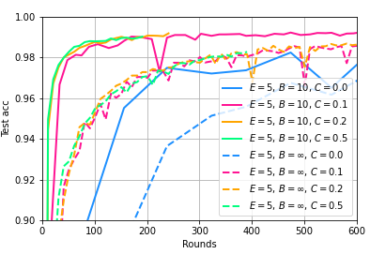
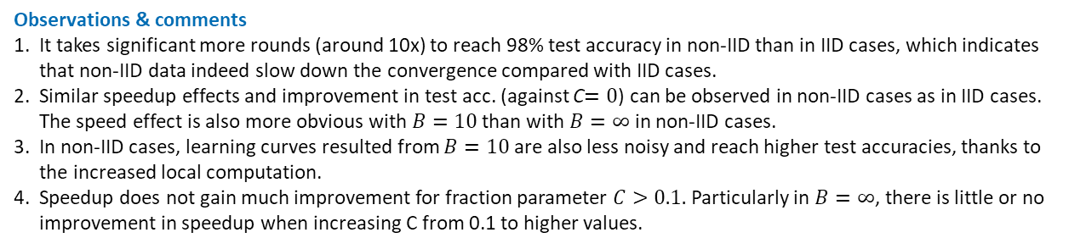
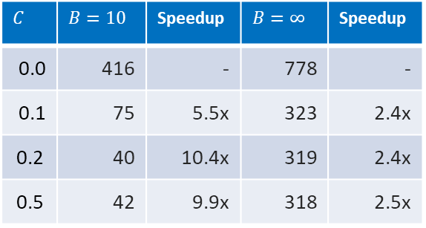
2. Experimental tests – Experiment 1B, increasing parallelism (non-IID)
Number of rounds for reaching 98% in test accuracy and speedup by increasing parallelism
$$C$$ | $$B=10$$ | Speedup | $$B=∞$$ | Speedup
0.0 | 416 | - | 778 | -
0.1 | 75 | 5.5x | 323 | 2.4x
0.2 | 40 | 10.4x | 319 | 2.4x
0.5 | 42 | 9.9x | 318 | 2.5x
Observations & comments
It takes significant more rounds (around 10x) to reach 98% test accuracy in non-IID than in IID cases, which indicates that non-IID data indeed slow down the convergence compared with IID cases.
Similar speedup effects and improvement in test acc. (against C$=0$) can be observed in non-IID cases as in IID cases. The speed effect is also more obvious with $B=10$ than with $B=∞$ in non-IID cases.
In non-IID cases, learning curves resulted from $B=10$ are also less noisy and reach higher test accuracies, thanks to the increased local computation.
Speedup does not gain much improvement for fraction parameter $C>0.1.$ Particularly in $B=∞$, there is little or no improvement in speedup when increasing C from 0.1 to higher values.

Slide 13
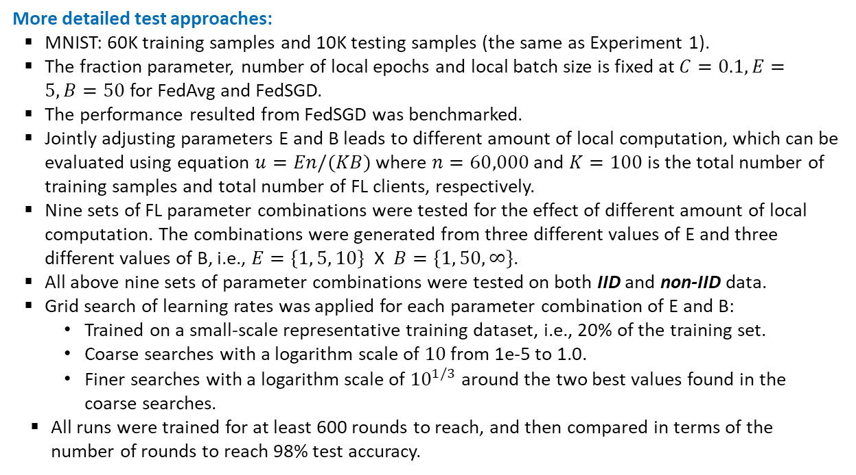
2. Experimental tests – Experiment set 2
More detailed test approaches:
MNIST: 60K training samples and 10K testing samples (the same as Experiment 1).
The fraction parameter, number of local epochs and local batch size is fixed at $C=0.1, E=5, B=50$ for FedAvg and FedSGD.
The performance resulted from FedSGD was benchmarked.
Jointly adjusting parameters E and B leads to different amount of local computation, which can be evaluated using equation $u=En/(KB)$ where $n=60,000$ and $K=100$ is the total number of training samples and total number of FL clients, respectively.
Nine sets of FL parameter combinations were tested for the effect of different amount of local computation. The combinations were generated from three different values of E and three different values of B, i.e., $E=\{1, 5, 10\}$ X $B=\{1, 50, ∞\}$.
All above nine sets of parameter combinations were tested on both IID and non-IID data.
Grid search of learning rates was applied for each parameter combination of E and B:
Trained on a small-scale representative training dataset, i.e., 20% of the training set.
Coarse searches with a logarithm scale of $10$ from 1e-5 to 1.0.
Finer searches with a logarithm scale of ${10}^{1/3}$ around the two best values found in the coarse searches.
All runs were trained for at least 600 rounds to reach, and then compared in terms of the number of rounds to reach 98% test accuracy.

Slide 14
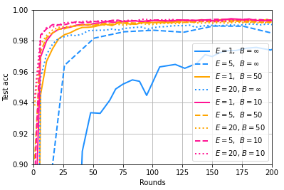
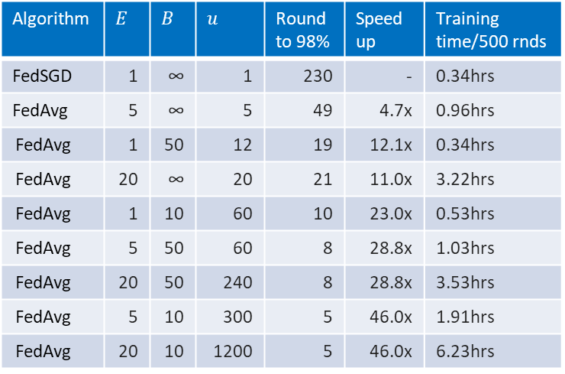
2. Experimental tests – Experiment 2A, increasing local computation (IID)
Algorithm | $$E$$ | $$B$$ | $$u$$ | Round to 98% | Speedup | Training time/500 rnds
FedSGD | 1 | ∞ | 1 | 230 | - | 0.34hrs
FedAvg | 5 | ∞ | 5 | 49 | 4.7x | 0.96hrs
FedAvg | 1 | 50 | 12 | 19 | 12.1x | 0.34hrs
FedAvg | 20 | ∞ | 20 | 21 | 11.0x | 3.22hrs
FedAvg | 1 | 10 | 60 | 10 | 23.0x | 0.53hrs
FedAvg | 5 | 50 | 60 | 8 | 28.8x | 1.03hrs
FedAvg | 20 | 50 | 240 | 8 | 28.8x | 3.53hrs
FedAvg | 5 | 10 | 300 | 5 | 46.0x | 1.91hrs
FedAvg | 20 | 10 | 1200 | 5 | 46.0x | 6.23hrs
Observation & comments
Compared with FedSGD, increasing local computation is indeed very effective in accelerating the convergence, decreasing the comm. cost, and decreasing the oscillation in test accuracy as well.
The gain in such speedup/acceleration declines as the local computation become massive enough (e.g., u>60).
In addition to what has been reported in the FL paper, it was found that as the local computation increase, the training time also increases in general, and the increase in local epoch number (i.e., parameter E) has stronger impact.
Remark:
These tests were performed in a single-machine standalone simulations manner for the time being. It would be interest in the future to see the performance and time elapsed on real-world distributed testbeds like Raspberry Pis.

Slide 15
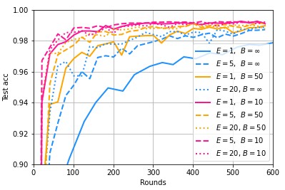
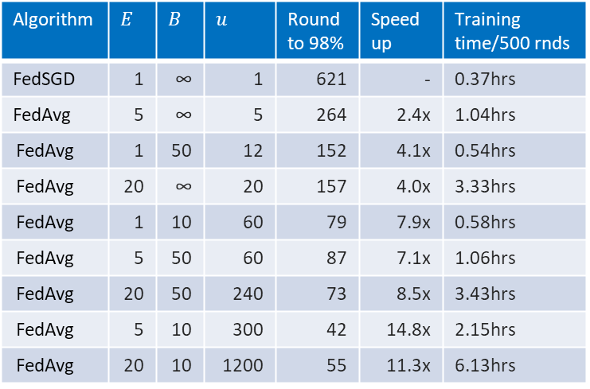
2. Experimental tests – Experiment 2B, increasing local computation (non-IID)
Algorithm | $$E$$ | $$B$$ | $$u$$ | Round to 98% | Speedup | Training time/500 rnds
FedSGD | 1 | ∞ | 1 | 621 | - | 0.37hrs
FedAvg | 5 | ∞ | 5 | 264 | 2.4x | 1.04hrs
FedAvg | 1 | 50 | 12 | 152 | 4.1x | 0.54hrs
FedAvg | 20 | ∞ | 20 | 157 | 4.0x | 3.33hrs
FedAvg | 1 | 10 | 60 | 79 | 7.9x | 0.58hrs
FedAvg | 5 | 50 | 60 | 87 | 7.1x | 1.06hrs
FedAvg | 20 | 50 | 240 | 73 | 8.5x | 3.43hrs
FedAvg | 5 | 10 | 300 | 42 | 14.8x | 2.15hrs
FedAvg | 20 | 10 | 1200 | 55 | 11.3x | 6.13hrs
Observations & comments
Like Experiment 2B, non-IID data slows down the convergence significantly and leads to more noisy learning curves compared with those in the IID cases.
Increasing local computation is still effective in accelerating the convergence compared with FedSGD, albeit the speedup benefits become less significant than in IID cases.
Similarly, in the non-IID cases, as the local computation increases, the training time also increases in general.

Slide 16
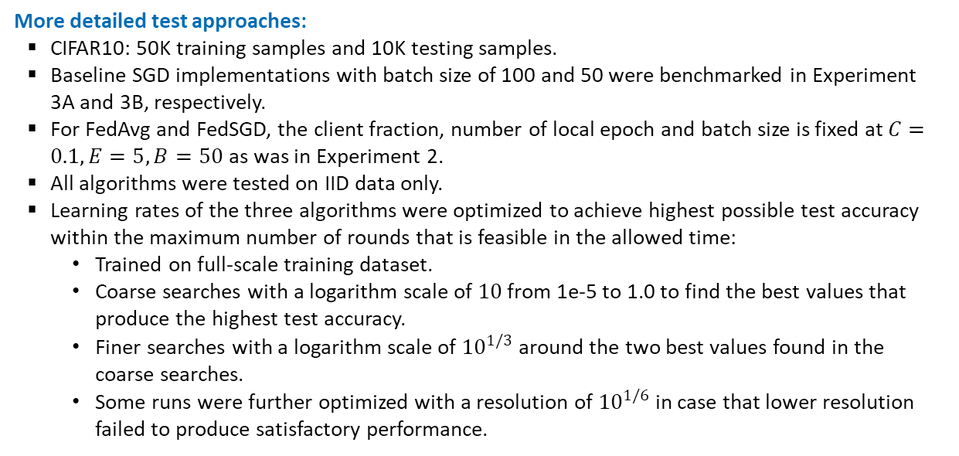
2. Experimental tests – Experiment set 3
More detailed test approaches:
CIFAR10: 50K training samples and 10K testing samples.
Baseline SGD implementations with batch size of 100 and 50 were benchmarked in Experiment 3A and 3B, respectively.
For FedAvg and FedSGD, the client fraction, number of local epoch and batch size is fixed at $C=0.1, E=5, B=50$ as was in Experiment 2.
All algorithms were tested on IID data only.
Learning rates of the three algorithms were optimized to achieve highest possible test accuracy within the maximum number of rounds that is feasible in the allowed time:
Trained on full-scale training dataset.
Coarse searches with a logarithm scale of $10$ from 1e-5 to 1.0 to find the best values that produce the highest test accuracy.
Finer searches with a logarithm scale of ${10}^{1/3}$ around the two best values found in the coarse searches.
Some runs were further optimized with a resolution of ${10}^{1/6}$ in case that lower resolution failed to produce satisfactory performance.

Slide 17
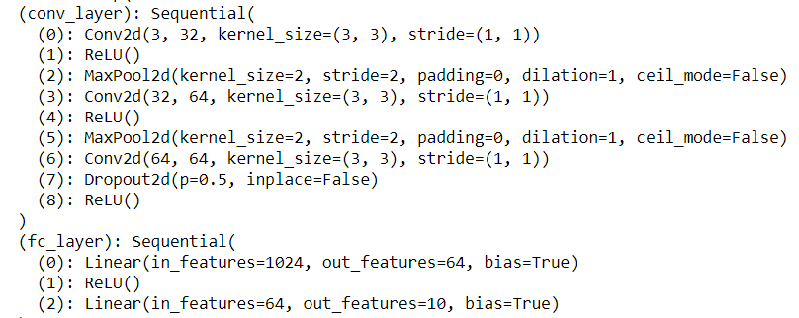
2. Experimental tests – Experiment set 3
The CNN model used in training and tests:
The FL paper reports that the model for CIFAR10 training is taken from the TensorFlow tutorial. However, the reference link provided in the paper has become invalid.
As an analogue, the architecture of the model used in Experiment 3 also follows the current TensorFlow tutorial (slightly different from the descriptions in the FL paper).
In addition, a Dropout layer was added right after the third Conv filter to prevent overfitting from happening too early and to improve the test accuracy of SGD and FedAvg within 4K rounds as much as possible.
The resulted model was written in PyTorch and is shown below, which has about 123,000 trainable parameters
2x of the original model in the source code, 1/8x of the model described in the paper.

Slide 18
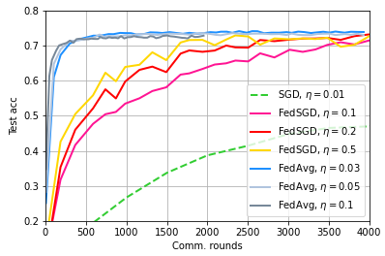
2. Experimental tests – Experiment 3A, accuracy-to-rounds convergence
Observations & comments
In the table of speedup benchmark, the runs that achieves the highest test accuracy was picked for each algorithm.
FedAvg and FedSGD achieves remarkable speedup in convergence to three different target accuracies due to the benefit of parallelism compared with pure SGD.
FedAvg achieves the most speed among all algorithms since FedAvg performs the most amount of local mini batch updates.
For FedAvg and FedSGD, some of the larger learning rate leads to quicker convergence but a lower test accuracy, e.g., FedAvg with lr=0.03 and FedSGD with lr=0.1 (surpass the other runs after 6K rounds, not shown in this figure).
Test accuracy | Round to 70% & speedup | speedup | Round to 72% & speedup | speed | Round to 74% & speed up
SGD | 19,000 | - | 23,000 | - | 37,500 | -
FedSGD | 3,268 | 5.8x | 4,202 | 5.5x | 5,836 | 6.4x
FedAvg | 293 | 64.8x | 431 | 53.4x | 1,585 | 23.7x

Slide 19
2. Experimental tests – Experiment 3A, accuracy-to-rounds convergence
Number of rounds for reaching target test accuracies and speedup benchmark among SGD, FedSGD, FedAvg
Test accuracy | Round to 70% & speedup | speedup | Round to 72% & speedup | speed | Round to 74% & speed up
SGD | 19,000 | - | 23,000 | - | 37,500 | -
FedSGD | 3,268 | 5.8x | 4,202 | 5.5x | 5,836 | 6.4x
FedAvg | 293 | 64.8x | 431 | 53.4x | 1,585 | 23.7x
Observations & comments
In the table of speedup benchmark, the runs that achieves the highest test accuracy was picked for each algorithm.
FedAvg and FedSGD achieves remarkable speedup in convergence to three different target accuracies due to the benefit of parallelism compared with pure SGD.
FedAvg achieves the most speed among all algorithms since FedAvg performs the most amount of local mini batch updates.
For FedAvg and FedSGD, some of the larger learning rate leads to quicker convergence but a lower test accuracy, e.g., FedAvg with lr=0.03 and FedSGD with lr=0.1 (surpass the other runs after 6K rounds, not shown in this figure).

Slide 20
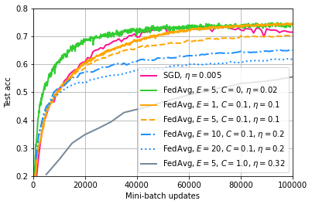
2. Experimental tests – Experiment 3B, accuracy-to-minibatch convergence
Observations & comments
Test runs of every algorithms were performed up to 100K minibatch updates. Learning rates of every algorithms are optimized to reach the highest possible test accuracy within 100K minibatch updates.
Just like the FL paper, the FedAvg test run with fraction C=0 achieves the quickest per-minibatch convergence among all FedAvg implementations.
However, unlike the FL paper, in this Experiment 3B, FedAvg with C=0 also outperforms the baseline SGD in terms of per-minibatch convergence rate in the first 10,000 minibatch updates (but ties with SGD in terms of average convergence rate around 50,000 minibatch updates where both algorithms reach their highest test accuracies).
Except for the FedAvg test run with C=0, other FedAvg test runs have similar per-minibatch progress as SGD within the first 10,000 minibatch updates, which is in line with the FL paper.
In addition, among all FedAvg runs, too many local computation (E>5) and too much parallelism (C=1.0) tends to slow down the per-minibatch convergence rate remarkably.

Slide 21
1
2
CONTENTS
3
4
Federated Learning - Algorithm
Experimental tests
Problems Encountered & Solutions
Concluding Remarks

Slide 22
3. Problems encountered & solutions
Description of issues | Causes | Possible solutions
Has not been able to perform more extensive tests, including: MLP-related experiments Very large local epoch number | [Major] Computing power of the available device is rather limited, which has considerably slowed down the overall progress [Minor] Allowed timeline is limited | Continue the unfinished test works in the future Get access to high-performance computing resources
Has not been able to perform tests with greater number of rounds, preventing more complete and in-depth observation and analysis from being conducted | Same as the above | Same as the above
Has not been able to further tune/optimize the training parameters such as the learning-rate decay, preventing more useful cases from being studied | Same as the above | Same as the above
Has not been able to perform more tests on LSTM models with language datasets | [Minor] Same as the above [Major] Yet to find suitable language datasets and models | Same as the above Search open-source language datasets that fit FL settings. Search suitable off-the-shelf models or create ones.

Slide 23
1
2
CONTENTS
3
4
Federated Learning - Algorithm
Experimental tests
Problems Encountered & Solutions
Concluding Remarks

Slide 24
4. Concluding remarks
Quick summary of completed works
Read and understood the provided FL paper as well as the searched supplementary document of the paper.
Read the provided source code, setup the experiment and performed test runs of the code, made necessary modifications and corrected errors for the original source code.
Created models and performed three different sets of experimental test (four in total as per FL paper) on two datasets (MNIST & CIFAR10), tuned parameters to improve the test performance for more accurate analysis.
Possible future explorations include
Non-IID scenarios for CIFAR10 training
Unbalanced non-IID scenarios for both MNIST and CIFAR10 training
Experiment with language models and datasets
Applying Momentum/NAG acceleration as well as other preconditioned methods (RMSprop, Adam, etc.) to FedAvg and FedSGD
Experiment using real-world IoT edge devices and networks (e.g., Raspberry Pi) rather than stand-alone simulation on single machine

