Slide 1
Lesson 02 Unit & Integration Tests
CSCN72010 Software Quality I: Testing Tools and Methodologies
Fall 2023

Slide 2
Agenda
Review Software Quality
Unit Testing
Integration Testing

Slide 3
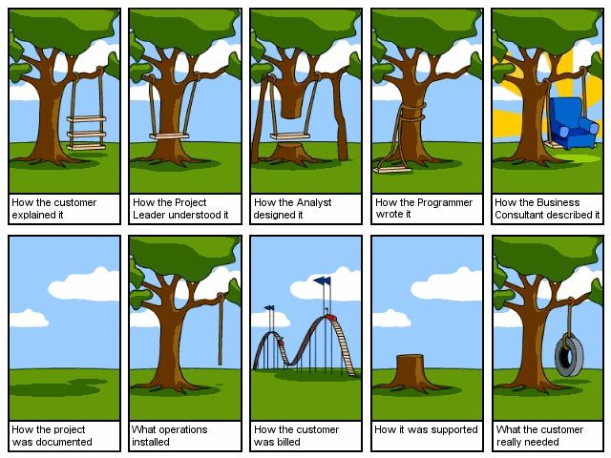
Poor Software Quality
Author unknown

Slide 4
Poor Software Quality…
Communication breakdown in requirements and design
Causes?
Solutions?

Slide 5
Unit Testing

Slide 6
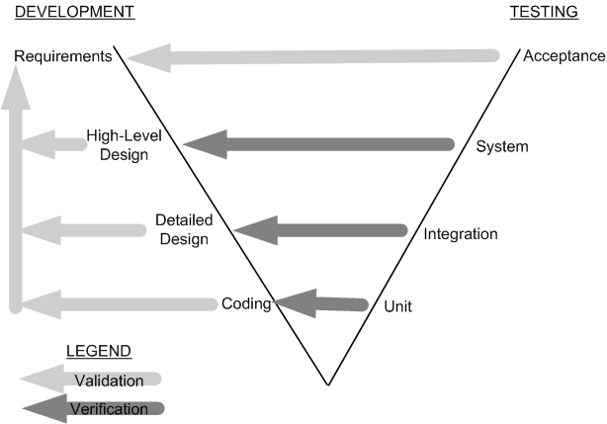
Testing Level – Unit Testing
Unit Testing
Individual program units, such as procedures, functions, methods in isolation
Development and testing phases in the V model

Slide 7
What is Unit Test?
Add Function
Input(num1, num2)
Summation
Is the add function providing us with the correct result?
Two options
Use the function within the application and then test it with the application
Write code to test the function before it goes to production
This code is called a Unit Test

Slide 8
Why Unit Test?
Identify defects early on
Reduce costs
Facilitates refactoring (restructuring) of code
Improve overall quality

Slide 9
Unit Testing –Types
Static Unit Testing
Code is examined over all possible behaviors that might arise during run time
Code of each unit is validated against requirements of the unit by reviewing the code
Dynamic Unit Testing
A program unit is executed, and its outcomes observed
One observes some representative program behavior; and can form some conclusions about the quality of the system

Slide 10
Dynamic Unit Testing (continued)
Units can invoke other units (methods can invoke other methods)
The emulation of the units in turn called by the UUT are called stubs
Stubs are dummy programs
The test driver and the stubs are together called scaffolding
The low-level design document provides guidance for selection of input test data

Slide 11
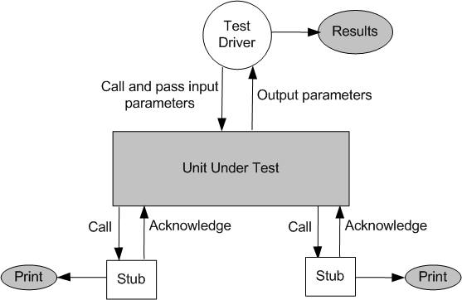
Dynamic Unit Testing (continued 2)
Test Driver
Program that invokes the unit under test (UUT)
Passes input parameters to the UUT and compares the result returned by the UUT to the expected outcome
Results: Pass/Fail (based on the comparison of the actual and expected results
Stubs
Units can invoke other units (and so on…)
Stubs are dummy programs to emulate the units invoked by the UUT
They return predetermined values/messages
TEST DRIVER + STUBS = SCAFFOLDING

Slide 12
Unit Testing Tools

Slide 13
Microsoft Unit Testing Framework for C#
Commonly called MSTest
Many testing frameworks available
JUnit is for Java applications, NUnit is for C#
MSTest, NUnit and JUnit are dynamic testing tools
Require the execution of the program
Can be used for integration testing, regression testing, and system testing as well by acting as a test driver

Slide 14
MSTest Cases
The .cs file has a class and method defined when you created it
Uses [TestClass] and [TestMethod] attributes
These make the methods discoverable from the Test Explorer Window
[TestMethod] always returns void
To produce a test result, we must include an assert using the class Assert
The Assert class contains many other methods for comparing expected versus actual results

Slide 15
MSTest Assertion Methods
Link to page with Assert Class methods
Examples (not exhaustive):
IsTrue()
IsFalse()
AreEqual()
AreNotEqual()
IsNull()

Slide 16
Structure of Test Project
Project containing your tests should be named ProjectThatYouAreTesting.Tests
This is a common naming standard that we will use in this course
Companies can have their own naming standard
It is important to be consistent and clear
Give TestClass a name that groups that tests within it
E.g. ArithmeticTests

Slide 17
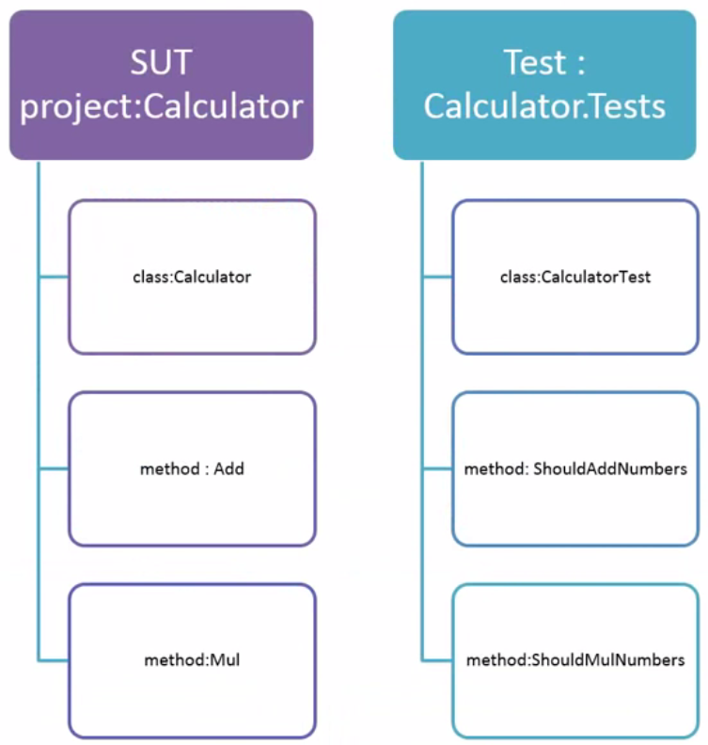
Structure of Test Project (continued)
SUT
System Under Test

Slide 18
Explanatory Names
Use explanatory names for your test methods, to make it easier to identify which tests are failing. For example:
public void Add_3_4_Return7()
{
}

Slide 19
Arrange, Act , Assert (AAA)
"Arrange-Act-Assert"
A pattern for arranging and formatting code in Unit Test methods
Each method should group these functional sections, separated by blank lines:
Arrange all necessary preconditions and inputs.
Act on the object or method under test.
Assert that the expected results have occurred.
Notes:
REVIEW

Slide 20
Arrange, Act , Assert (AAA) (continued)
[TestMethod]
public void Add_3_4_Return7()
{
//Arrange
int num1 = 3;
int num2 = 4;
int result;
//Act
result = Methods.AreEqual(num1, num2);
//Assert
Assert.AreEqual(7, result);
}

Slide 21
Integration Testing

Slide 22
Unit Testing Recap
Unit tests test small program units or modules of a software system
Often individual classes or small components such as methods
Unit tests are:
Fully automated
Easy to develop using a framework such as MSTest
Execute quickly
Provide good test coverage
However, …

Slide 23
Unit Tests Alone Are Not Enough
Your classes and their methods may be implemented correctly
They are well-tested individually
However, that doesn't mean your system's components – made of many classes – are built to work together properly
We need to test modules working in combination
Termed Integration Testing

Slide 24
Testing Level – Integration Testing
Unit Testing
Individual program units, such as procedures, functions, methods in isolation
Integration Testing
Modules are assembled to construct a larger subsystem and tested
Development and testing phases in the V model

Slide 25
Coupling
In Software Engineering, coupling refers to the degree of inter-relationship or dependency between modules.
Highly coupled program units usually have more errors
Looser coupling minimizes unit interdependence and thereby minimizes software risk
One can minimize coupling by:
Minimize the number of parameters passed between units
Avoid passing undesirable data
Avoid passing complex data structures
Avoid the use of global variables
Make sure each module performs a specific task
If it performs more than one specific task, create another module/s

Slide 26
About Integration Testing
Construction of a working system from the pieces is not a straightforward task because of numerous interface errors
The objective of system integration testing (SIT) is to build a "working" version of the system
Putting modules together in an incremental manner
Ensuring that the additional modules work as expected without disturbing the functionalities of the modules already put together

Slide 27
Complete Integration Testing
Integration testing is said to be complete when
The system is fully integrated together (to create a working system)
All the test cases have been executed
All the severe and moderated defects found have been fixed

Slide 28
Advantages of Integration Testing
Defects are detected early
It is easier to fix defects detected earlier
We get earlier feedback on the health and acceptability of the individual modules and on the overall system
The scheduling of defect fixes can be flexible – it can overlap with development

Slide 29
Granularity of Integration Testing
System integration testing is performed at different levels of granularity
Intra-system testing
This form of testing constitutes low-level integration testing with the objective of combining the modules together to build a cohesive system

Slide 30
Granularity of Integration Testing (continued)
Inter-system testing
It is a high-level testing phase which requires interfacing independently tested systems
Pairwise testing
In pairwise integration, only two interconnected systems in an overall system are tested at a time
The purpose of pairwise testing is to ensure that two systems under consideration can function together, assuming that the other systems within the overall environment behave as expected

Slide 31
Common Approaches to Integration Testing
Common approaches to perform system integration testing
Top-down
Bottom-up
Sandwich
Big-bang

Slide 32
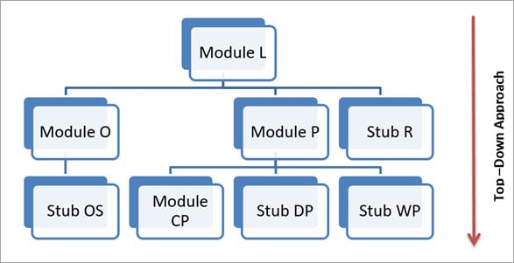
Top-Down Testing
Follows the structural flow of applications
Unavailable or undeveloped modules are substituted by stubs
Testing is done starting with the topmost module in the hierarchy
https://www.softwaretestinghelp.com/

Slide 33
Top-Down Testing- Breadth First
Test Case1: Module L and Module O will be integrated and tested Test Case2: Module L, O and P will be integrated and tested Test Case3: Module L, O, P and R will be integrated and tested.
This is an example of Breadth-First top-down integration testing
https://www.softwaretestinghelp.com/

Slide 34
Top-Down Testing- Depth First
Test Case1: Module L and Module O will be integrated and tested Test Case2: Module L, O and OS will be integrated and tested Test Case3: Module L, O, OS,P will be integrated and tested Test Case4: Module L, O, OS, P, CP will be integrated and tested
https://www.softwaretestinghelp.com/

Slide 35
Top-Down Testing (Merits and Demerits)
Merits of Top-down Methodology
Early exposure to architecture defects
It outlines the working of an application as a whole in early stages and helps in early disclosure of design defects
The main control points are tested early
Demerits of Top-down Methodology
Significant modules are tested late in the cycle
It can be quite challenging to write test conditions
The stub is not a perfect implementation of the related Module. It just simulates the data flow between the two modules
https://www.softwaretestinghelp.com/

Slide 36
Bottom-Up Testing
Modules at bottom layer are integrated and tested first and then sequentially other modules are integrated as we move up.
Unavailable or undeveloped modules are replaced by drivers.
D1
D2
D3
D4
M3
M2
https://www.softwaretestinghelp.com/

Slide 37
Bottom-Up Testing (Test Cases)
Test Case1: Unit testing of M1 and M2 Test Case2: Integration and testing of Modules D4,M1 and M2 Test Case3: Integration and testing of Modules D2,D4,M1 and M2 Test Case4: Unit testing of D3 Test Case5: Integration and testing of Modules D1,D3,D2,D4,M1, M2
D1
D2
D3
D4
M1
M2
https://www.softwaretestinghelp.com/

Slide 38
Bottom-Up Testing (Merits and Demerits)
The Merits of Bottom-up Methodology
It’s easier to create test conditions in the bottom-up approach
Leads to testing of critical modules or functionality at an early stage. This helps in early discovery of errors
Interface defects are detected at an early stage
Demerits of Bottom-Up Methodology
Drivers are more difficult to write than stubs
Design defects are caught in the later stage

Slide 39
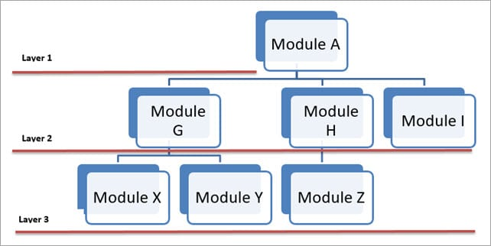
Sandwich Testing
Combination of top-down and bottom-up methodology.
Also known as Hybrid Testing
Stubs and drivers are used for incomplete or undeveloped modules.
https://www.softwaretestinghelp.com/

Slide 40
Sandwich Testing (Test Cases)
Test Case1: Test A,G,H,I Test Case2: Test G, X, and Y Test Case3: Test H, Z
Test Case 4: Test I,A Test Case5: Test A, G, H, I, X, Y, and Z

Slide 41
Sandwich Testing
Advantages
Combines the best practices of both top-down and bottom-up
Beneficial for larger projects
Disadvantages
Higher Testing Costs (Time)
Not every efficient when modules have high levels of coupling

Slide 42
Big Bang Testing
Big bang integration testing is a testing approach where all components or modules are integrated and tested as a single unit.
Typical performed after multiple levels of unit and integration testing
Before system testing and acceptance testing

Slide 43
Recap and Conclusion
Unit Testing
MSTEST
Assert Methods
Integration Testing
Top down
Bottom up
Sandwich

Slide 44
Thank you!
Any questions?

