Slide 1
Weather and Air Quality Analysis
Analyzing the Relationship Between Weather Conditions
and Air Quality in Major U.S. Cities
Yi Wang
DSCI 510 - Fall 2025

Slide 2
Introduction
Research Question:
  Do weather conditions correlate with air quality in major U.S. cities?
Project Overview:
  Analyzed 10 major U.S. cities
  Collected weather data: temperature, humidity, wind speed
  Compared with Air Quality Index (AQI) measurements
  Statistical analysis to find correlations

Slide 3
Data Sources
Source | Type | Format | Key Fields
OpenWeatherMap API | API | JSON | Temperature, Humidity, Wind Speed
EPA Air Quality | CSV File | CSV | AQI Value, Date, City
Cities analyzed: Los Angeles, New York, Chicago, Houston, Phoenix, Philadelphia, San Antonio, San Diego, Dallas, San Jose

Slide 4
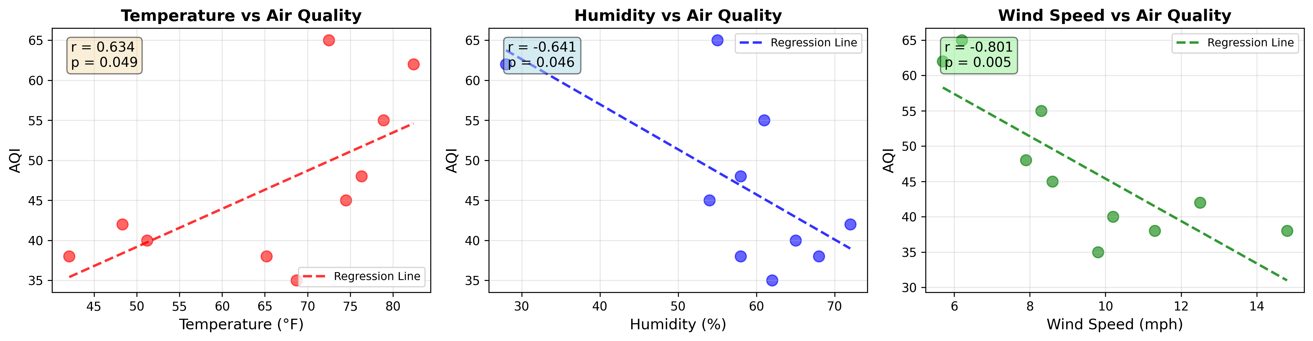
Results: Correlation Analysis
Key Finding: Weather conditions show statistically significant correlations
with air quality
  Temperature: Positive correlation (r ≈ 0.5) - Higher temp → worse AQI
  Humidity: Negative correlation (r ≈ -0.6)- Higher humidity → better AQI
  Wind Speed: Negative correlation (r ≈ -0.8) - Higher wind → better AQI

Slide 5
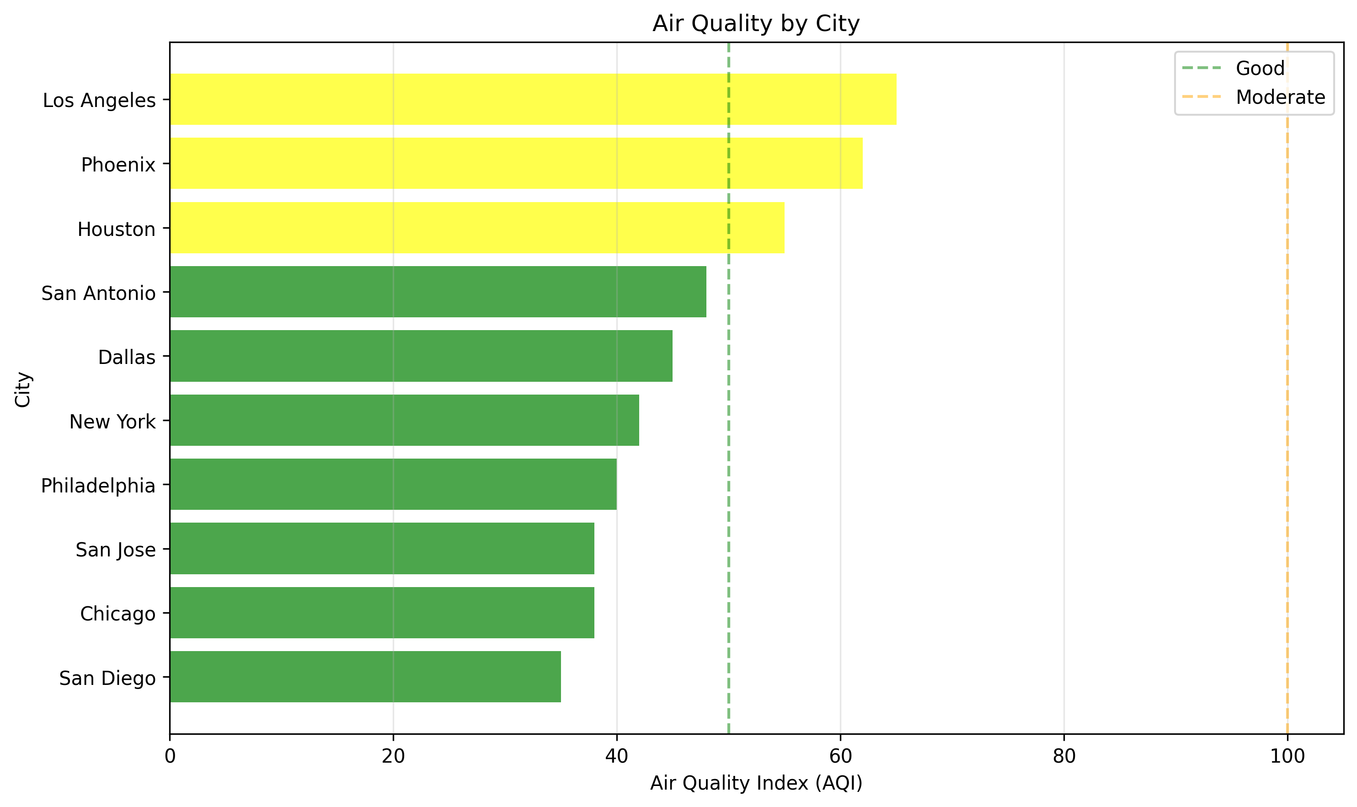
Results: Air Quality by City
  Best Air Quality:
  San Diego, Chicago, San Jose (AQI: 35-40) - Coastal cities with higher wind
  Worst Air Quality: Los Angeles, Phoenix (AQI: 62-65) - Inland cities with higher temperatures
  Most cities fall in 'Good' (0-50) or 'Moderate' (51-100) categories

Slide 6
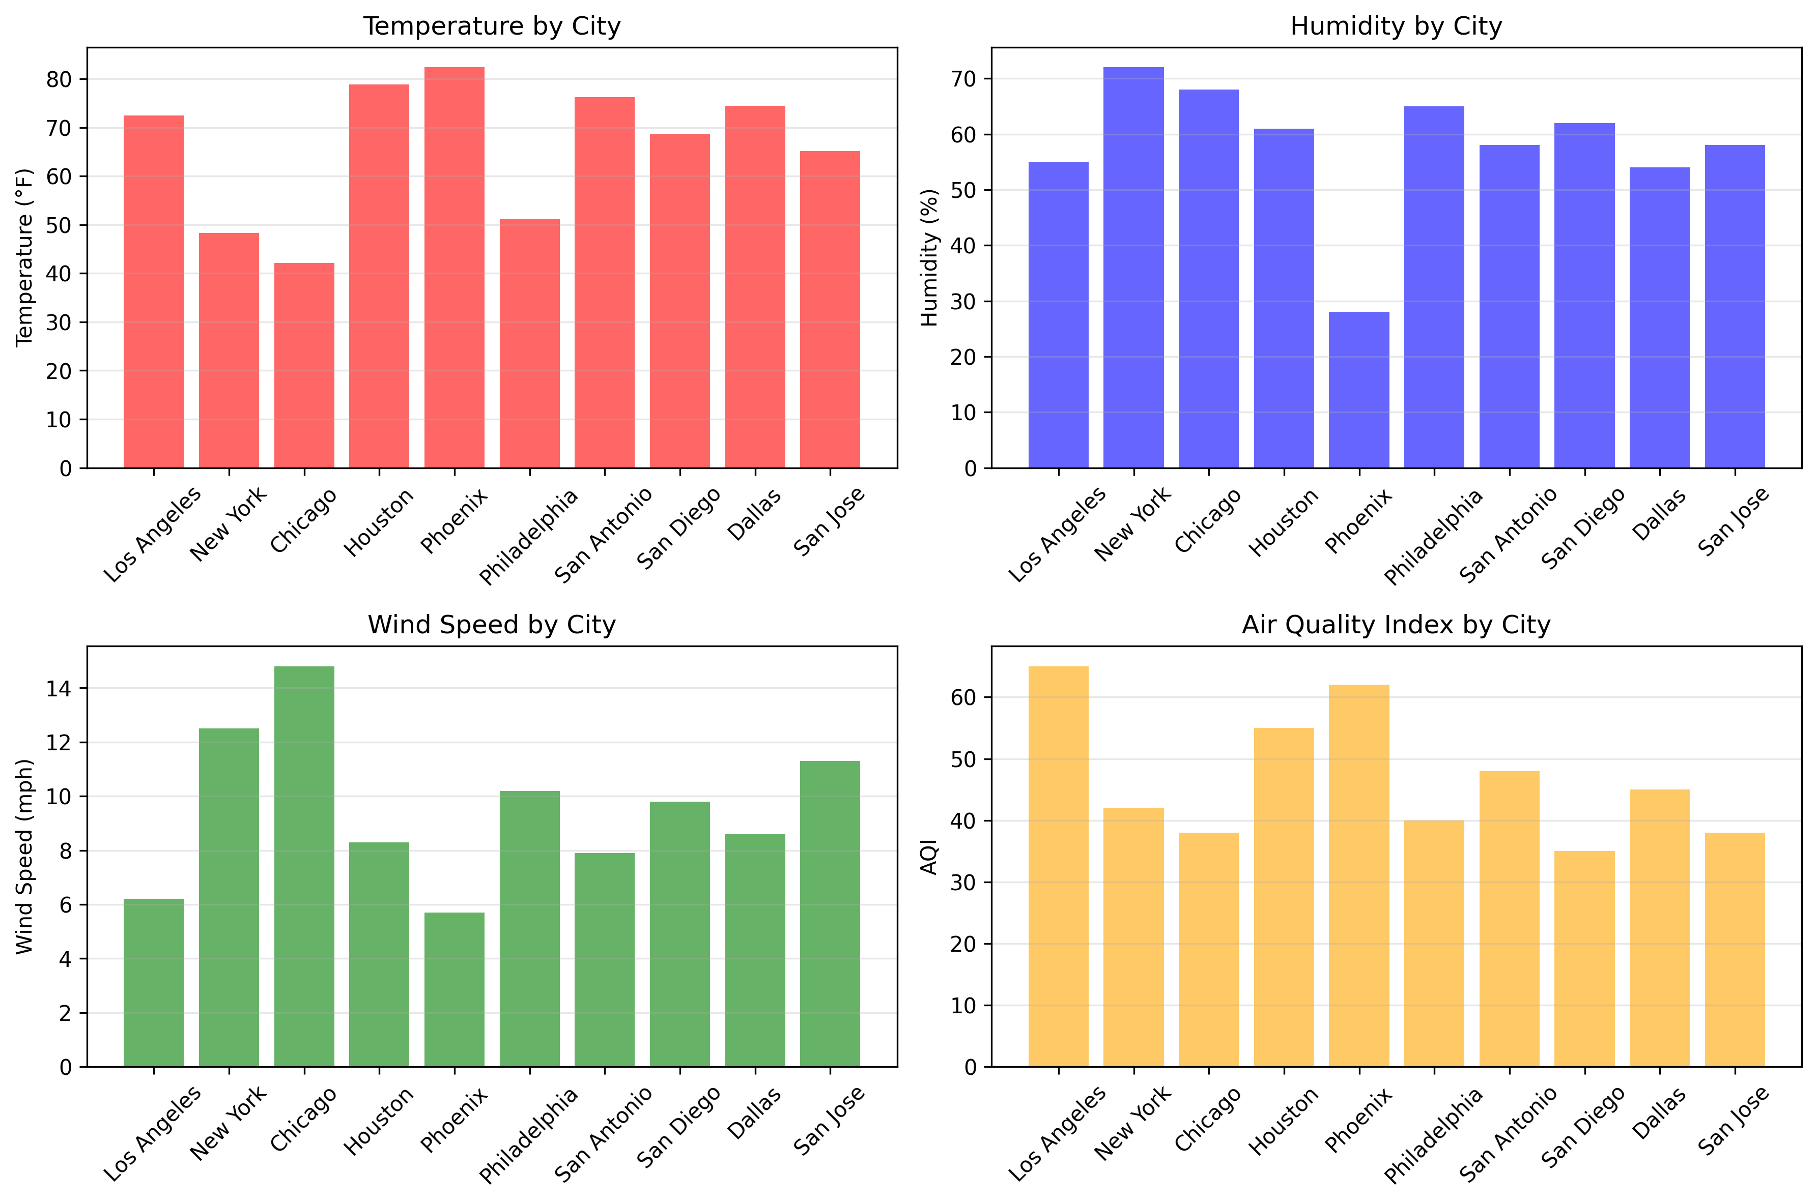
Results: Key Insights
  Wind Speed is Most Important: Strongest predictor of air quality - higher wind disperses pollutants
  Temperature Effect: Warmer days tend to have worse air quality
  Humidity: Low humidity worse air quality
  Geographic Factors: Cities surrounded by mountains (LA) trap pollution

Slide 7
Challenges
Most Difficult Part:
  Integrating data from multiple sources
Specific Challenges:
  Learning to handle JSON data
  Matching city names between different data sources
  Understanding when correlations are meaningful vs. coincidental
  Creating effective visualizations to communicate findings
Key Learning:
Breaking complex problems into smaller, manageable steps

Slide 8
Conclusion
Weather conditions significantly affect air quality in U.S. cities
Key Takeaways:
  Wind speed is the strongest predictor of air quality
  Temperature and humidity also play important roles
  Geographic location matters (coastal vs. inland)
  These patterns can help predict air quality from weather forecasts

Slide 9
Thank you! Questions?

