Slide 1
CS6513 Big Data Final Project By Group GGWP
Yuhui Wang yw4479@nyu.edu
Xinchi Huang xh1255@nyu.edu

Slide 2
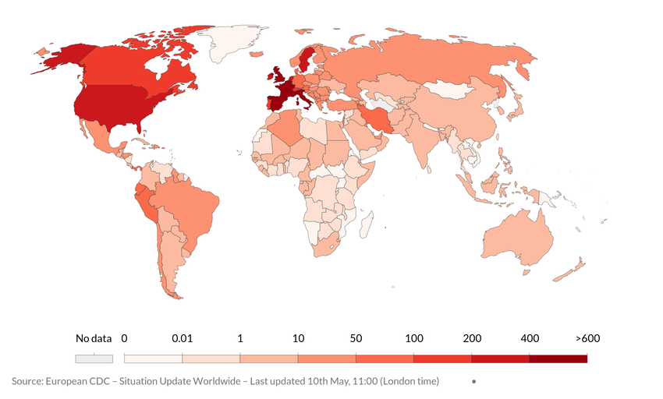
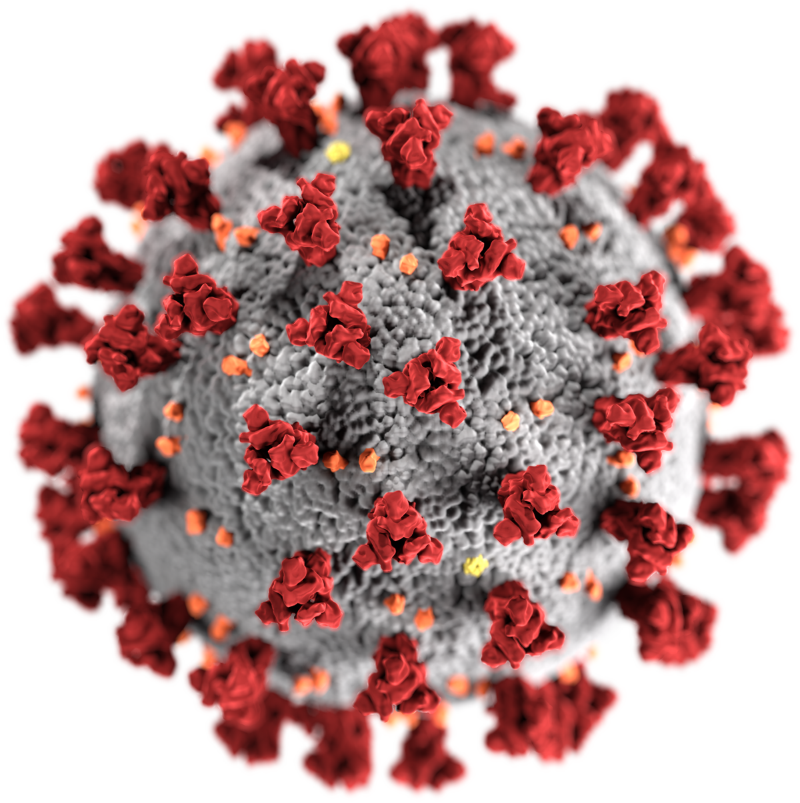
Project Topic: Analyzing the COVID-19 Spread and the Effect of Interventions

Slide 3
Datasets:
Raw Data:
Countries-Confirmed.csv
Countries-Deaths.csv
Countries-Recovered.csv
US.csv
US-states.csv
StateLatLong.csv
Processing:
Cleaning
Clustering
Consistancy
Checking
Results:
World_confirmed_top20.out
World_deaths_top20.out
World_recovered_top20.out
US_daily_increase.out
NY_daily_increase.out
State_geo.out

Slide 4

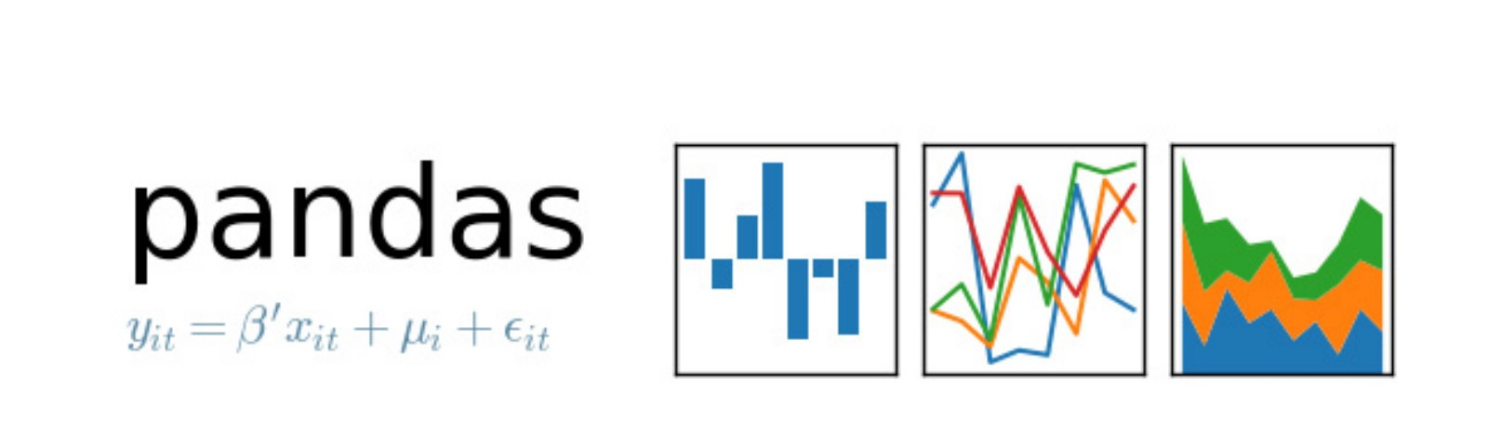
Data Visualization

Slide 5
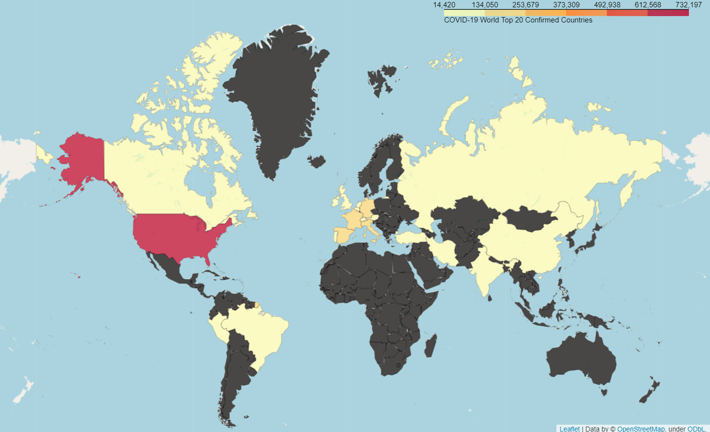
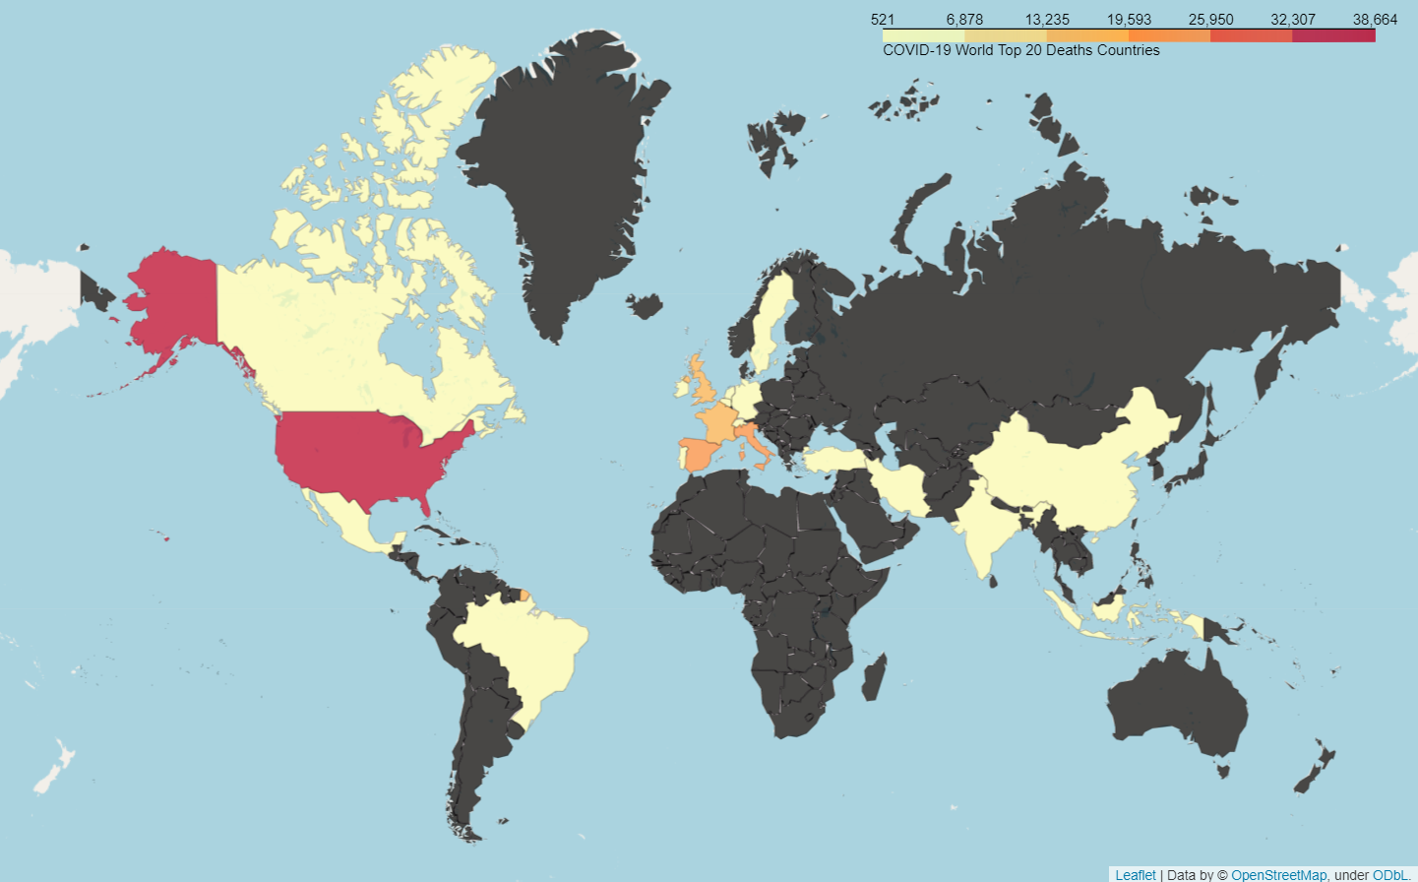
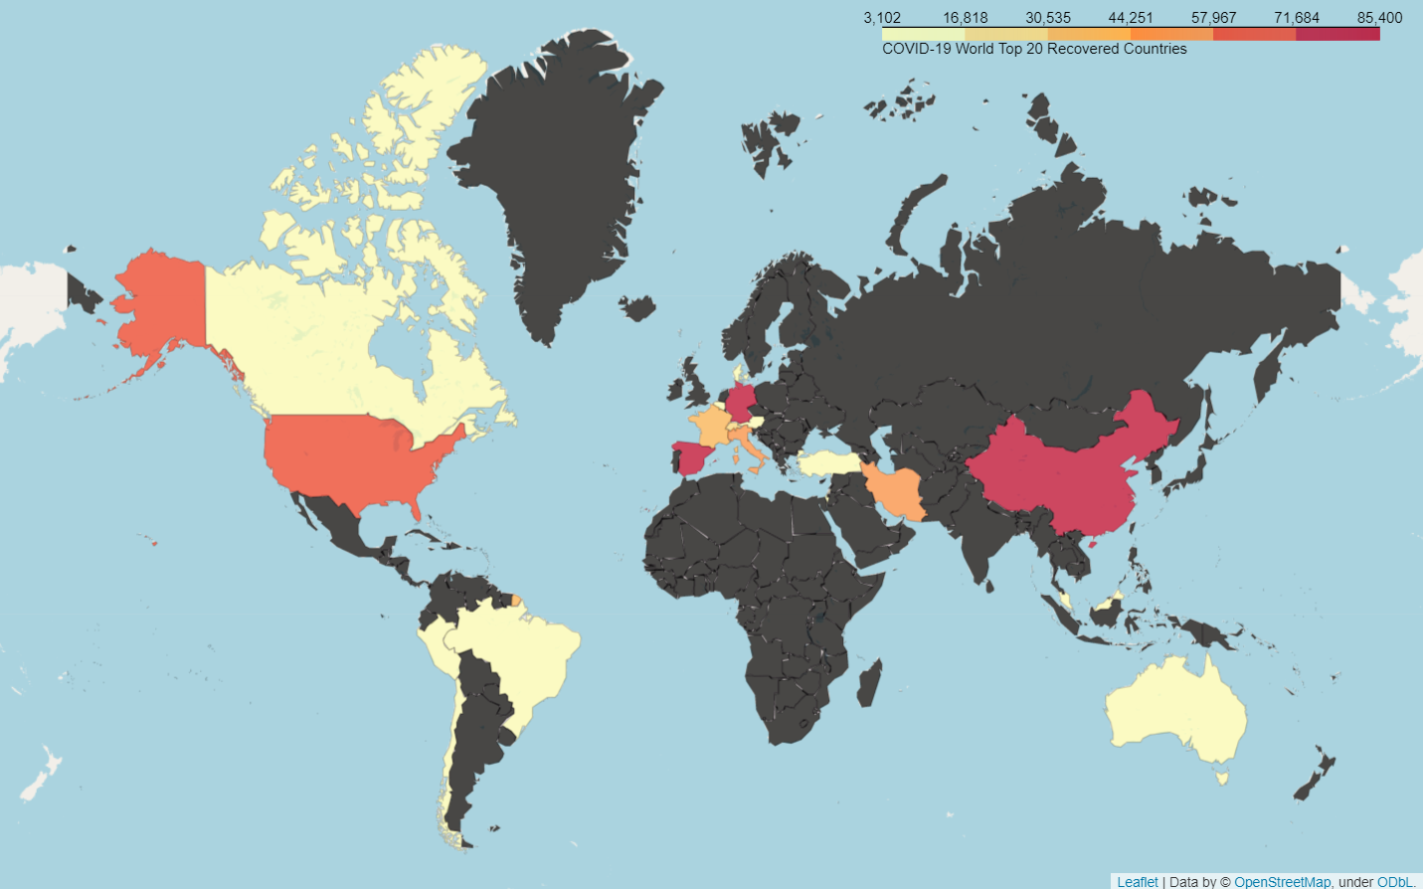
World Top20 Countries
Confirmed Cases
Deaths Cases
Recovered Cases

Slide 6
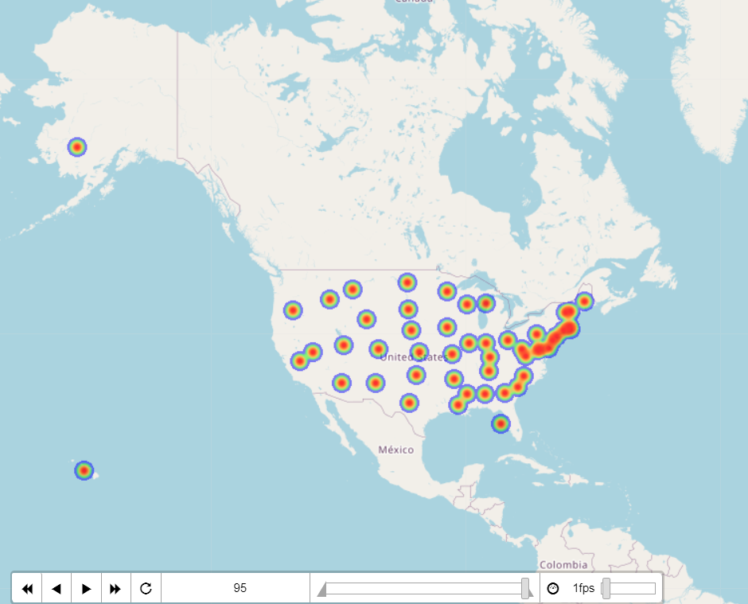
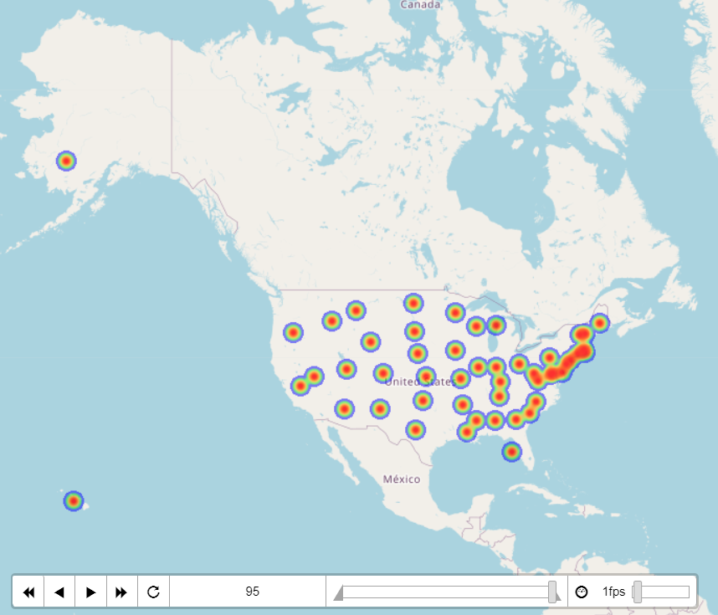
U.S. Heatmap
Confirmed Cases
Deaths Cases

Slide 7
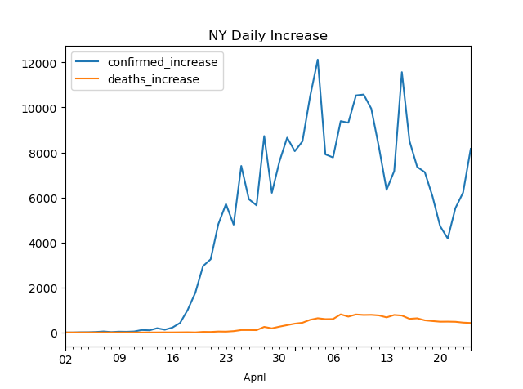
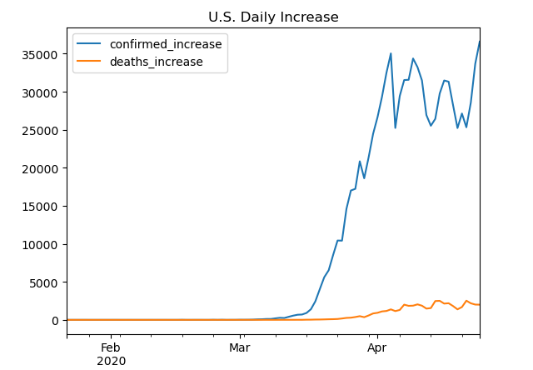
Daily Increase Curve

Slide 8
Analysis and Findings
By 18th April, U.S. had become the country with most confirmed cases (732,197) and deaths (38,664) in the world. But Germany with only 143,342 confirmed cases, had most recovered cases (85,400).
The early spread in European countries like Italy forced German government prepared better
Although U.S. block international transportations, it did not stop domestic spread.
Starting from April, the daily increase of confirmed cases in U.S. has been fluctuating around 30,000.
We have two possible explainations:
The policies carried out by the U.S. government were effective and the situation was gradually under control. (Good news !)
The daily available test quota reached its limit. (Bad new...)

Slide 9
Challenges & Limitations
Country/State name abbreviations
(E.g. Saint Helena-> St. Helena, New York -> NY)
Drawing Heatmap with time
How to match geo json with Heatmap?
How to get case coordinates?
Heatmap accuracy

