Slide 1
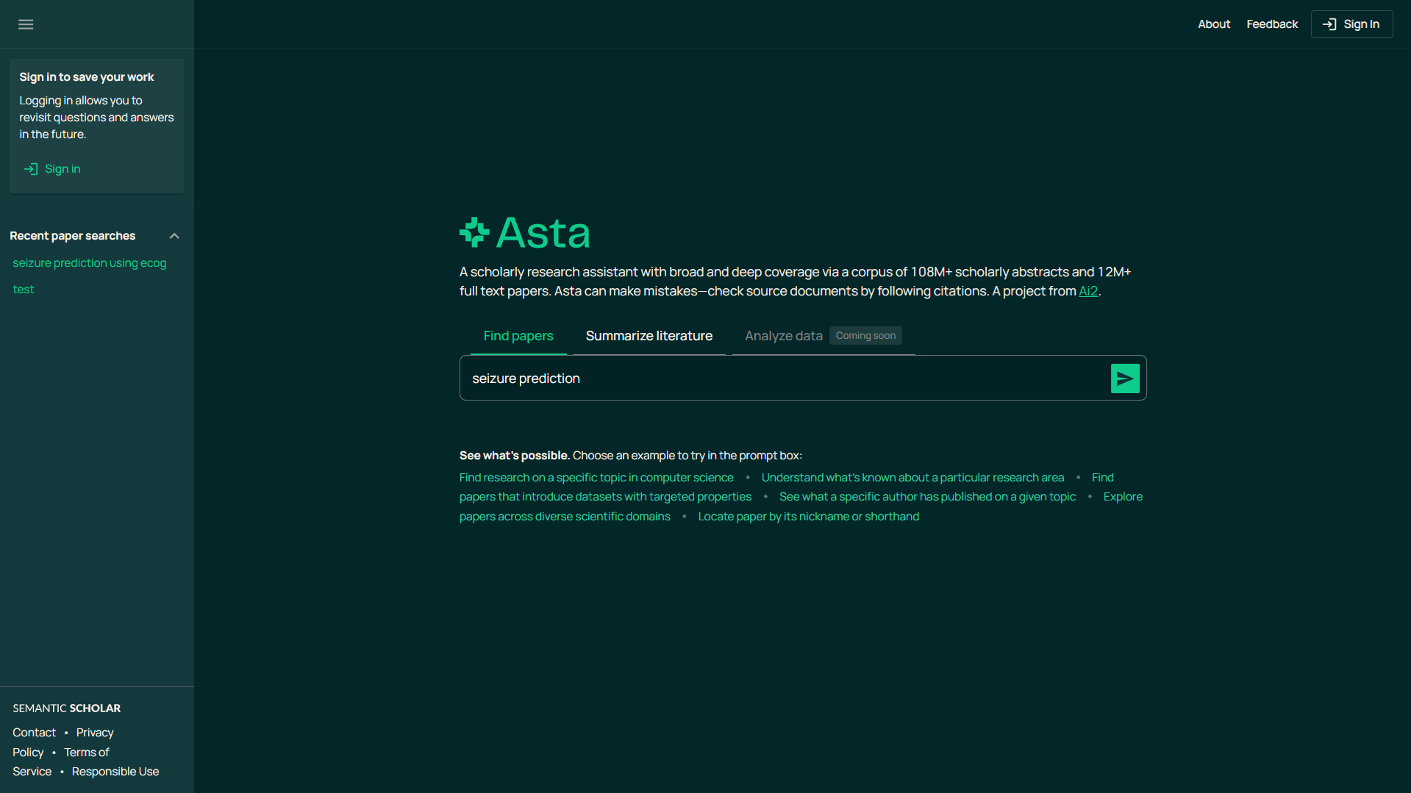
1. Type your query
2. Click

Slide 2
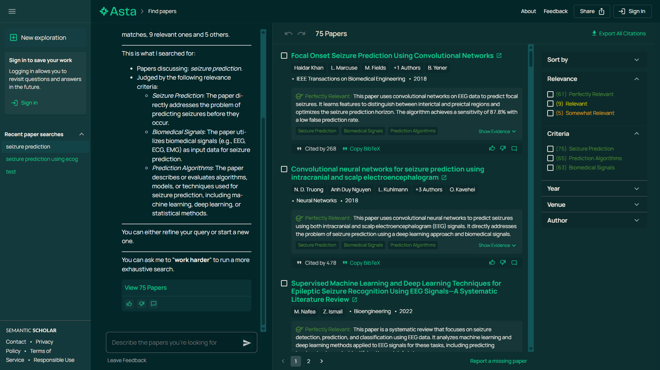
After Asta’s research end, click the “Export All Citations” button here

