Slide 1
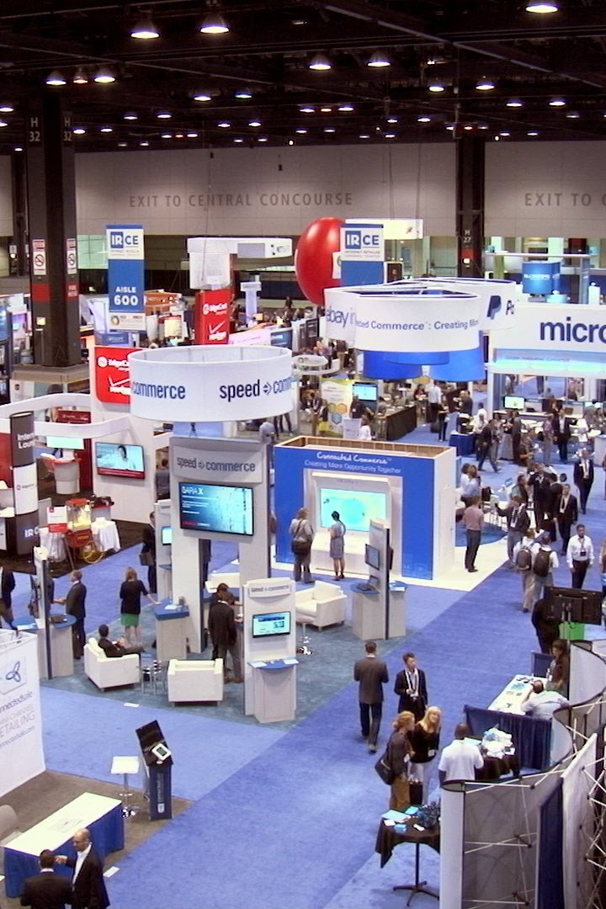
Item-Based-Recommendation
In the dynamic exhibition industry finding relevant products can be a challenge. We aim to develop an item-based recommendation model that improves attendee's experiences in finding products efficiently.
by Yuwei Chen

Slide 2
Try to Answer
What are the key product features ? How can the item-based recommendation model effectively utilize these product features?
How can machine learning techniques be applied?
What are the suitable similarity analysis techniques and algorithms that can measure item?

Slide 3
Dataset Attributes
Product_id: The unique ID of the product
Product_Name: The name or title of the product in Chinese
Vendor_id: The unique ID of the vendor
Main_Category: The main category or exhibition type of the product
Sub_Category: The sub-category or specific category of the product
Description: The text description of the product in Chinese
Product_Name_en: The name or title of the product in English
Description_en: The text description of the product in English

Slide 4
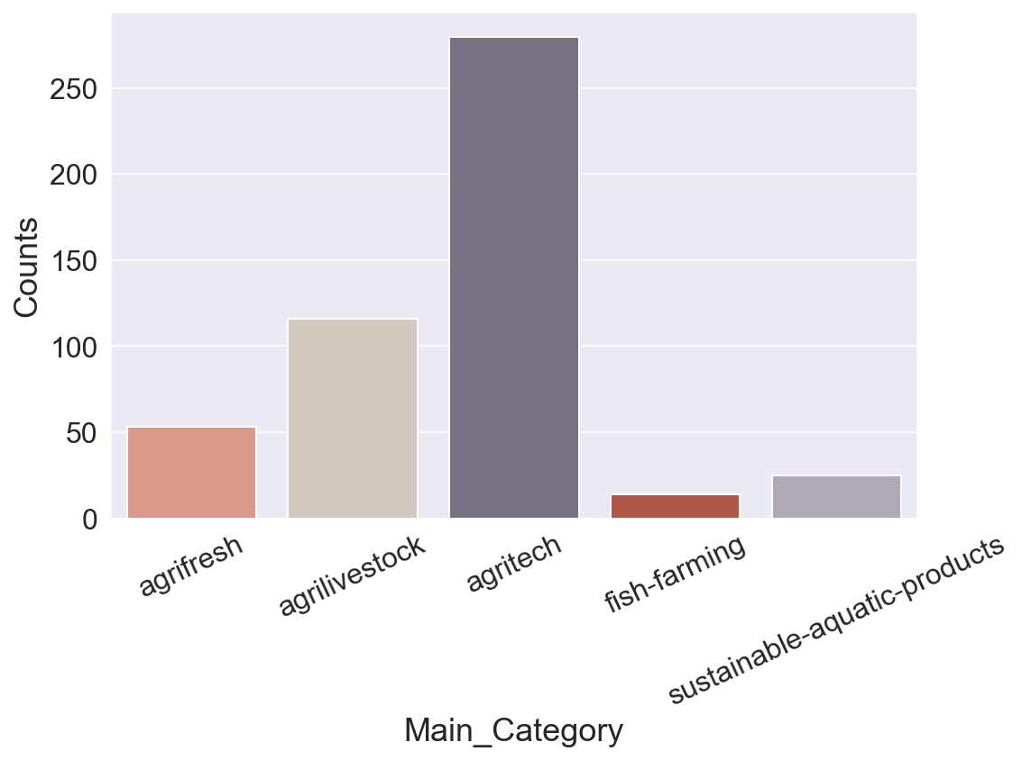

Slide 5
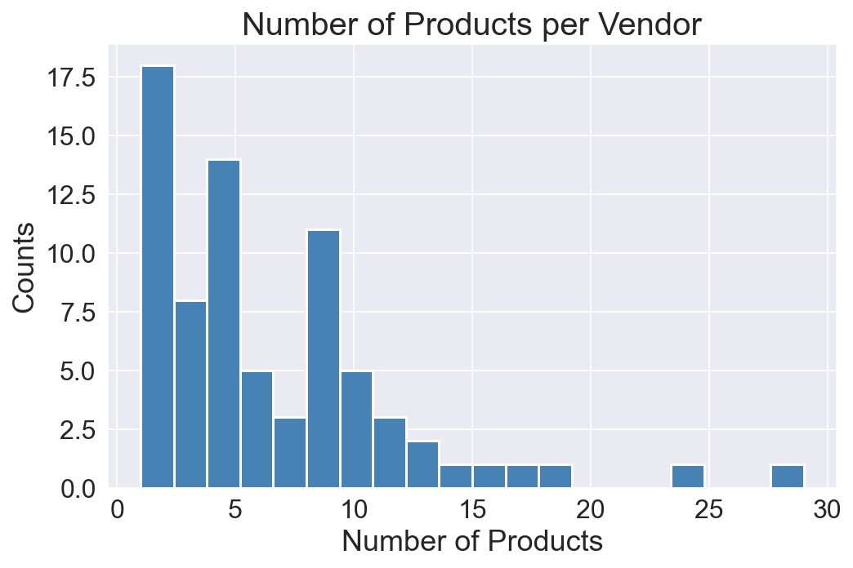

Slide 6

Difficulties
1
Unsupervised Learning
2
Lack of Quantitative Features
3
Reliance on Text Information

Slide 7
Task/Method:
Our goal is to employ machine learning techniques to overcome the mentioned difficulties and train an item-based recommendation model. To address these challenges, we propose the following methods:
Feature Engineering
Weights for Embeddings
Evaluate similarity

Slide 8
Embeddings Structure
0
1
0
1
0
0.02
0.03
0.11
0.25
0.36
0.01
0.04
One hot encoding of Category variables
Embedding of the text information:
Generated from Sentence-BERT

Slide 9
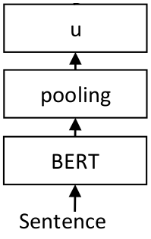
Sentence-BERT (Reimers & Gurevych, 2019)
Model Detail Information:
Distiluse-base-multilingual-cased-v1:
Supports 15 languages: Arabic, Chinese(zh & zh-tw), Dutch, English, French, German, Italian, Korean, Polish, Portuguese, Russian, Spanish, Turkish.
Training Corpus:
OPUS website3 (Tiedemann, 2012) provides parallel data for hundreds of language pairs.
Figure. Model Structure
Sentence-BERT documentation: https://www.sbert.net/index.html
Multi-Lingual Models Collection: https://www.sbert.net/docs/pretrained_models.html#multi-lingual-models

Slide 10
Feature Engineering:
Key features include categories, product names, and product descriptions.
Encoding category variables: Utilize one-hot encoding to represent categories as embeddings
Text Information: Sentence-BERT generate embeddings for Product_Name and Description

Slide 11
Weights for Embeddings
After obtaining the embeddings, we determine the ratio of weights assigned to each embedding during the recommendation process.
The weight allocation is based on the importance of each embedding's contribution to accurate item recommendations, allowing us to provide more relevant suggestions

Slide 12
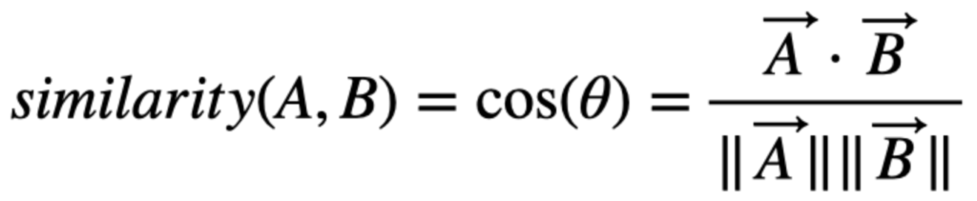
Evaluate similarity
To measure item similarity, we employ cosine similarity, which mitigates the impact of magnitude when calculating similarity scores.
Cosine similarity provides a reliable measure for recommendation purposes, enabling effective similarity analysis between items based on the available product features.

Slide 13
Flask API
@app.route('/', methods = ['GET'])
@app.route('/recommend_by_id', methods=['POST'])
@app.route('/recommend_by_keywords', methods=['POST'])

Slide 14
Recommend_by_keywords()
SBERT
Tape
0
0.22
0
0.01
0
0.02
0.03
0.11
0.25
0.36
0.01
0.04
0
0.01
0
0.34
0
0.05
0.03
0.11
0.25
0.76
0.01
0.04
Calculate similarity to recommend items
Other Items Embeddings
0
0.01
0
0.04
0
0.02
0.03
0.51
0
0.86
0.01
0.02
0
0.03
0.07
0
0
0.02
0
0.11
0.25
0
0.01
0.04

Slide 15
Items Embeddings
Integrate English and Chinese text embedding by summation directly
Similar inputs in different languages are mapped close in vector space in SBERT by Making Monolingual Sentence Embeddings Multilingual using Knowledge Distillation (Nils Reimers, 2020)
However…..

Slide 16
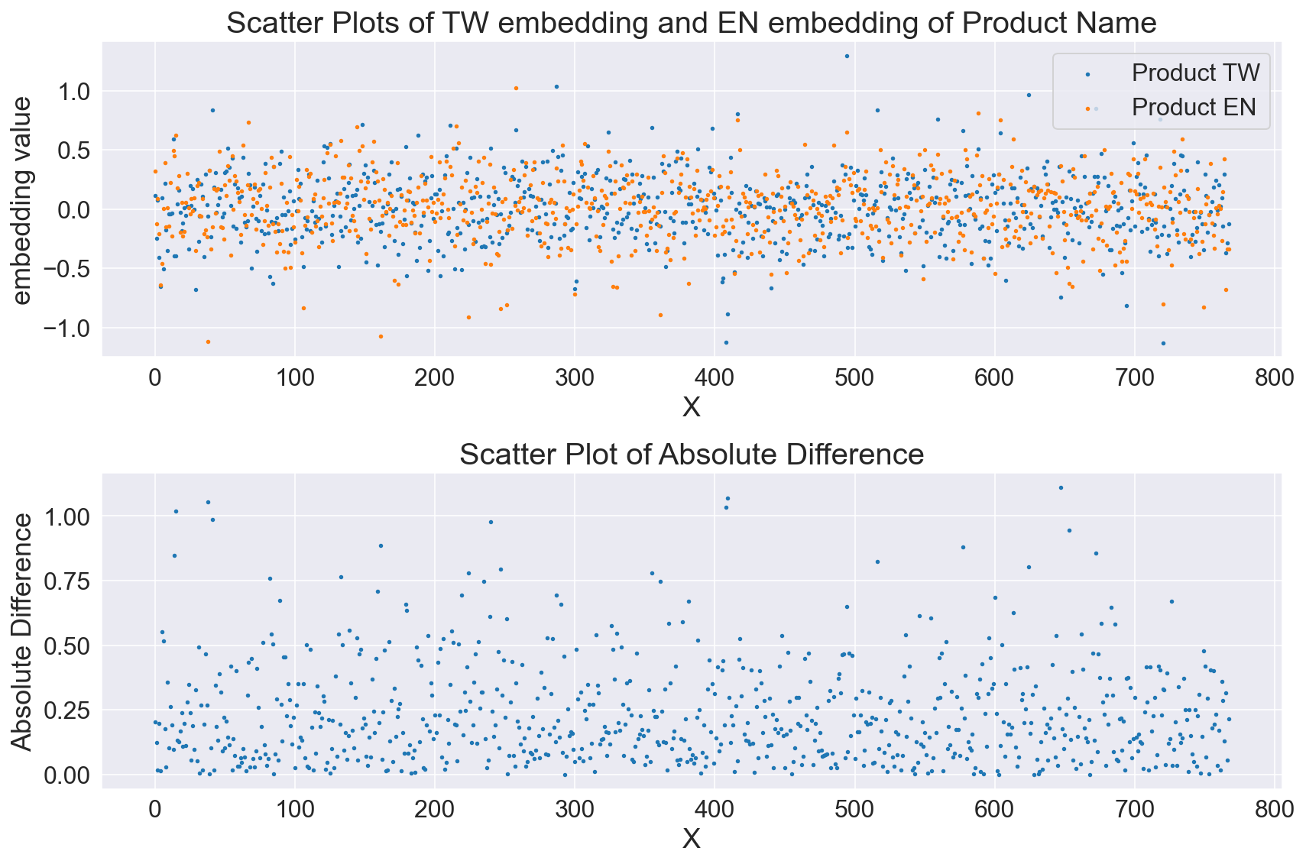

Slide 17

Advanced Search Capabilities: offers powerful search functionality, enabling complex searches using keywords and Boolean operators.
NoSQL Data Store: a NoSQL database that stores data in a flexible JSON-like
Extensive RESTful API: easy to work with and integrate into various applications.

Slide 18
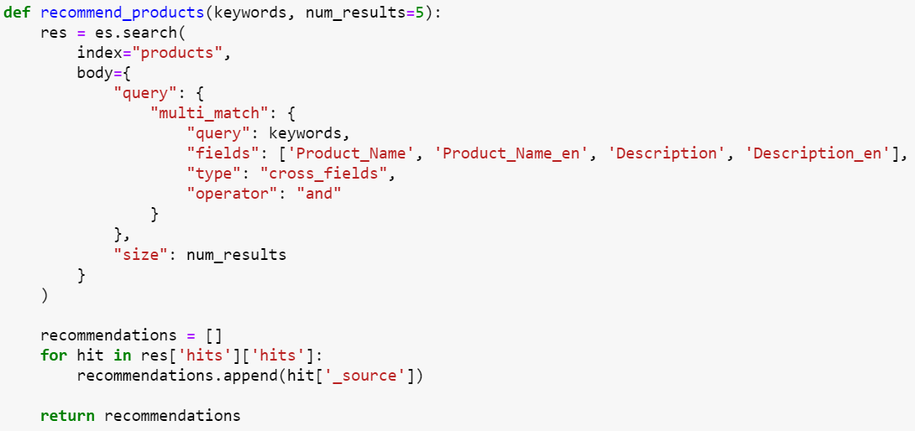

Slide 19
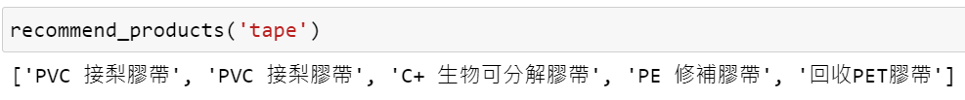

Slide 20
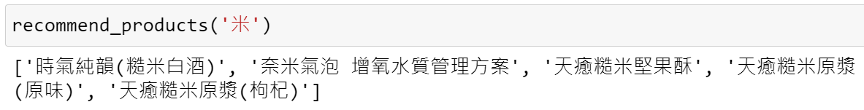
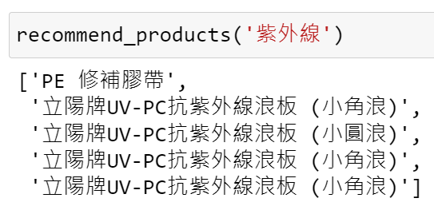

Slide 21
Similarity Score: Keywords and Product
Embedding of the keywords
Embedding of the keywords
0.03
0.11
0.25
0.36
0.04
0.02
0.03
0.11
0.25
0.36
0.01
0.04
Inner Product
0.25
0.21
0.14
0.32
0.10
0.02
0.03
0.11
0.25
0.36
0.01
0.04
Embedding of the product name
Embedding of the product description

