Slide 1
MLForecast
by Yuwei Chen

Slide 2
Variables Explanation
(Lags Transform 1: [rolling_mean, window size = 4])
Lags3
Lags2
Lags1
0
2
3
1
0
1
2
4
3
2
1
4
Train Data (Lags Transform 1: [expanding_mean])
Test Data

Slide 3
沖調飲品

Slide 4
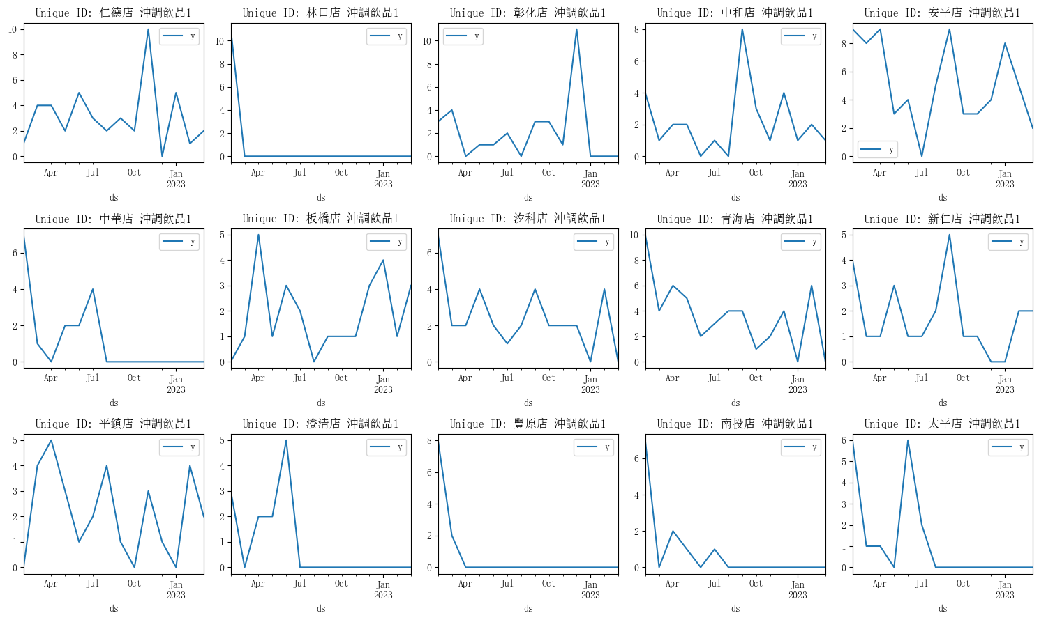

Slide 5
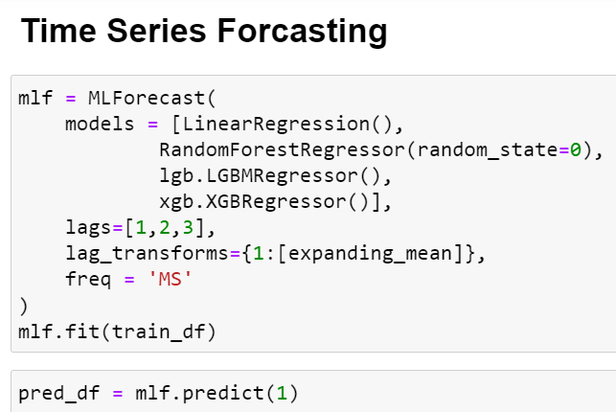
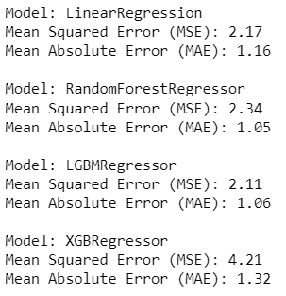
Number of unique_id: 64

Slide 6
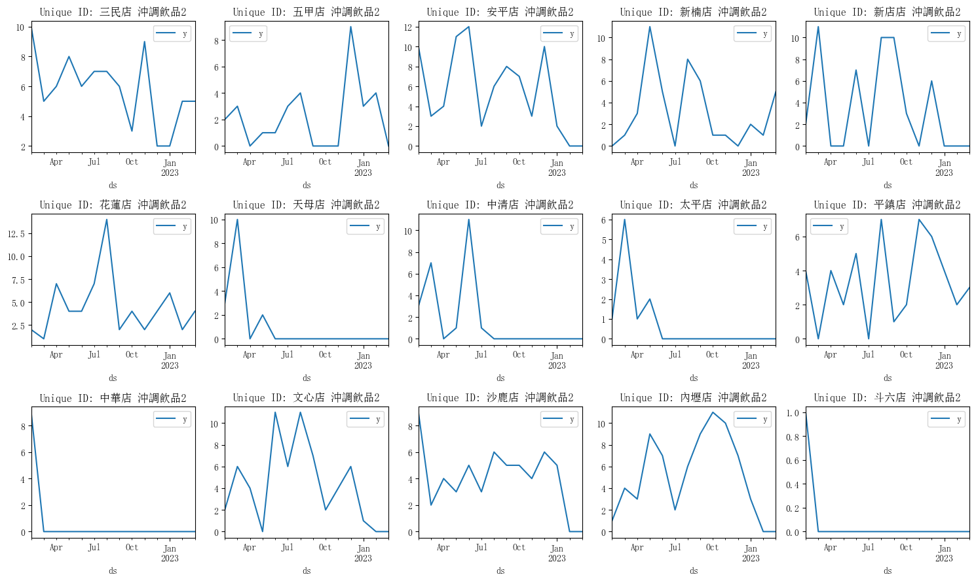

Slide 7
完整實驗數據:沖調飲品&營養食品

Slide 8
Category | LinearRegression | RandomForestRegressor | LGBMRegressor | XGBRegressor
沖調飲品1 | 1.47/1.16/0.14 | 1.53/1.05/0.29 | 1.45/1.06/0.21 | 2.05/1.32/0.28
沖調飲品2 | 2.74/2.18/0.34 | 3.11/2.00/0.54 | 3.10/2.04/0.43 | 3.72/2.12/0.41
沖調飲品3 | 1.34/1.20/0.21 | 1.43/0.97/0.25 | 1.38/1.02/0.25 | 1.76/1.25/0.28
沖調飲品4 | 1.30/1.07/0.18 | 1.87/1.21/0.36 | 1.57/1.06/0.24 | 2.04/1.29/0.39
營養食品1 | 1.22/0.91/0.08 | 1.04/0.54/0.15 | 1.02/0.58/0.09 | 1.05/0.60/0.12
營養食品2 | 4.84/4.01/0.63 | 4.82/4.00/0.71 | 4.96/3.98/0.76 | 5.20/4.23/0.76
營養食品3 | 1.44/1.22/0.29 | 2.18/1.62/0.41 | 2.04/1.61/0.46 | 2.56/1.90/0.59
營養食品4 | 1.49/1.23/0.35 | 1.98/1.48/0.41 | 1.77/1.39/0.42 | 2.57/1.67/0.42
營養食品5 | 2.07/1.43/0.35 | 2.25/1.50/0.42 | 2.25/1.55/0.39 | 2.32/1.61/0.45
營養食品6 | 2.04/1.58/0.36 | 2.25/1.74/0.49 | 2.37/1.87/0.47 | 2.29/1.85/0.49
營養食品7 | 2.27/1.61/0.36 | 2.34/1.69/0.47 | 2.36/1.62/0.46 | 2.69/1.91/0.57
營養食品8 | 6.37/4.95/0.59 | 6.19/4.77/0.63 | 6.59/5.20/0.74 | 6.85/5.24/0.71
Average | 2.84/1.88/0.32 | 2.95/1.88/0.44 | 3.01/1.92/0.41 | 3.31/2.08/0.46

Slide 9
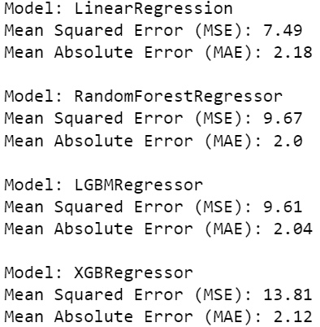
Number of unique_id: 64

Slide 10
酒

Slide 11
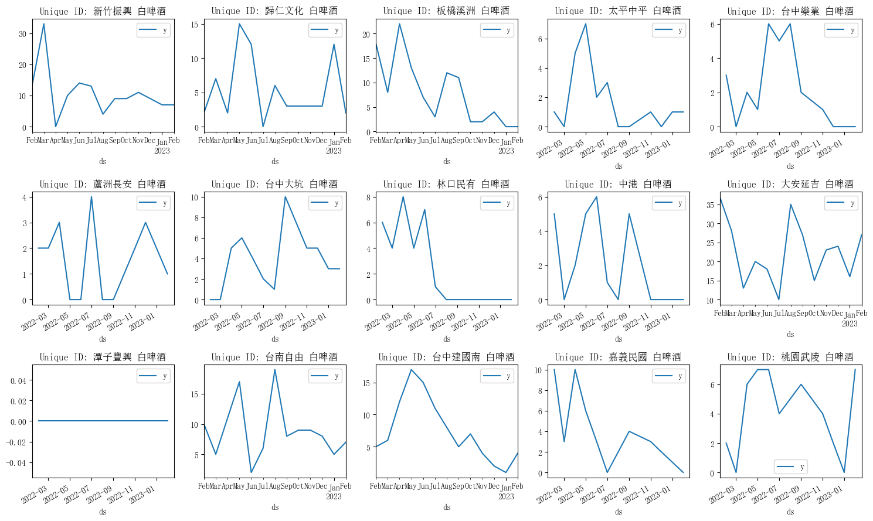

Slide 12
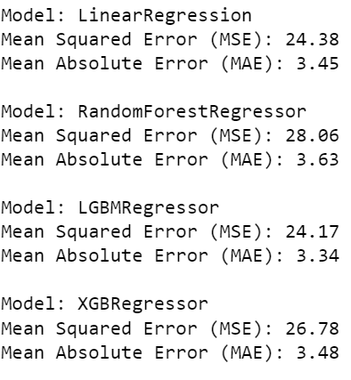
Number of unique_id: 1088

Slide 13
完整實驗數據: 酒

Slide 14
Category | LinearRegression | RandomForestRegressor | LGBMRegressor | XGBRegressor
白啤酒 | 4.94/3.45/0.84 | 5.30/3.63/0.92 | 4.92/3.34/0.81 | 5.17/3.48/0.83
黑啤酒 | 7.28/5.30/1.43 | 6.24/4.59/1.24 | 6.32/4.35/1.17 | 5.96/4.32/1.16
生啤酒 | 3.96/2.93/0.80 | 4.23/3.08/0.84 | 3.98/2.88/0.78 | 4.11/2.97/0.78
Average | 5.57/3.89/1.02 | 5.32/3.76/1.00 | 5.16/3.52/0.92 | 5.13/3.59/0.92

Slide 15
完整實驗數據:保健食品

Slide 16
Category | LinearRegression | RandomForestRegressor | LGBMRegressor | XGBRegressor
保健食品1 | 0.69/0.49/0.09 | 0.91/0.59/0.10 | 0.82/0.58/0.11 | 0.94/0.59/0.12
保健食品2 | 1.37/1.00/0.28 | 1.35/0.94/0.29 | 1.39/0.94/0.28 | 1.35/0.90/0.29
保健食品3 | 0.69/0.45/0.20 | 0.68/0.42/0.27 | 0.70/0.46/0.23 | 0.70/0.44/0.23
保健食品4 | 0.76/0.62/0.13 | 0.86/0.66/0.15 | 0.74/0.58/0.14 | 0.91/0.64/0.12
保健食品5 | 0.90/0.50/0.13 | 1.14/0.64/0.29 | 1.05/0.60/0.19 | 1.24/0.64/0.28
保健食品6 | 0.89/0.66/0.24 | 1.01/0.73/0.28 | 0.96/0.72/0.27 | 1.00/0.72/0.28
保健食品7 | 0.51/0.39/0.15 | 0.58/0.39/0.18 | 0.57/0.39/0.17 | 0.56/0.38/0.17
保健食品8 | 0.77/0.59/0.19 | 0.82/0.63/0.23 | 0.81/0.67/0.23 | 0.83/0.63/0.23
保健食品9 | 0.81/0.58/0.18 | 0.78/0.56/0.22 | 0.81/0.58/0.19 | 0.62/0.48/0.17
保健食品10 | 0.57/0.46/0.17 | 0.64/0.44/0.26 | 0.60/0.45/0.19 | 0.68/0.48/0.23
保健食品11 | 0.55/0.38/0.14 | 0.57/0.34/0.19 | 0.57/0.38/0.16 | 0.58/0.35/0.15
保健食品12 | 2.08/1.36/0.27 | 2.04/1.27/0.29 | 2.03/1.27/0.28 | 2.07/1.28/0.28
保健食品13 | 0.92/0.79/0.09 | 0.94/0.80/0.09 | 0.85/0.74/0.12 | 1.11/0.90/0.14
保健食品14 | 0.88/0.72/0.14 | 1.05/0.78/0.15 | 0.97/0.68/0.15 | 1.06/0.69/0.15
保健食品15 | 2.63/1.62/0.21 | 2.61/1.63/0.27 | 2.71/1.58/0.25 | 2.44/1.58/0.24
保健食品16 | 0.68/0.47/0.20 | 0.77/0.51/0.24 | 0.71/0.47/0.21 | 0.75/0.47/0.22
保健食品17 | 2.41/1.79/0.10 | 2.33/1.69/0.09 | 2.30/1.58/0.09 | 2.42/1.61/0.09
保健食品18 | 1.45/1.12/0.26 | 1.42/1.10/0.29 | 1.39/1.11/0.29 | 1.49/1.18/0.34
保健食品19 | 1.32/1.01/0.29 | 1.35/0.99/0.29 | 1.25/0.89/0.25 | 1.31/0.93/0.27
保健食品20 | 0.71/0.57/0.15 | 0.69/0.52/0.15 | 0.55/0.43/0.12 | 0.69/0.49/0.15
保健食品21 | 0.31/0.09/0.02 | 0.32/0.08/0.06 | 0.31/0.09/0.02 | 0.31/0.08/0.02
保健食品22 | 0.70/0.47/0.09 | 0.69/0.37/0.10 | 0.66/0.39/0.09 | 0.61/0.36/0.08
保健食品23 | 0.90/0.68/0.25 | 0.83/0.60/0.27 | 0.87/0.61/0.21 | 0.75/0.54/0.23
保健食品24 | 0.49/0.32/0.17 | 0.56/0.34/0.20 | 0.54/0.38/0.18 | 0.57/0.34/0.18
保健食品25 | 0.45/0.24/0.13 | 0.46/0.26/0.19 | 0.43/0.24/0.14 | 0.44/0.25/0.14
保健食品26 | 0.73/0.48/0.13 | 0.74/0.42/0.17 | 0.59/0.41/0.12 | 0.75/0.47/0.15
保健食品27 | 1.85/1.11/0.27 | 1.88/1.17/0.31 | 1.87/1.16/0.29 | 1.90/1.14/0.29
保健食品28 | 0.01/0.01/0.00 | 0.06/0.02/0.00 | 0.11/0.03/0.00 | 0.06/0.01/0.00
保健食品29 | 0.02/0.00/0.00 | 0.00/0.00/nan | 0.01/0.00/0.00 | 0.00/0.00/0.00
保健食品30 | 0.26/0.18/0.06 | 0.44/0.25/0.07 | 0.35/0.24/0.06 | 0.50/0.28/0.05
保健食品31 | 0.62/0.43/0.12 | 0.66/0.42/0.15 | 0.59/0.40/0.12 | 0.60/0.38/0.13
保健食品32 | 0.35/0.17/0.03 | 0.30/0.15/0.05 | 0.21/0.13/0.02 | 0.32/0.16/0.02
保健食品34 | 0.79/0.65/0.14 | 1.00/0.76/0.16 | 1.02/0.79/0.16 | 0.87/0.72/0.17
保健食品35 | 1.26/1.02/0.07 | 1.45/1.05/0.07 | 1.31/1.01/0.08 | 1.53/1.11/0.08
保健食品36 | 0.24/0.15/0.02 | 0.25/0.10/0.02 | 0.24/0.12/0.02 | 0.21/0.09/0.02
保健食品37 | 0.42/0.23/0.13 | 0.45/0.24/0.18 | 0.41/0.23/0.13 | 0.44/0.23/0.13
保健食品38 | 1.85/1.49/0.34 | 1.97/1.40/0.43 | 1.84/1.31/0.36 | 2.38/1.63/0.52
保健食品39 | 1.31/0.86/0.19 | 1.42/0.88/0.23 | 1.47/0.95/0.21 | 1.42/0.87/0.19
保健食品40 | 2.08/1.52/0.12 | 2.08/1.35/0.12 | 2.09/1.33/0.12 | 2.03/1.12/0.13
保健食品41 | 0.55/0.34/0.12 | 0.63/0.35/0.20 | 0.63/0.36/0.16 | 0.65/0.36/0.17
Average | 1.11/0.65/0.15 | 1.15/0.65/0.19 | 1.12/0.63/0.16 | 1.16/0.64/0.17

Slide 17
沖調飲品2
From the following page, we noted that there is no significant pattern or trend for each series across different shops selling the same products. The lack of noticeable trends indicates that there might not be a substantial relationship among the values over time. As a result, it may not be appropriate to develop a time series model.

Slide 18
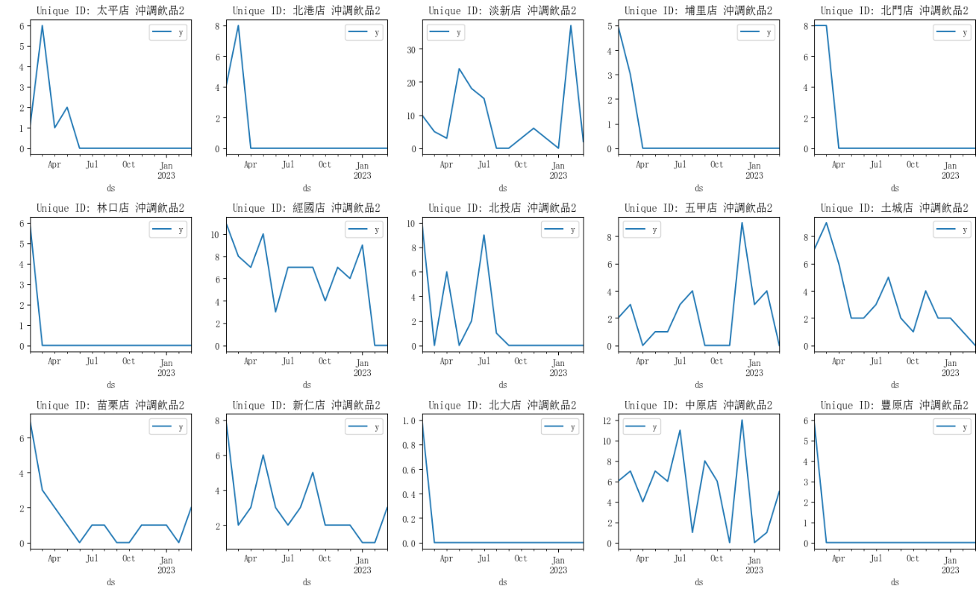

Slide 19
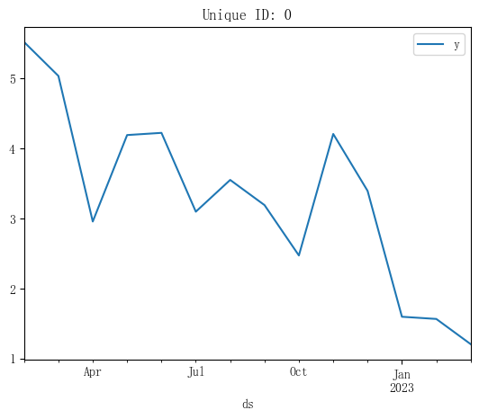
Take the average of sales volume from stores to explore the total demand. If there isn't significant regional variation, a model based on the total demand could potentially replace a model built using a dataset of n records (where n is the number of unique IDs).

Slide 20
ACF (Autocorrelation Function):
Definition: Measures correlation between data points at different lags
Focus: Relationship between a data point and its past values
Purpose: Understand the influence of previous values on a data point
Interpretation: ACF values close to zero suggest little correlation between data points at different time points
PACF (Partial Autocorrelation Function):
Definition: Measures correlation between a data point and a lagged version of itself, accounting for intermediate points
Focus: Direct relationship between a data point and its previous values
Purpose: Identify specific past values' direct impact on the current data point
Advantage: Excludes influence of intermediate points for clearer insights

Slide 21
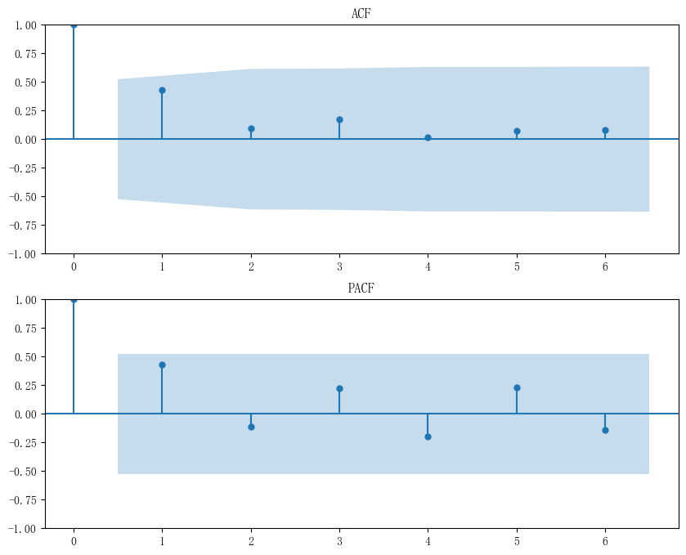
From the ACF and PACF, we can determine the correlation involving lags. If this correlation is not substantial, it implies that constructing a time series model based on lags might not be effective. This is due to the limited influence of previous values on the current ones, suggesting their predictive significance is low.

Slide 22
沖調飲品&營養食品: Grouped versus Ungrouped
Build a model using a series that utilizes the average sales from the previous shops. We intend to compare this modified series with the original model. However, the results indicate that these two models do not significantly differ.

Slide 23
RMSE/MAE/MAPE | LinearRegression | RandomForestRegressor | LGBMRegressor | XGBRegressor
沖調飲品1 | 1.47/1.16/0.14 | 1.53/1.05/0.29 | 1.45/1.06/0.21 | 2.05/1.32/0.28
沖調飲品2 | 2.74/2.18/0.34 | 3.11/2.00/0.54 | 3.10/2.04/0.43 | 3.72/2.12/0.41
沖調飲品3 | 1.34/1.20/0.21 | 1.43/0.97/0.25 | 1.38/1.02/0.25 | 1.76/1.25/0.28
沖調飲品4 | 1.30/1.07/0.18 | 1.87/1.21/0.36 | 1.57/1.06/0.24 | 2.04/1.29/0.39
RMSE/MAE/MAPE (Grouped) | LinearRegression | RandomForestRegressor | LGBMRegressor | XGBRegressor
沖調飲品1 | 1.90/1.73/0.18 | 1.32/1.13/0.14 | 1.65/1.49/0.15 | 1.29/1.06/0.14
沖調飲品2 | 2.81/2.59/0.22 | 2.35/2.14/0.18 | 2.78/2.56/0.22 | 2.07/1.78/0.16
沖調飲品3 | 0.95/0.73/0.18 | 1.04/0.93/0.10 | 2.12/2.00/0.19 | 1.05/0.94/0.10
沖調飲品4 | 1.21/1.13/0.11 | 1.10/1.00/0.11 | 1.69/1.54/0.11 | 1.14/1.04/0.11

Slide 24
RMSE/MAE/MAPE | LinearRegression | RandomForestRegressor | LGBMRegressor | XGBRegressor
營養食品1 | 1.22/0.91/0.08 | 1.04/0.54/0.15 | 1.02/0.58/0.09 | 1.05/0.60/0.12
營養食品2 | 4.84/4.01/0.63 | 4.82/4.00/0.71 | 4.96/3.98/0.76 | 5.20/4.23/0.76
營養食品3 | 1.44/1.22/0.29 | 2.18/1.62/0.41 | 2.04/1.61/0.46 | 2.56/1.90/0.59
營養食品4 | 1.49/1.23/0.35 | 1.98/1.48/0.41 | 1.77/1.39/0.42 | 2.57/1.67/0.42
RMSE/MAE/MAPE (Grouped) | LinearRegression | RandomForestRegressor | LGBMRegressor | XGBRegressor
營養食品1 | 1.27/0.91/0.09 | 1.23/0.72/0.11 | 1.51/1.35/0.07 | 1.23/0.71/0.11
營養食品2 | 4.78/3.96/0.63 | 5.17/4.28/0.63 | 4.81/3.98/0.63 | 5.60/4.66/0.65
營養食品3 | 1.46/1.25/0.30 | 1.41/1.20/0.28 | 1.36/1.15/0.26 | 1.75/1.54/0.43
營養食品4 | 1.53/1.26/0.37 | 1.52/1.24/0.36 | 1.54/1.26/0.37 | 1.50/1.18/0.32

Slide 25
Top-50-csv

Slide 26
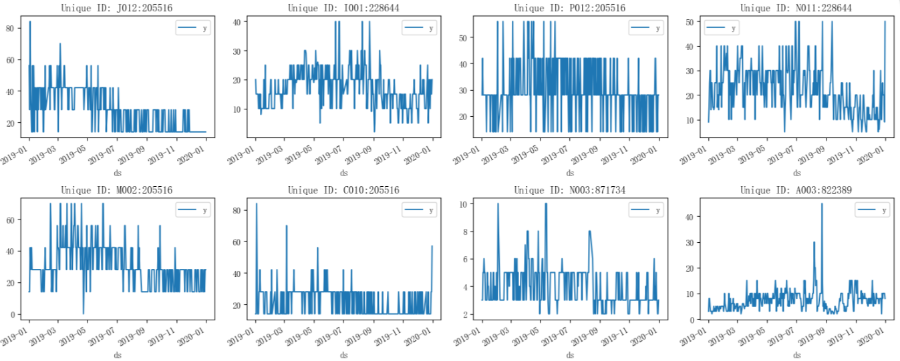
Daily Timeseries for a year
Number of unique_id: 50

Slide 27
Model Training and Testing
The unique_id count is 50, indicating a total of 50 models.
The dataset covers nearly a year of data, though some dates are discontinuous.
The last day of the dataset serves as the testing set, while the remaining days constitute the training set.
While the series is long, the researcher could try to use rolling mean with specific window size. While the series is short, expanding mean may be more suitable option

Slide 28
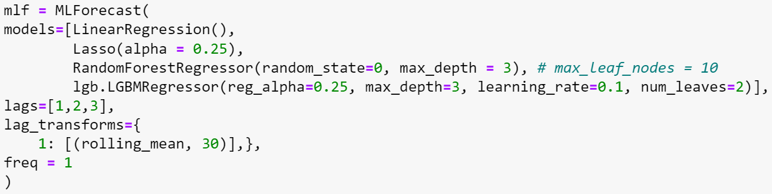
Model Selection
reg_alpha (float, optional (default=0.)) – L1 regularization term on weights
max_depth: Maximum tree depth
Average Performance for one day (RMSE/MAE/MAPE): 13.46/7.18/0.23 (Lasso)
Average Performance for three days (RMSE/MAE/MAPE): 9.52/5.54/0.28 (Linear Regression)

Slide 29
Performance of Predictions for One day

Slide 30
Category | LinearRegression | Lasso | RandomForestRegressor | LGBMRegressor | Ensemble
C008:871734 | 2.28/2.28/0.57 | 2.18/2.18/0.54 | 1.50/1.50/0.38 | 1.64/1.64/0.41 | 1.90/1.90/0.47
A003:228644 | 10.38/10.38/0.35 | 10.33/10.33/0.34 | 12.63/12.63/0.42 | 11.52/11.52/0.38 | 11.21/11.21/0.37
C008:822389 | 1.63/1.63/0.05 | 1.66/1.66/0.05 | 7.11/7.11/0.20 | 5.13/5.13/0.15 | 3.88/3.88/0.11
A003:822389 | 1.05/1.05/0.13 | 0.99/0.99/0.12 | 1.14/1.14/0.14 | 2.00/2.00/0.25 | 1.30/1.30/0.16
A003:890285 | 12.89/12.89/0.32 | 13.02/13.02/0.33 | 15.60/15.60/0.39 | 15.61/15.61/0.39 | 14.28/14.28/0.36
C008:890285 | 28.75/28.75/0.48 | 28.80/28.80/0.48 | 28.98/28.98/0.48 | 26.52/26.52/0.44 | 28.26/28.26/0.47
N003:228644 | 0.24/0.24/0.02 | 0.25/0.25/0.02 | 0.95/0.95/0.06 | 0.26/0.26/0.02 | 0.05/0.05/0.00
D005:871734 | 0.08/0.08/0.01 | 0.10/0.10/0.01 | 0.55/0.55/0.05 | 0.19/0.19/0.02 | 0.23/0.23/0.02
K006:205516 | 0.99/0.99/0.04 | 1.01/1.01/0.04 | 0.85/0.85/0.03 | 0.55/0.55/0.02 | 0.85/0.85/0.03
A005:205516 | 0.37/0.37/0.01 | 0.39/0.39/0.01 | 0.01/0.01/0.00 | 0.02/0.02/0.00 | 0.20/0.20/0.01
L002:890285 | 13.52/13.52/0.27 | 13.55/13.55/0.27 | 12.75/12.75/0.26 | 11.80/11.80/0.24 | 12.91/12.91/0.26
G005:871734 | 1.14/1.14/0.23 | 0.84/0.84/0.17 | 1.06/1.06/0.21 | 1.22/1.22/0.24 | 1.06/1.06/0.21
C008:228644 | 4.81/4.81/0.19 | 4.80/4.80/0.19 | 3.38/3.38/0.14 | 6.67/6.67/0.27 | 4.91/4.91/0.20
M010:205516 | 0.55/0.55/0.02 | 0.56/0.56/0.02 | 0.56/0.56/0.02 | 0.37/0.37/0.01 | 0.05/0.05/0.00
B001:205516 | 0.34/0.34/0.01 | 0.38/0.38/0.01 | 0.17/0.17/0.00 | 0.81/0.81/0.02 | 0.07/0.07/0.00
P009:890285 | 0.94/0.94/0.02 | 1.01/1.01/0.03 | 6.50/6.50/0.16 | 1.58/1.58/0.04 | 2.51/2.51/0.06
G005:890285 | 20.67/20.67/0.34 | 20.71/20.71/0.35 | 21.11/21.11/0.35 | 20.14/20.14/0.34 | 20.66/20.66/0.34
N011:205516 | 1.33/1.33/0.05 | 1.40/1.40/0.05 | 0.12/0.12/0.00 | 0.27/0.27/0.01 | 0.65/0.65/0.02
G005:228644 | 0.07/0.07/0.00 | 0.02/0.02/0.00 | 1.30/1.30/0.05 | 1.23/1.23/0.05 | 0.65/0.65/0.03
A003:683601 | 0.32/0.32/0.16 | 0.75/0.75/0.38 | 0.20/0.20/0.10 | 0.24/0.24/0.12 | 0.38/0.38/0.19
D005:228644 | 14.01/14.01/0.28 | 13.92/13.92/0.28 | 14.54/14.54/0.29 | 15.06/15.06/0.30 | 14.38/14.38/0.29
A003:871734 | 1.15/1.15/0.23 | 0.74/0.74/0.15 | 1.03/1.03/0.21 | 1.14/1.14/0.23 | 1.01/1.01/0.20
N003:871734 | 0.20/0.20/0.07 | 0.06/0.06/0.02 | 0.39/0.39/0.13 | 0.32/0.32/0.11 | 0.21/0.21/0.07
C008:849886 | 0.01/0.01/0.00 | 0.04/0.04/0.00 | 1.57/1.57/0.06 | 0.97/0.97/0.04 | 0.64/0.64/0.03
J012:205516 | 0.55/0.55/0.04 | 0.52/0.52/0.04 | 1.62/1.62/0.12 | 1.98/1.98/0.14 | 0.63/0.63/0.05
H011:566768 | 7.76/7.76/0.19 | 7.63/7.63/0.19 | 9.04/9.04/0.23 | 9.49/9.49/0.24 | 8.48/8.48/0.21
A003:566768 | 1.65/1.65/0.21 | 1.98/1.98/0.25 | 0.13/0.13/0.02 | 0.23/0.23/0.03 | 0.82/0.82/0.10
J011:205516 | 3.78/3.78/0.13 | 3.70/3.70/0.13 | 1.23/1.23/0.04 | 0.04/0.04/0.00 | 1.55/1.55/0.06
N011:228644 | 39.05/39.05/0.78 | 38.86/38.86/0.78 | 38.62/38.62/0.77 | 38.06/38.06/0.76 | 38.65/38.65/0.77
N003:822389 | 0.93/0.93/0.19 | 0.75/0.75/0.15 | 0.76/0.76/0.15 | 0.76/0.76/0.15 | 0.80/0.80/0.16
B008:871734 | 1.15/1.15/0.38 | 1.42/1.42/0.47 | 0.82/0.82/0.27 | 1.07/1.07/0.36 | 1.11/1.11/0.37
C010:205516 | 38.28/38.28/0.67 | 38.15/38.15/0.67 | 38.51/38.51/0.68 | 37.94/37.94/0.67 | 38.22/38.22/0.67
P016:205516 | 5.56/5.56/0.20 | 5.39/5.39/0.19 | 5.62/5.62/0.20 | 5.23/5.23/0.19 | 5.45/5.45/0.19
P012:205516 | 2.59/2.59/0.09 | 2.48/2.48/0.09 | 4.46/4.46/0.16 | 4.19/4.19/0.15 | 3.43/3.43/0.12
J004:228644 | 2.66/2.66/0.11 | 2.53/2.53/0.10 | 2.94/2.94/0.12 | 2.31/2.31/0.09 | 2.61/2.61/0.10
H005:205516 | 0.41/0.41/0.03 | 0.51/0.51/0.04 | 0.29/0.29/0.02 | 0.30/0.30/0.02 | 0.38/0.38/0.03
K010:228644 | 3.87/3.87/0.15 | 3.85/3.85/0.15 | 5.80/5.80/0.23 | 5.86/5.86/0.23 | 4.85/4.85/0.19
K010:871734 | 1.74/1.74/0.43 | 1.90/1.90/0.47 | 1.15/1.15/0.29 | 1.05/1.05/0.26 | 1.46/1.46/0.36
C008:784457 | 0.56/0.56/0.07 | 0.45/0.45/0.06 | 1.55/1.55/0.19 | 1.64/1.64/0.20 | 1.05/1.05/0.13
N001:205516 | 10.85/10.85/0.39 | 10.76/10.76/0.38 | 11.27/11.27/0.40 | 11.46/11.46/0.41 | 11.08/11.08/0.40
L008:205516 | 4.18/4.18/0.30 | 4.34/4.34/0.31 | 5.68/5.68/0.41 | 5.82/5.82/0.42 | 5.01/5.01/0.36
N001:871734 | 1.23/1.23/0.15 | 1.05/1.05/0.13 | 1.20/1.20/0.15 | 1.29/1.29/0.16 | 1.19/1.19/0.15
N010:228644 | 3.25/3.25/0.33 | 3.41/3.41/0.34 | 4.62/4.62/0.46 | 4.41/4.41/0.44 | 3.92/3.92/0.39
I001:205516 | 12.14/12.14/0.87 | 12.21/12.21/0.87 | 11.29/11.29/0.81 | 11.34/11.34/0.81 | 11.75/11.75/0.84
F001:228644 | 0.55/0.55/0.04 | 0.65/0.65/0.04 | 2.38/2.38/0.16 | 0.69/0.69/0.05 | 1.07/1.07/0.07
M010:228644 | 26.53/26.53/0.53 | 26.44/26.44/0.53 | 26.91/26.91/0.54 | 27.53/27.53/0.55 | 26.85/26.85/0.54
I001:228644 | 4.77/4.77/0.24 | 4.74/4.74/0.24 | 5.20/5.20/0.26 | 4.75/4.75/0.24 | 4.86/4.86/0.24
C001:205516 | 11.38/11.38/0.41 | 11.43/11.43/0.41 | 17.00/17.00/0.61 | 13.73/13.73/0.49 | 13.39/13.39/0.48
M002:205516 | 2.97/2.97/0.11 | 2.98/2.98/0.11 | 3.57/3.57/0.13 | 2.39/2.39/0.09 | 2.98/2.98/0.11
C009:228644 | 53.46/53.46/0.67 | 53.35/53.35/0.67 | 51.81/51.81/0.65 | 53.54/53.54/0.67 | 53.04/53.04/0.66
Average[1, 2, 3] | 13.49/7.19/0.23 | 13.46/7.18/0.23 | 13.70/7.75/0.24 | 13.54/7.45/0.24 | 13.52/7.34/0.23

Slide 31
Performance of Predictions for Three days

Slide 32
Category | LinearRegression | Lasso | RandomForestRegressor | LGBMRegressor
C008:871734 | 1.35/0.96/0.23 | 1.27/0.85/0.21 | 1.03/0.97/0.21 | 0.95/0.74/0.17
A003:228644 | 6.19/4.14/0.15 | 6.14/4.06/0.14 | 7.59/5.75/0.22 | 6.85/4.98/0.18
C008:822389 | 8.49/7.07/0.19 | 8.52/7.10/0.19 | 9.27/8.05/0.22 | 9.33/8.09/0.22
A003:822389 | 1.07/0.97/0.10 | 1.11/0.98/0.10 | 1.23/0.97/0.10 | 1.17/0.75/0.09
A003:890285 | 14.86/12.18/0.31 | 14.93/12.29/0.31 | 12.97/11.41/0.31 | 13.60/12.12/0.33
C008:890285 | 23.18/19.63/0.41 | 23.21/19.67/0.41 | 25.71/22.49/0.48 | 24.92/21.79/0.46
N003:228644 | 1.33/1.13/0.08 | 1.20/0.98/0.07 | 2.51/2.48/0.17 | 1.41/1.14/0.08
D005:871734 | 1.11/1.06/0.11 | 1.05/1.00/0.10 | 1.53/1.45/0.15 | 1.50/1.36/0.14
K006:205516 | 2.10/2.08/0.07 | 2.12/2.11/0.08 | 0.72/0.64/0.02 | 0.56/0.56/0.02
A005:205516 | 0.46/0.46/0.02 | 0.50/0.49/0.02 | 0.00/0.00/0.00 | 0.02/0.02/0.00
L002:890285 | 10.77/8.85/0.20 | 10.80/8.87/0.20 | 11.23/8.62/0.19 | 11.36/9.42/0.21
G005:871734 | 1.93/1.62/0.69 | 1.90/1.60/0.68 | 1.87/1.57/0.66 | 1.87/1.56/0.66
C008:228644 | 7.54/6.45/0.27 | 7.50/6.41/0.26 | 9.20/7.92/0.33 | 9.08/7.41/0.30
M010:205516 | 1.04/0.97/0.03 | 1.08/0.98/0.04 | 0.85/0.83/0.03 | 1.48/1.21/0.04
B001:205516 | 0.94/0.92/0.02 | 0.98/0.97/0.02 | 0.34/0.34/0.01 | 0.91/0.91/0.02
P009:890285 | 1.62/1.59/0.04 | 1.72/1.69/0.04 | 7.25/7.25/0.18 | 1.69/1.69/0.04
G005:890285 | 14.35/11.28/0.22 | 14.39/11.33/0.22 | 14.39/10.46/0.19 | 11.58/8.48/0.16
N011:205516 | 6.62/4.53/0.30 | 6.71/4.57/0.30 | 7.30/4.26/0.30 | 8.38/5.16/0.36
G005:228644 | 2.17/1.57/0.08 | 2.20/1.51/0.07 | 2.96/2.67/0.11 | 2.16/1.85/0.09
A003:683601 | 0.45/0.44/0.22 | 0.89/0.88/0.44 | 0.79/0.71/0.36 | 0.25/0.25/0.13
D005:228644 | 9.56/7.96/0.18 | 9.49/7.92/0.18 | 9.17/7.89/0.19 | 9.89/8.18/0.18
A003:871734 | 0.97/0.94/0.28 | 1.27/1.04/0.35 | 1.01/1.01/0.29 | 0.92/0.91/0.26
N003:871734 | 1.17/1.12/0.52 | 1.47/1.42/0.66 | 1.10/0.99/0.48 | 1.08/0.97/0.47
C008:849886 | 5.60/4.87/0.24 | 5.59/4.84/0.23 | 5.55/4.78/0.24 | 6.55/5.97/0.27
J012:205516 | 0.67/0.67/0.05 | 0.63/0.62/0.04 | 1.77/1.77/0.13 | 2.05/2.05/0.15
H011:566768 | 7.37/6.51/0.25 | 7.41/6.58/0.25 | 6.75/5.62/0.20 | 6.80/5.87/0.22
A003:566768 | 1.79/1.77/0.22 | 2.19/2.17/0.27 | 1.08/1.03/0.13 | 1.08/1.05/0.13
J011:205516 | 8.67/5.76/0.38 | 8.73/5.71/0.38 | 10.14/7.42/0.47 | 9.98/6.06/0.42
N011:228644 | 21.10/15.12/0.51 | 20.95/15.05/0.51 | 20.71/14.89/0.51 | 21.45/15.33/0.55
N003:822389 | 2.49/2.35/0.73 | 2.64/2.52/0.78 | 2.37/2.15/0.68 | 2.56/2.37/0.75
B008:871734 | 2.06/2.06/0.69 | 2.32/2.32/0.77 | 1.60/1.60/0.53 | 2.12/2.10/0.70
C010:205516 | 23.45/19.08/0.45 | 23.42/19.06/0.45 | 23.68/19.36/0.46 | 23.48/19.09/0.45
P016:205516 | 9.78/9.12/0.60 | 9.85/9.15/0.61 | 9.55/8.45/0.58 | 9.95/8.99/0.61
P012:205516 | 6.94/5.37/0.33 | 6.98/5.35/0.33 | 6.38/5.62/0.32 | 6.40/5.51/0.32
J004:228644 | 6.67/6.50/0.23 | 6.56/6.38/0.22 | 8.27/8.14/0.29 | 6.56/6.18/0.21
H005:205516 | 0.47/0.46/0.03 | 0.57/0.57/0.04 | 0.29/0.29/0.02 | 0.29/0.29/0.02
K010:228644 | 9.56/9.35/0.35 | 9.42/9.20/0.34 | 10.24/10.02/0.37 | 10.63/10.37/0.38
K010:871734 | 1.45/1.32/0.30 | 1.65/1.52/0.34 | 0.68/0.49/0.12 | 0.61/0.39/0.09
C008:784457 | 2.30/2.16/0.30 | 2.24/2.09/0.29 | 2.25/2.08/0.27 | 2.53/2.31/0.29
N001:205516 | 8.79/8.11/0.28 | 8.75/8.09/0.28 | 9.44/8.47/0.29 | 9.56/8.53/0.30
L008:205516 | 9.26/9.23/0.66 | 9.42/9.39/0.67 | 12.29/12.29/0.88 | 11.35/11.35/0.81
N001:871734 | 1.59/1.23/0.22 | 1.61/1.19/0.22 | 1.40/1.33/0.21 | 1.46/1.41/0.23
N010:228644 | 4.46/4.26/0.43 | 4.60/4.40/0.44 | 7.03/6.73/0.67 | 6.71/6.59/0.66
I001:205516 | 7.11/5.29/0.33 | 7.13/5.26/0.33 | 6.89/5.66/0.34 | 6.88/5.57/0.33
F001:228644 | 6.07/5.49/0.28 | 5.93/5.34/0.28 | 2.56/2.53/0.14 | 6.13/5.65/0.30
M010:228644 | 17.55/13.02/0.31 | 17.46/12.96/0.31 | 19.14/14.38/0.35 | 18.92/14.23/0.34
I001:228644 | 2.91/2.23/0.12 | 2.84/2.22/0.12 | 3.22/2.57/0.14 | 3.05/2.66/0.15
C001:205516 | 9.62/8.21/0.29 | 9.67/8.23/0.29 | 15.44/14.35/0.48 | 12.19/10.52/0.37
M002:205516 | 7.80/7.61/0.39 | 7.76/7.55/0.39 | 6.80/5.79/0.34 | 6.60/5.51/0.32
C009:228644 | 30.41/22.05/0.51 | 30.38/22.05/0.51 | 30.80/24.04/0.63 | 31.21/21.91/0.48
Average[1, 2, 3] | 9.52/5.54/0.28 | 9.52/5.57/0.30 | 10.06/6.01/0.30 | 9.88/5.75/0.29

Slide 33
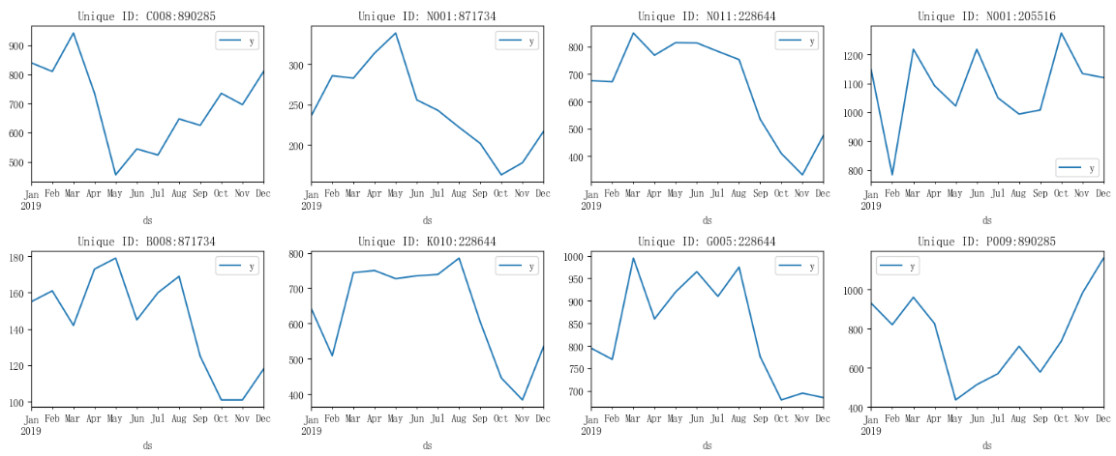
Aggregate Daily Data to Monthly Timeseries
Number of unique_id: 50

Slide 34
Average Performance (RMSE/MAE/MAPE): 157.16/101.08/0.18 (XGBoost)

Slide 35
Category | LinearRegression | RandomForestRegressor | LGBMRegressor | XGBRegressor
A003:228644 | 612.22/612.22/1.06 | 22.22/22.22/0.04 | 102.12/102.12/0.18 | 66.84/66.84/0.12
A003:566768 | 72.57/72.57/0.33 | 128.28/128.28/0.58 | 90.50/90.50/0.41 | 104.99/104.99/0.47
A003:683601 | 5.37/5.37/0.08 | 25.34/25.34/0.37 | 24.62/24.62/0.36 | 30.76/30.76/0.45
A003:822389 | 397.05/397.05/1.59 | 23.01/23.01/0.09 | 7.38/7.38/0.03 | 76.94/76.94/0.31
A003:871734 | 10.15/10.15/0.08 | 44.06/44.06/0.37 | 38.25/38.25/0.32 | 37.43/37.43/0.31
A003:890285 | 84.55/84.55/0.11 | 298.40/298.40/0.40 | 303.12/303.12/0.41 | 255.18/255.18/0.35
A005:205516 | 264.69/264.69/0.30 | 50.40/50.40/0.06 | 225.75/225.75/0.26 | 14.00/14.00/0.02
B001:205516 | 332.28/332.28/0.28 | 249.12/249.12/0.21 | 487.75/487.75/0.41 | 275.79/275.79/0.23
B008:871734 | 70.74/70.74/0.60 | 8.64/8.64/0.07 | 26.12/26.12/0.22 | 22.20/22.20/0.19
C001:205516 | 376.86/376.86/0.35 | 271.60/271.60/0.25 | 353.50/353.50/0.32 | 238.00/238.00/0.22
C008:228644 | 11.22/11.22/0.02 | 112.95/112.95/0.23 | 69.12/69.12/0.14 | 119.60/119.60/0.24
C008:784457 | 28.23/28.23/0.15 | 0.75/0.75/0.00 | 29.88/29.88/0.16 | 3.21/3.21/0.02
C008:822389 | 527.73/527.73/0.73 | 38.97/38.97/0.05 | 52.12/52.12/0.07 | 144.71/144.71/0.20
C008:849886 | 73.07/73.07/0.10 | 210.77/210.77/0.29 | 242.75/242.75/0.34 | 177.95/177.95/0.25
C008:871734 | 38.76/38.76/0.21 | 29.91/29.91/0.16 | 27.25/27.25/0.15 | 31.00/31.00/0.17
C008:890285 | 116.95/116.95/0.14 | 115.14/115.14/0.14 | 190.00/190.00/0.23 | 75.07/75.07/0.09
C009:228644 | 3.35/3.35/0.00 | 117.53/117.53/0.15 | 115.75/115.75/0.15 | 99.74/99.74/0.13
C010:205516 | 5.94/5.94/0.01 | 73.66/73.66/0.13 | 69.00/69.00/0.12 | 16.50/16.50/0.03
D005:228644 | 178.07/178.07/0.17 | 36.43/36.43/0.04 | 134.50/134.50/0.13 | 39.41/39.41/0.04
D005:871734 | 57.46/57.46/0.20 | 22.03/22.03/0.08 | 9.88/9.88/0.03 | 13.92/13.92/0.05
F001:228644 | 155.06/155.06/0.40 | 77.24/77.24/0.20 | 220.12/220.12/0.57 | 2.73/2.73/0.01
G005:228644 | 173.51/173.51/0.25 | 66.10/66.10/0.10 | 162.62/162.62/0.24 | 3.57/3.57/0.01
G005:871734 | 75.85/75.85/0.61 | 13.48/13.48/0.11 | 13.38/13.38/0.11 | 3.38/3.38/0.03
G005:890285 | 373.62/373.62/0.27 | 652.24/652.24/0.47 | 719.25/719.25/0.52 | 696.58/696.58/0.50
H005:205516 | 61.89/61.89/0.14 | 11.62/11.62/0.03 | 105.00/105.00/0.24 | 14.00/14.00/0.03
H011:566768 | 343.60/343.60/0.38 | 50.90/50.90/0.06 | 150.62/150.62/0.17 | 85.83/85.83/0.10
I001:205516 | 61.02/61.02/0.08 | 11.62/11.62/0.02 | 0.00/0.00/0.00 | 22.92/22.92/0.03
I001:228644 | 98.09/98.09/0.23 | 72.71/72.71/0.17 | 99.88/99.88/0.23 | 102.36/102.36/0.24
J004:228644 | 124.09/124.09/0.20 | 13.97/13.97/0.02 | 199.62/199.62/0.33 | 2.00/2.00/0.00
J011:205516 | 176.30/176.30/0.22 | 108.81/108.81/0.13 | 376.62/376.62/0.46 | 78.67/78.67/0.10
J012:205516 | 36.74/36.74/0.09 | 109.48/109.48/0.26 | 332.50/332.50/0.79 | 91.41/91.41/0.22
K006:205516 | 394.57/394.57/0.44 | 0.56/0.56/0.00 | 267.75/267.75/0.30 | 7.85/7.85/0.01
K010:228644 | 311.84/311.84/0.58 | 5.92/5.92/0.01 | 111.38/111.38/0.21 | 115.14/115.14/0.22
K010:871734 | 2.92/2.92/0.02 | 29.39/29.39/0.16 | 20.75/20.75/0.11 | 31.27/31.27/0.17
L002:890285 | 312.68/312.68/0.26 | 503.48/503.48/0.42 | 496.00/496.00/0.41 | 421.33/421.33/0.35
L008:205516 | 254.91/254.91/0.51 | 209.44/209.44/0.42 | 260.75/260.75/0.52 | 196.68/196.68/0.39
M002:205516 | 186.04/186.04/0.29 | 29.96/29.96/0.05 | 273.00/273.00/0.42 | 28.64/28.64/0.04
M010:205516 | 23.31/23.31/0.03 | 112.56/112.56/0.13 | 24.50/24.50/0.03 | 140.00/140.00/0.16
M010:228644 | 156.07/156.07/0.28 | 32.45/32.45/0.06 | 162.25/162.25/0.29 | 64.03/64.03/0.11
N001:205516 | 130.67/130.67/0.12 | 78.54/78.54/0.07 | 21.00/21.00/0.02 | 128.68/128.68/0.11
N001:871734 | 4.22/4.22/0.02 | 38.43/38.43/0.18 | 22.62/22.62/0.10 | 39.00/39.00/0.18
N003:228644 | 365.71/365.71/0.85 | 52.30/52.30/0.12 | 164.62/164.62/0.38 | 41.00/41.00/0.10
N003:822389 | 271.00/271.00/1.69 | 95.07/95.07/0.59 | 84.12/84.12/0.53 | 104.00/104.00/0.65
N003:871734 | 10.27/10.27/0.10 | 6.26/6.26/0.06 | 11.12/11.12/0.11 | 16.14/16.14/0.15
N010:228644 | 176.04/176.04/0.48 | 222.94/222.94/0.61 | 265.38/265.38/0.72 | 212.06/212.06/0.58
N011:205516 | 54.81/54.81/0.06 | 51.38/51.38/0.06 | 176.75/176.75/0.20 | 88.32/88.32/0.10
N011:228644 | 337.85/337.85/0.71 | 89.78/89.78/0.19 | 174.38/174.38/0.37 | 145.00/145.00/0.30
P009:890285 | 129.49/129.49/0.11 | 410.58/410.58/0.35 | 491.00/491.00/0.42 | 199.70/199.70/0.17
P012:205516 | 54.11/54.11/0.07 | 93.52/93.52/0.12 | 141.75/141.75/0.19 | 42.00/42.00/0.06
P016:205516 | 21.46/21.46/0.03 | 126.14/126.14/0.19 | 152.25/152.25/0.23 | 86.40/86.40/0.13
Average | 221.72/162.90/0.32 | 167.06/105.12/0.18 | 225.73/166.01/0.27 | 157.16/101.08/0.18

