Slide 1
Linux Essentials
josephdeng@g2.usc.edu.tw

Slide 2
Outline
A Brief Introduction to Linux
Bash Shell
Process Management
Editing text files with vi
Disk and File Systems
User accounts, groups and file permissions
Searching keywords and files

Slide 3
A Brief Introduction to Linux
What is Linux?
An operating system.
Kernel + Programs.
Where did Linux come from?
Linus Torvalds and Richard Stallman.
Why use Linux?
Hosting Web Sites/VMs/Services/Apps
Programming, especially Python
Networking (router/gateway)
Who are the major players?
Red Hat, Debian, Ubuntu, SuSE

Slide 4
Major Linux Distributions
RPM-based
Red Hat Enterprise Linux(RHEL)
Fedora
CentOS
Scientific Linux
SUSE
openSUSE
Debian-based
Ubuntu
Linux Mint
Kali Linux
Pacman-based
Arch Linux
Gentoo-based
Chrome OS
Notes:
https://linoxide.com/linux-how-to/what-are-best-linux-distros/

Slide 5
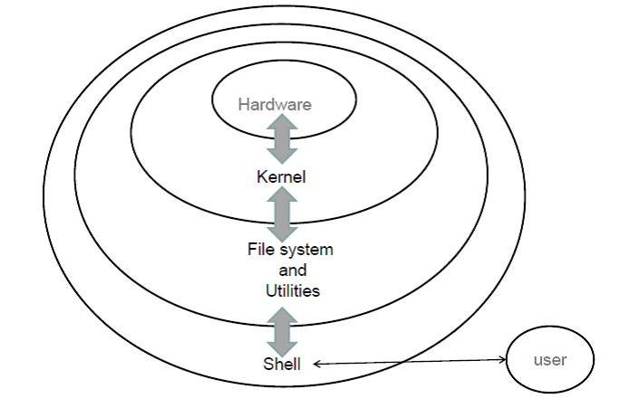
Linux System Components

Slide 6
What is a Shell?
User interface
Your interface into the kernel.
Command line interpreter
The command prompt, where you enter commands
Common Shells
bourne (sh), bash (bash) , C (csh) and many more

Slide 7
Bash Features
Basic bash features
Command execution,
Aliases,
Variables,
Environment variables (PATH),
Tab completion
Advanced bash features
Job control,
Command substitution,
Input and output redirection,
Pipes and scripts

Slide 8
Accessing and Interacting with a Prompt
Locally
Console, GNOME terminal, xterm
Remote/secure shell (ssh)
MobaXterm, putty/PieTTY
Keyboard shortcuts
Ctrl+a 回到此行最前面
Ctrl+e 到此行的最後面
Command history
history
!!
!
Tab completion
Single TAB
Must have a unique prefix already
Double TAB
List all names available when the prefix is not unique
Notes:
Bash keyboard shortcuts: https://blog.longwin.com.tw/2006/09/bash_hot_key_2006/
Bash history: https://blog.longwin.com.tw/2017/05/linux-bash-history-date-time-display-2017/

Slide 9
Executing Commands
Command | Options | Arguments
ls | -al | /home
Command | Options | Sourceses | Destination
cp | -r | /etc/mtab /etc/fstab | /tmp
Command | Options | Destination | Sources
tar | czf | backup.tar.gz | /etc /home

Slide 10
Common Commands
ls - list directory contents
pwd - print working directory
cd - change directory
~ - home directory
uptime - up time
top
w - who is logged in
who
lastlog - recent login records
last
more/less - pager
lspci - list pci bus devices
lshw - list hardware
lscpu
lsusb
lsblk - list block devices
uname - print system info.
date - print date and time
wc - word count
file - tell file type
su - switch (to super) user
sudo - switch user and do something
man - manual lookup

Slide 11
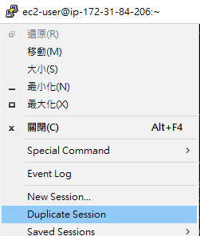
練習：檢查目前線上人數
以 putty 遠端登入你在 EC2 上的 Linux VM
以 who 指令列出目前系統登入的人數
以 putty 的 Duplicate Session 功能再開一個登入視窗
再以 who 指令列出目前系統登入的人數
以 ls -al 指令列出目前目錄之中所有的檔案
以 cat .bashrc 指令印出 .bashrc 檔案的內容

Slide 12
練習：檢查目前線上人數（續）
依序執行下列指令： echo 'N=`who | wc -l`' >> .bashrc echo 'echo "There are $N users online."' >> .bashrc
以 putty 的 Duplicate Session 功能再開一個登入視窗，觀察登入訊息是否發生改變？
以 cat .bashrc 指令印出 .bashrc 觀察檔案內容，檔案裡面多了什麼？

Slide 13
Variables
Environment variables
Global or local ones
env
VARIABLE_NAME=variable_value
export VARIABLE_NAME
echo $VARIABLE_NAME
unset VARIABLE_NAME
No space between!

Slide 14
Aliases
User defined command shortcuts
alias alias-name='command combinations'
alias docker-refresh='docker-compose down && docker-compose up'
alias serve-dir='python -m SimpleHTTPServer'

Slide 15
Startup Files
System startup scripts
/etc/profile
/etc/bash.bashrc
/etc/profile.d/
Per user startup scripts
~/.profile
~/.bashrc
~/.bash_logout
To reload a startup script:
source script_name
source ~/.bashrc
source env/bin/activate
. env/bin/activate

Slide 16
Exercise: Files & Executables
Download example script if you don’t have it yet:
cd ~
wget http://uscoj2.im.usc.edu.tw/~ywdeng/files/1082/Cloud/loop
file loop
chmod +x loop
file loop
Run ./loop
Why loop does not work?
Move loop to ~/bin and set PATH to include ~/bin
mkdir ~/bin
mv loop ~/bin
PATH=~/bin:$PATH
Run loop
Why does it work now? Use which to check it out.

Slide 17
Common Commands
mkdir : make directory
mv : move/rename
chmod : change mode
which : locate a command
rmdir : remove directory
rm : remove file
whereis : locate the binary, source, and manual page files for a command
locate : find files by name

Slide 18
Switching Users
Switching Users
su - switches to another user. Defaults to root.
Executing Commands As Another User(default as root)
sudo command
sudo -u user command
Hide super user password
sudo su -
Loading Profiles
Add a dash su -

Slide 19
Manual Pages
man - an interface to the on-line reference manuals
Examples
man ls
Display the manual page for the item (program) ls.
man 3 sleep
Display the manual page for sleep from section 3.
man -k printf
Search for keyword printf
Linux manual sections
1 – user commands
2 – system calls
3 – library calls
5 – file formats
7 – misc. files and documents

Slide 20
Process Management
What is a Process?
A process is an instance of a program in execution
Including its program code, memory and resources
Process Creation
fork - parent process yields a child process with a PID
Process Tree
The hierarchy of parent and it’s child processes
Viewing and monitoring processes
ps, top, ps --forest, gnome-system-monitor
Process states
Running, Sleeping, Runnable, Stopped and Zombie

Slide 21
Controlling Processes
Niceness: sets execution priority
nice - run a program with modified scheduling priority
renice - alter priority of running processes
Signals: method of process control
kill - send a signal to a process
killall - kill processes by name
pkill - signal processes based on name and other attributes

Slide 22
Job Control
Run a program in background
command &
Suspend a running process
CTRL+z
Resume a suspended process and run it in background
bg
Bring a background process back to foreground
fg
List suspended processes
jobs
Interrupt a foreground process
CTRL+c
Send end-of-file to a foreground process waiting for input
CTRL+d

Slide 23
Exercise: Process Management
Download example script if you don’t have it yet:
wget http://uscoj2.im.usc.edu.tw/~ywdeng/files/1082/Cloud/loop
chmod +x loop
Run loop for 3 times
Examines the PID and PPID of these 3 processes
Run one more loop with priority -2
Promote one of these loop processes’ priority to -3
Terminates all the loop processes

Slide 24
Using the vi Text Editor
vi
Text editor, that simple!
vim
vi iMproved - syntax highlighting, split screen, differencing files
Why learn vi/vim?
Included in all UNIX/Linux distributions.
There when you need it!
To install vim on Ubuntu 18.04
sudo apt-get -y install vim
Notes:
Basic reference commands - https://www.cs.colostate.edu/helpdocs/vi.html

Slide 25
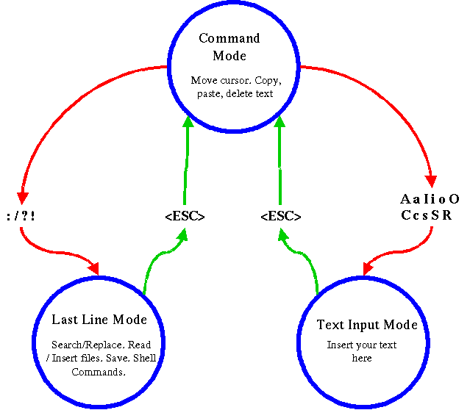
Modes of vi
Command Mode
Instructions to vi to perform functions, save, copy/paste, quit,
search…
Insert Mode
Actual text editing
Notes:
http://www.colinabrett.me.uk/htdocs/vi_demystified.html

Slide 26
Common vi Commands
File Operations
Save
:w - Save
:w fileName - Save new file
Quitting
:q - Quit if no changes
:q! - Quit ignore changes
Read a file into current position
:r filename

Slide 27
Navigation
Moving cursor
up/down/left/right
k / j / h / l
Moving between words
w - Move right one word
b - Move left one word
Start of file
[[
:1
End of file
]]
G
Page Up/Down
CTRL+F, CTRL+B
Move to start of line
0 (zero)
End of line
$
Search for text forward
/searchstring
:nohl
Find and Replace
:s/s1/s2

Slide 28
Editing Text
Inserting
a - append current position
A - append end of line
i - insert current position
I - insert beginning of line
r - replace current position
cw - change word
o - start new line, below current position
O - start new line, above current position
Copy and Paste
yy - copy current line to a buffer
p - paste line in buffer below current line
n p - n is a number, paste n times
Joint lines
J - joint next line

Slide 29
Editing Text(cont’d)
Undo
u - undo the last edit
CTRL+r - redo
Deleting
x - delete character to the right
X - delete character to the left
dw - delete word
dd - delete one line
n dd - delete n lines of text
d$ - delete to end-of-line
dG - delete to end-of-file

Slide 30
Other Text Editors
nano
Easier than vi for Windows users
gedit
text editor for the GNOME Desktop

Slide 31
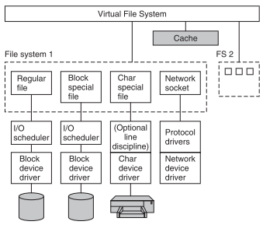
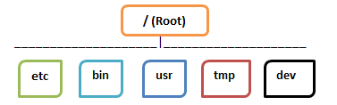
Disk and File Systems
Disks are block devices
All physical devices are represented by device special files
1st hard disk: /dev/sda
1st partition of 2nd hard disk: /dev/sdb1
Everything is a file!
File system is a tree.

Slide 32
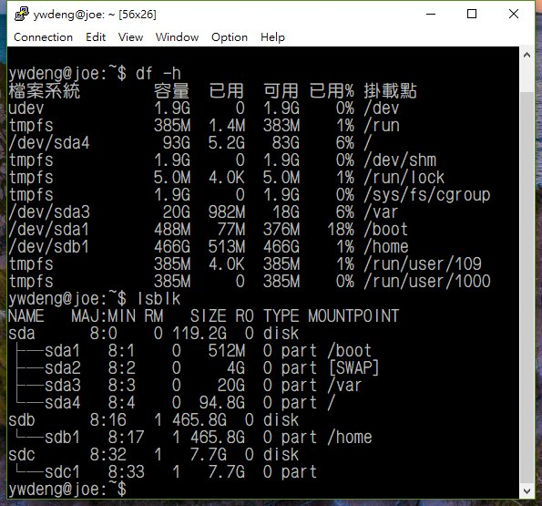
Disk and File Systems
/
boot
var
dev
usr
etc
opt
home
spool
log
lib
bin
local
lib
bin
etc
/dev/sda
/dev/sdb
/dev/sda4
partition#4
/dev/sda3
partition#3
/dev/sda2
partition#2
/dev/sda1
partition#1
partition#1
/dev/sdb1
SATA Disk#1
SATA Disk#2

Slide 33
Directories and Paths
Absolute
/home/demo/Desktop
Relative
Current .
Parent ..
Parent’s parent ../..
Sibling ../joseph/bin/start-service

Slide 34
Links
i-node
File’s block information, permissions, owner, access times
Soft/symbolic Links
Shortcut to a file, a second i-node entry
ln -s ../project1/doc .
Hard Links
Shortcut to a file, the same i-node entry.
Cannot be used for directories.

Slide 35
Common Files and Directory Operations
File Operations
Create
touch
Delete
rm
Move/Rename
mv
View Contents
cat
less/more
head/tail
Copy
cp
Directory Operations
Create
mkdir
Delete
rm
rmdir
Move/Rename
mv
View Contents
ls
Copy
cp -r

Slide 36
Using Compression and Archive Utilities
Compress files
gzip and bzip2
Decompress files
gunzip and bunzip2
Archive a collection of files into a single file
tar options c - create x - extract t - test z - gzip j - bzip2
Create a tarball:
tar cvf etc-backup.tar /etc
Create a compressed tarbal
tar cvzf etc-backup.tar.gz /etc
Extract a tarball
tar xvzf etc-backup.tar.gz

Slide 37
Exercise: Archive
Create a backup copy of the /etc directory using current datetime as archive filename.
To generate current date date -d now +%Y%m%d
Test the integrity of the backup copy.
Extract the backup copy into ~/tmp, a temporary directory in your home directory.
Discussion
Is it necessary to name a tarball with .tar or .tar.gz extension?
How to determine the compression method of a tarball if its filename ends with .tar?

Slide 38
I/O Redirection and Pipes
Redirect standard output(stdout)
Normally directed to terminal
Useful for redirecting the output of a command to file ( > or >> )
Redirect standard input(stdin)
Normally input via keyboard
Useful for directing input from a file ( < )
Redirect standard error(stderr)
Normally output to terminal
Useful for separating error output from standard output and redirect to another location ( 2> )
Using a pipe ( | )
Inter-process communication
Internal buffers

Slide 39
I/O Redirection
# redirect input
prog < file
# redirect output(overwrite)
prog > file
# redirect output(append)
prog >> logfile

Slide 40
Pipes

Slide 41
Exercise
Download initcap.py and make it executable: wget http://uscoj2.im.usc.edu.tw/~ywdeng/files/1082/Cloud/initcap.py chmod +x initcap.py
Execute ./initcap.py < initcap.py and examine the output
Execute ./initcap.py < initcap.py > capc.txt and examine the output
Execute ./initcap.py initcap.py capc > caps.txt and examine the outputs
Can you redirect the error messages into a log file?
i.e. redirect stdout to caps.txt while stderr to initcap.log

Slide 42
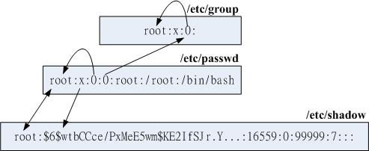
Account Management
Create
adduser - add a user
addgroup - add a group
Add an existing user to an existing group
adduser user group
Delete
deluser - remove a user
To completely remove an account: deluser --remove-all-files user userdel -r user
delgroup - remove a group
Change password
passwd - change user password

Slide 43
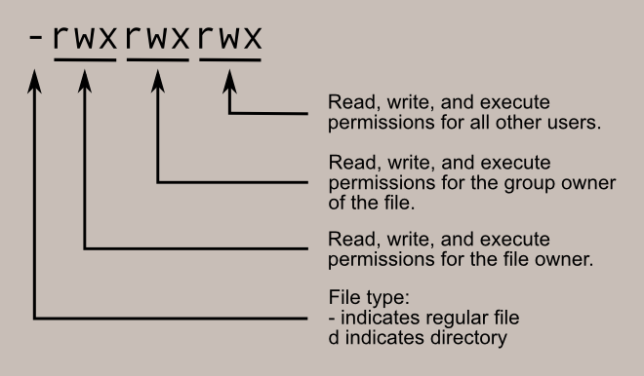
File and Directory Permissions
Permission modes
r - read
w - write
x - execute/search
There 3 groups of permissions
User - defined in /etc/passwd
Group - defined in /etc/group
Other - others
Use chmod to change permission
Use chown to change user/owner
Use chgrp to change group

Slide 44
Default Permissions and umask
umask
Sets the default file permissions for newly created files and directories
Set in bash profile to be persistent on reboot, user or system?
Default - 002
Calculates the default permission by subtracting initial permission from the umask
Directories
777 - 002 = 775 = rwx, rwx, rx
Files
666 - 002 = 664 = rw, rw, r
umask mask
umask 006
Files - 666 - 006 = 660 = rw, rw, no access
Directories - 777 - 006 = 771 = rwx, rwx, x

Slide 45
SUID, SGID and Sticky Bit
Permission | Value | Symbol | On Files | On Directories
SUID | 4 | u+s | User executable file with permission of file owner | n/a
SGID | 2 | g+s | User executable file with permission of group owner | File creation in directory gets the same group owner
Sticky bit | 1 | +t | n/a | Users are prevented from deleting files from other users

Slide 46
Exercise: Users & Groups
Create a working area for a Project
Create users: pm1, sa1, sa2
Create group: project1
Add users sw, pm1 and sa1 into group project1
sudo mkdir /home/project1
sudo chown pm1 /home/project1
sudo chgrp project1 /home/project1
sudo chmod 2770 /home/project1
su - pm1
touch /home/project1/plan.doc
su - sa1
touch /home/project1/req.doc
su - sa2
cat /home/project1/req.doc

Slide 47
Exercise: Users & Groups(continued)
Discussion
/home/project1/req.doc belongs to which group? Why?
Can pm1 edit /home/project1/req.doc ? Why?
Can pm1 edit /home/sa1/.bashrc ? Why?
Can sa2 read /home/project1/req.doc ? Why?

Slide 48
Searching keywords and files
grep - print lines matching a pattern
Options
i – ignore case
r – recursive into sub-directories
l – list file names only
find - search for files in a directory hierarchy
Options
name – find by name
type – find by type, d=>directory, f=>regular file
whereis - locate the binary, source, and manual page files for a command
locate - find files by name

Slide 49
Regular Expressions, Basics
Line and word anchors
^ – begins with
$ – ends with
Character classes
[abc]– brackets
[a-z]– range expressions
Wildcards
* – preceding character zero or more times
? – preceding character at most one time

Slide 50
Examples
Find all shell scripts in /usr/bin
cd /usr/bin; file * | grep script | less
Find all backup files in home and delete them
find ~ -name "*.bak" -exec rm -f {} \;

Slide 51
Wrap Up
Linux Basics
Bash Shell
Process Management
Disk and File Systems
Editing text files with vi
User accounts, groups and file permissions
Searching keywords and files

Slide 52
What’s Next…
Accessing remote files: ftp, scp, samba and nfs
Shell scripting
bash, sort, uniq, cut, awk, sed
Regular Expressions
Hosting Web servers
Apache httpd
Nginx
Hosting virtual machines
Kernel Virtual Machine(KVM)
Hosting apps
Linux Container/Docker

