Slide 1
Python Essentials
josephdeng@g2.usc.edu.tw
2020-03-27

Slide 2
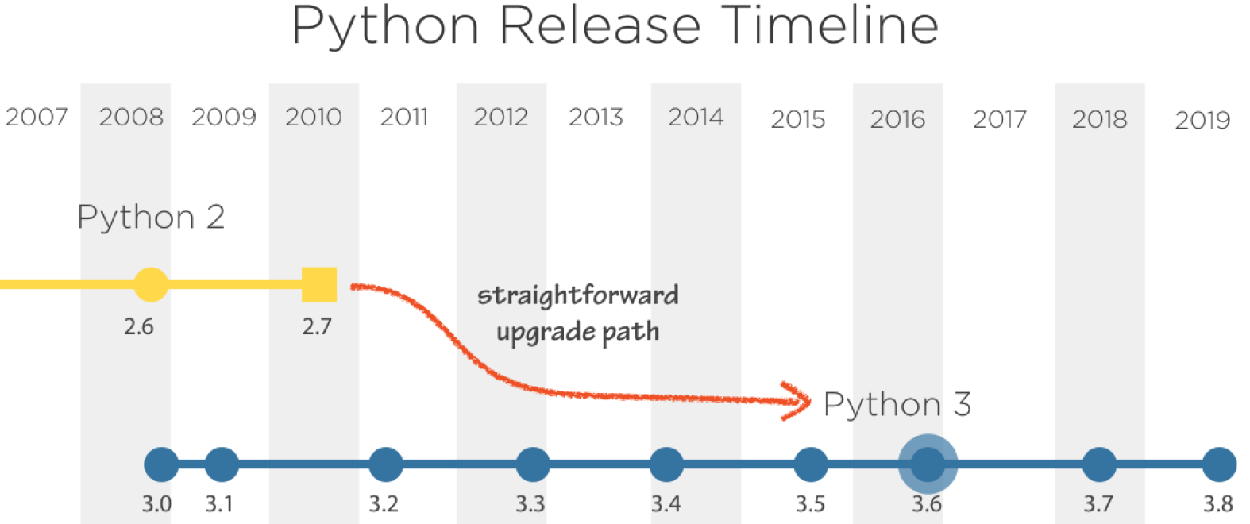
Python 2.7 will not be maintained past 2020!
Notes:
https://blog.longwin.com.tw/2018/03/python-2-stop-maintain-2020-2018/

Slide 3
Introduction
Download and install Python 3 on Windows and macOS
Download and install Python from https://www.python.org/downloads/
Install Python 3 on AWS Linux 2 sudo yum install python3 python3-pip

Slide 4
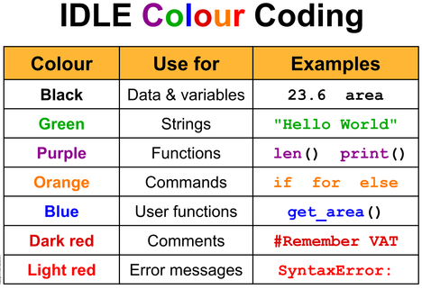
Interactive Python
Running Python on Windows
Python Shell
Python IDLE
Running Python3 on Linux python3
REPL
Read
Evaluate
Print
Loop

Slide 5
Running Python Script
countdown.py
#!/usr/bin/python3
"""
倒數計時
"""
import sys
import random
import time
s = r'\|/-' # symbols for rotation
# an integer number in [10,100]
n = random.randint(10, 100)
# if there is an argument passed by user
if len(sys.argv) == 2:
n = int(sys.argv[1])
while n:
print(s[n % len(s)], n, '\r', end='')
n = n - 1
time.sleep(1)
Python script file extension .py
Run a Python script file from command line
Windows python countdown.py
Linux python3 countdown.py

Slide 6
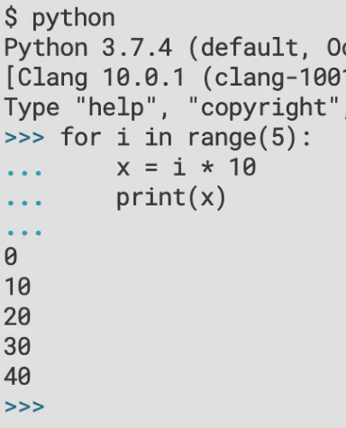
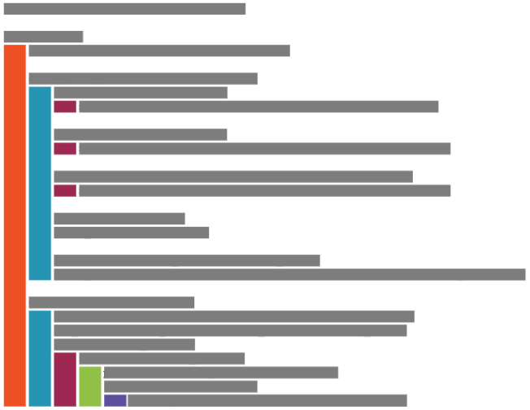
Significant Whitespace
縮排

Slide 7
Significant Whitespace Rule
Prefer 4 spaces 每一層縮排 4 個空格
Never mix spaces and tabs 切勿混用空格和 Tab
Be consistent on consecutive lines 縮排風格要一致
Only deviate to improve readability 程式的可讀性最重要

Slide 8
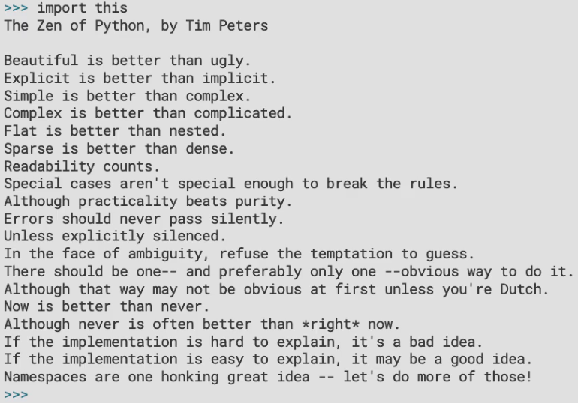
The Zen of Python

Slide 9
Using Standard Library
The import keyword 匯入程式模組 import module_name from module_name import function from module_name import function as alias

Slide 10
Exiting the REPL
End-of-Input 結束輸入
On Windows ^Z
On Linux/macOS ^D

Slide 11
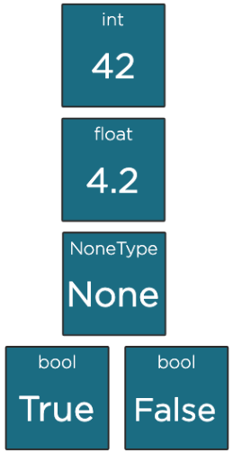
Scalar Type
Arbitrary precision integer 整數，任意長度
64-bit floating point numbers 浮點數
The null object 空
Boolean logical values 布林邏輯

Slide 12
Integer 整數
2進位
>>> 10
10
>>> 0b10
2
>>> 0o10
8
>>> 0x10
16
>>> int(3.5)
3
>>> int(-3.5)
-3
>>> int("496")
496
>>> int("10000", 3)
81
8進位
16進位
強制型別轉換

Slide 13
Float 浮點數
>>> 3.125
3.125
>>> 3e8
300000000.0
>>> 1.616e-35
1.616e-35
>>> float(7)
7.0
>>> float("1.618")
1.618
>>> float("nan")
nan
>>> float("inf")
inf
>>> float("-inf")
-inf
>>> 3.0 + 1
4.0
IEEE-754 double-precision with 53-bits of binary precesion
15-16 significant digits in decimal

Slide 14
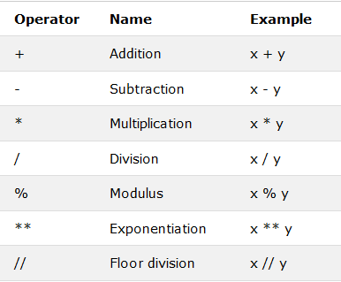
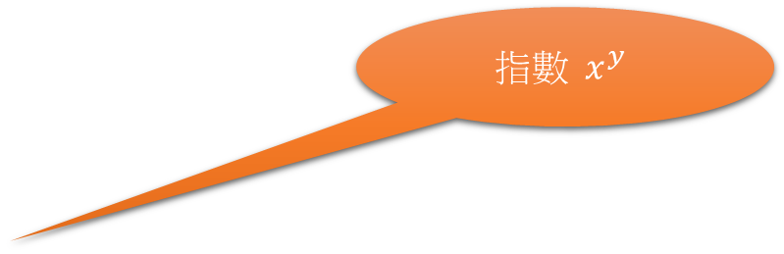
Arithmetic Operators
浮點數除法
整數除法取餘數
$$指數 x^{y}$$
整數除法

Slide 15
None
Null value
Often represents the absence of value
>>> None
>>> a = None
>>> a is None
True

Slide 16
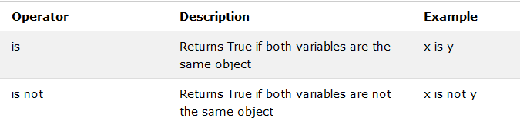
Identity Operators

Slide 17
bool
>>> True
True
>>> False
False
>>> bool(0)
False
>>> bool(42)
True
>>> bool(-1)
True
>>> bool(0.0)
False
>>> bool(0.207)
True
>>> bool(-1.117)
True
>>> bool([])
False
>>> bool([1, 5, 9])
True
>>> bool("")
False
>>> bool("Spam")
True
>>> bool("False")
True
>>> bool("True")
True
Boolean logical values

Slide 18
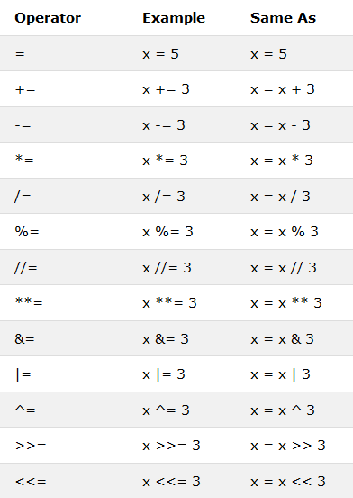
Assignment Operators

Slide 19
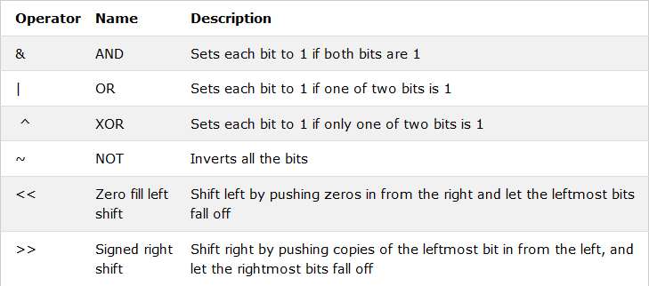
Bitwise Operators

Slide 20
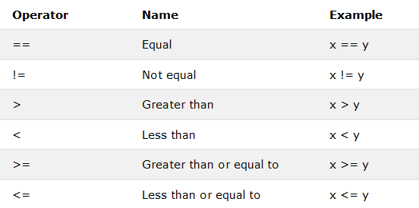
Relational Operators

Slide 21
Relational Operators
>>> g = 20
>>> g == 20
True
>>> g == 13
False
>>> g != 20
False
>>> g != 13
True
>>> g < 30
True
>>> g <= 20
True
>>> g > 30
False
>>> g >= 20
True

Slide 22
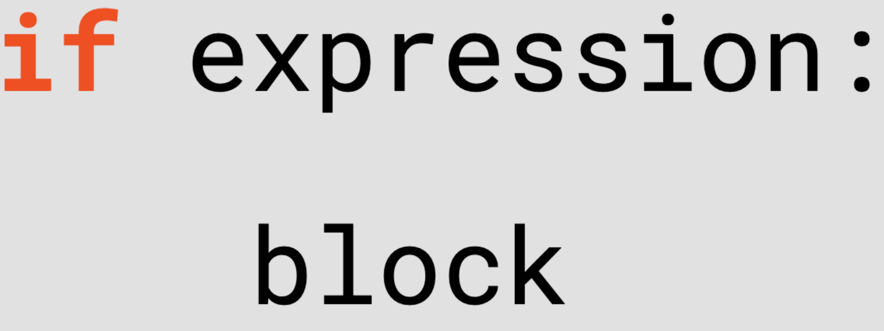
Control flow
Conditional statement
Branch execution based on the value of an expression
Loops
Repeat execution

Slide 23
If-else
>>> h = 42
>>> if h > 50:
... print("Greater than 50")
... else:
... print("50 or smaller")
...
50 or smaller
>>> if h > 50:
... print("Greater than 50")
... else:
... if h < 20:
... print("Less than 20")
... else:
... print("Between 20 and 50")
...
Between 20 and 50
>>> if h > 50:
... print("Greater than 50")
... elif h < 20:
... print("Less than 20")
... else:
... print("Between 20 and 50")
...
Between 20 and 50
if expression:
block
>>> if True:
... print("It's true!")
...
It's true!
>>> if False:
... print("It's true!")
...
>>> if bool("eggs"):
... print("Yes please!")
...
Yes please!
>>> if "eggs":
... print("Yes please!")
...
Yes please!

Slide 24
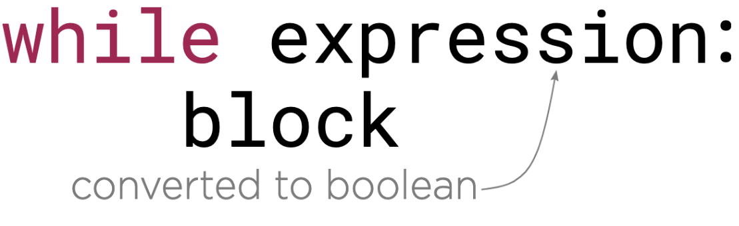
While-loops
>>> c = 5
>>> while c != 0:
... print(c)
... c -= 1
...
5
4
3
2
1
>>> c = 5
>>> while c:
... print(c)
... c -= 1
...
5
4
3
2
1

Slide 25
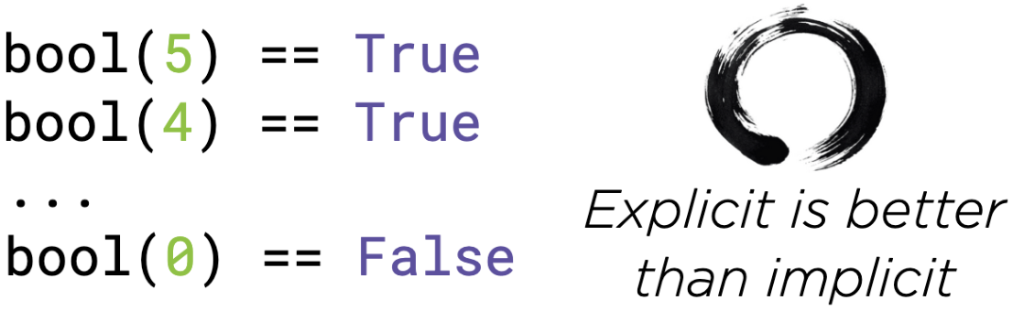
Int truthness

Slide 26
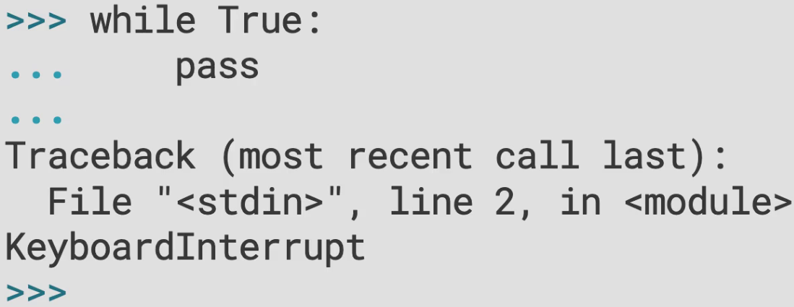
Relational operators
無窮迴圈!
按 ^C 中斷!

Slide 27
break
Many languages support a loop ending in a predicate test
C, C++, C# and Java have do-while
Python require you to use while True and break
break jumps out of the inner-most executing loop to the line immediately after it
>>> while True:
... response = input()
... if int(response) % 7 == 0:
... break
...
12
67
34
28

Slide 28
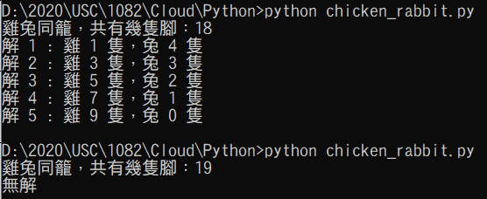
練習：解雞兔同籠問題
輸入：雞兔同籠，共有幾隻腳
輸出：所有的解

Slide 29
Collections
str
bytes
list
dict
For-loop

Slide 30
String
Data type: str
Sequence of Unicode code points
Immutable 不能修改內容

Slide 31
String Literals
>>> 'This is a string'
'This is a string'
>>> "This is also a string"
'This is also a string'
>>> "inconsistent'
File "<stdin>", line 1
"inconsistent'
^
SyntaxError: EOL while scanning string literal
>>> "It's a good thing."
"It's a good thing."
>>> '"Yes!", he said, "I agree!"'
'"Yes!", he said, "I agree!"'
>>> "first" "second"
'firstsecond'

Slide 32
Strings with Newlines
Multiline strings
Escape sequences
Spread the literal across multiple lines
Embed escape sequence in a single-line literal
>>> """This is
... a multiline
... string"""
'This is\na multiline\nstring'
>>> '''So
... is
... this.'''
'So\nis\nthis.'
>>> m = 'This string\nspans multiple\nlines'
>>> m
'This string\nspans multiple\nlines'
>>> print(m)
This string
spans multiple
lines

Slide 33
Newlines and Operating Systems
Windows: carriage-return, line-feed \r\n
Linux and macOS: carriage-return \r
Universal Newlines
Python translates \n to the appropriate newline sequence for your platform
PEP 278: python.org/dev/peps/pep-0278/

Slide 34
Escape Sequences
>>> "This is a \" in a string"
'This is a " in a string'
>>> 'This is a \' in a string'
"This is a ' in a string"
>>> 'This is a \" and a \' in a string'
'This is a " and a \' in a string'
>>> k = 'A \\ in a string'
>>> k
'A \\ in a string'
>>> print(k)
A \ in a string

Slide 35
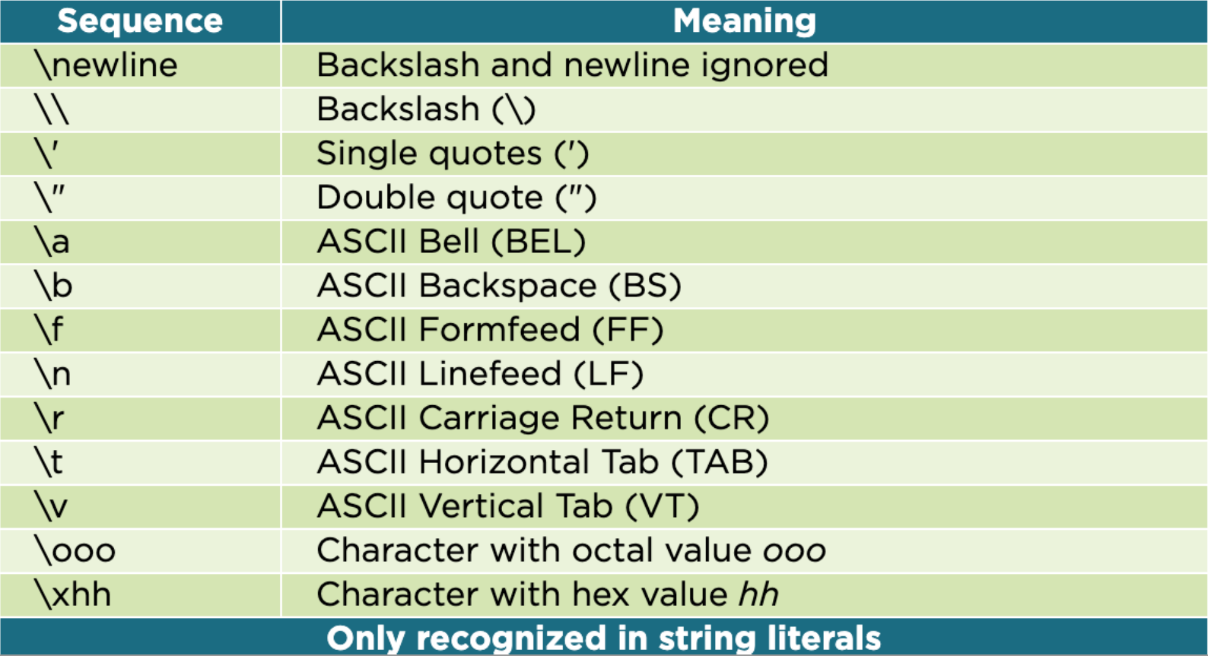
All Escape Sequences

Slide 36
String Features
>>> path = r'C:\Users\ywdeng\Documents\Spells'
>>> path
'C:\\Users\\ywdeng\\Documents\\Spells'
>>> print(path)
C:\Users\ywdeng\Documents\Spells
>>> str(496)
'496'
>>> str(6.02e23)
'6.02e+23'
>>> s = 'parrot'
>>> s[4]
'o'
>>> type(s[4])
<class 'str'>

Slide 37
String Features
>>> path = r'C:\Users\ywdeng\Documents\Spells'
>>> path
'C:\\Users\\ywdeng\\Documents\\Spells'
>>> print(path)
C:\Users\ywdeng\Documents\Spells
>>> str(496)
'496'
>>> str(6.02e23)
'6.02e+23'
>>> s = 'parrot'
>>> s[4]
'o'
>>> type(s[4])
<class 'str'>
試試
help(str)

Slide 38
Upper Case / Lower Case
S.capitalize() -> str
Return a capitalized version of S, i.e. make the first character have upper case and the rest lower case. 字串首字大寫
S.title() -> str
Return a titlecased version of S, i.e. words start with title case characters, all remaining cased characters have lower case. 每一個英文字首字大寫
S.upper() -> str
Return a copy of S converted to uppercase. 全部轉大寫
S.lower() -> str
Return a copy of the string S converted to lowercase. 全部轉小寫
S.islower() -> bool 是否小寫
S.istitle() -> bool 是否 title
S.isupper() -> bool 是否大寫

Slide 39
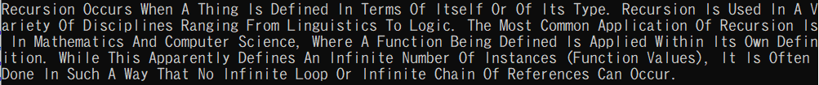
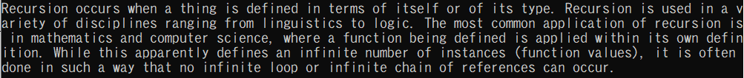
練習: 字首轉大寫
輸入：一篇英文文章，例如 這個文件
下載方式 wget http://uscoj.im.usc.edu.tw/~ywdeng/files/1082/Cloud/initcap-ex1.txt
輸出：
第一題：每一個英文字的第一個字母都大寫
第二題：每一個英文句子的第一個字母都大寫

Slide 40
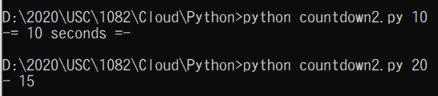
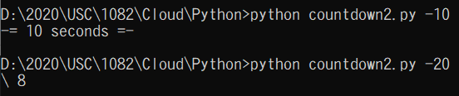
練習: 倒數計時
試修改 countdown.py 讓它能夠在倒數結束時印出總共數了多少秒
當輸入參數為負值時，改成正向計數

